Slide 1
Lisbon (Portugal) 4. svibnja 2022.

Slide 2
Science Museum in Lisbon
There we could learn about safe drinking water with the help of science
https://www.pavconhecimento.pt/agua-uma-exposicao-sem-filtro/

Slide 3
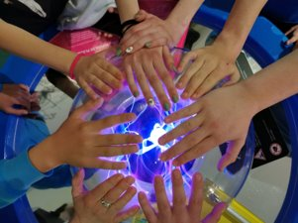
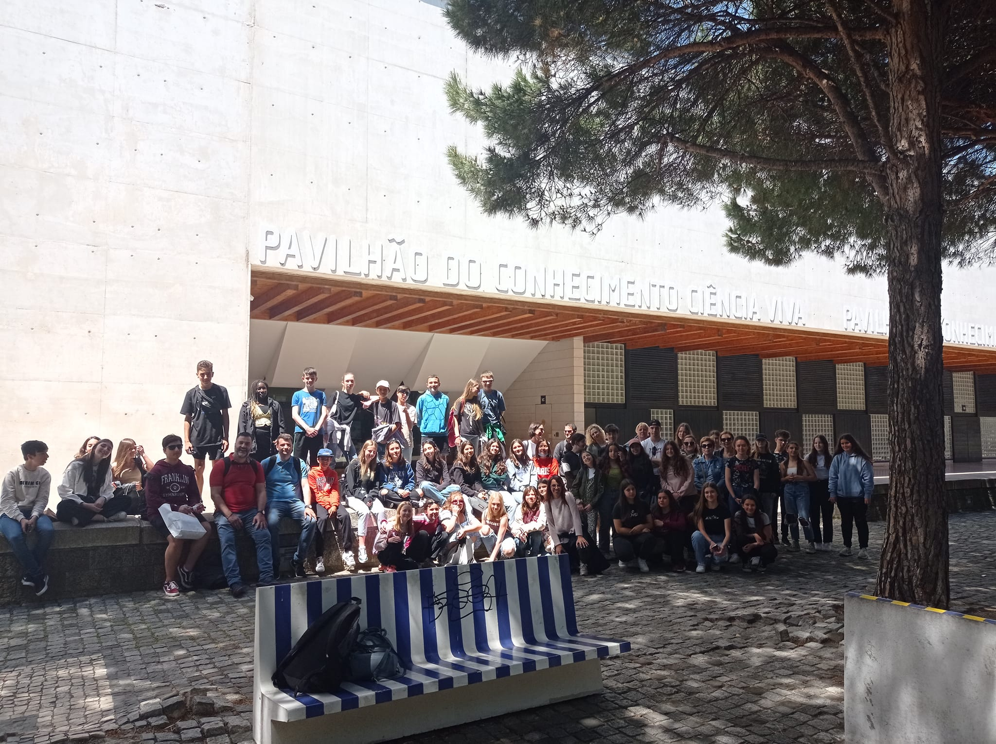
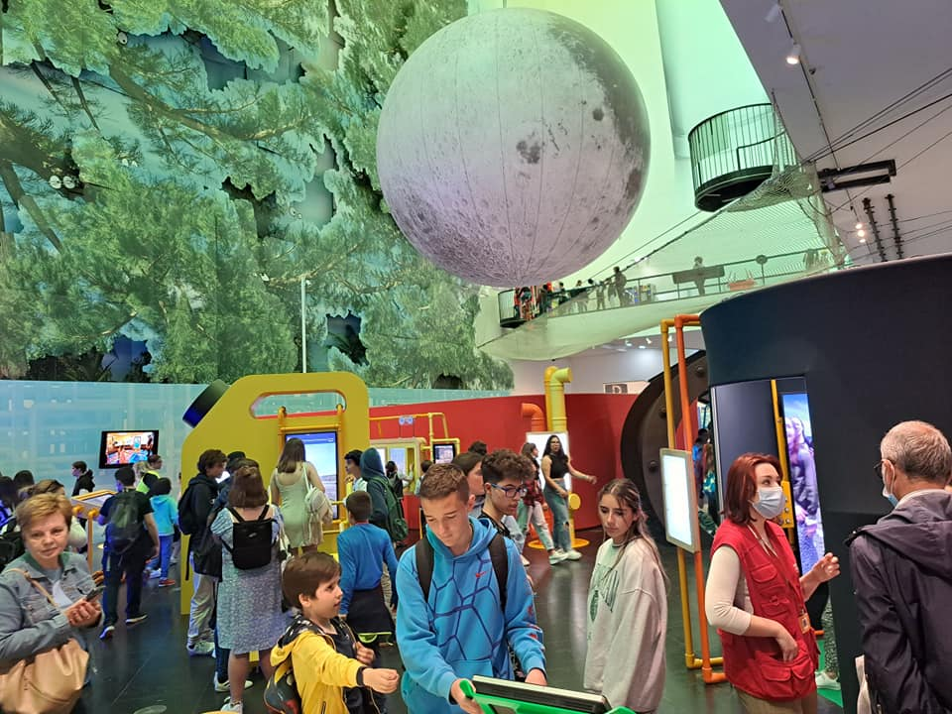
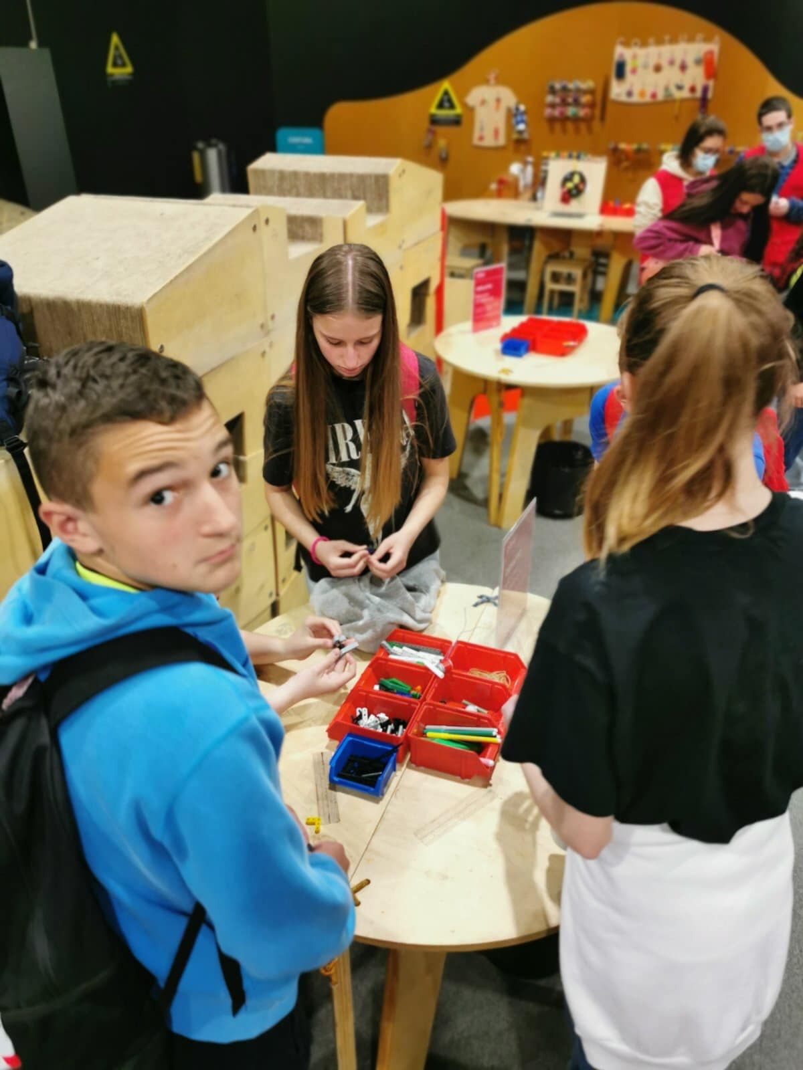
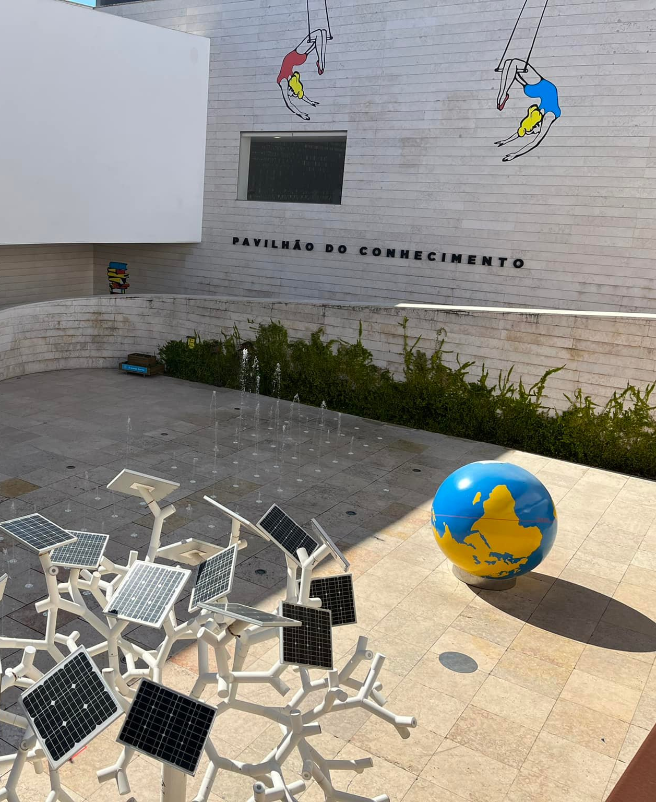
Pictures from museum:

Slide 4
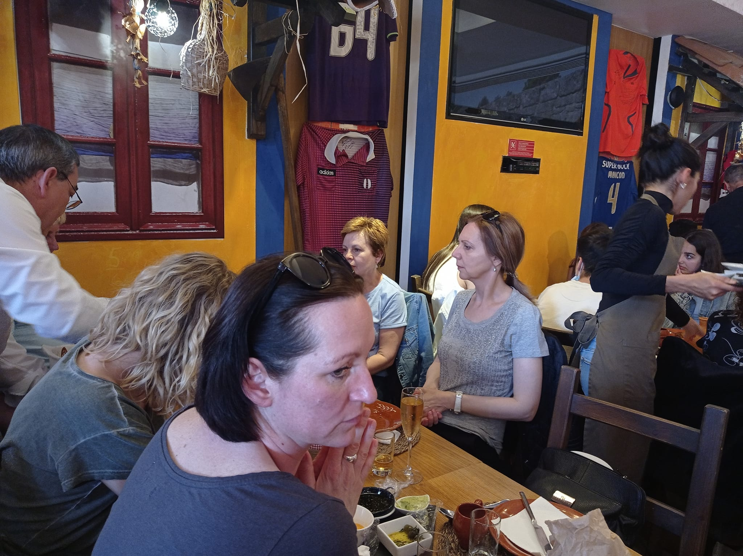
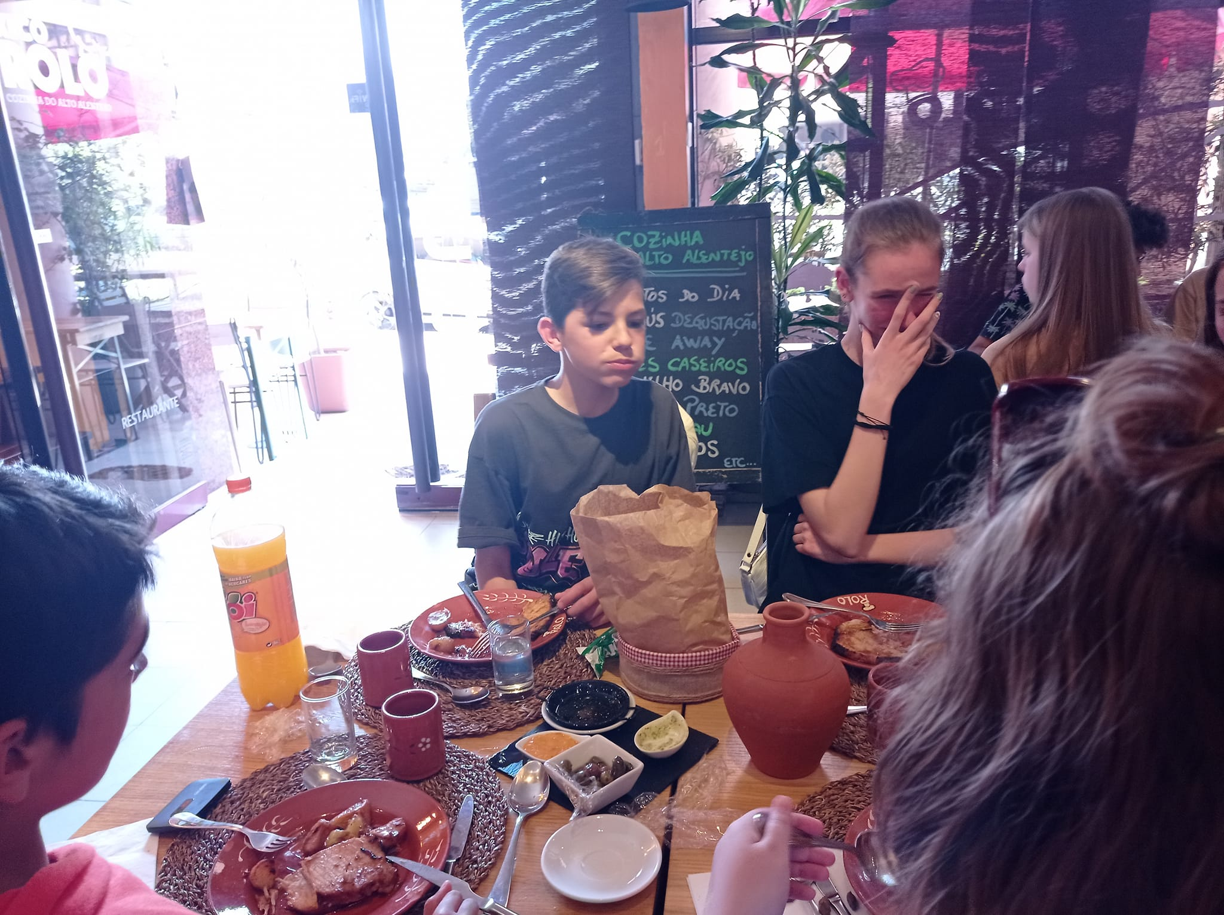
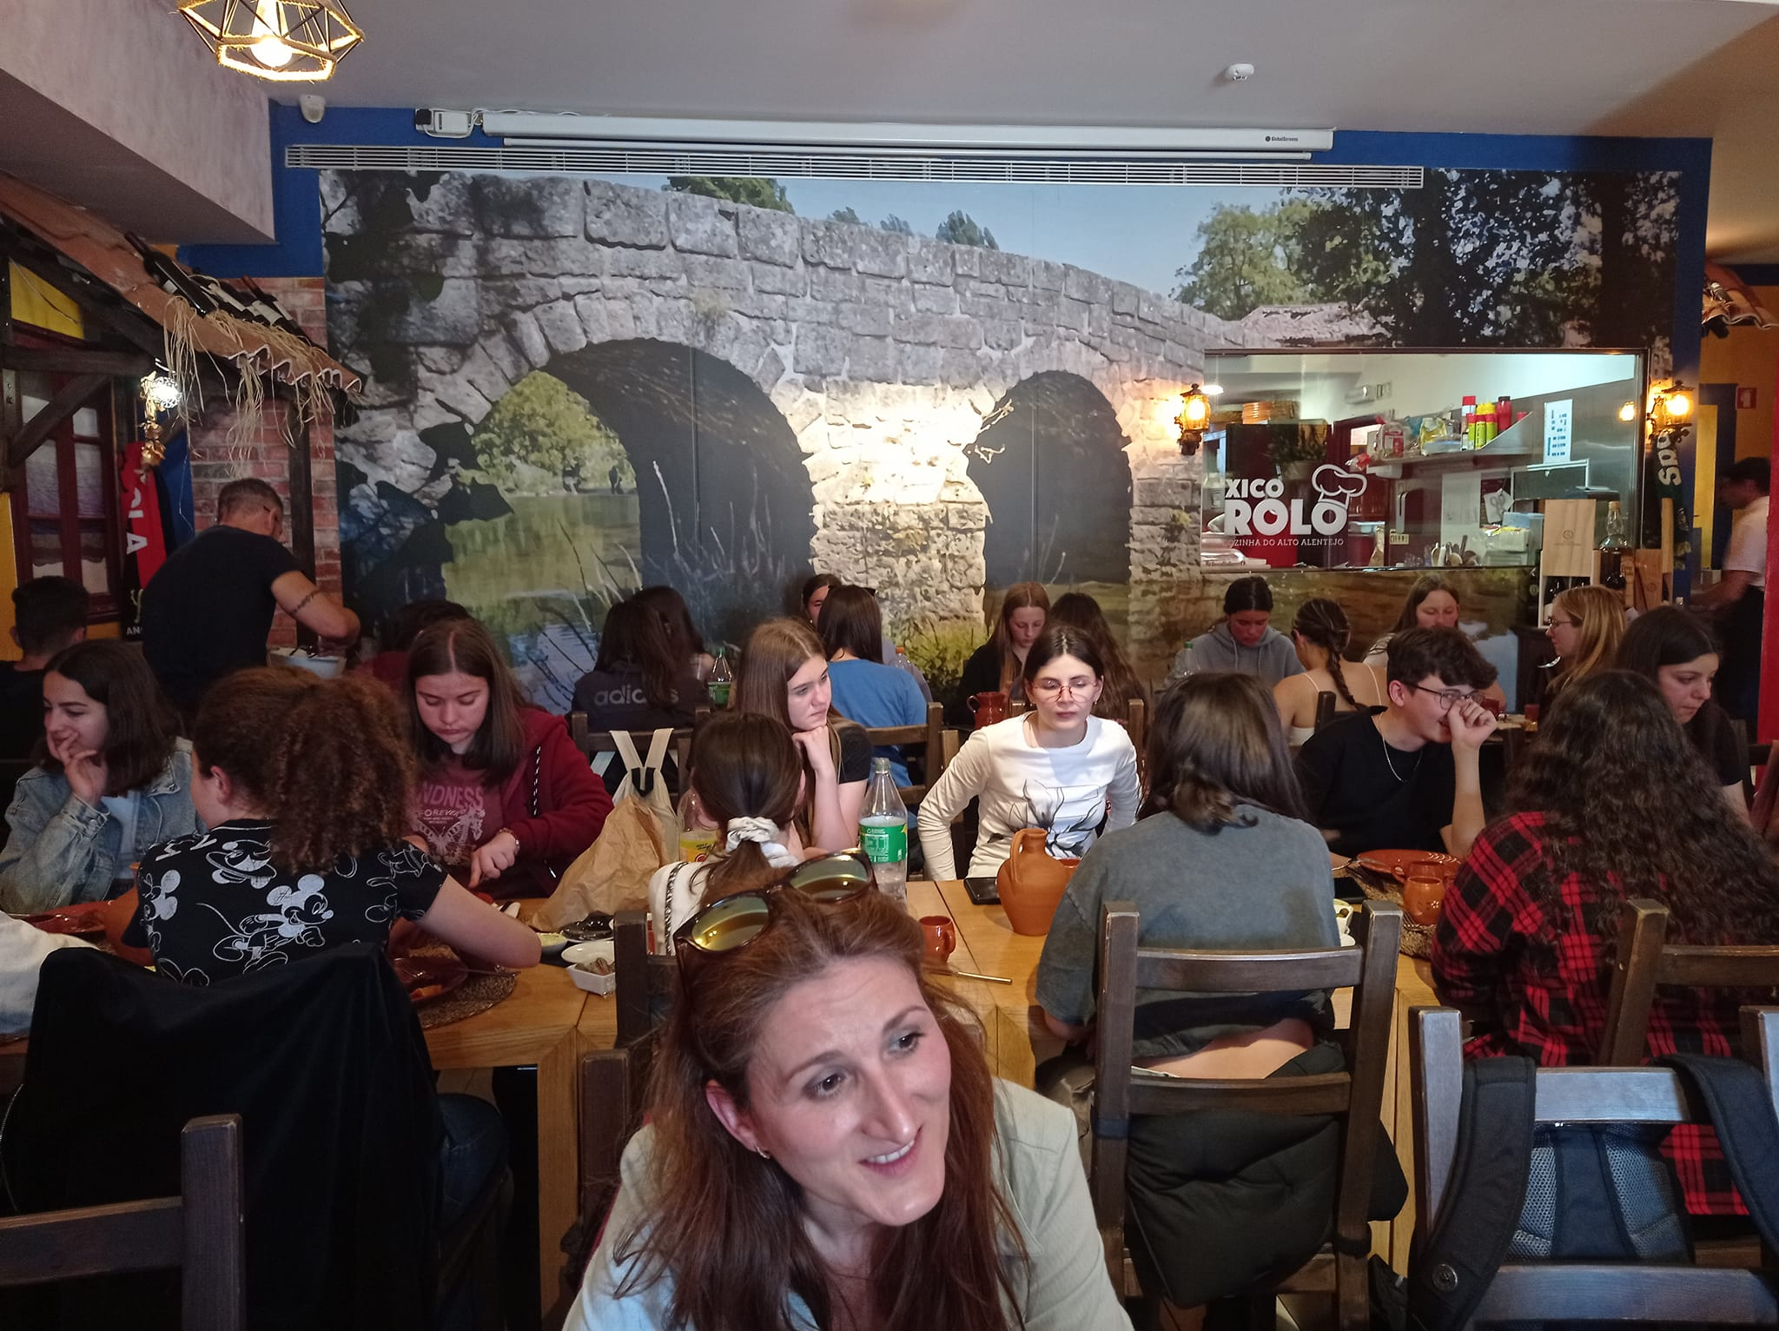
We were at lunch in restaurant:
We ate baked meat and potatoes soup as appetizer.

Slide 5
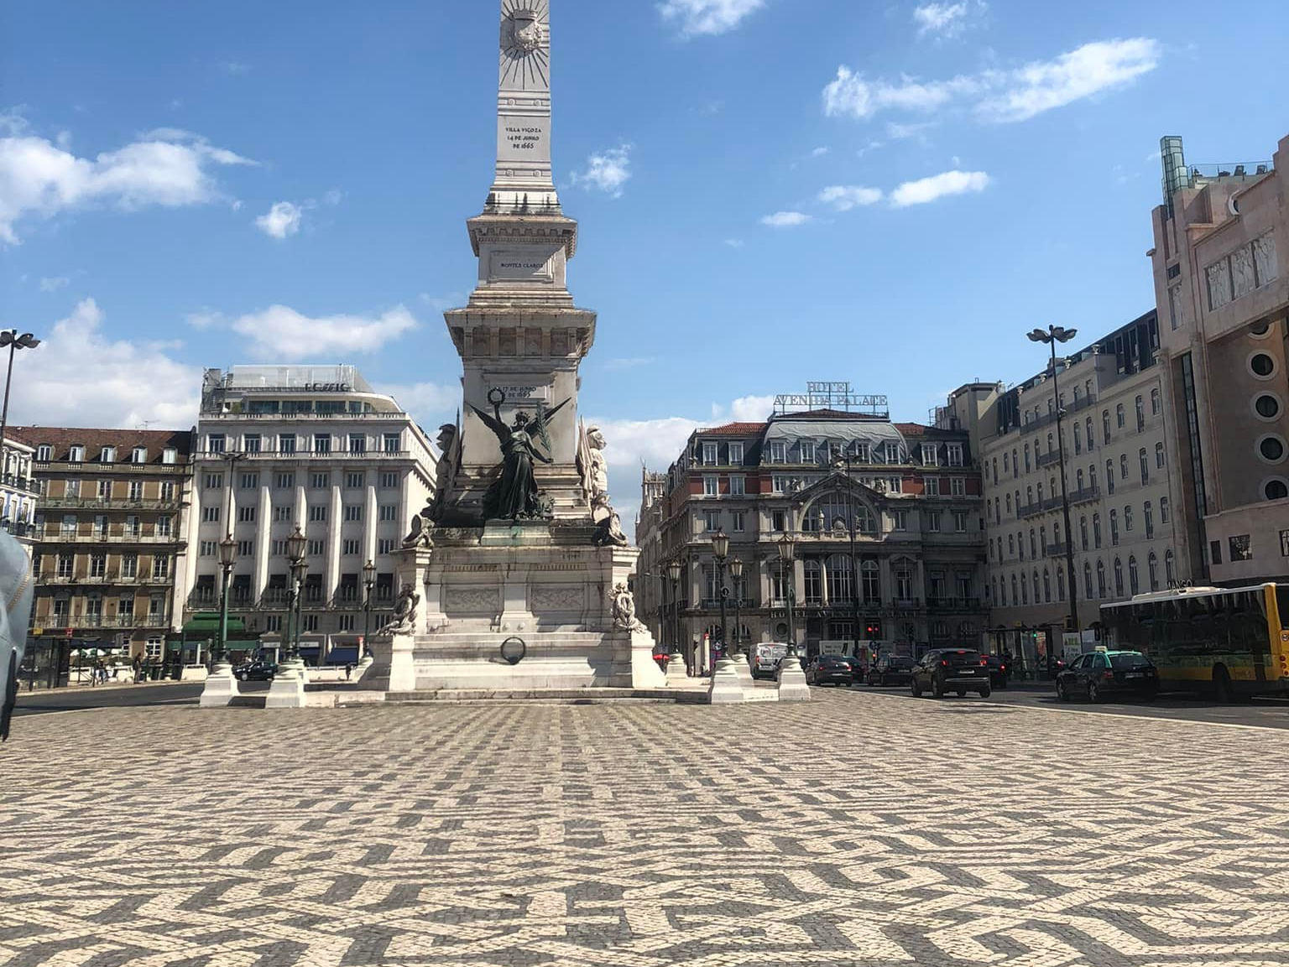
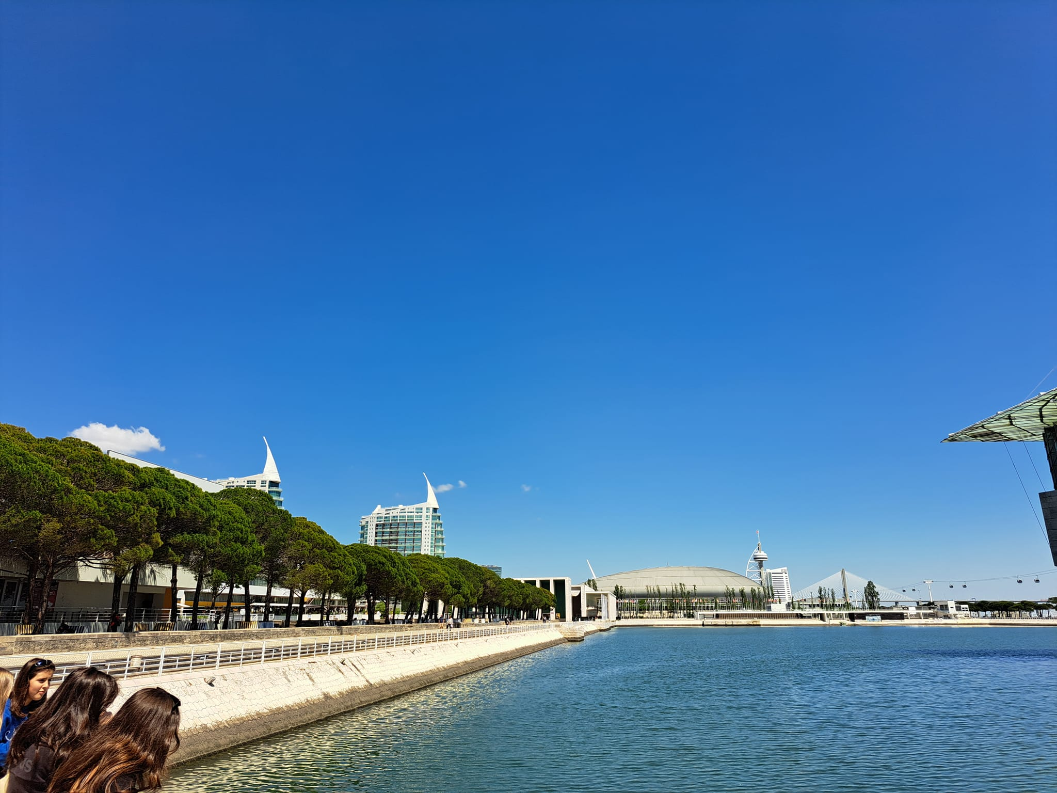
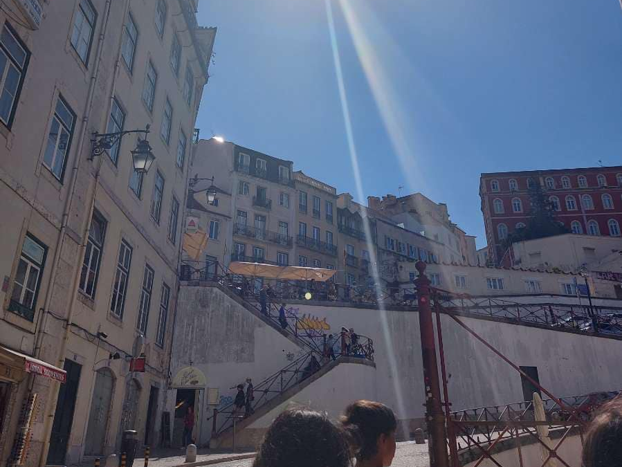
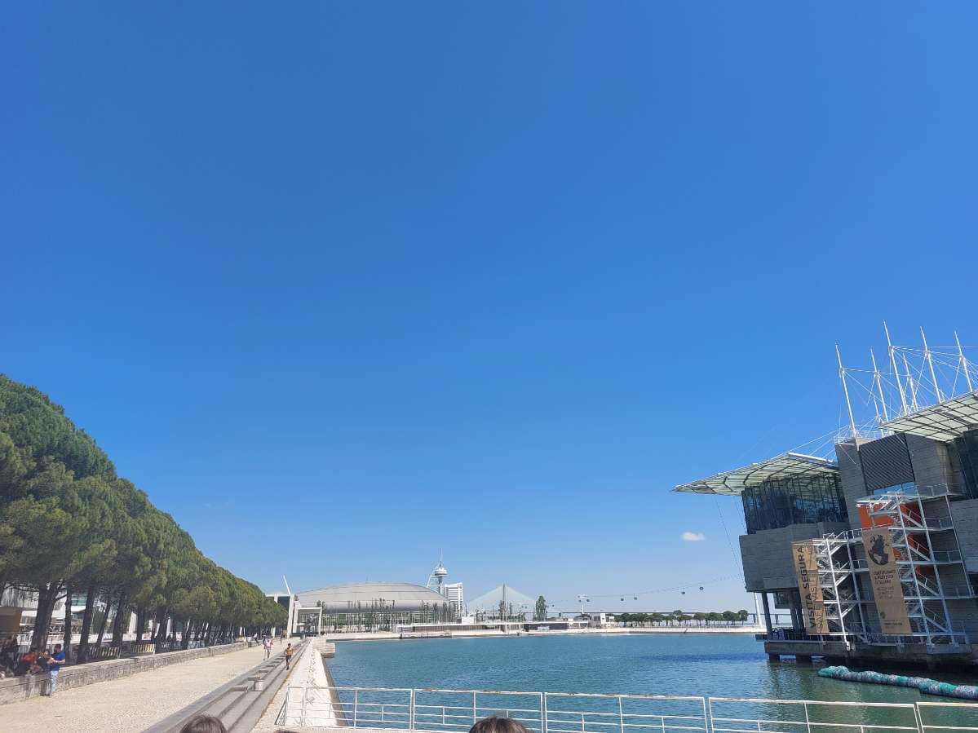
Free time in Lisbon:

Slide 6
Izradili:
Tim 4.

