Slide 1
Edo Murtić
Croatian painter

Slide 2
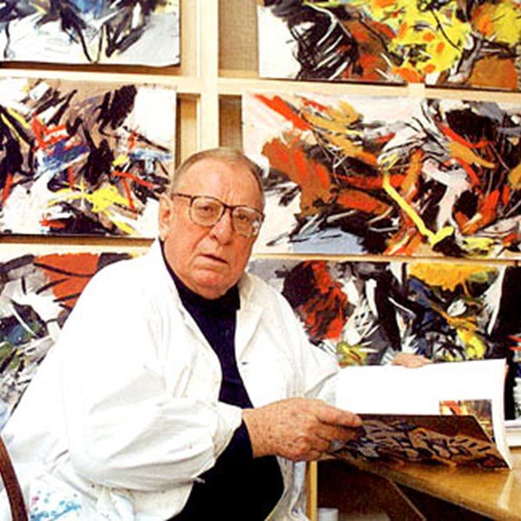
Biography
Edo Murtić was a croatian painter best known for his lyrical abstract exepression style. He made paintings and drawings along with murals and mosaics, theatrical scenography and graphic design.

Slide 3
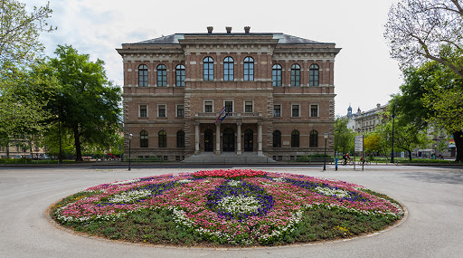
He was born in 1921. in the township of Velika Pisanica, Croatia. In 1939 he enrolled into the Academy of Arts in Zagreb. He participated in World War II in 1941 and two years later he was involved in the resistance movement.

Slide 4
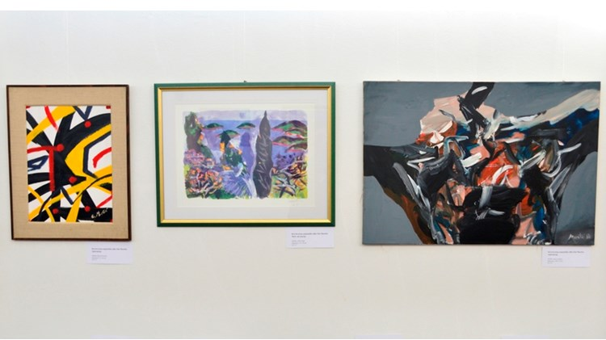
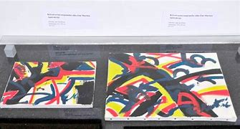
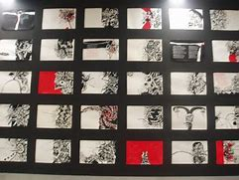
He traveled internationally a lot, especially in France, USA and Italy. That is how he gained international recognition for his work which can be seen in museums, galleries and private collections worldwide.

Slide 5
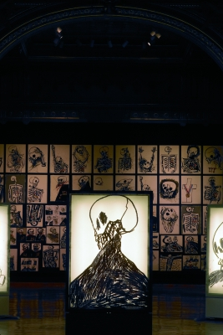
He had about 150 solo exhibitions and 300 group ones. The first solo exhibition was in in 1935 in Croatia’s capital city Zagreb.

Slide 6
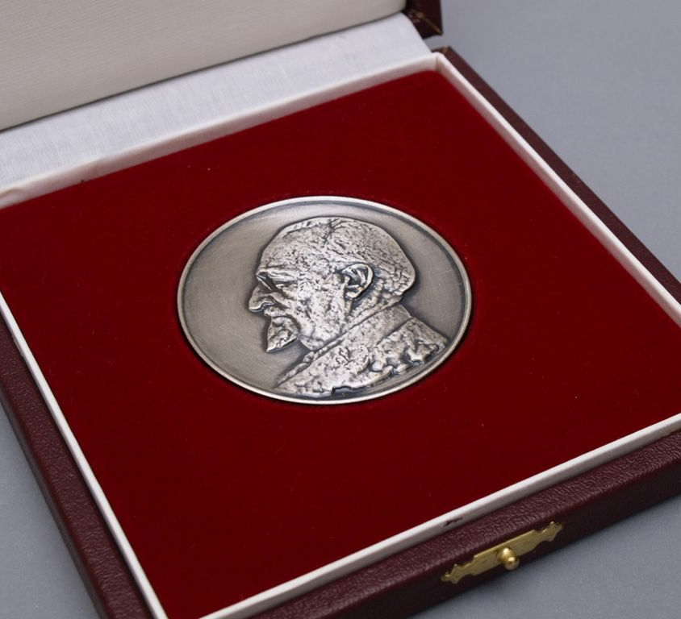
Edo Murtić had received many international awards for his artworks. He had participated in a lot of events in the world of contemporary art.

Slide 7
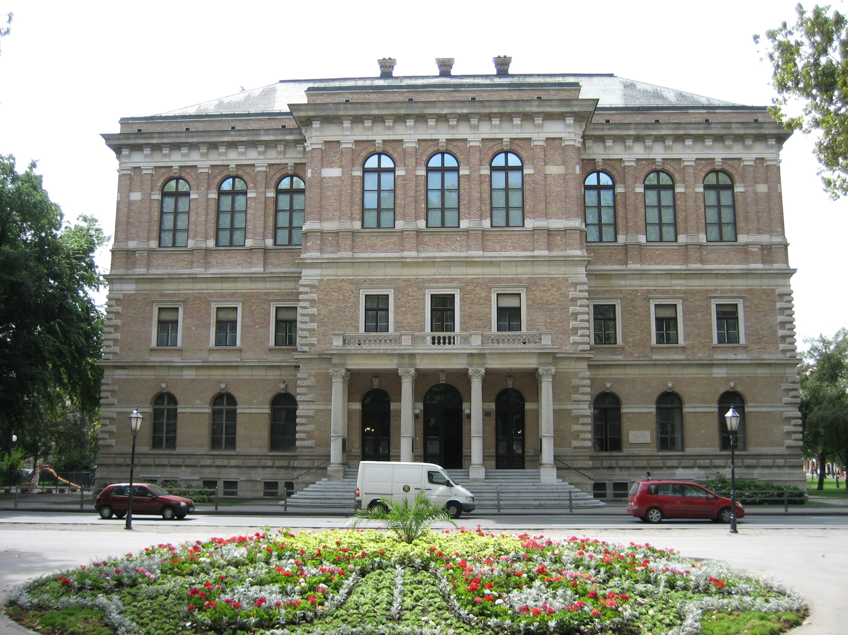
Murtić was one of the founders of the group „Mart” (March), a member of the Croatian Academy of Sciences and Arts and a member of the Croatian Helsinki Committee for Human Rights. He was declared a honorable citizen of Bjelovar. He died in 2005. in Zagreb.

Slide 8
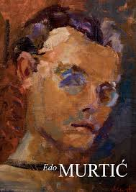
Edo Murtić's career as an artist started with drawing portrets, interiors and still life in the spirit of realism.

Slide 9
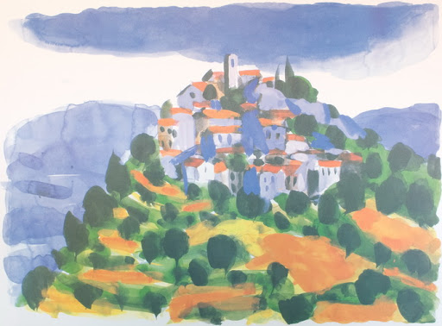
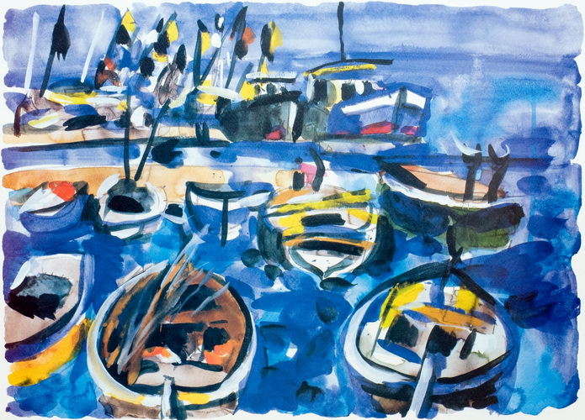
His inspiration came from motives of island cities, ships in ports, vineyards, gardens, olive groves of Croatias islands which he expressed through post-impressionist artworks.

Slide 10
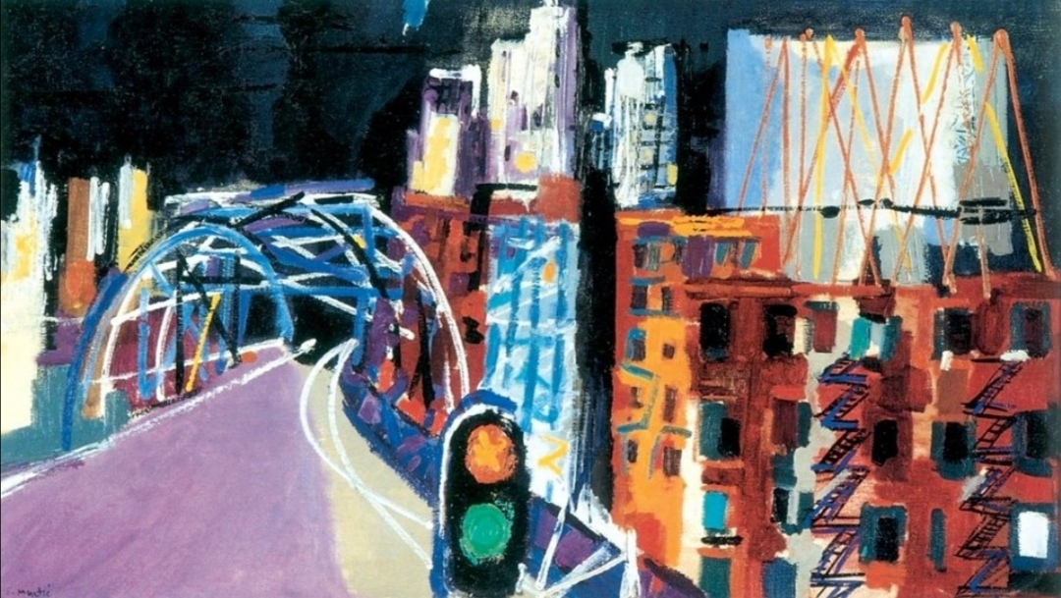
During a stay in USA and Canada he met abstract expressionism and made a series of paintings called „Doživljaj Amerike" or "The experience of America" with motives of strong color.

Slide 11
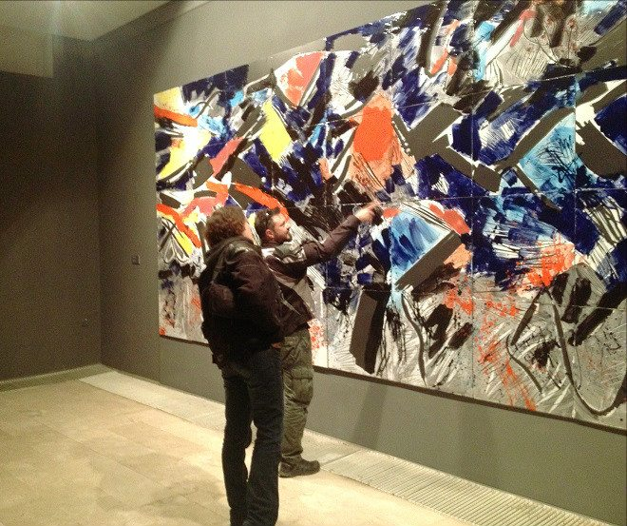
Later on, he would ilustrate literary works with graphics and drawings, make giant wall decorations, mosaics, ceramics, posters and scenography.

Slide 12
Some of his most significant artworks

Slide 13
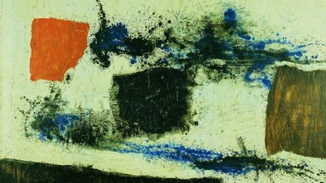
WHITE BACKGROUND
technique: oil paint (paint)
textile material: canvas

Slide 14
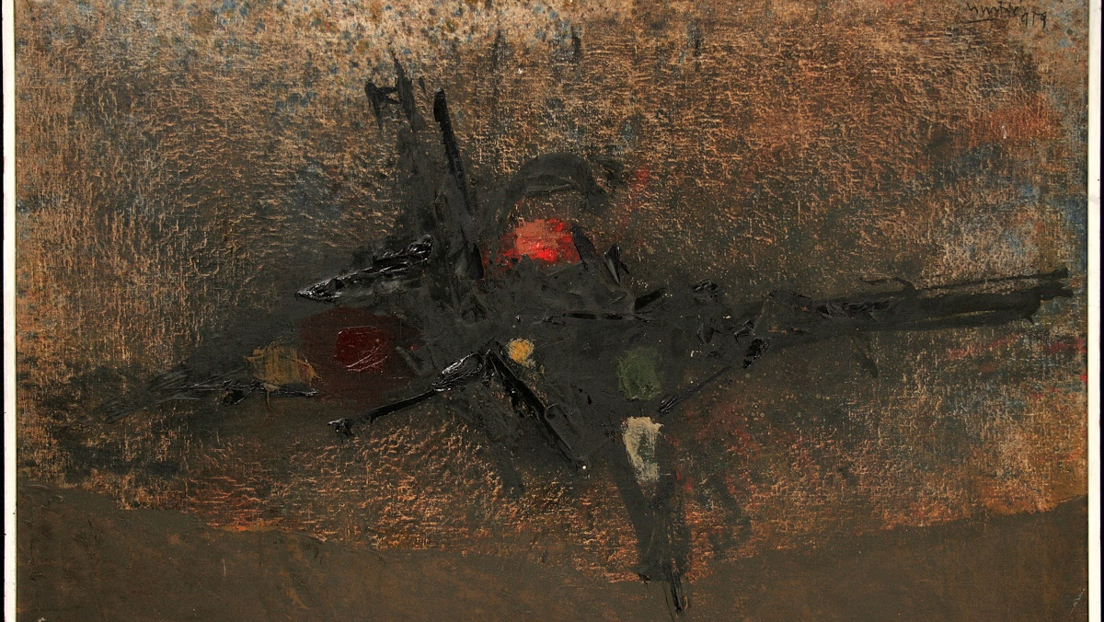
TWO RED DOTS
technique: oil paint
textile material: canvas

Slide 15
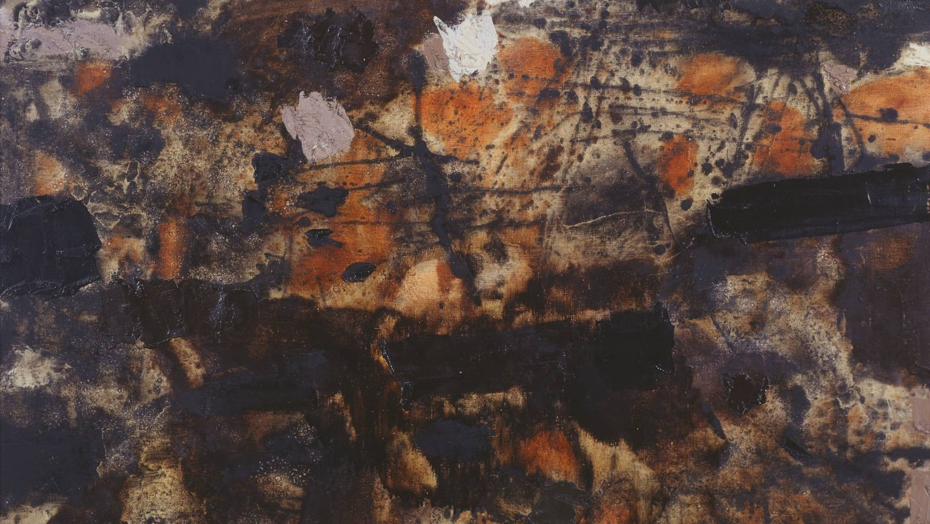
RED AND BROWN
technique: oil paint
texitile: canvas

Slide 16
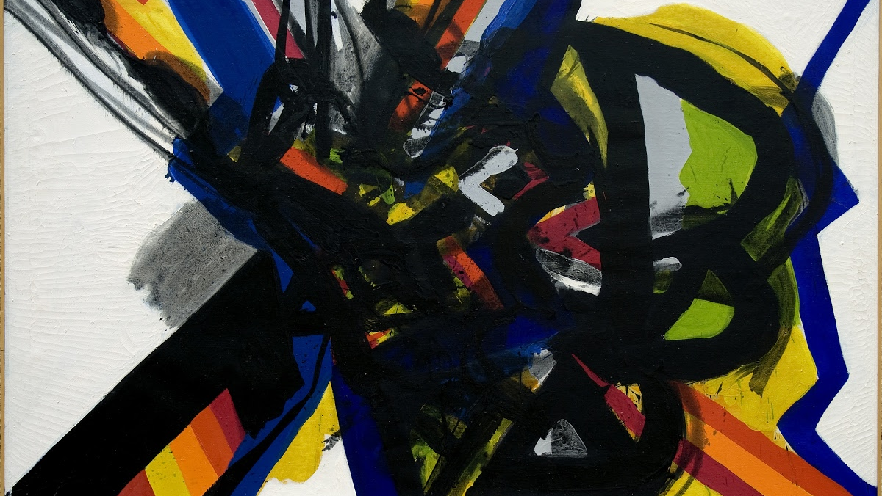
BROKEN MILESTONES
technique: oil paint
texitile: canvas

Slide 17
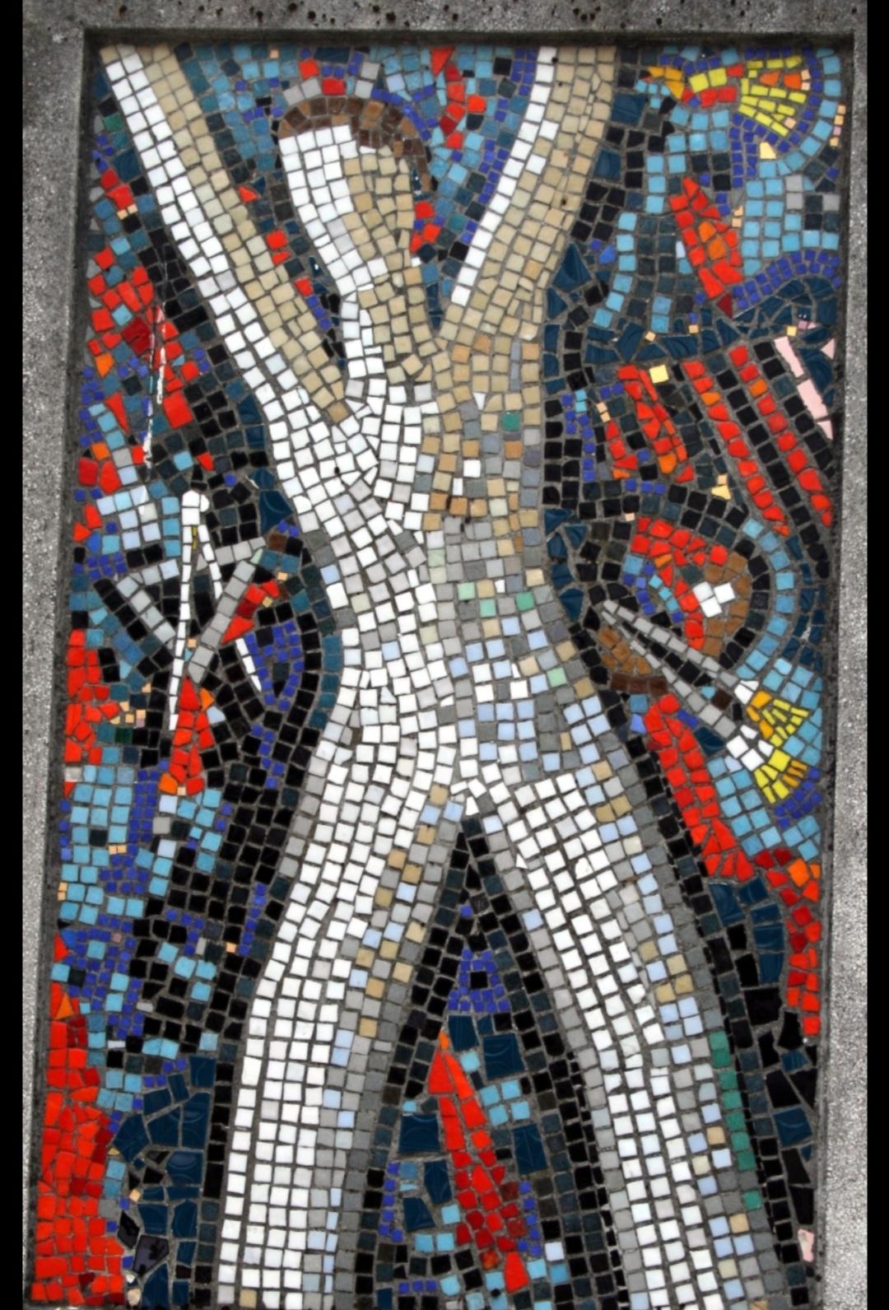
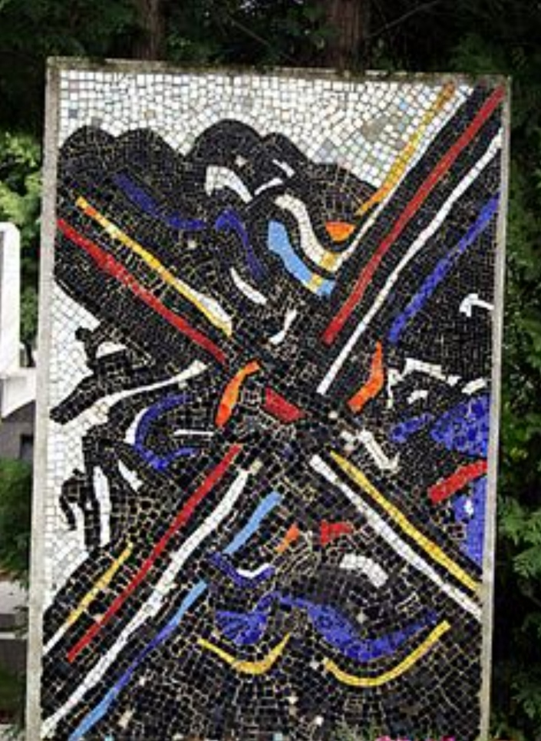
Mosaics

Slide 18
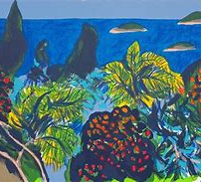
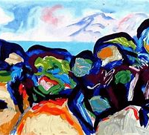
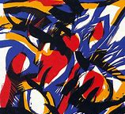
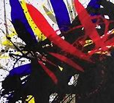
More artworks

Slide 19
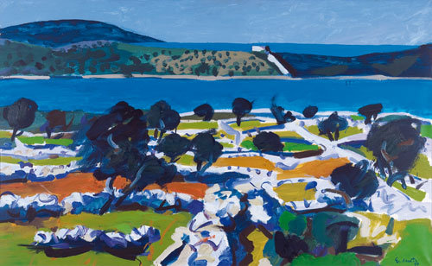
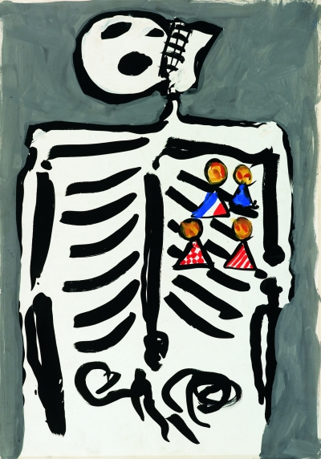
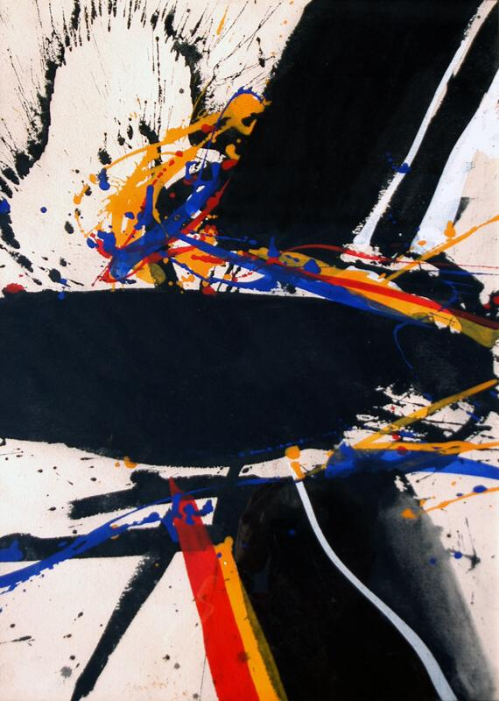
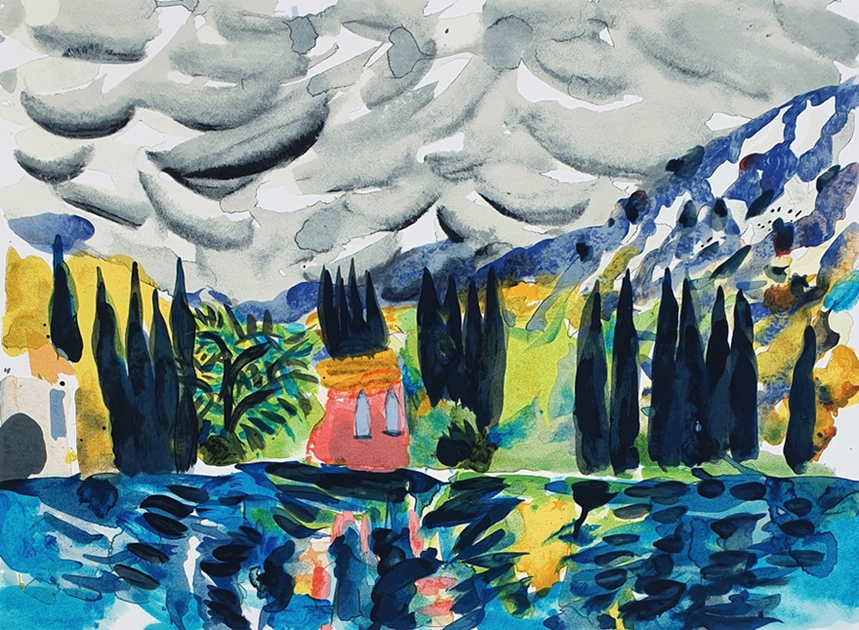

Slide 20
Made by:
Klara Horvat,
Lorena Posilović and
Julia Đuranec

