Slide 1
MY SCHOOL the timetable and favourite subjects
Primary School 7, Legionowo
class 4g

Slide 2
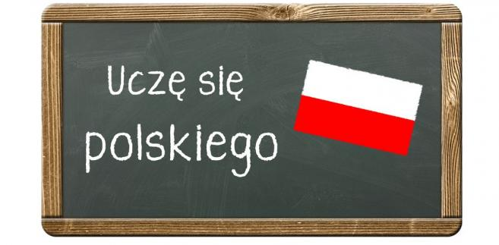
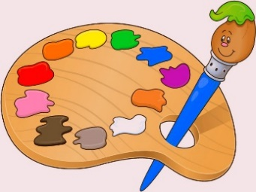
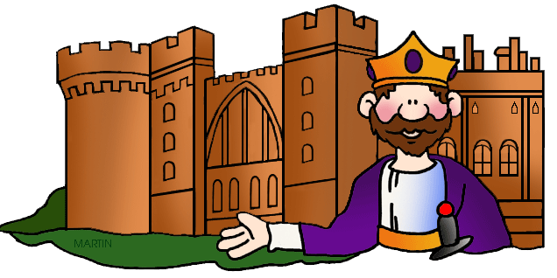
SCHOOL SUBJECTS
Polish
Maths
ICT
English
Art and Crafts
History
Nature
The lesson with the class teacher

Slide 3
 | 1 8.00 – 8.45 | 2 8.55 – 9.40 | 3 9.50 – 10.35 | 4 10.45 – 11.30 | 5 11.50 – 12.35 | 6 12.55 – 13.40 | 7 13.50 – 14.35 | 8 14.45 – 15.30
Monday
Tuesday
Wednesday
Thursday
Friday

Slide 4
What about you?

