Slide 1
HELLO

Slide 2
I am DENİZ
I am 15 years old.I have brown hair and green eyes.

Slide 3
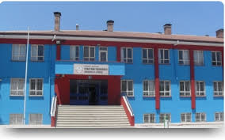
I’m a student in Fitnat Nuri Tekerekoğlu high school.

Slide 4
I like english and history lessons but I hate maths lesson ☺

Slide 5
I like swimming,playing basketball,reading book and listening music.

Slide 6
I don’t like drawing,singing,playing computer.

Slide 7
I hate lie,snake and onion ☺

Slide 8
I love DUMAN Band.I love listening to Duman.(Kaan Tangöze) is very handsome ☺

Slide 9
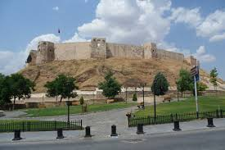
I live Gaziantep.Gaziantep is very beautiful city.Bakırcılar bazaar,museums,Antep’s castle…

Slide 10
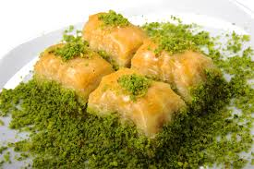
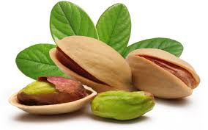
Gaziantep’s foods are very nice; kebab,baklava and Antep peanut.

Slide 11
I want to be a student 9 th Eylül University.I want to be a lawyer and I want to travel the world.

Slide 12
GOOD BYE

