Slide 1
HELLO MY FRIENDs I am berki

Slide 2
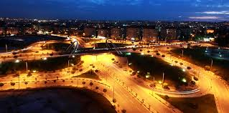
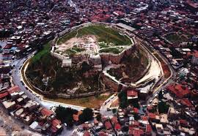
MY NAME IS BERKİ
I WAS BORN İN 2000 IN GAZİANTEP

Slide 3
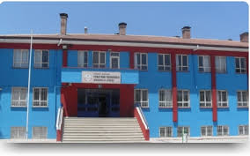
I AM STUDENT AT THE HIGH SCHOOL

Slide 4
MY FAVORITE LESSONs ARE
ENGLISH AND MATH

Slide 5
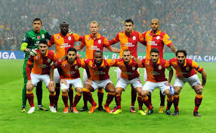
MY FAVORITE TEAM IS GALATASARAY

Slide 6
I AM CHEERFUL AND HARDWORKING

Slide 7
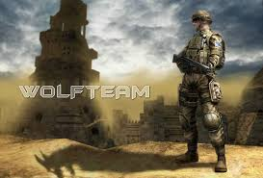
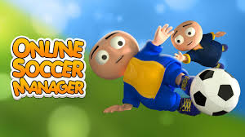
I LIKE PLAYİNG COMPUTER GAMES

Slide 8
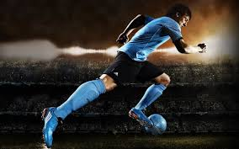
I LIKE PLAYİNG FOOTBALL

Slide 9
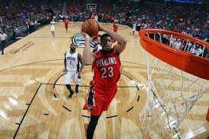
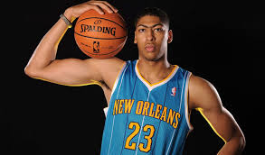
I LIKE WATCHING BASKETBALL MATCH BUT
I DON’T LIKE PLAYING BASKETBALL

Slide 10
BYE ☺

