Slide 1
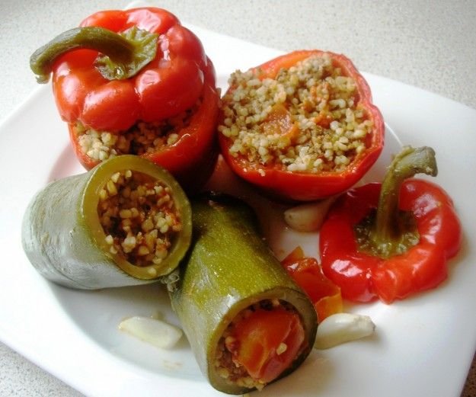
Food in Hatay
Dolma: Stuffed bell peppers and zucchini (courgettes) with bulgur (cracked wheat), ground meat and spices.

Slide 2
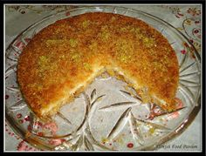
Künefe
Künefe is considered to be one of the most delicious Turkish desserts, especially in the city of Antakya (Antioch) located on Mediterrenean Sea, in Southern Turkey. Although künefe shops are very common throughout Hatay, Kilis, Adana, Mersin and Gaziantep provinces, the city of Antakya in Hatay is known for the best künefe in Turkey. What distinguishes Antakya’s künefe from others is the daily made fresh, elastic cheese that is only made in Hatay region.

Slide 3
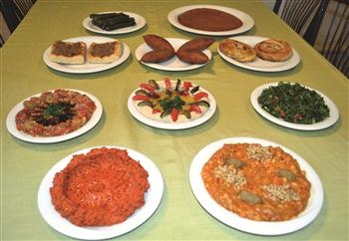
Meze

Slide 4
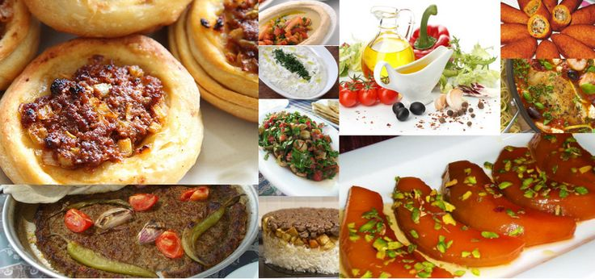
Hatay has 600 different dishes and extraordinary tastes. Here you see a part of them!

