Slide 1
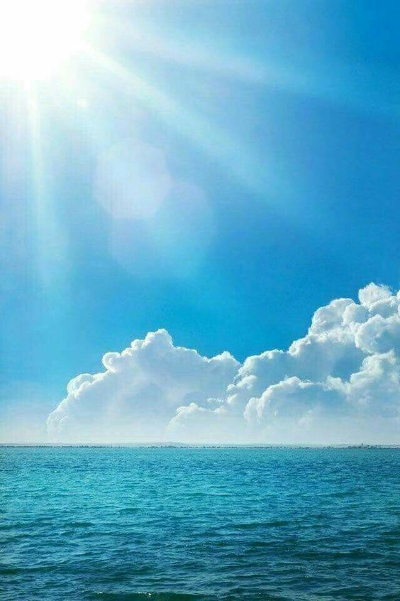

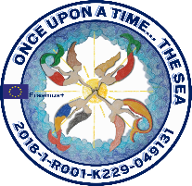
ONCE UPON A TIME…
THE SEA
PROJECT FINANCED BY THE EUROPEAN UNION - ERASMUS + PROGRAMME
ACTION KA2 - EDUCATION, INTER-SCHOOL EXCHANGE PROJECTS
REFERENCE NUMBER: 2018-1-RO01-KA229-049131_1
The European Commission support for the production of this material does not constitute an endorsement of the contents which reflects the views only of the authors, and the Commission cannot be held responsible for any use which may be made of the information contained therein.

Slide 2

SEA TRAVELERS
Presented by
SCOALA GIMNAZIALA LUCIAN GRIGORESCU
MEDGIDIA-ROMANIA

Slide 3
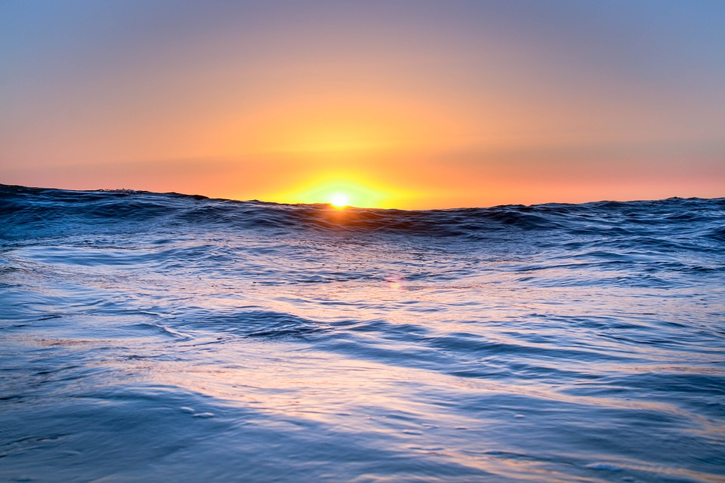
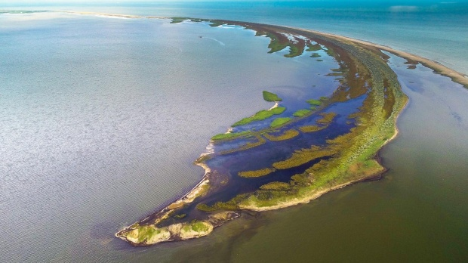
THE BLACK SEA
The Black Sea has been popular also due to a number of features that are surprisingly unusual. For a long time, it has been called inhospitable because of the difficulty in navigation since its shores were inhabited by savage tribes.
However, as time passed, the image of the Black Sea has changed. Beside this, there are a lot of interesting facts that makes it an attraction to marine enthusiasts. The Black Sea is home to about ten small islands, which are an amazing habitat for fauna and flora and major tourist attractions, playing an import role in the economy of the countries around.

Slide 4
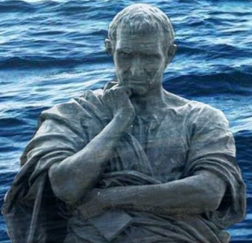
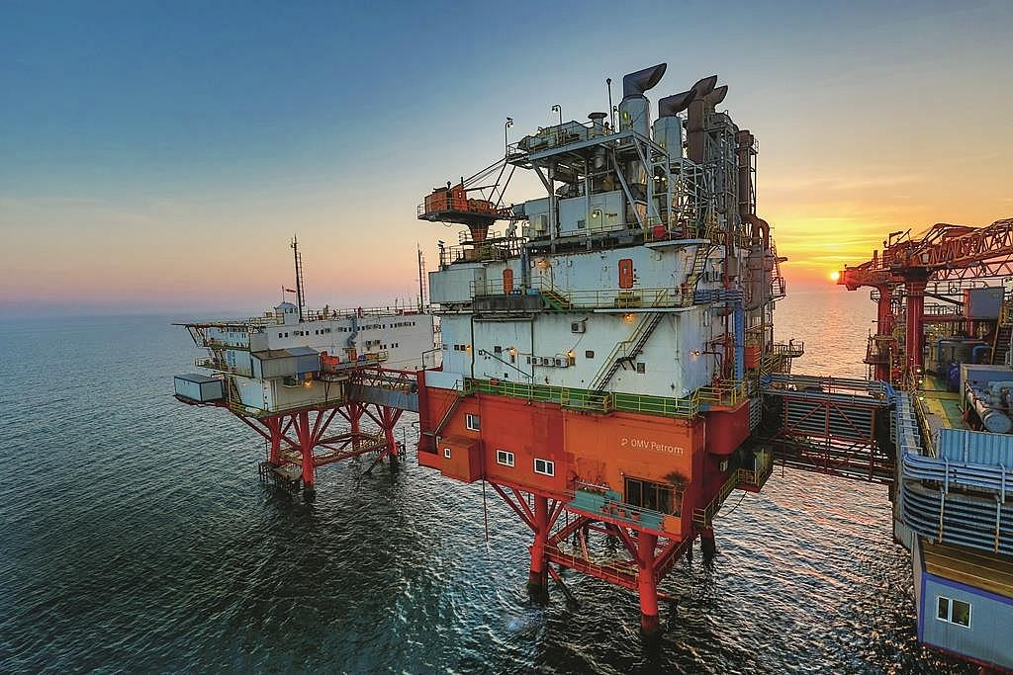
Since the time of the ancient poet Ovidiu, there has been told a lot about the Black Sea and much can still be, but one thing seems to be certain: it has a special significance in the construction of Romania's foreign and security policy, and soon in the construction of national energy policies.
With an annual output of nearly
11 billion cubic meters in 2016, Romania is the most important natural gas producer in Eastern Europe.

Slide 5
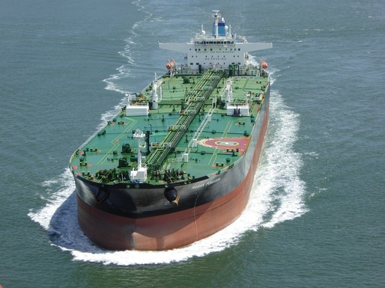
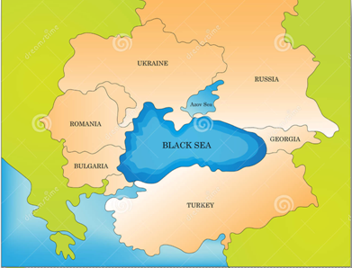
The petroleum deposits from the Caspian Sea will have to be transported to Europe and the entire world, and one of the main routes is the Black Sea. Oil tanks reach Constanta.
Given that it is located away from the ocean, the Black Sea provides Romania with a remarkable strategic position due to the port of Constanta from where the exported products come from or in which the imported goods are shipped.

Slide 6
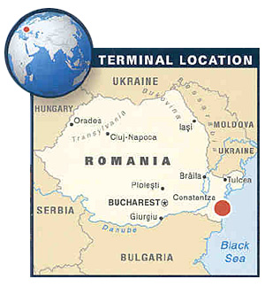

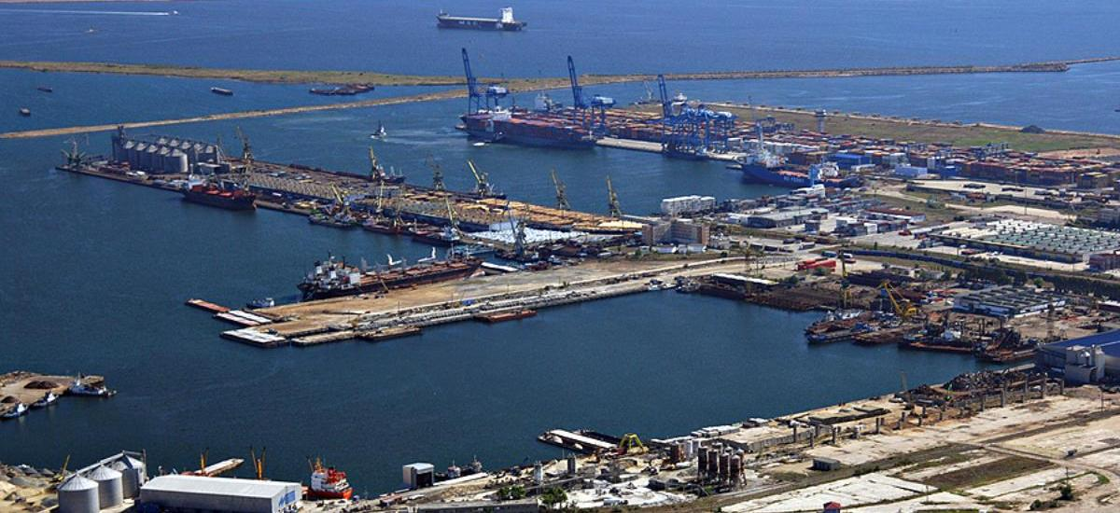
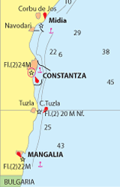
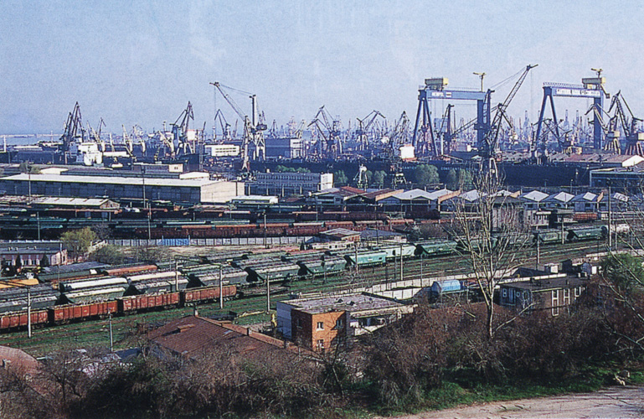
THE PORT OF CONSTANTA
The Port of Constanta is the main port in Romania and the largest in the Black Sea. Nowadays it is a powerful industrial commercial and touristic centre, a wide gate towards the world.
It has two satellites - Midia and Mangalia.
The 3 ports are provided with shipyards where are built ships as large as 250,000 dwt.

Slide 7
CONSTANTA PORT has a handling capacity of 100 million tons per year and 156 berths, of which 140 are operational. The total quay length is 29.83 km, and the depths range between 8 and 19 meters.
Daily, more than 200 river vessels are here for cargo loading or unloading or waiting to be operated.

Slide 8
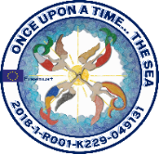
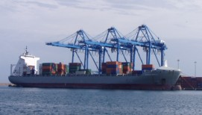
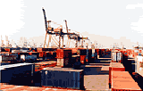
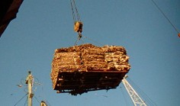
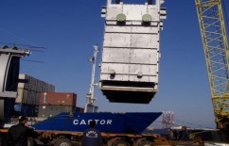
The main container lines provide a fast and efficient connection between Constanta Port and the most important ones of the world.
The port offers competitive facilities for perishable cargo storage which can be stored in adequate conditions in refrigerated warehouses and reefer containers.

Slide 9
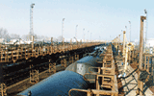
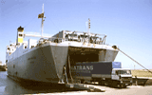
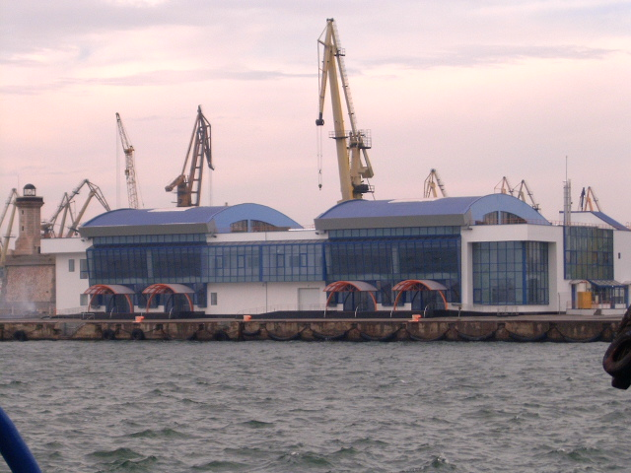
Ferry services provide a fast and direct link on the West - East axis.
A pipeline network connects the port with the main refineries in the country thus securing fast transportation.
The oil terminal is equipped with the most modern and efficient fire and pollution fighting facilities.
The Port of Constanta is a traditional partner for the Eastern and Central European countries with high agricultural production that transit their cargo towards worldwide destinations.

Slide 10

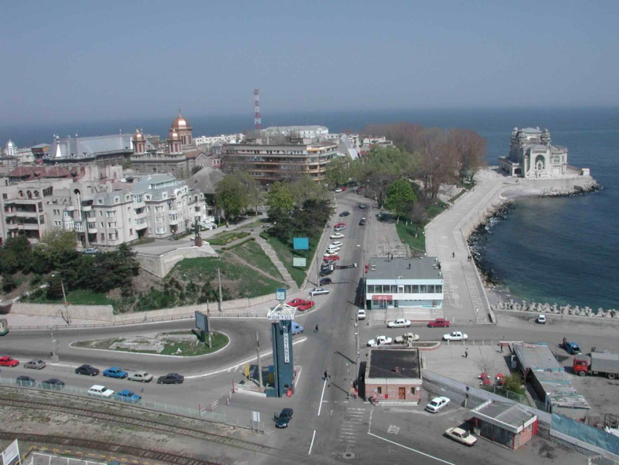
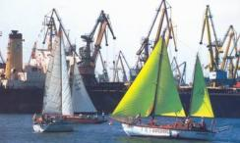
Passenger Terminals offer excellent starting point for touristic trips, sightseeing, entertainment Lighthouse, the Port Museum, the Touristic Port, the city center) and facilities for transportation and accommodation in resorts situated close to the location.
The touristic port is integrated in a harmoniously with the architectural design of the city. Due to its favourable location it has a high potential for nautical tourism, sports activities and entertainment.

Slide 11
CONSTANTA PORT
With its ships
Which sails or don’t
It’s our lighthouse
For the world
And for sailors
The second home
It is a host
For boat races
An open gate
To so nice places

Slide 12
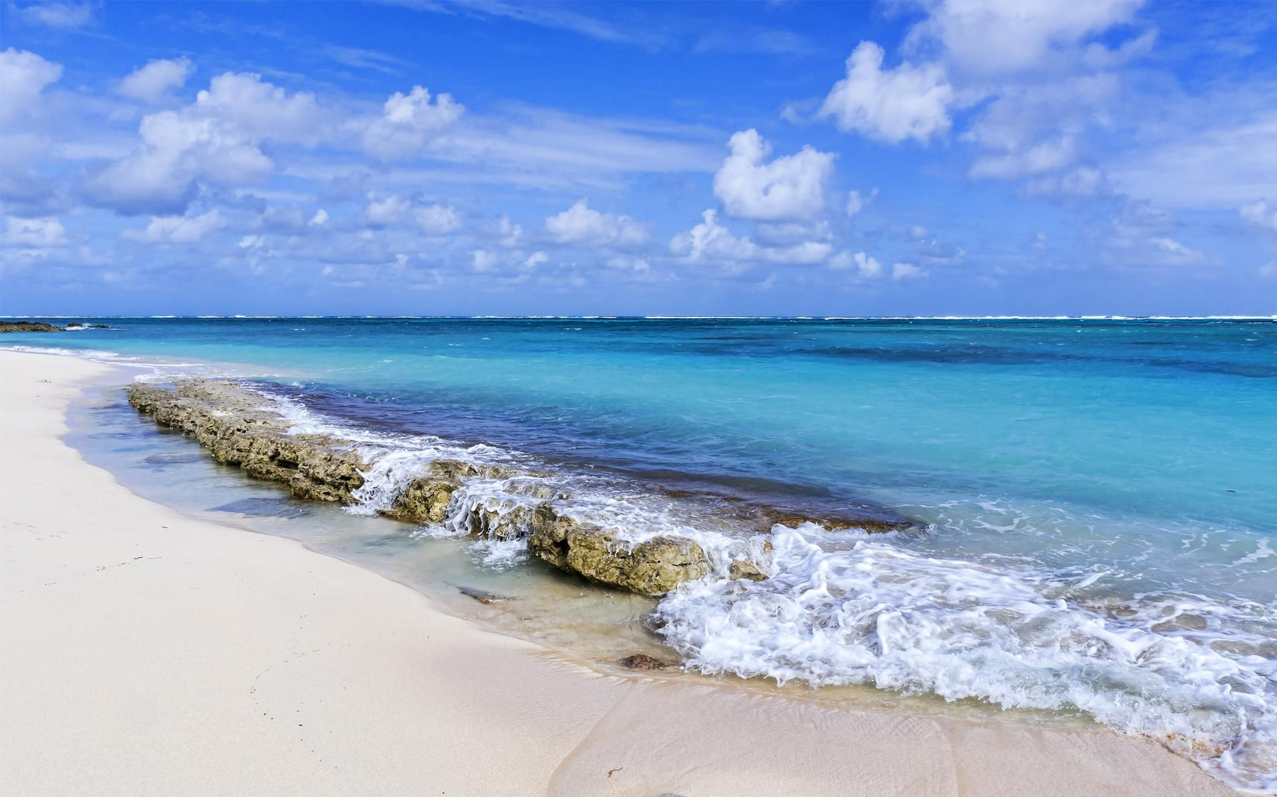
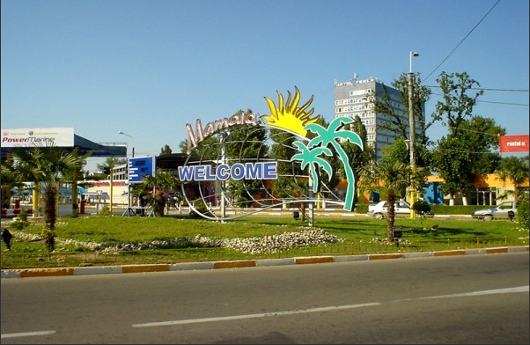
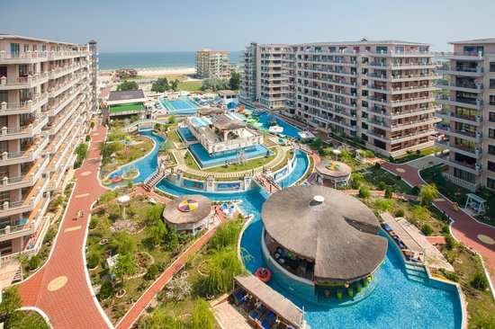
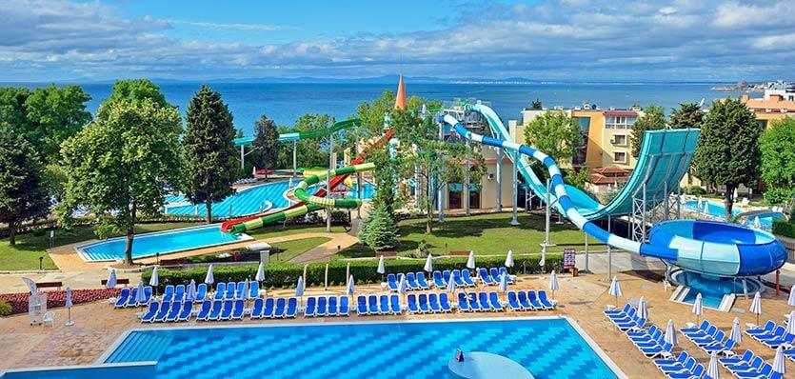
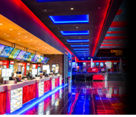
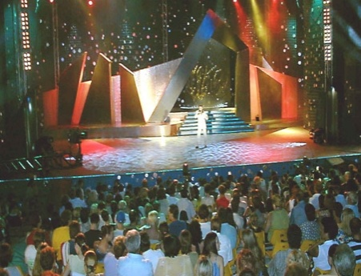

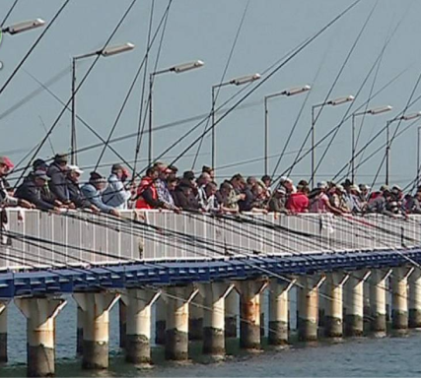
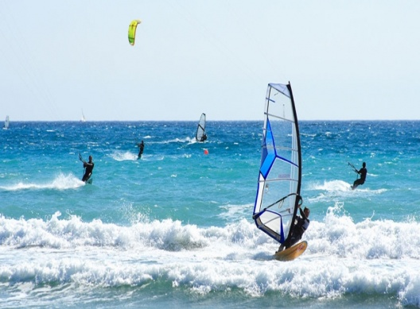
MAMAIA, THE PEARL
OF THE ROMANIAN RIVIERA
Mamaia resort offers numerous accommodation facilities in hotels with tennis courts and mini golf courses, outdoor swimming pools and discos. Tourists can enjoy the amusement parks, a cinema and a theatre, having also the opportunity to practice water sports or fish in Mamaia Lake.

Slide 13
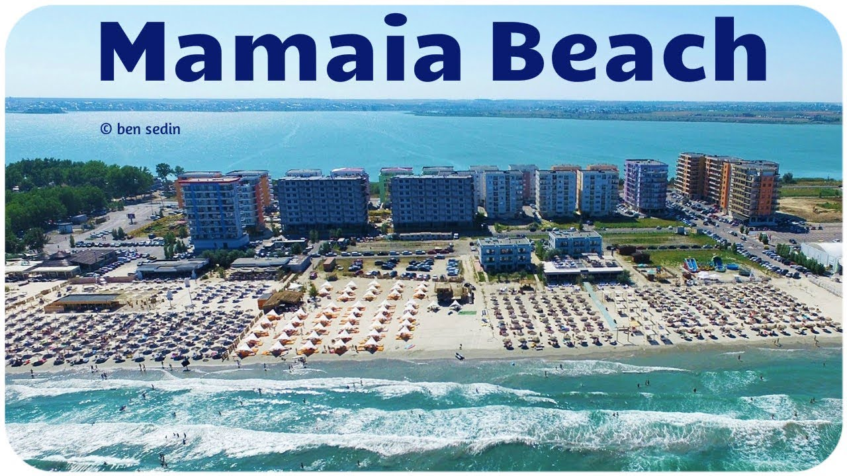
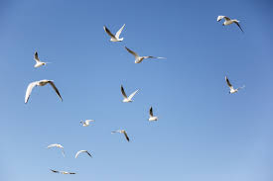
has a length of eight km
and a width between 100 and 250 m.

Slide 14
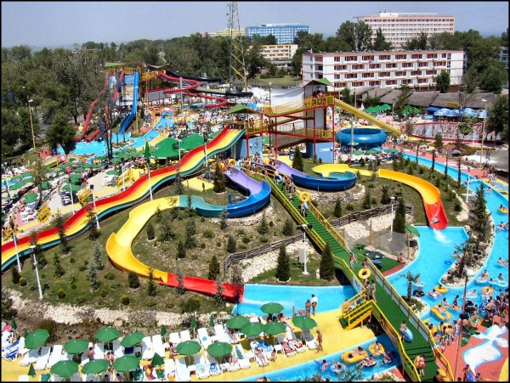
AQUA MAGIC is the most modern water park on the Romanian Black Sea coast.
It stretches over an area of ​​2.7 hectares and includes slides, pools for adults and children, water drops, restaurants, bars, fast food and souvenir shops.

Slide 15
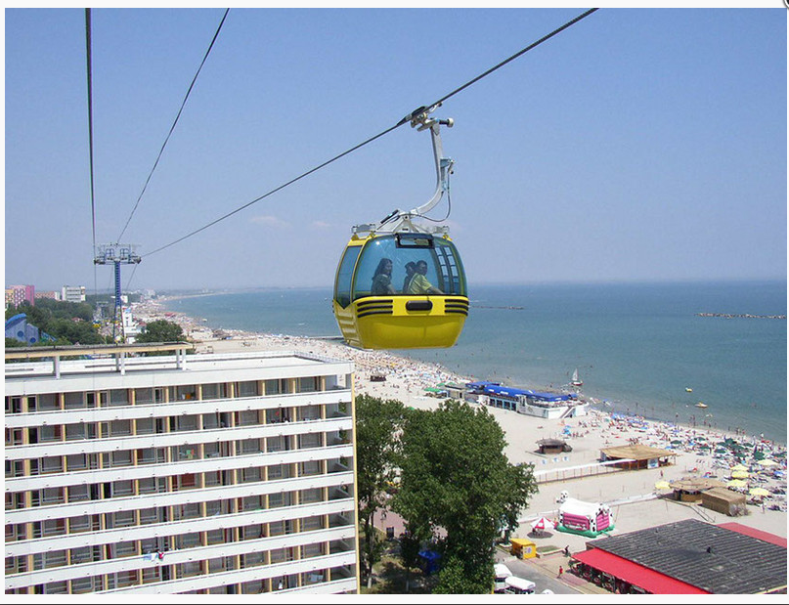
THE GONDOLA is actually a system of cable transport for tourists who want to admire the spectacular panorama of Mamaia and remain with the best memories of summer holidays. The movement is at a height of 50 m, at a speed of 5 m per second, the entire 2.1 km route being completed in seven minutes.

Slide 16
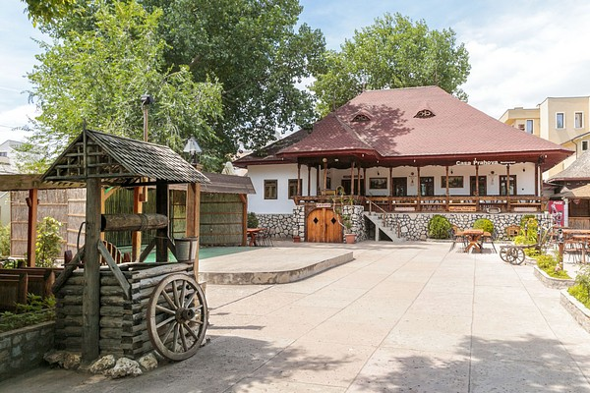
THE HOLIDAY VILLAGE is a picturesque place, where there are 31 traditional Romanian houses decorated in rustic style, according to the region they each represent and where tourists can enjoy the culinary specific of different Romanian provinces.

Slide 17
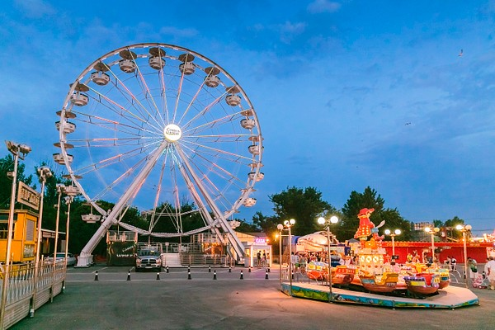
The main attraction of the Holiday Village is the amusement LUNA PARK, a place in high glee.Here you can find carousels and trains for the children, but also the centrifuge, the roll-coaster, hammers and other such installations for adults. If you have the courage to get into the big wheel, you will be compensated by an impressing panorama over Mamaia resort and Constanta city.

Slide 18

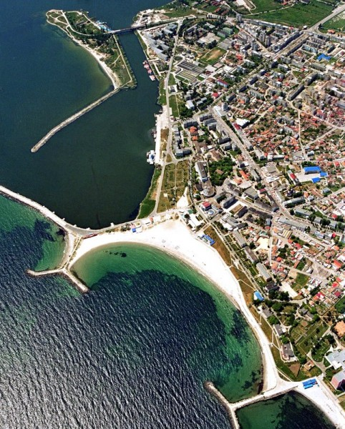
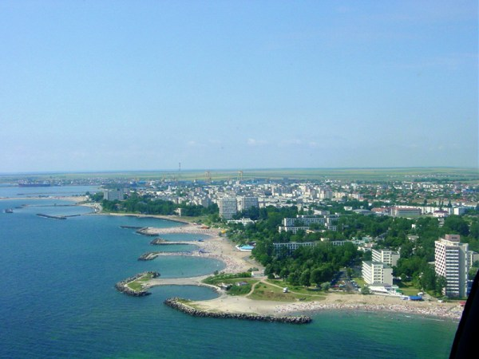
MANGALIA municipality is situated at 45 km South of Constanta, a clean and stylish city, which has successfully mastered the attribute of balneotherapeutic resort in the last decades.

Slide 19
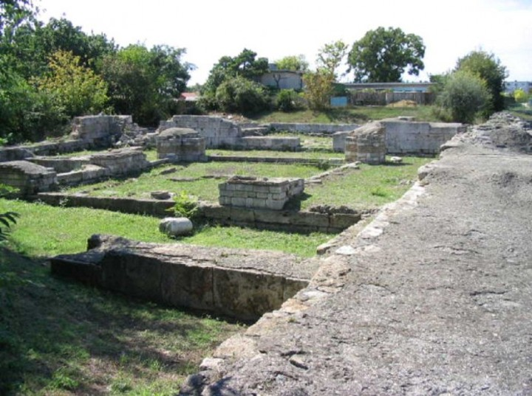
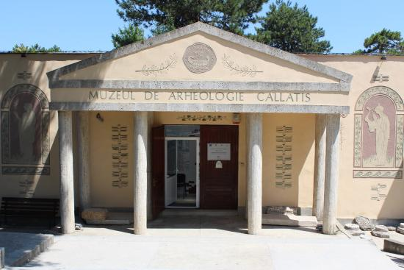
As a resort it offers the tourists many opportunities to spend free time: the beach, the museums, monuments and fortresses which present the history of the region, underwater entertainment, spectacular shows, festivals and cultural events.

Slide 20
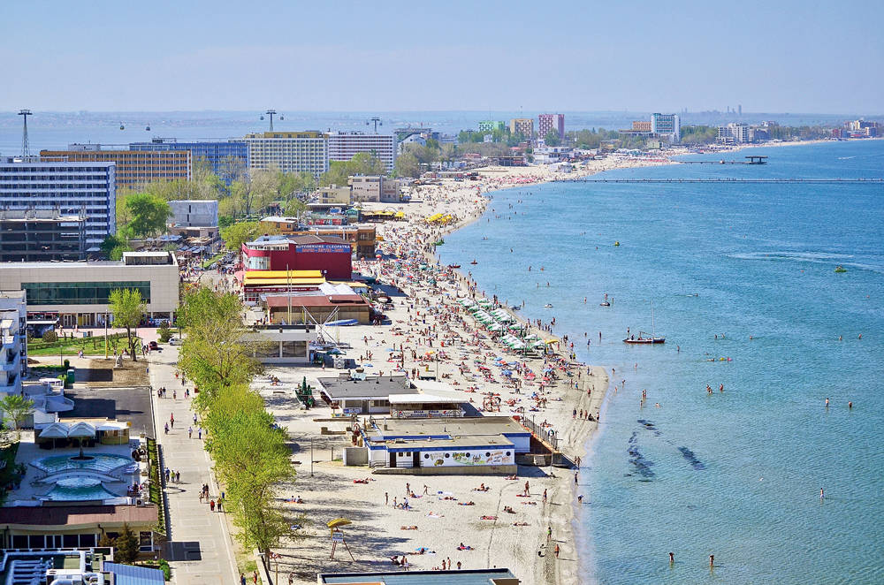
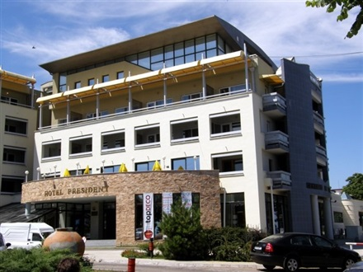
The beach of Mangalia is covered with fine sand and the largest width is reached in its center, having almost 120 meters. President Hotel is a modern location, which includes in its structure in a very original way, a fragment of the Roman fortress of Callatis.

Slide 21
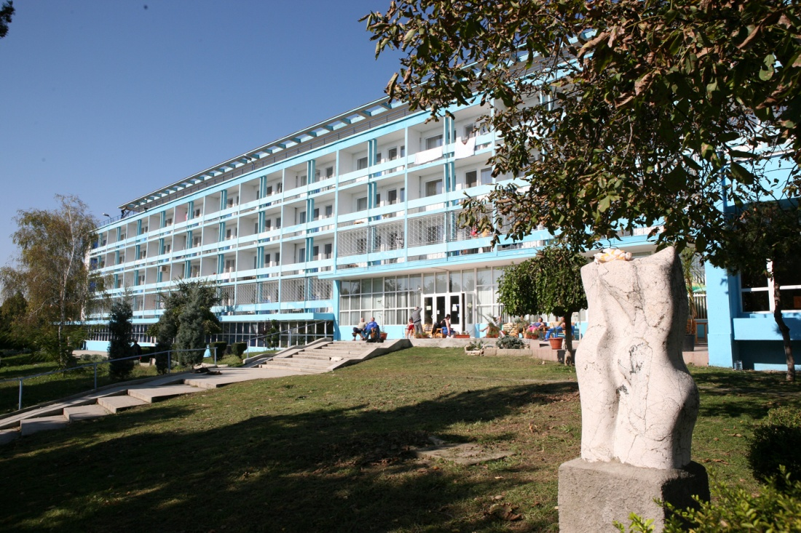
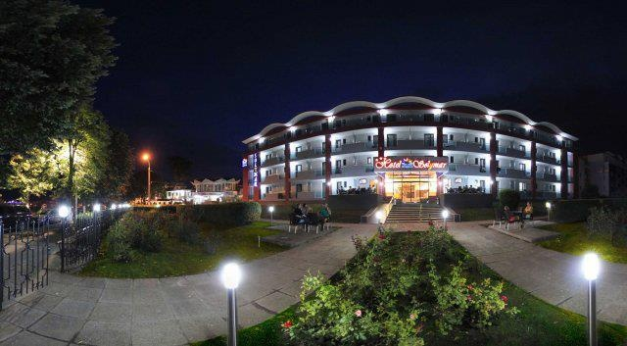
Mangalia resort has two modern treatment centers equipped with modern installations for the sulphurous mud which is rich in minerals and is extracted from the swamps and have a strengthening effect on the human organism.

Slide 22
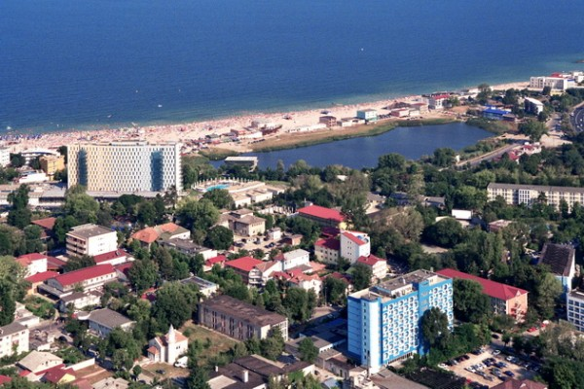
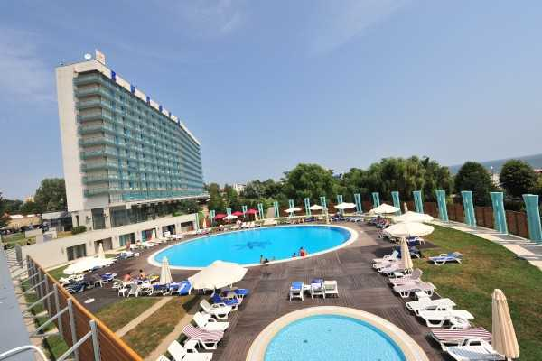
EFORIE NORD is the second largest resort of Romanian seaside, a balneary one which is famous not only inside the country but also abroad.
The treatment centers from the resort attract every year a large number of tourists, both Romanians and foreigners, offering them health cures using the natural factors from the area.

Slide 23
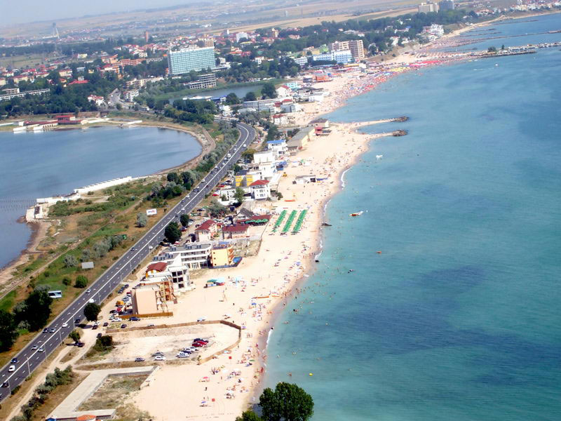
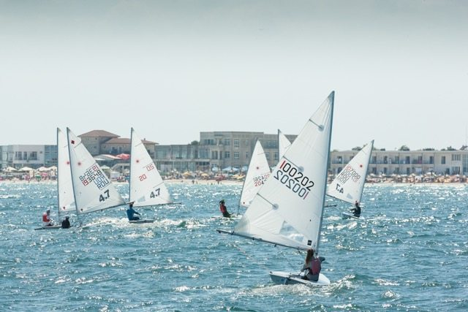
Eforie Nord resort enjoys a wide opening to the sea and a cliff whose altitude reaches even 30 meters. The beach has about 4 km in length, and its width varies between 20 and 100 m.
The resort offers also other possibilities of fun and relaxation. The fans of water sports can rent sailing boats or can take diving lessons.

Slide 24
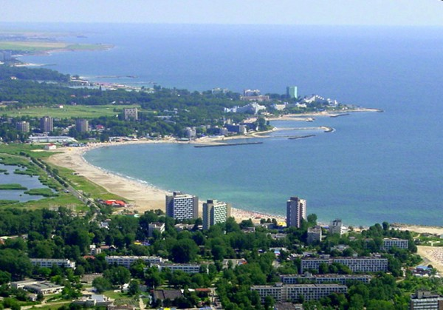

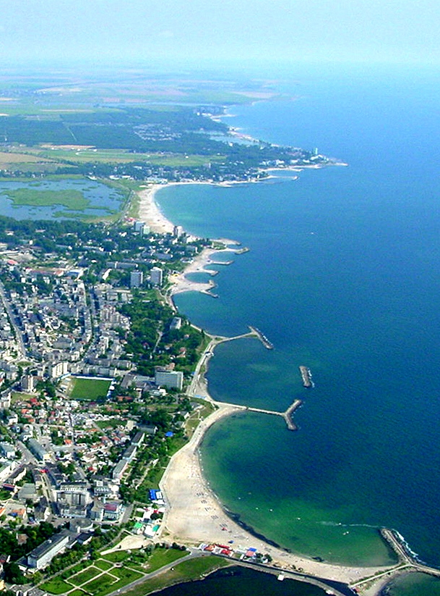
NEPTUN and OLIMP are two resorts which are their own extension, on the Romanian sea coast on the Black Sea.
Situated in a very beautiful landscape, boarded by a forest and a lake, Neptun – Olimp is an aired resort, very well configured which hasn’t lost his charm and elegance.

Slide 25


The beaches are good for aerohelitherapy, talasotherapy and cold mud wraps.
During the day, tourists can enjoy the entertainment centers both on the lake and on the beach, so they can ride hydrobicycles, sailing boats, skyjets and the famous bananas.

Slide 26



Costinesti is a resort in Constanta county, located on the shore of the Black Sea. It is a summer destination, most popular with young people and students.

Slide 27

Costinesti resort has a small inland lake, the only one on the Romanian coast that is not fed underground. Due to the high salinity degree, a considerable amount of sludge is used to treat rheumatic diseases.

Slide 28
Despite all the mystery linked to the Black Sea, the fact remains that this inland body of water happens to be a major holiday destination all the year round.
So, welcome to the Black Sea shore of ROMANIA!

Slide 29

BIBLIOGRAPHY:
www.portofconstantza.com
https://ro.wikipedia.org/wiki/Portul_Constan%C8%9Ba
http://www.rasfoiesc.com/educatie/geografie/Portul-Constanta95.php
http://portbusiness.ro/portul-constanta/
https://www.litoralulromanesc.ro
https://ro.wikipedia.org/wiki/Mamaia
https://ro.wikipedia.org/wiki/Mangalia
https://en.wikipedia.org/wiki/Romanian_Black_Sea_resorts
https://www.directbooking.ro/visit-romanian-seaside.aspx?tip=statiuni&id=8

