Slide 1
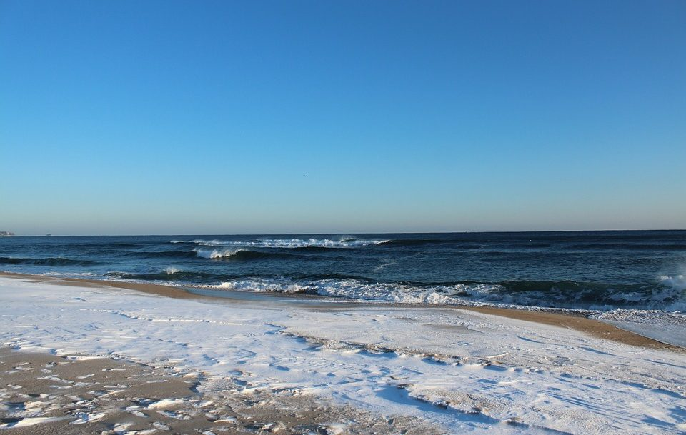
PROJECT LOGO CONTEST
The project logo must contain mandatory elements:
- the Erasmus + logo
- the flags of the participating countries
- the name of the project (in English)
- as content - respect the project theme.

Slide 2
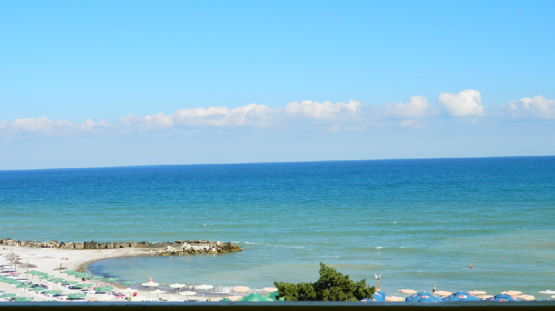
ART CRAFT CONTEST – NOVEMBER 2019
Participants – students from I –VI grades, grouped on two sections: I-III and IV-VI
The purpose of the contest: Developing students' creativity and their imagination.
Content, technics and format of work:
- format of work must be A4 or A3;
- it can use any technique;
- the work must respect the theme;
- each work must be individual and signed on the reverse - name, surname, class.
Assessment criteria: respecting the theme of the project, originality, creativity, artistic qualities, use sea materials, aesthetic aspect and careful execution.
Deadline: November, 20th 2019
Prizes:
There will be awarded a prize I, II, III and 2 honourable entions.
The works will remain at school, at the organizers' disposal.

Slide 3
LITERARY CONTESTS
SEA POEMS – December 2018
STORIES AND LEGENDS OF THE SEA – December 2019
Purpose: to raise pupils 'interest in lyrical creation, culture, affirmation, knowledge and stimulation of students' artistic and creative potential.
Objectives:
• Developing love for beauty.
• Stimulating the creative potential of students.
Target group: talented students from partner schools
Organizers:
Each partner school and Romania at a transnational level
Typing of creation:
The theme of the creation will correspond to the specificity of the project. If this condition is not respected, the works will be removed from the contest.
A student can participate with a single work.
5 poems from each country will be sent in A4 size, portrait, written in Times New Roman, 12, 1.5 rows, 20 mm equal margins.

Slide 4
Judging the works
Between 15 and 20 December 2018, the jury of the competition, consisting of one teacher from Italy, Spain, Portugal and 2 from Romania will select the works to be awarded. To avoid subjectivism, members of the jury will receive the works of the participants without their names. Creations can be identified by a number that will be assigned to each competitor according to the order of enrollment in the contest.
Announcing Winners: December 21, 2018 prizes are awarded.The jury can award special prizes to poems considered artistically distinct.
►Evaluation Criteria:
• observance of the requested theme and the required editing standards;
• correctness of expression;
• text coherence (linguistic register, style, lexicon);
• the content must respect the theme of this project;
• the impact of the transmitted message;
• creativity (language, figurative, artistic images);
• technical elements, compositional particularities (layout, paragraphs, lyrics).

Slide 5
►The scoring system
Among the poems included in the competition, for each section, the jury will choose lyrical creations considered superior in artistic terms (their number will be later chosen in relation to the number of poems entered in the competition).
For each prize, special mention and award will be given as follows:
1st prize between 90 and 100 points;
2nd prize between 80 and 89 points;
3rd prize between 70 and 79 points;
honourable mention between 60 and 69 points;
special prize between 50 and 59 points.

