Slide 1
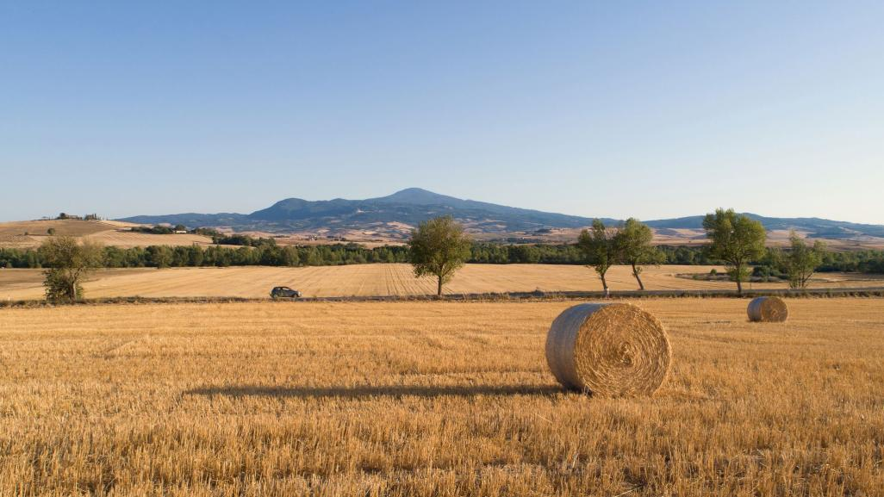
Zamora and its surroundings
IES LA VAGUADA

Slide 2
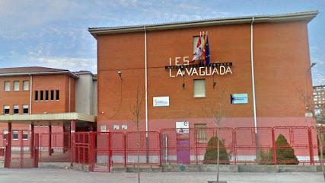
IES LA VAGUADA HIGHSCHOOL
LA VAGUADA is a highschool located in Zamora.

Slide 3
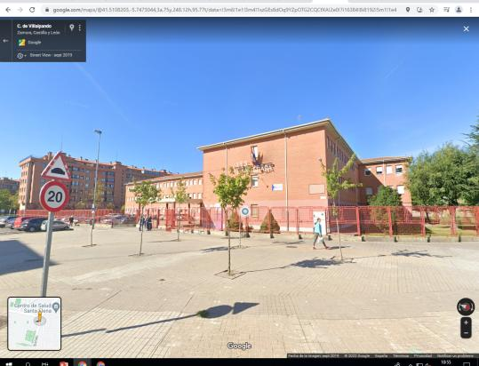
LOCATION

Slide 4
Sanabria lake

Slide 5
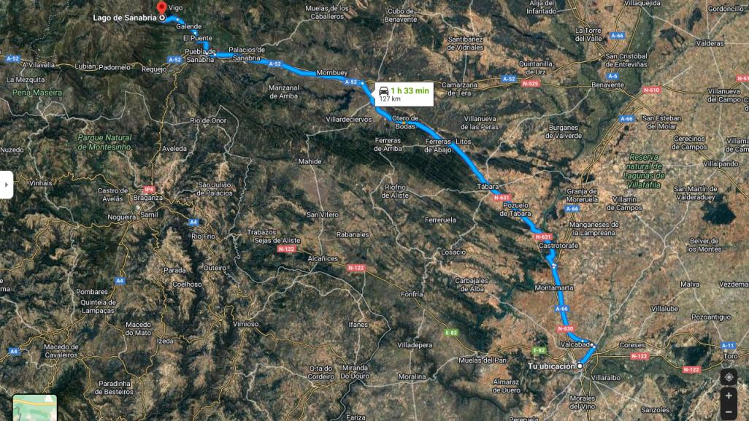
WHERE IS IT?
Located about 130 km away from our town or an hour and a half it is one of the best places to spend the day in summer.

Slide 6
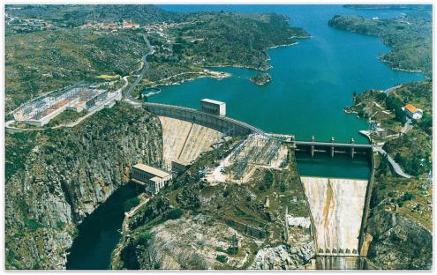
Reservoir of Ricobayo
The Ricobayo reservoir, also known as Salto de Ricobayo, is a hydroelectric engineering work built on the lower course of the Esla River. The works begin in May 1929. It was put into operation in January 1935 with an installed capacity of 100 MW, which in 1947 will be increased to 133 MW.

Slide 7
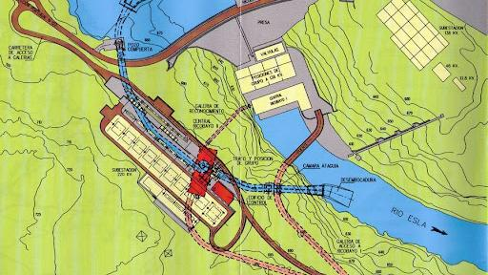
WHERE IS IT?
They are located on the Esla river, less than 1 kilometer from Ricobayo de Alba, in the province of Zamora.

Slide 8
LAGOONS OF VILLAFAFILA
The Lagoons de Villafáfila is a nature reserve, that is a protected natural area

Slide 9
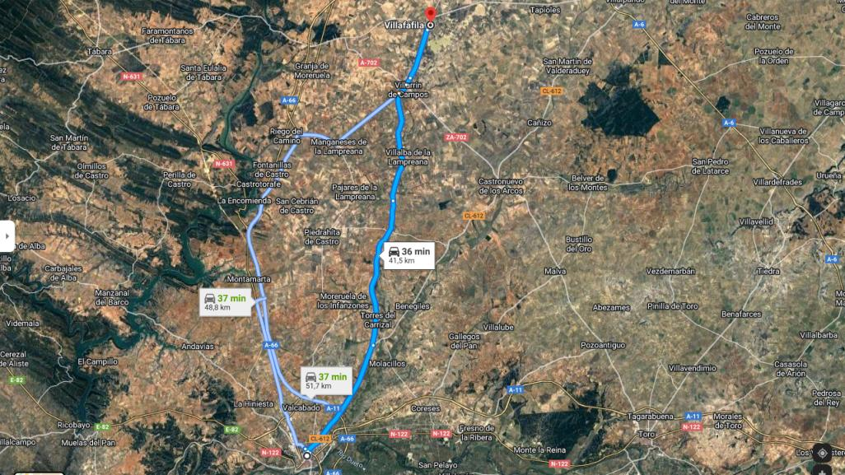
WHERE IS IT?
Is located in the northeast quadrant of the province of Zamora, Castilla y León, Spain
The lagoons are located in a meeting area of ​​the Campos and Pan lands, corresponding to the interfluvium of the Esla and Valderaduey rivers
It is a perfect place to see birds and different types of animals

Slide 10
ARRIBES DEL DUERO It is a canyon of the river Duero declared a natural park You can go canoeing along the river through the canyon.

Slide 11
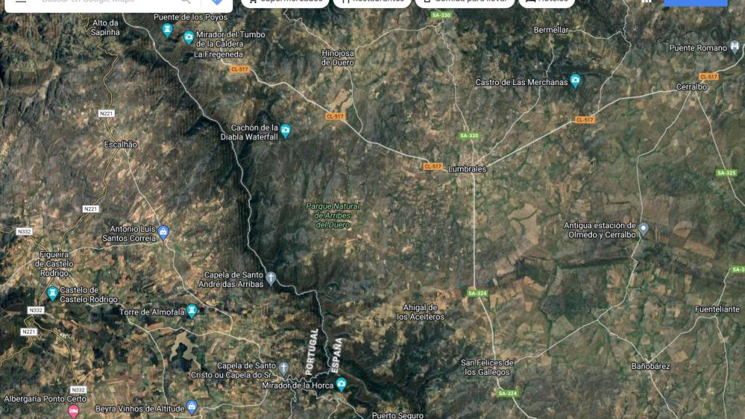
WHERE IS IT?
Arribes del Duero make frontieer between Spain and Portugal.

Slide 12
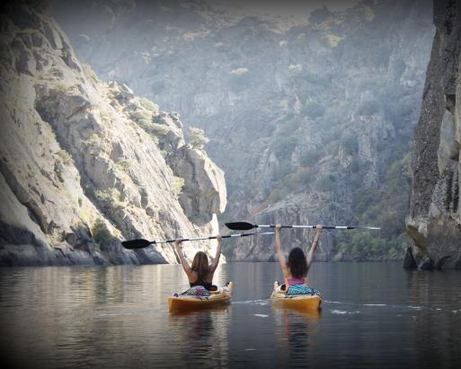
WHAT TO DO
One of the most well known activities to do is canoeing. You can travel along the river and enjoy it´s views.
Haga clic para agregar texto

Slide 13
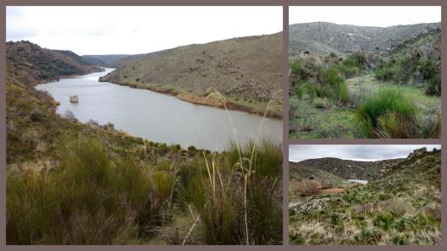
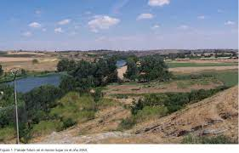
Carrascal
The Pajarancas
A beautiful zone in Carrascal

Slide 14
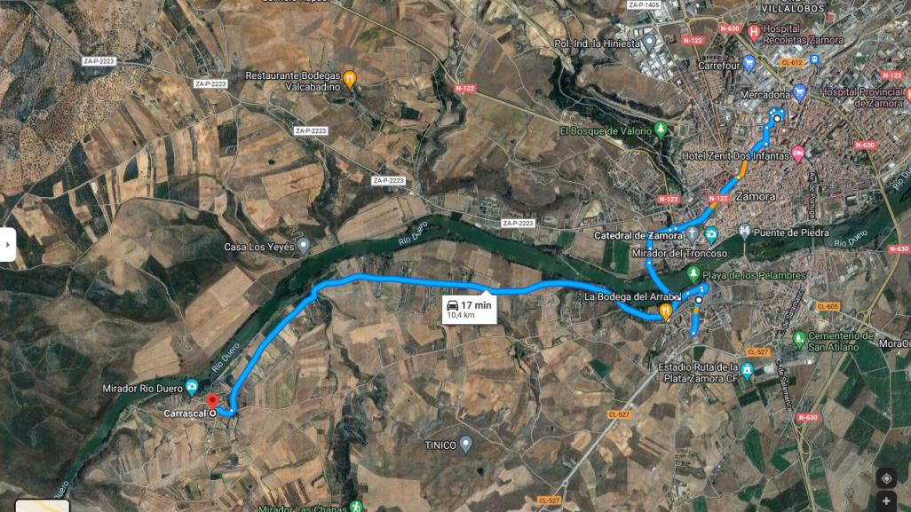
WHERE IS IT?
Carrascal is famous because of the birds.
It is near to Zamora.
You can also go there by bike but is a bit dangerous.

Slide 15
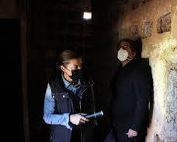
An amazing place for observating the birds

Slide 16
SIERRA DE LA CULEBRA

Slide 17
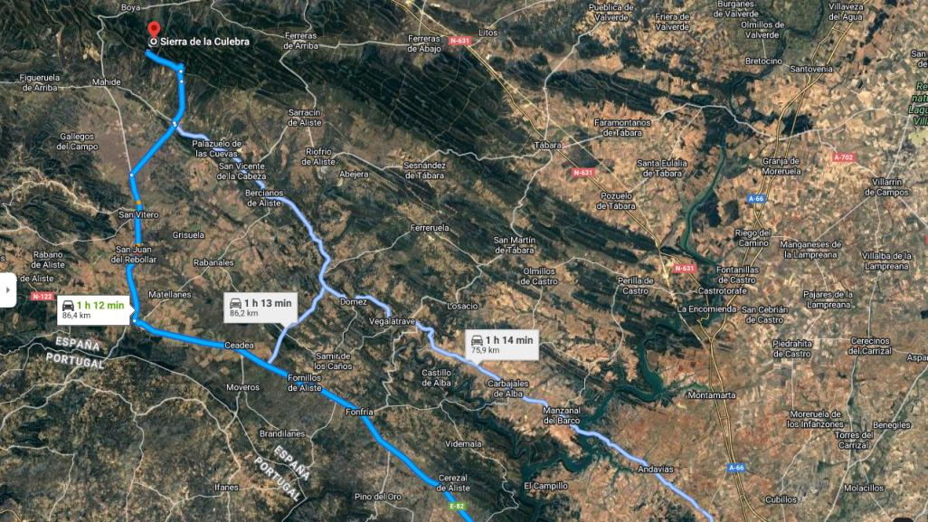
WHERE IS IT?
The Sierra de la Culebra is about 80 km away from zamora or 1.15 hours

Slide 18
HISTORY OF THE SIERRA DE LA CULEBRA
THE SIERRA DE LA CULEBRA IS A SPANISH MOUNTAIN RANGE LOCATED IN ZAMORA. INTERNATIONALLY, IT IS KNOWN FOR HOSTING ONE OF THE JAUNAL JEWELS AND EMBLEM ONE OF THE CONSERVATION STRUGGLE, THE IBERIAN WOLF

Slide 19
IBERIAN WOLVES IN THE SIERRA DE LA CULEBRA

