Slide 1
Activities related with 'water'
Ángel Calvo, Marcos Gazapo, Alba Martín, Paula Escola, Carolina Herrero y Adrián prieto
Haga clic para agregar texto

Slide 2
WHAT IS WATER AND WHY IS SO IMPORTANT?
Water is an element we can find in nature and it's a part of natural ecosystems . Water is essential for the maintanceand reproduction of life on the planet.I´s an essential factor of the biological processes that make it possible

Slide 3
WATER PROYECTS:
ACTIVITY ONE:
We did a questionary called "escape from Atlantis". It was interesting, but we got too little time.

Slide 4
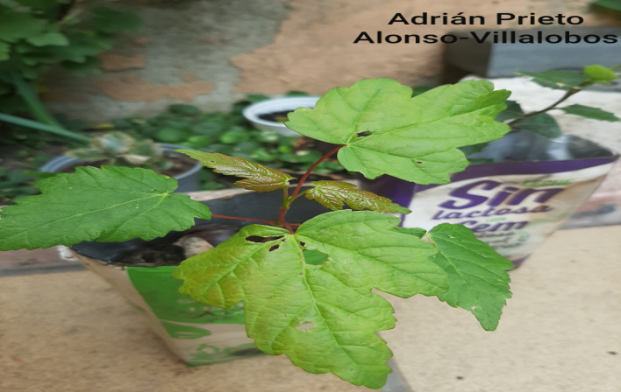
ACTIVITY TWO:
Last year we planted trees, very few of us kept them and other planted them in our gardens or houses.

Slide 5
ACTIVITY 3: Last day we went to river Duero to do canoying, but a student and a teacher fell to the river

Slide 6
ACTIVITY 4:
We did this activity in music class, we worked different rithym patters and percussion. We played this song singing and with different phone apps
https://youtu.be/k0EffP8mgCo

Slide 7
ACTIVITY 5:
We learnt how to use passive voice through learning about the hydraulic engineering work. This was located in our region but due to covid_19 we coludn´t go to there
https://youtu.be/pNmSZmulI7E

Slide 8
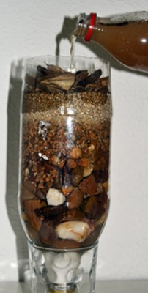
ACTIVITY 6:
We made an interesanting practice with our teacher Alberto. We learnt how to filter contaminated water to clean water.

Slide 9
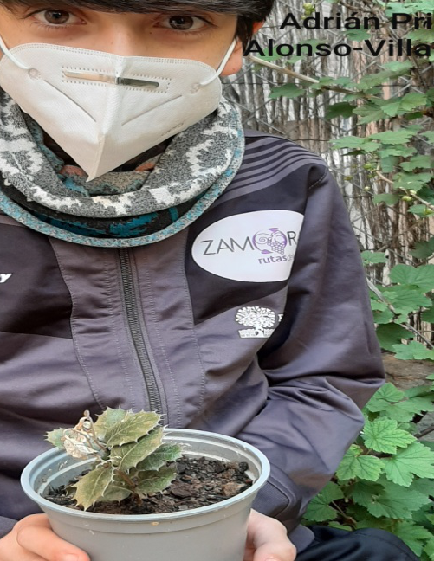
THANKS FOR READING :-)

