Slide 1
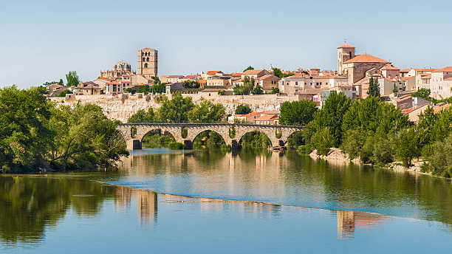
CULTURE OF ZAMORA

Slide 2
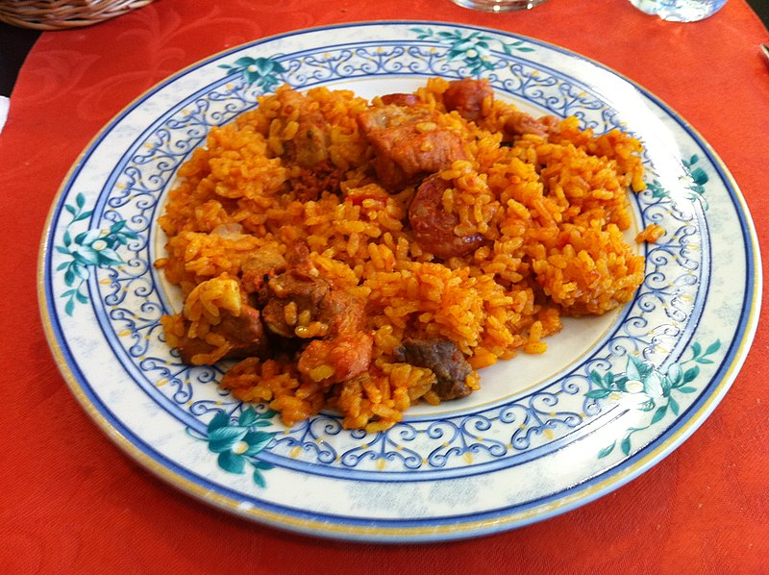
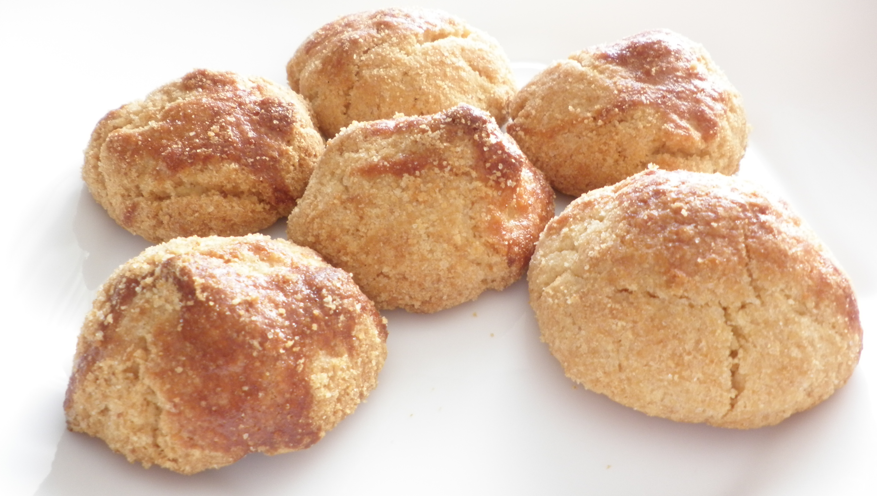
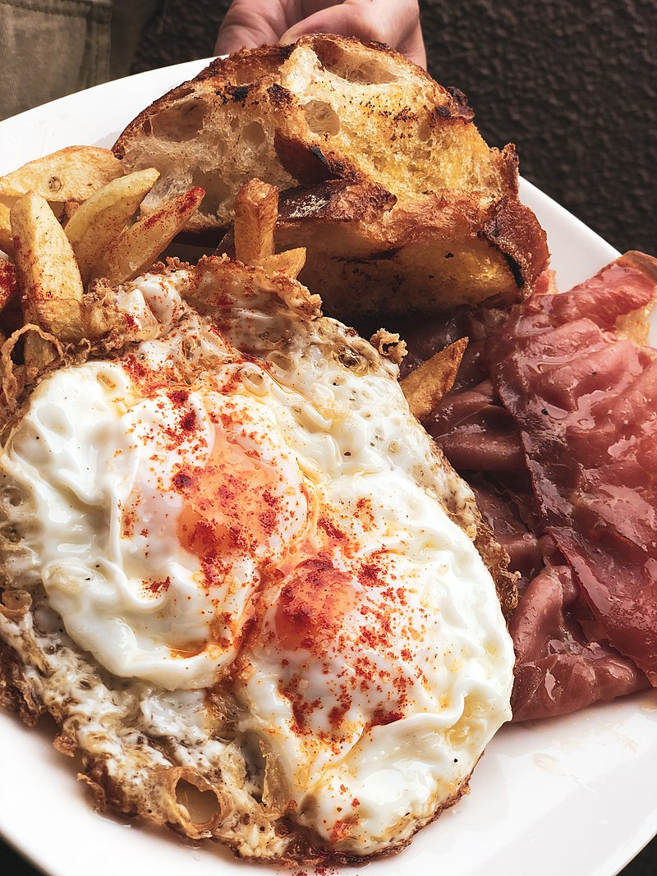
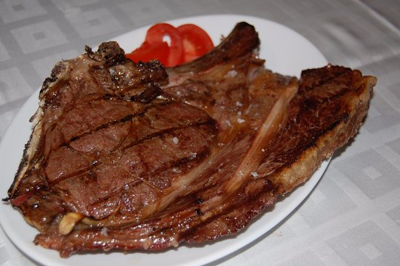
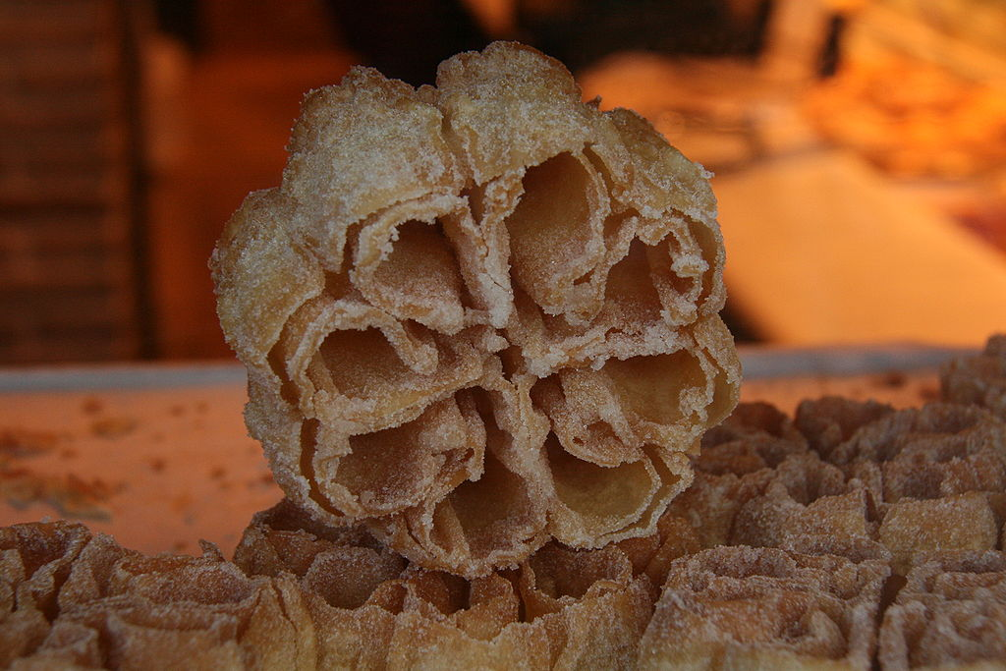
TYPICAL FOOD
Zamora's rice
"Aceitadas"
"Dos y pingada"
Aliste's Beef
Carnival flowers

Slide 3
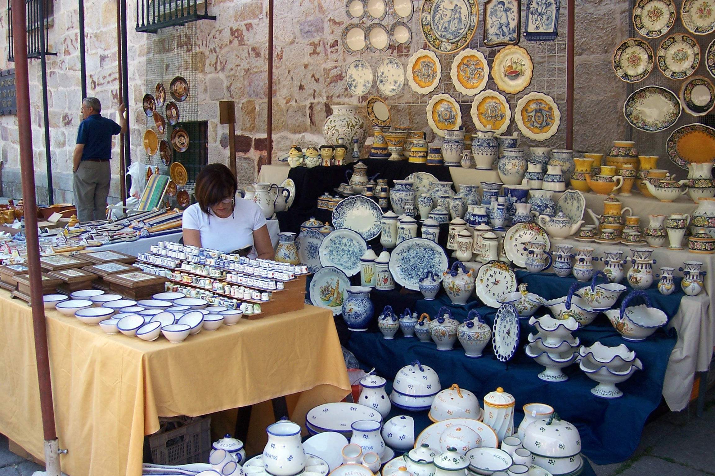
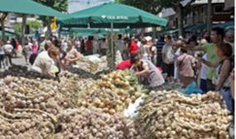
TRADITIONAL CELEBRATIONS
San Pedro:
It´s the most remarkable celebration of the town. It lasts 10 days (more or less) and it ends on the 29th of June. During that time the Ceramics Fair and he Garlic Fair take place and also exhibitions of regional dances, pilgrimages, music concerts, bullfights, and a fireworks display by the river to close.

Slide 4
San José Obrero:
It´s a celebration in the neighbourhood of San José Obrero. Its duration is of one week more or less and it has different activities like traditional games, cars races that are cars that make the people to do that race, there are also concerts. It´s the best known celebration of the neighbourhoods of Zamora.

Slide 5
La Hiniesta:
It´s a pilgrimage for moving the the virgin of the hiniesta from the town to the church of San Antolín. People go in procession to the church and they spend the day there.

Slide 6
TRADITIONAL GAMES
Roman billiards:
A game that consists of leaving your team's balls as close as possible to the bili, which is a smaller ball. Similar to petanque, it is played in an enclosed area and on an octagonal pitch that is below ground level.

Slide 7
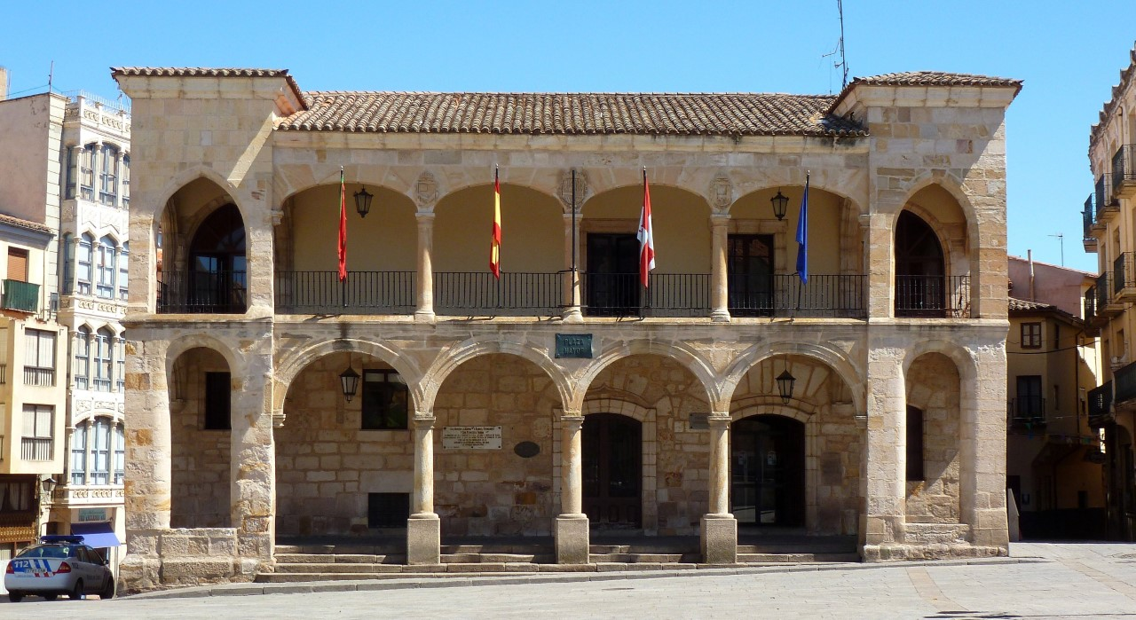
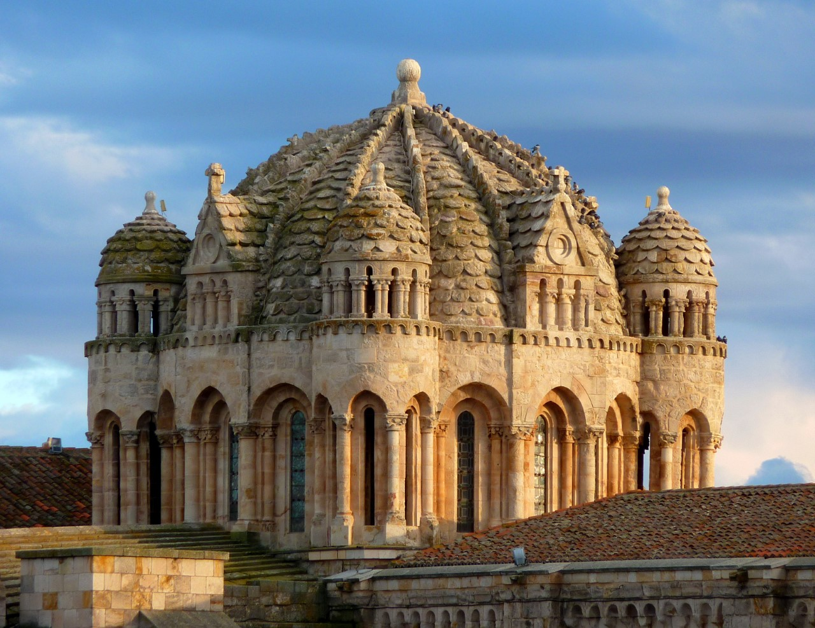
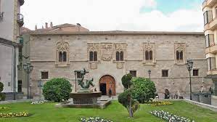
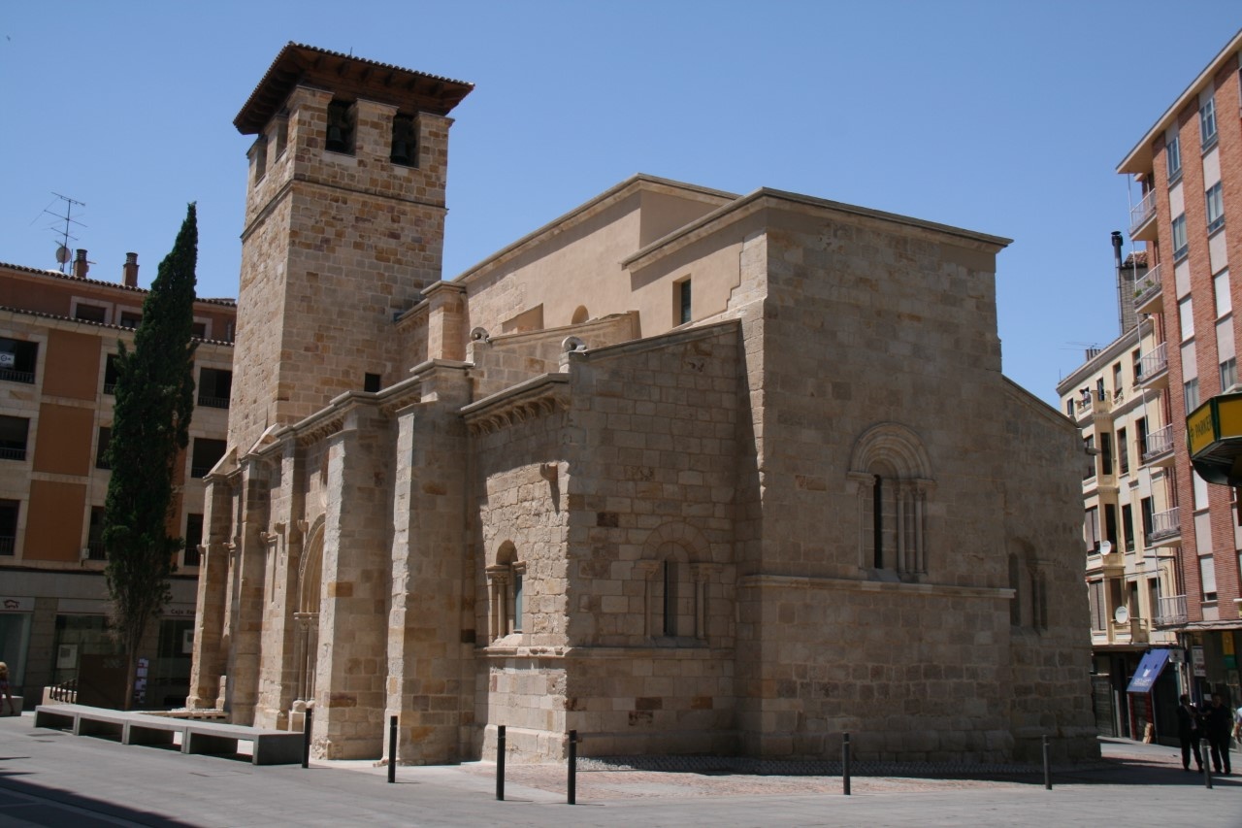
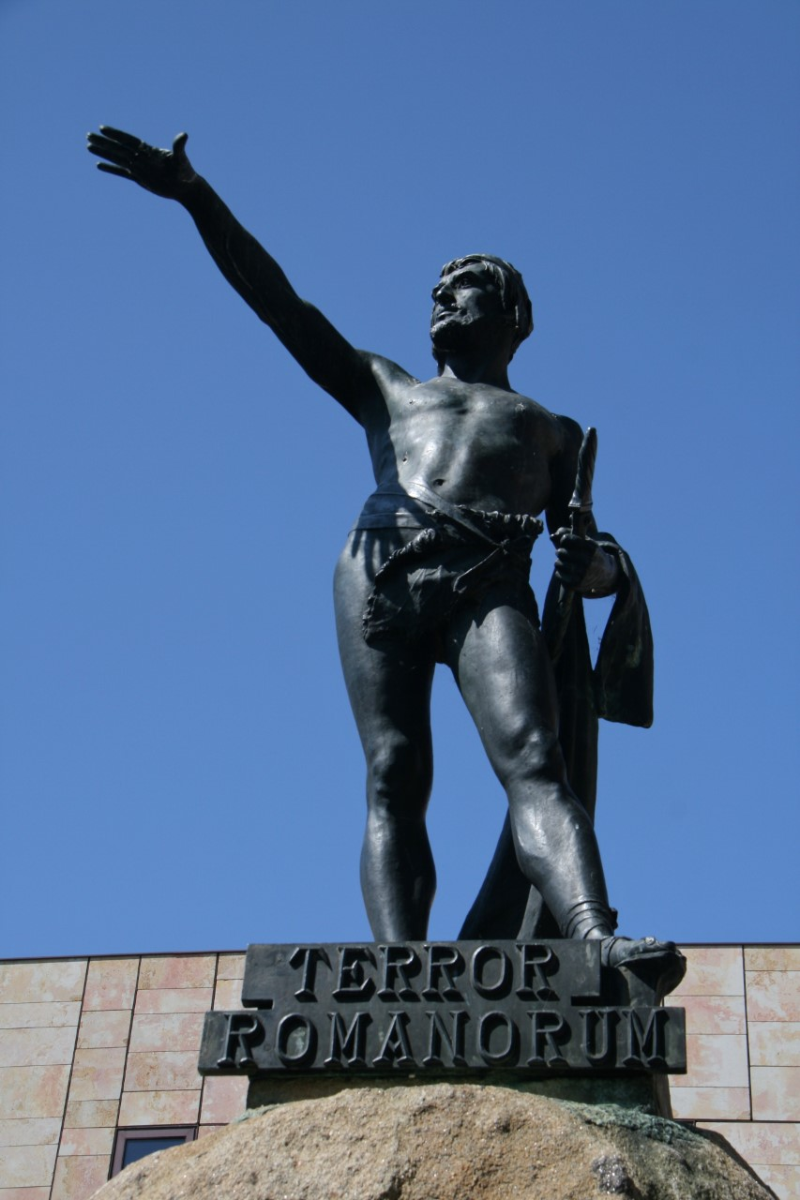
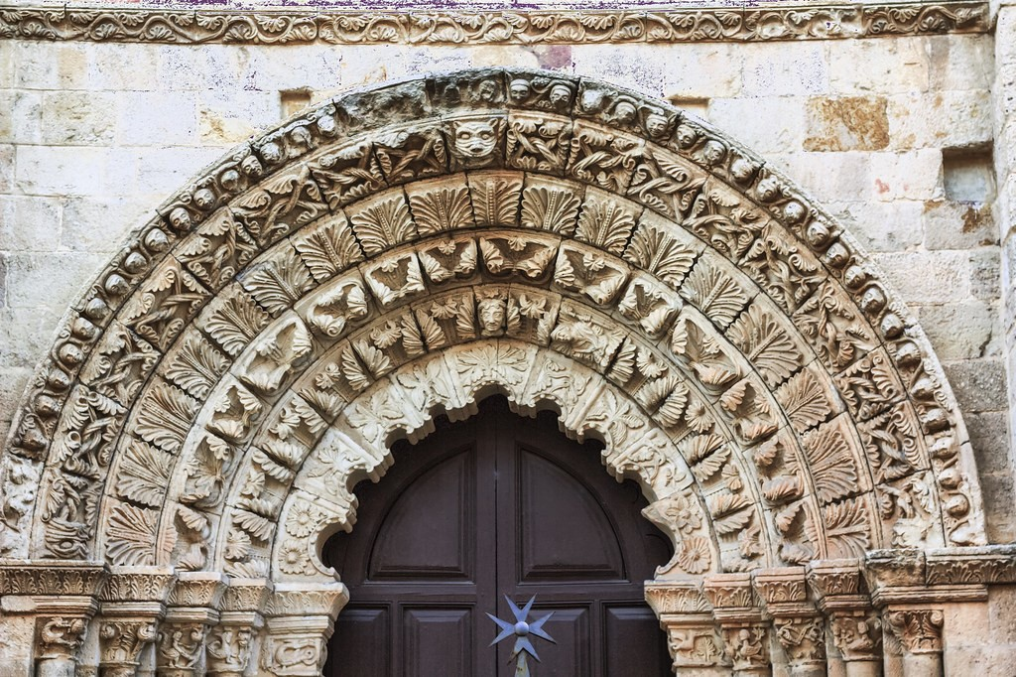
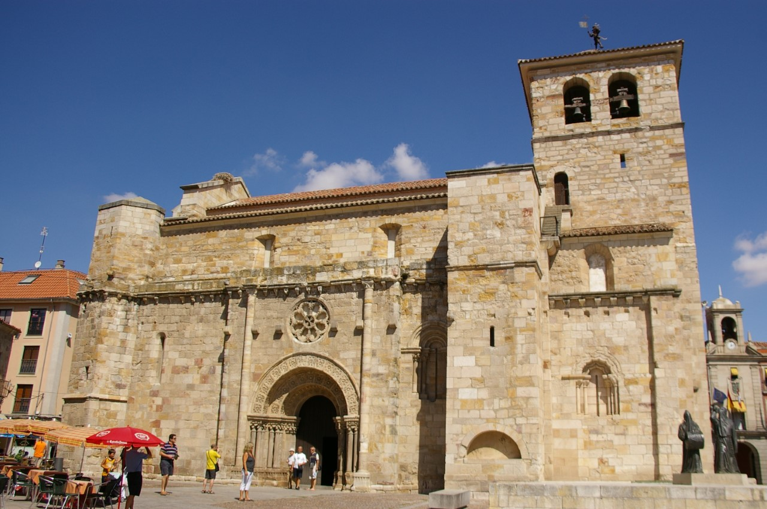
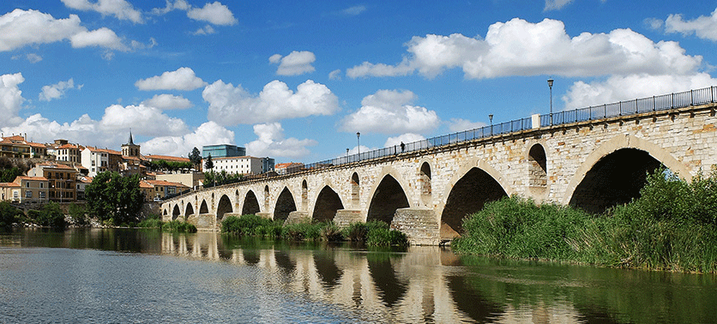
MONUMENTS
It is characterised by the Romanesque. It is the municipality with the most examples of it in Spain, and possibly in Europe
THE CIMBORRIUM
SOUTH FACADE OF SANTIAGO DEL BURGO
PALACE OF THE MOMOS
OLD TOWN HALL
SOUTH COVER OF SAINT MARY MAGDALENE
CHURCH OF SAN JUAN
STATUE OF VIRIATHUS
STONE BRIDGE

Slide 8
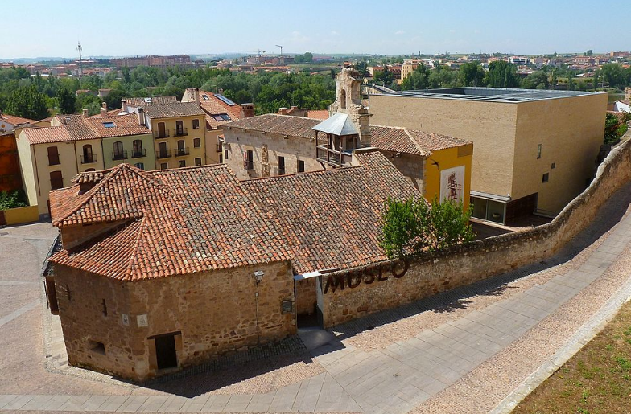
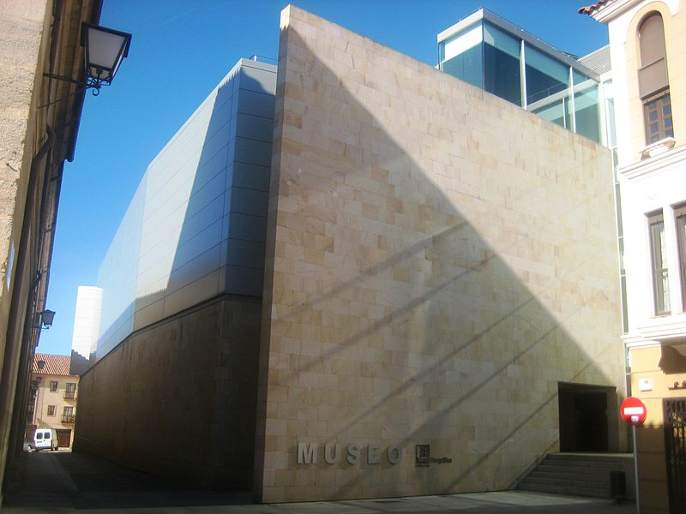
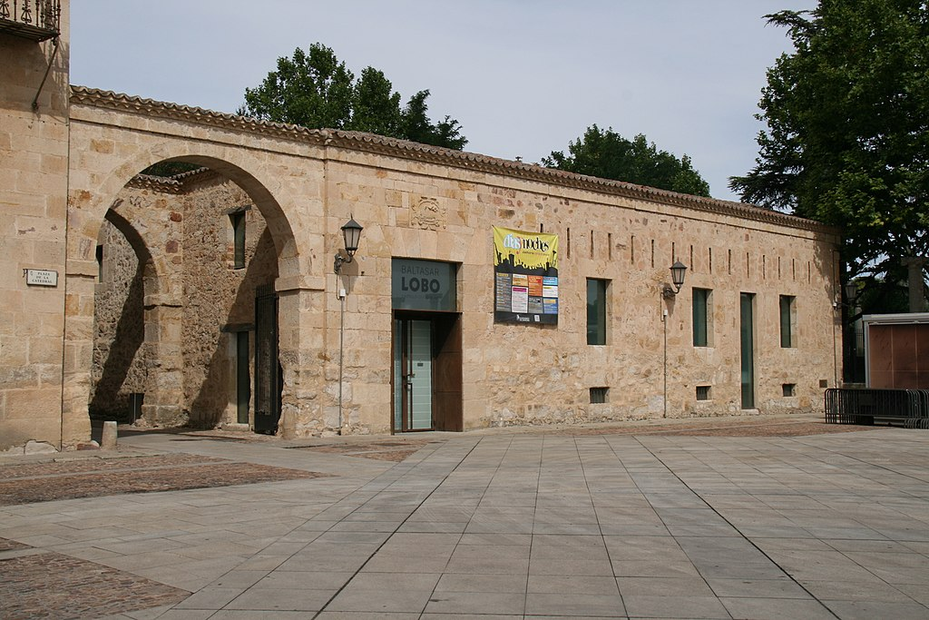
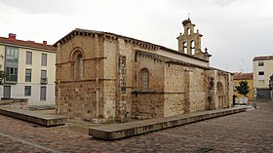
MUSEUMS
Museum of Zamora
Ethnographic museum
Baltasar Lobo Museum
Diocesan Museum of Zamora
Interpretation Center of medieval cities

Slide 9
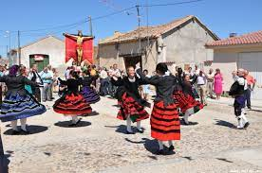
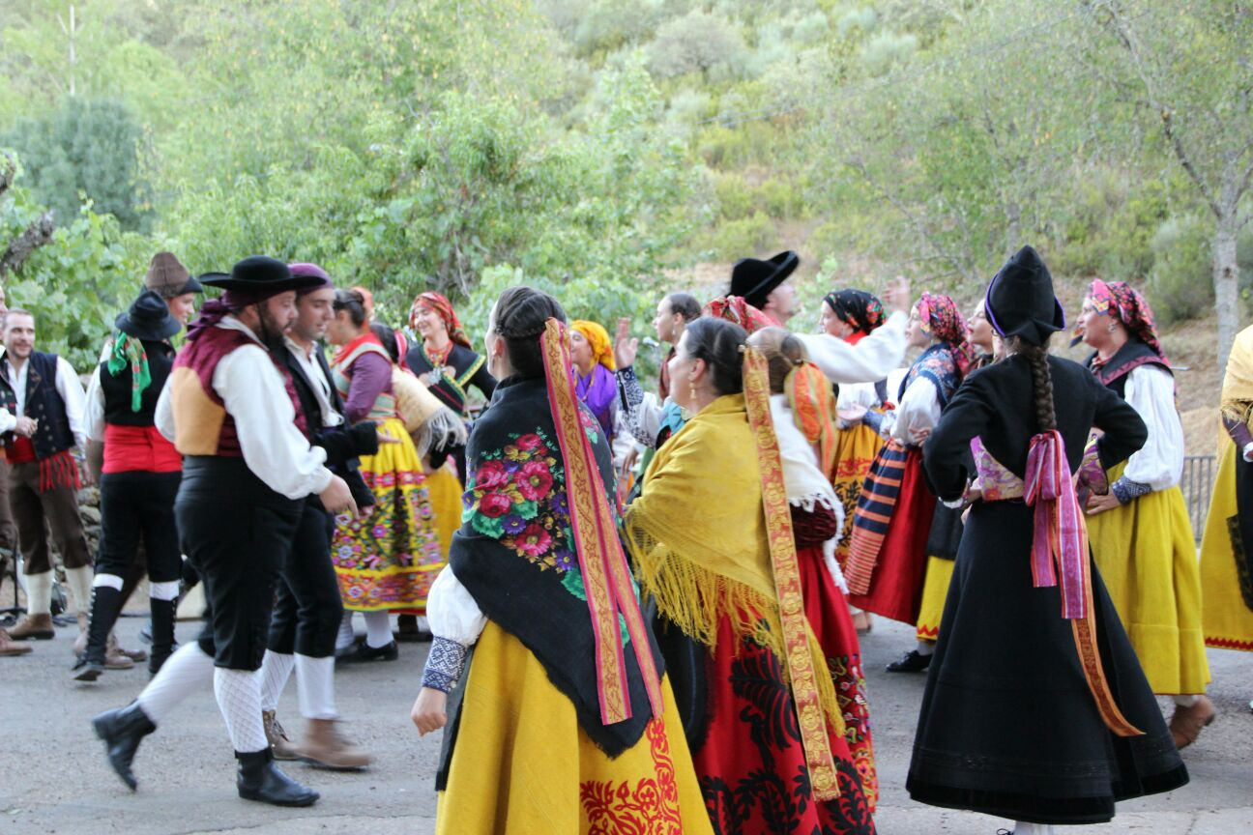
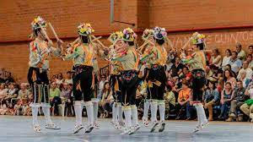
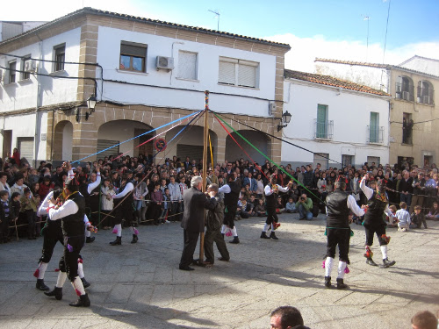
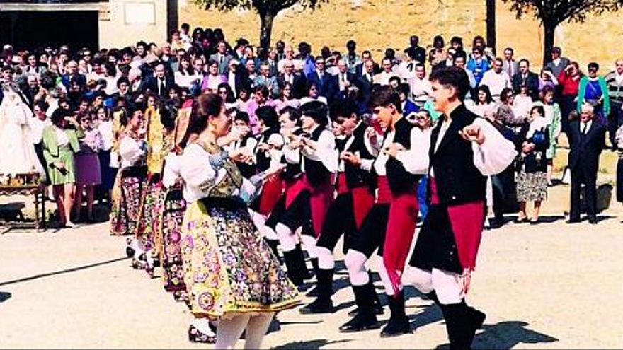
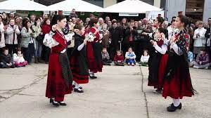
TRADITIONAL DANCES
"Habas verdes"
"Jota"
"Paloteos"
"Cordones"
"Boleros"
"Charros"

Slide 10
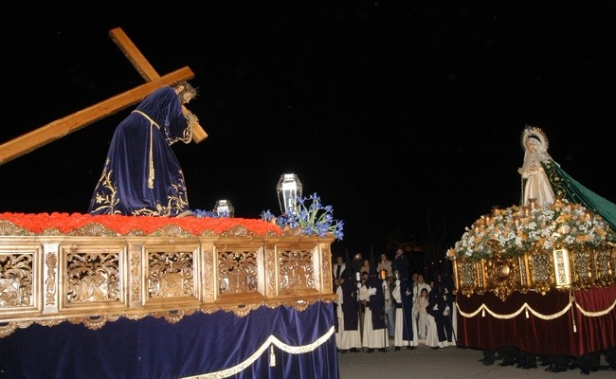
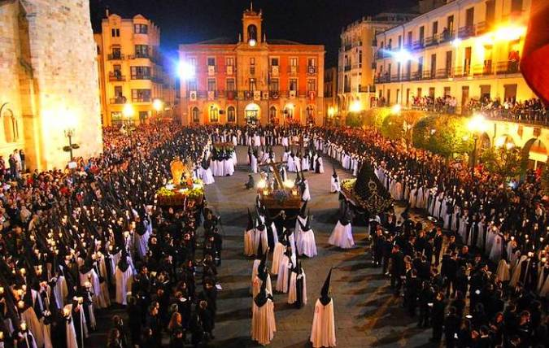
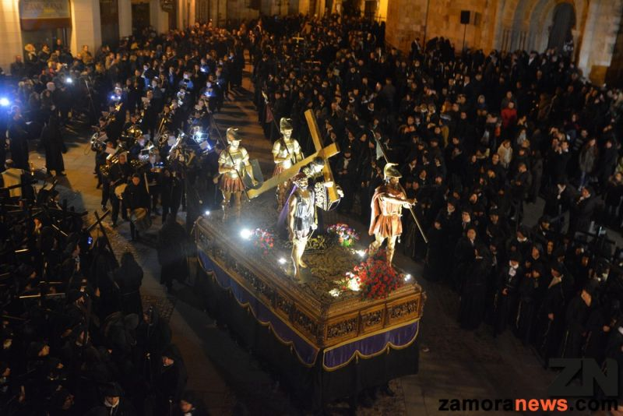
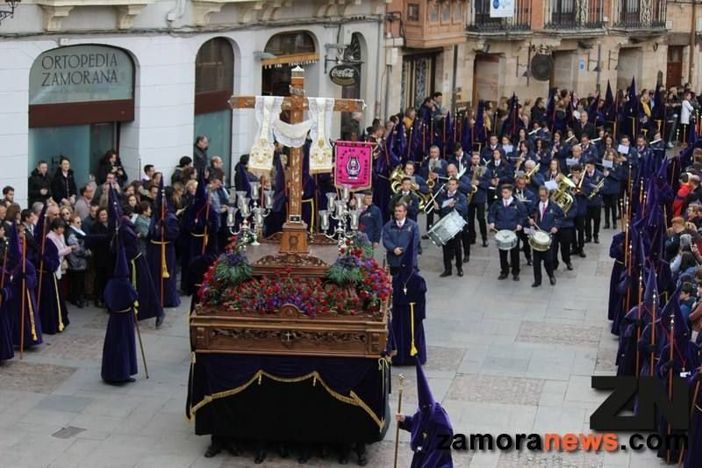
HOLY WEEK
There are processions all the days to represent the passion, death and resurrection of Christ. Some of the steps are on the holy week museum and others are in different churches of the town.
Most important days:
Tuesday there´s a procession in the afternoon that in its finishing, on the stone bridge the step of Christ makes a reverence to the step of the virgin of hope.
Friday morning: in the procession steps stay in a line except the virgin of loneliness. The virgin starts to walk and all the other steps make reverences to her.

