Slide 1
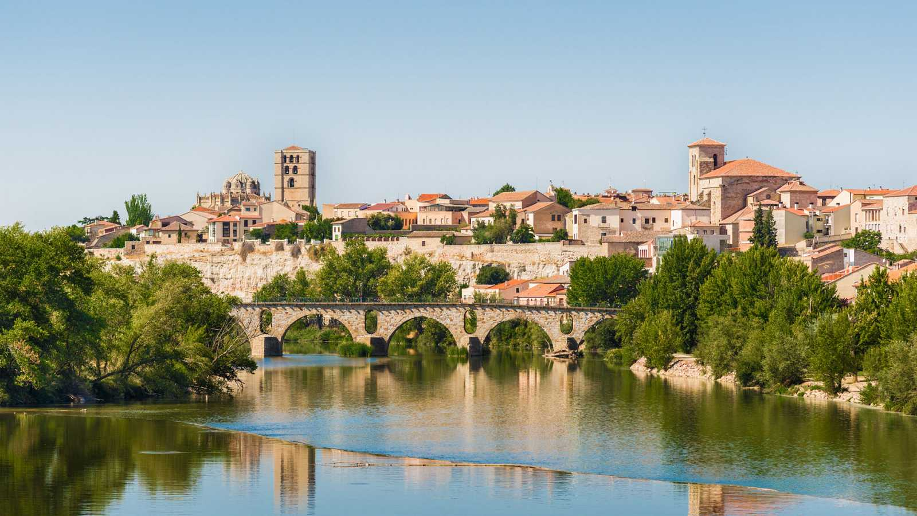
ZAMORA

Slide 2
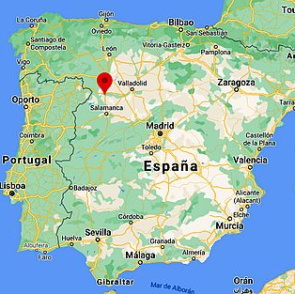
ZAMORA
It is located in the northeast of Spain.
It has got a population around 60000 people.
It is surrounded by the Duero river.

Slide 3
HISTORY
Zamora was found in 1574 by Virrey Martin Enriquez de Almanza.
It is known as "the romanasque city", because it has got a lot of monuments of this style.
There are a lot of romanesque churches in the centre of the city and in the surrondings.

Slide 4
THE FLAG
One of the hallmarks of Zamora is its flag. A unique city emblem because it is made up of 8 strips of red cloth and one green. Apparently, the origin of this flag is due to the Lusitanian warrior Viriato, who every time he won a battle against the Romans, he tore a strip of the red layer of his cape and placed it on his spear. The green strip of the flag was included by Fernando the Catholic as a tribute to Zamora's support in the Battle of Toro, adding a green sash to the red strips.

Slide 5
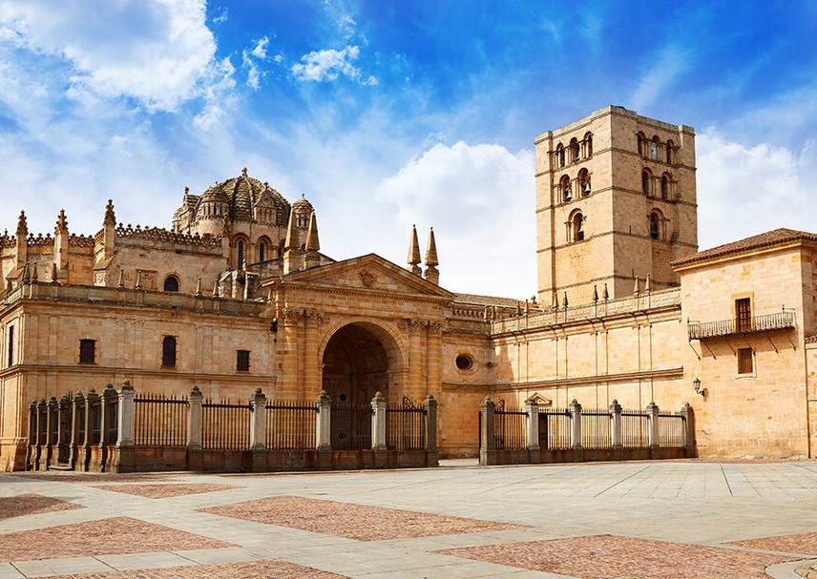
FAMOUS THINGS
You should visit the following monumets:
The cathedral
The castle
You should know some leyends of the city, such as the legend of Sanabria´s lake.

Slide 6
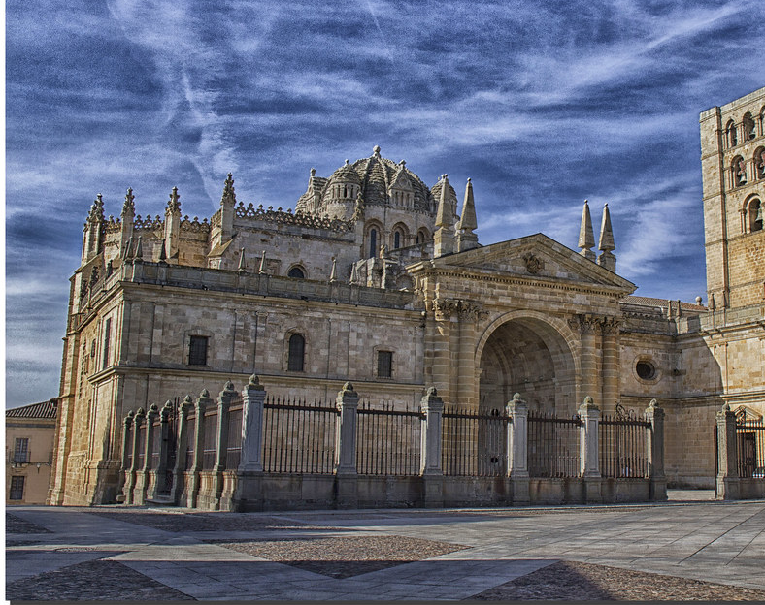
THE CATHEDRAL
It is dedicated to the Savior, is part of the Duero Romanesque style and stands out for being the smallest and oldest of the eleven in the Community of Castilla y León. It was declared a National Monument on September 5, in 1889.

Slide 7
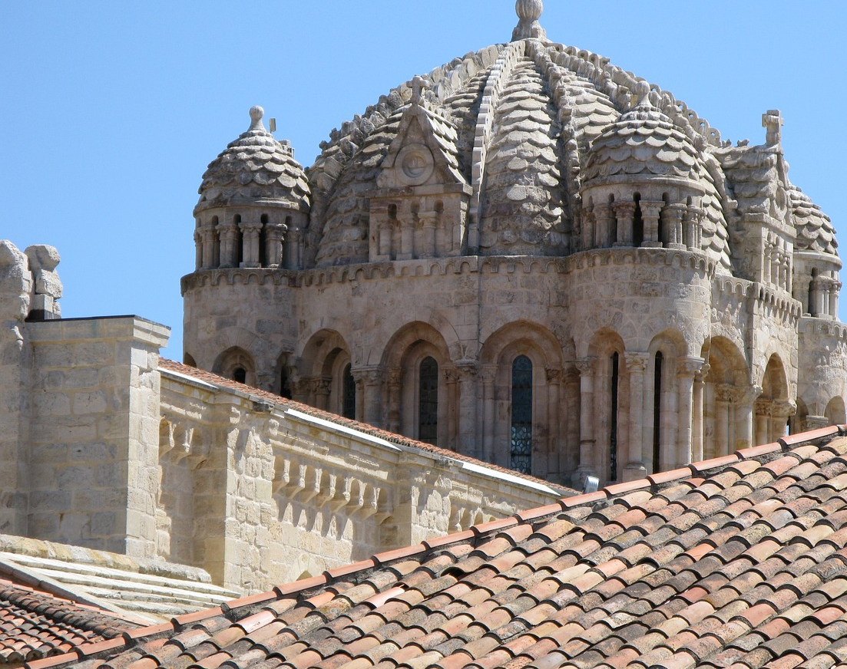
The main feature of the Cathedral is its magnificent dome. Its type of architecture is medieval. It is a cylindrical body with sixteen stained glass windows and four small towers at its corners. Two domes rise above this drum, one internal and the other external.

Slide 8
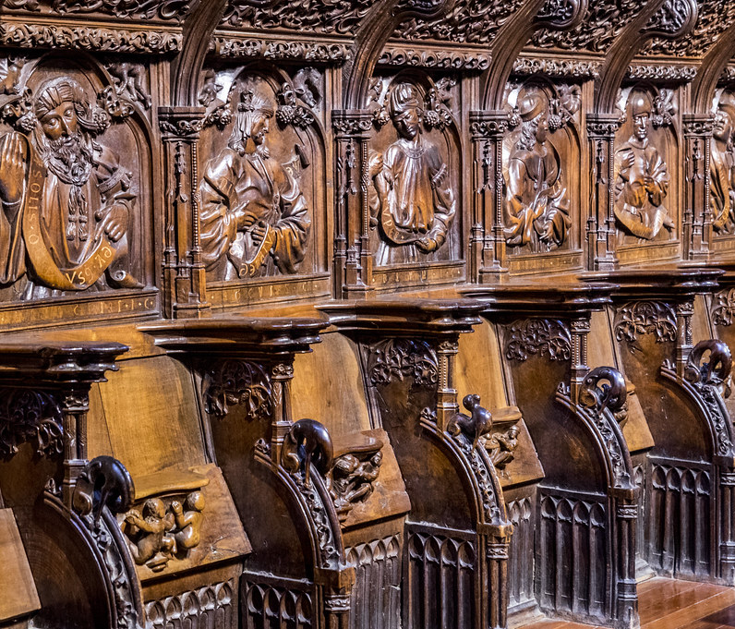
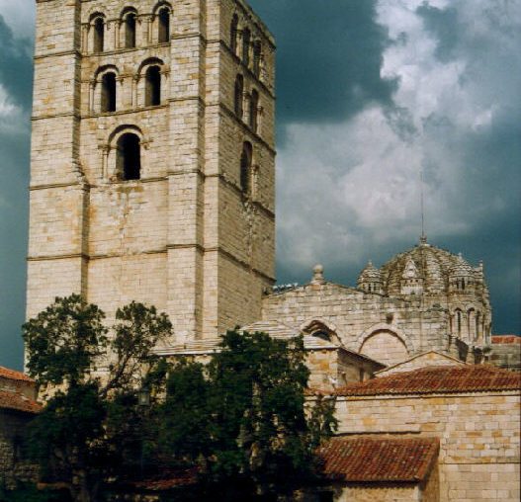
Another emblematic element of this cathedral is the Torre del Salvador, built during the 13th century. This forty-five meter high tower is Romanesque in style.
One of the most impressive works inside the Zamora cathedral is the choir stalls located in the central nave. It was made in the 16th century, in walnut wood, and shows a synthesis of the history of salvation.

Slide 9
The Castle of Zamora

Slide 10
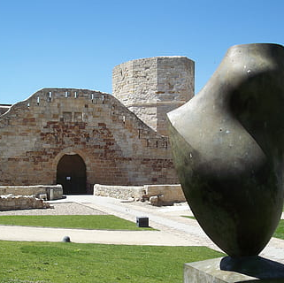
HISTORY
It is a fortification of the town.
In 2009 the castle was able to open to the public for visits.
It is located on a natural elevation that would give it even more defensive power.
Attached to the castle is an area known as "Parque del Castillo", made up of gardens and a viewpoint.

Slide 11
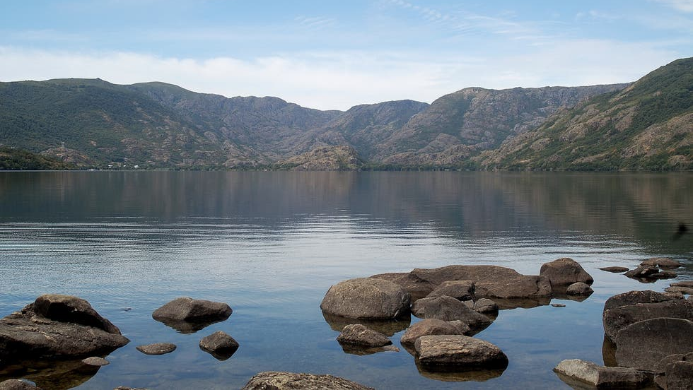
Legend of Sanabria´s lake
A long time ago in a valley in the town of Valverde de Lucerna, one dark and cold night, a hungry and tired pilgrim arrived requesting a place to stay and something to eat. Finally, he arrived at a house on the outskirts of the town inhabited by a family that opened their doors to him. The grateful pilgrim confessed to them that he had come to the town to warn them to flee before a whirlwind of water arose at the bottom of the earth. Finally the town was sunk under water, giving rise to the lake of Sanabria.

