Slide 1
Hello everyone. We are in Year 7 and this is our class some years ago ☺

Slide 2
Hi, I am Szymon Kołbus
and
I am going to tell you about myself.

Slide 3
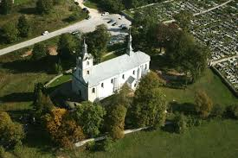
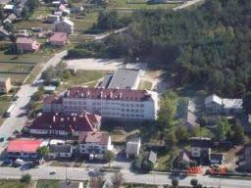
I’m thirteen years old. I live in Brzeziny but I go to school in Morawica. It’s about 4 km from my school.

Slide 4
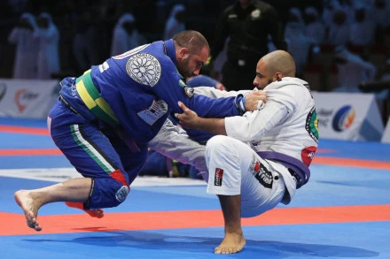
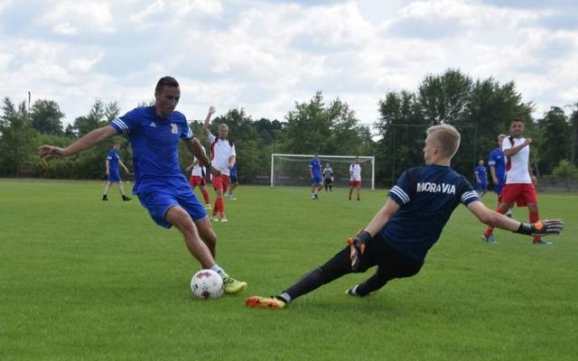
My sports
Some time ago I trained Brazilian Jiu Jitsu in Copacabana Kielce.
Now I train football in the club called Moravia.
I am also interested in running.

Slide 5
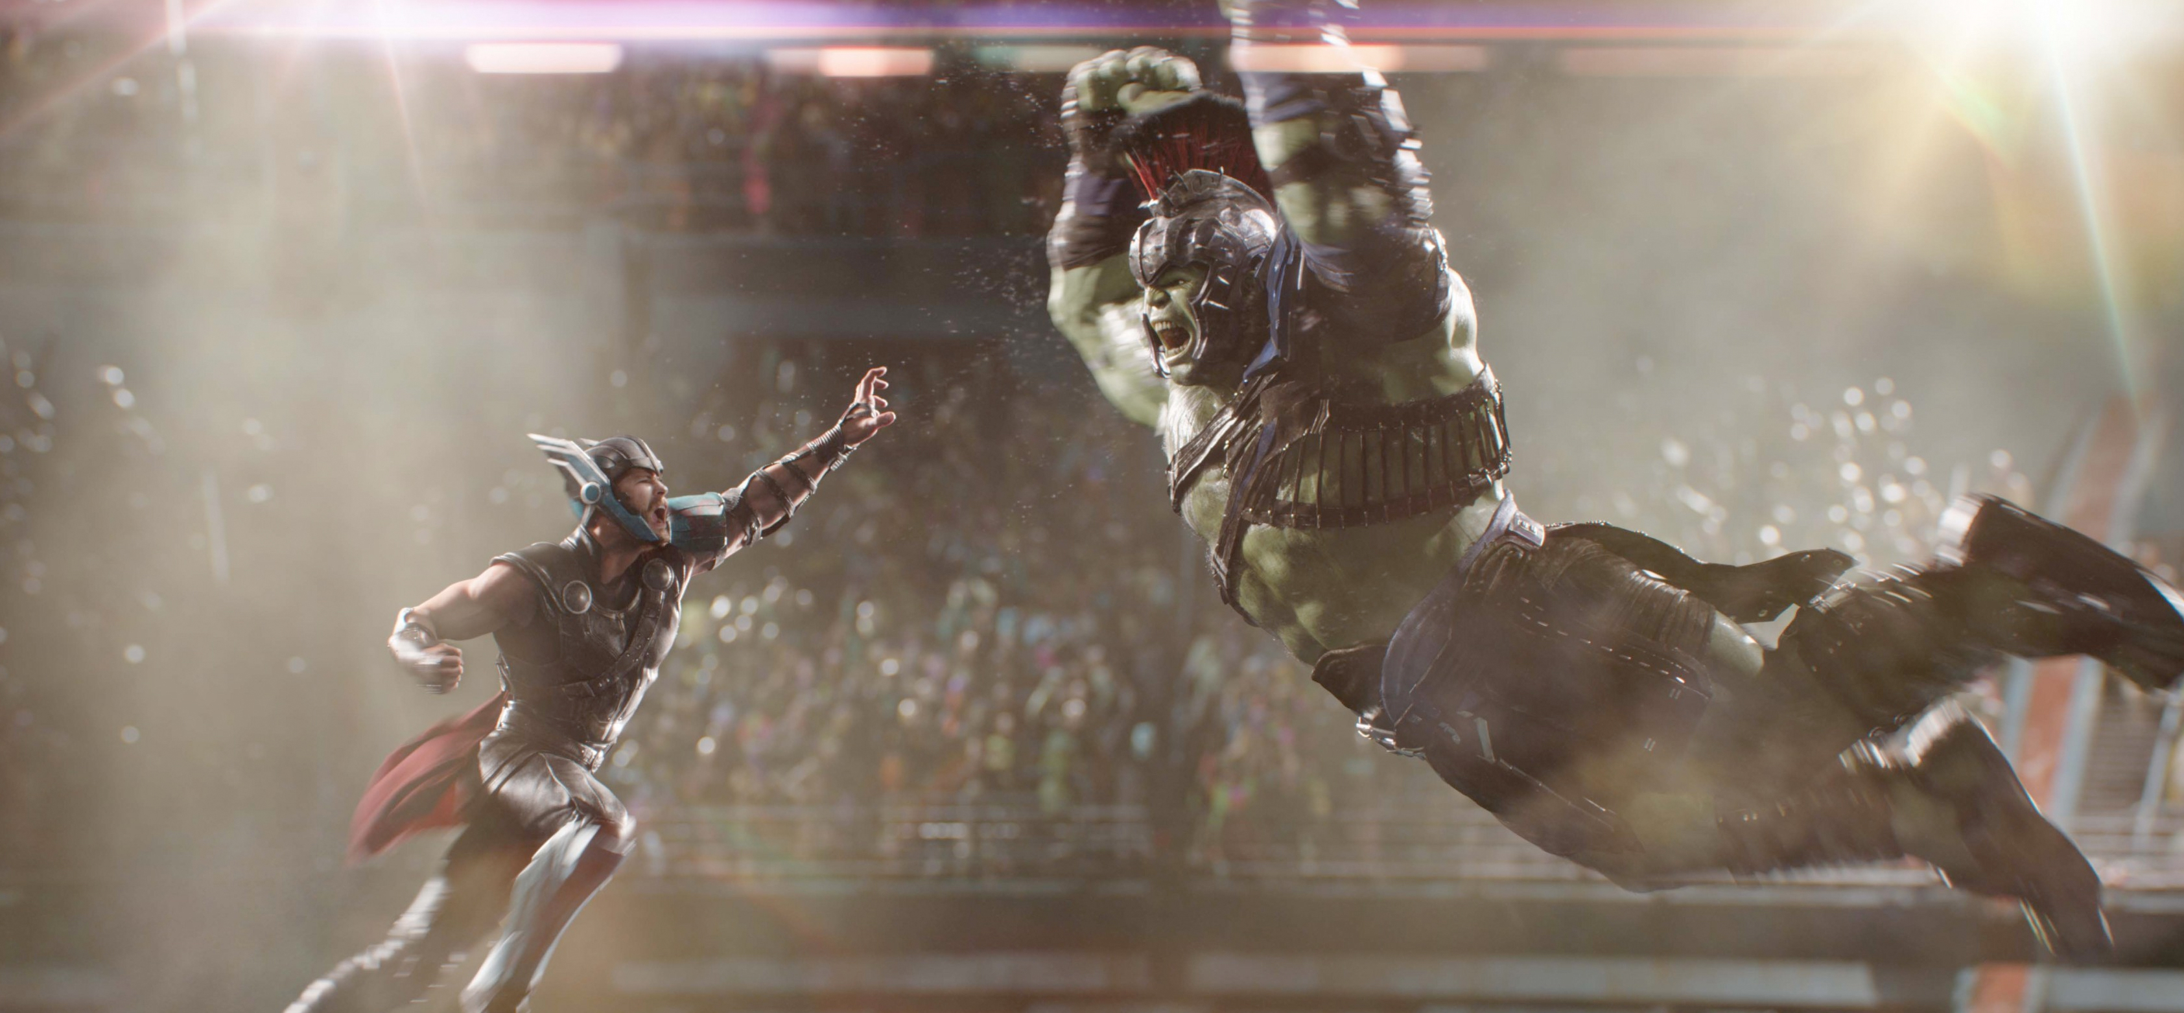
hobbies
I’m interested in Marvel movies and comics. One of my favourite comic series is Deadpool and my favourite movie is Thor Ragnarok.

Slide 6
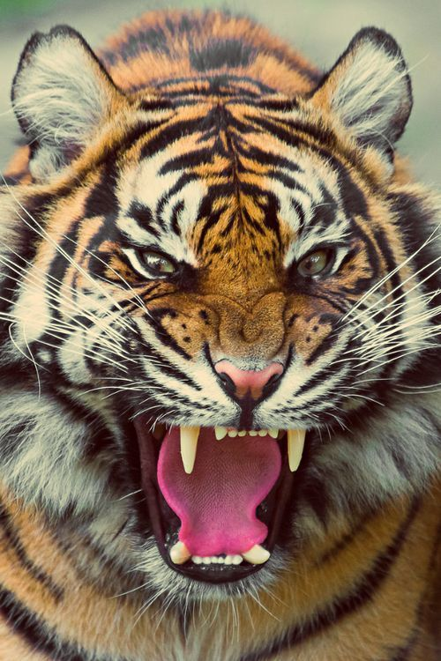
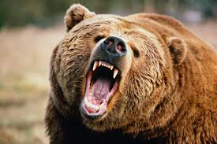
My favourite color is green.
I really like eating Italian dishes, such as spaghetti and pizza.
When it comes to animals I can’t decide between a tiger and a bear. I think I like them both.
VS

Slide 7
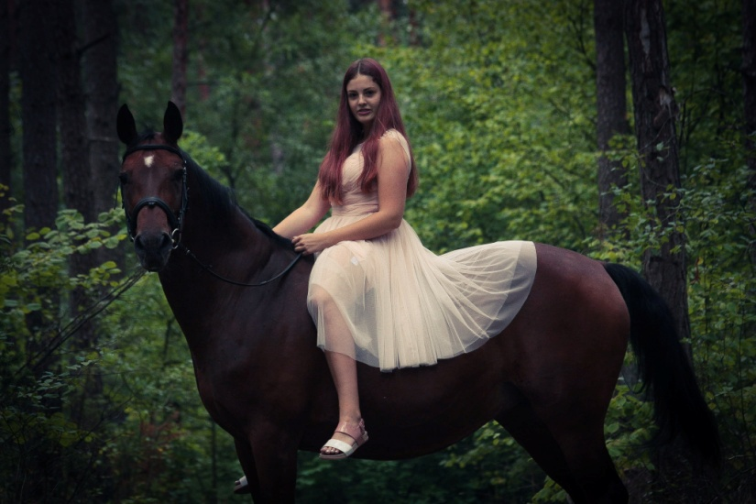
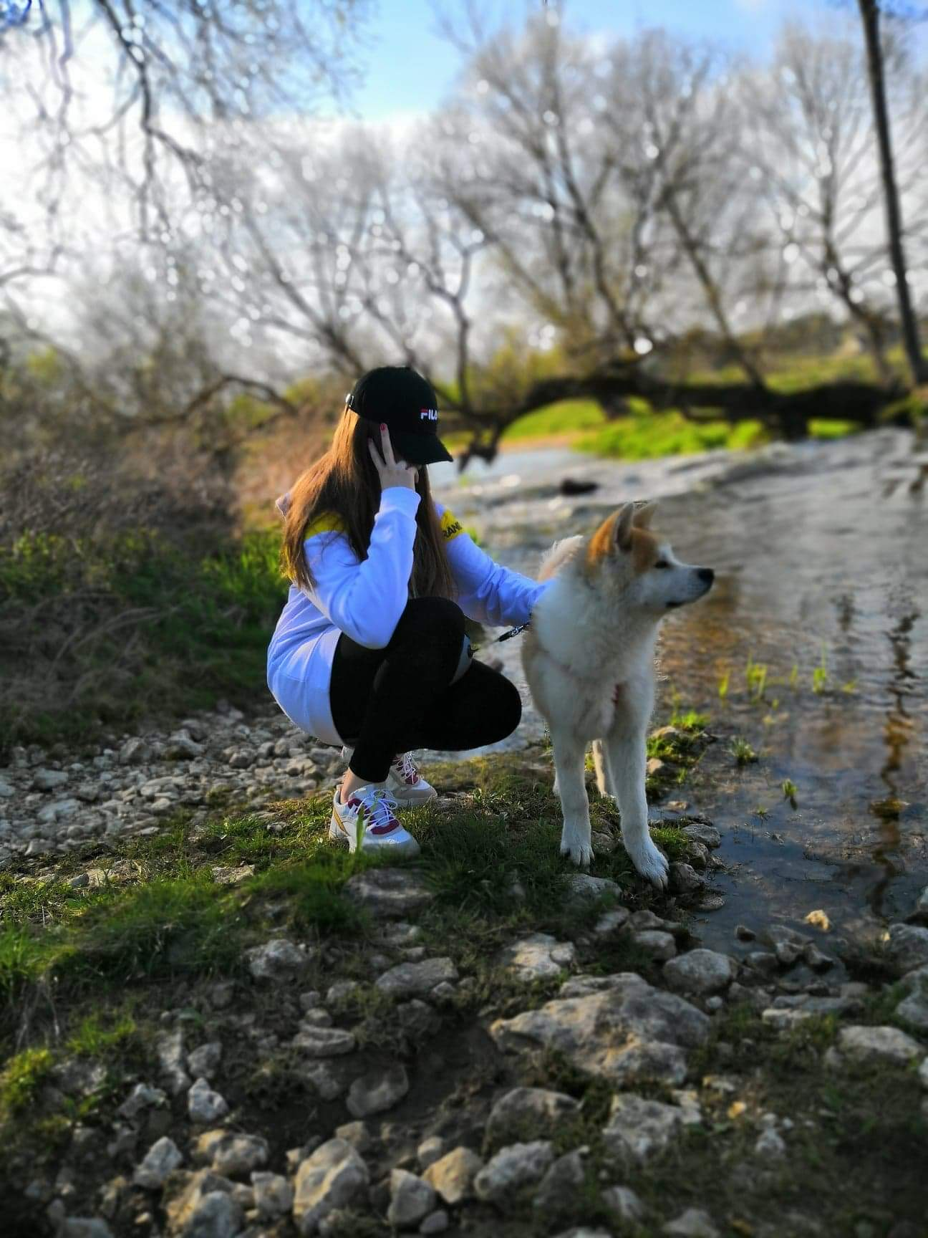
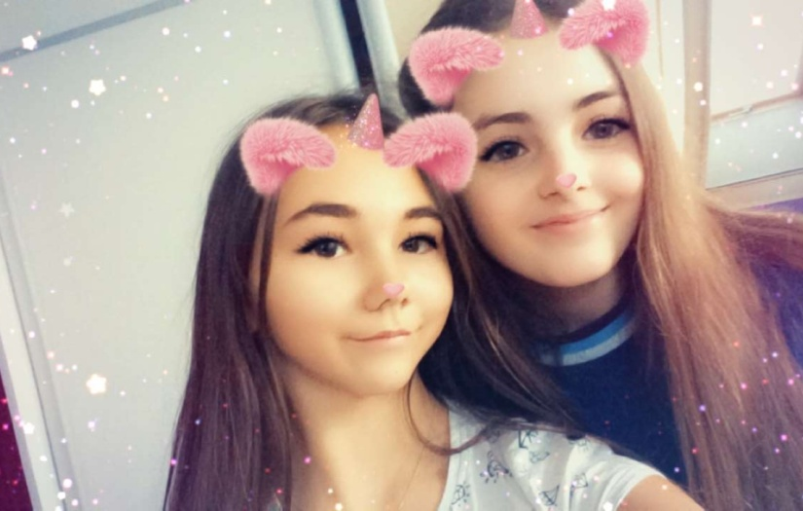
Hi, my name is Ala. I’m thirteen years old, and I’m from Poland. My parents are the best in the world. I have younger brother and a dog. My favourite singer is Shawn Mendes and Ariana Grande. I am addicted to the phone and often write text messages with friends.
I spend most of my time at school and I spend all of my free time riding a horse. This is my passion. I love horses, because they make me feel happy and relaxed.
I danced in the band „Pyramid" for 4 years. Unfortunately, I don't dance anymore because horse riding is my passion now. I would like to go back to dance lessons next year.
I spend my summer holidays by the Baltic Sea. I went there by car with my best friend. Her name is Nikola. I was swimming, dancing, relaxing. It was very nice holidays.

Slide 8
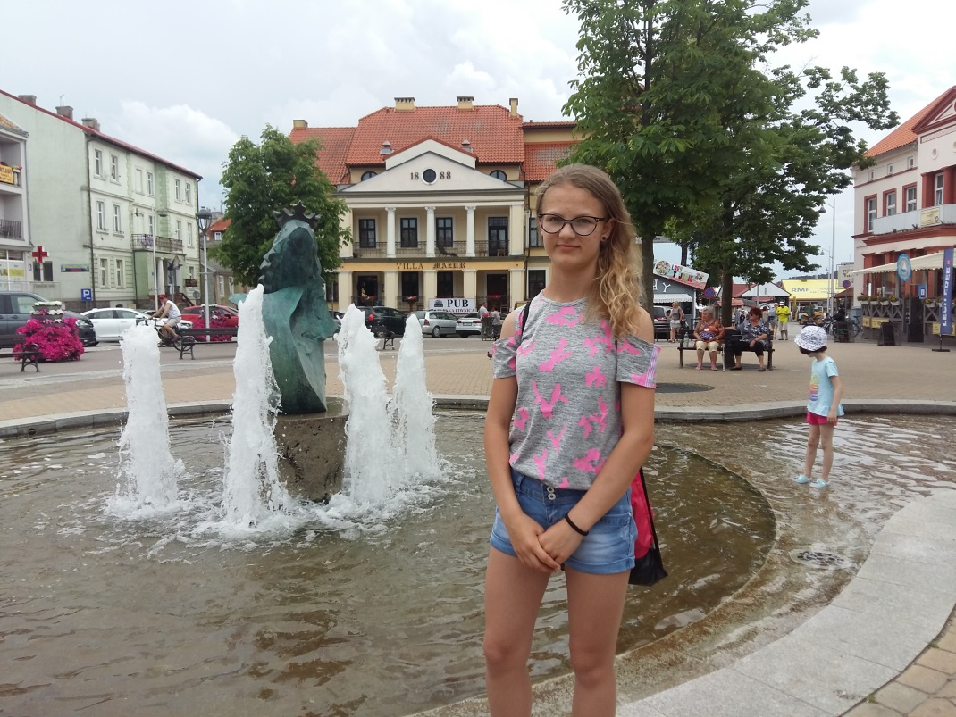
My name is Martyna. I go to class 7A. I have two younger brothers. I really like cycling, rollerblading, scooter, skateboard.
I like to play soccer, which is why I love playing sports. I don’t really like Science, but it is not a problem for me to study it. I often look after my siblings, but they are not always polite. I have wonderful parents who take us from time to time on trips, spend a lot of time with us and help us with various things. On holidays, I always go to my
beloved grandparents. In the
school year we visit our family with
our parents and brothers.
I must admit that I have a very
niece and loving family.

Slide 9
Hi! I’m Miłosz Kozioł I’m thirteen years old

Slide 10
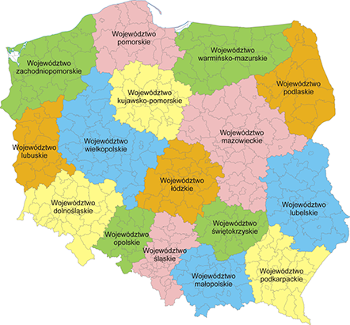
I live in Poland in Świętokrzyskie.

Slide 11
My hobby
My hobby is riding BMX.
I like watching adventure movies and comedies.
My favorite is „Fast and Furious”

Slide 12
I like playing handball

Slide 13
and football

Slide 14
and my number one is basketball

Slide 15
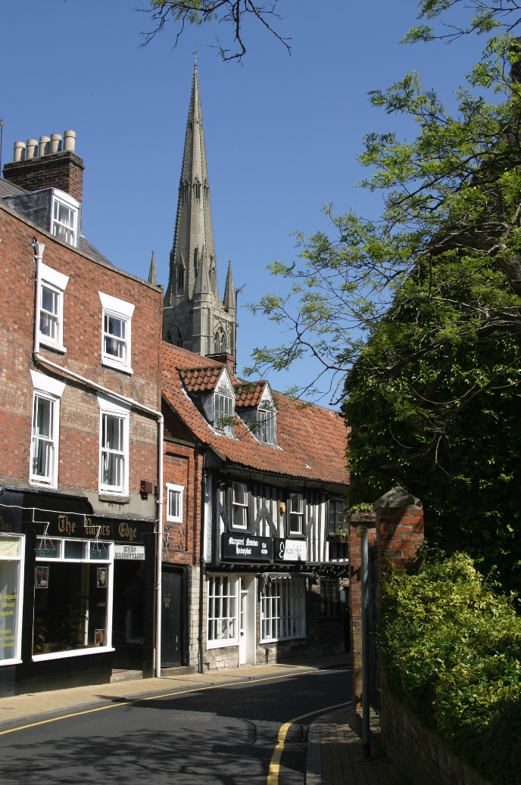
Hi, my name is Franek. I have a sister whose name is Zosia and I have 2 fabulous parents whose names are Pawel and Dominika. We live in Morawica. I started school 3 weeks ago. So far the school is amazing. I lived in England for 11 years until 2019. I have 7 cousins. I have 10 cats and 2 dogs. One of the dogs is really old. In the UK I used to go to a school, which was called Charles Read Academy. I lived in Grantham. I really like animals, especially dogs. I had a guinea pig in the UK but it sadly passed away in July. We moved to Poland in August. We took everything with us except some things that we left my aunt because she didn't move to Poland with us. I'm really happy in Poland, in Morawica and with my family.

Slide 16
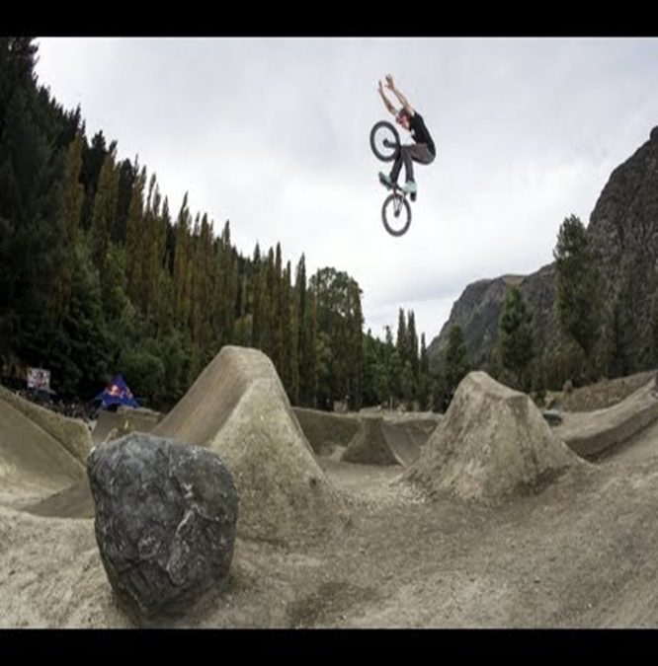
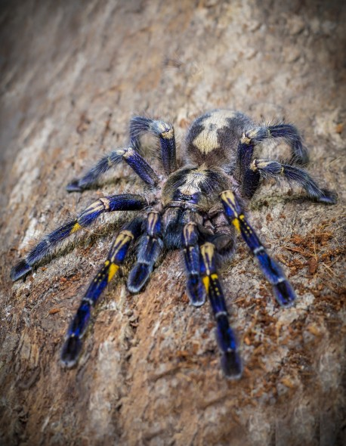
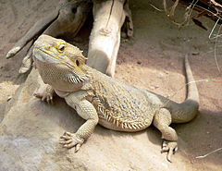
Red bull roast it 2016
My name is Kornel.I have one sister. I’m interested in reptiles and dirt jumping.

Slide 17
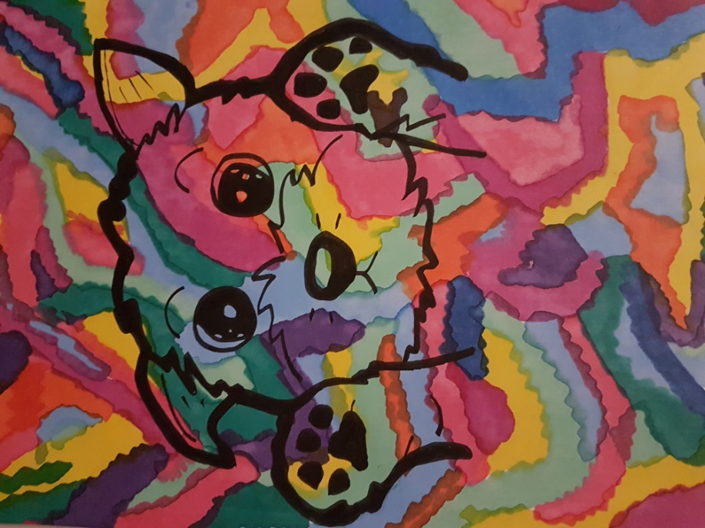
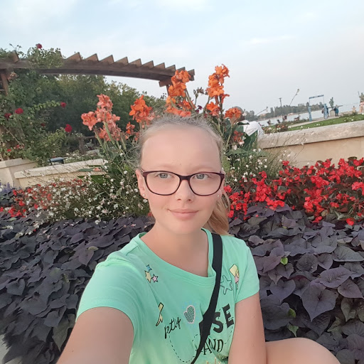
My name is Wiktoria and I am
in 7th grade. I live in Poland. My
hobby is drawing my works. I am
also interested in modern fashion.
I don’t like reading books but when
I read a book I try to understand it
and read it to the end. I like sports
but my fovourite is handball and volleball.

Slide 18
Hello . My name is Marceli. I live in Poland. I have two brothers. I'm in the 7th year.

Slide 19
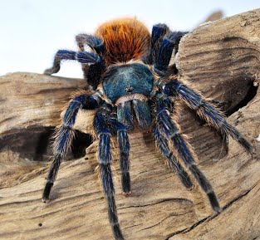
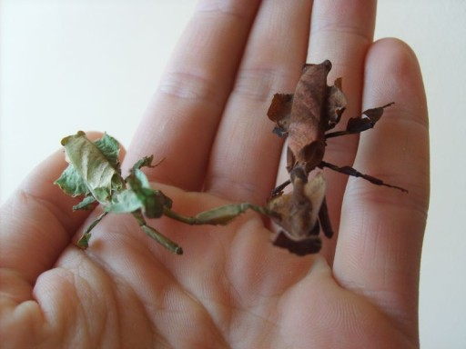
I'm interested in terraristics. I have a pair of mantis and one spider.

Slide 20
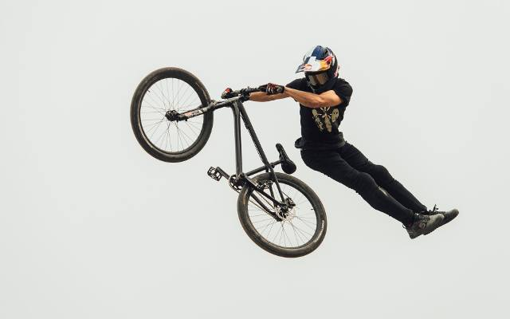
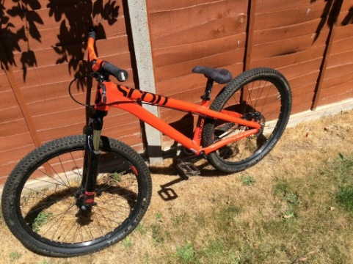
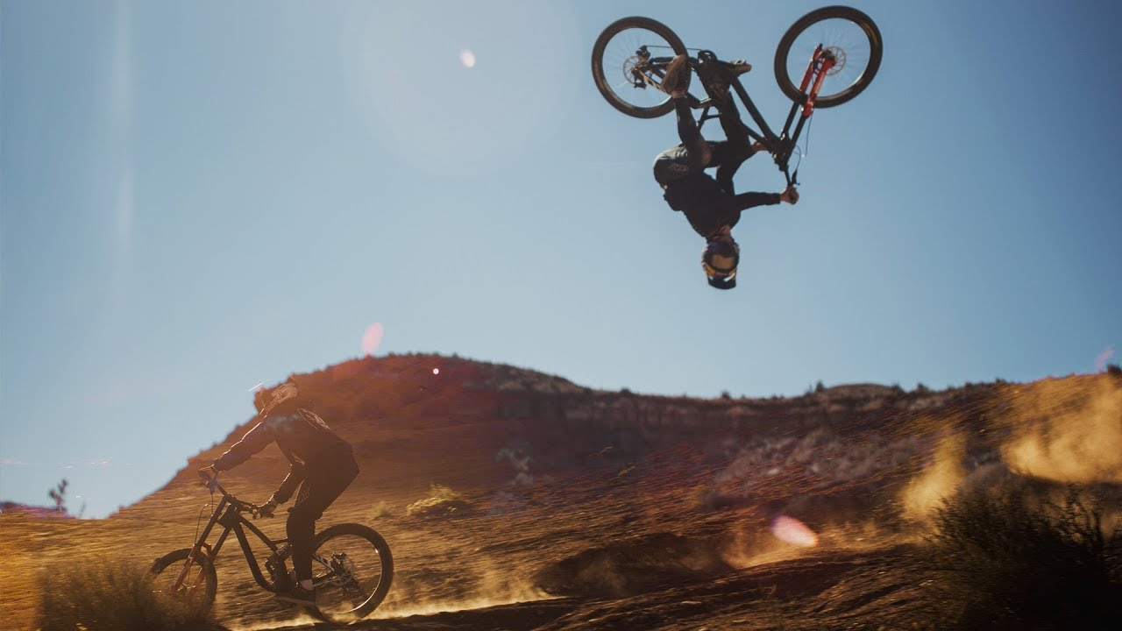
My second passion is riding a dirt bike. I love it!!

Slide 21
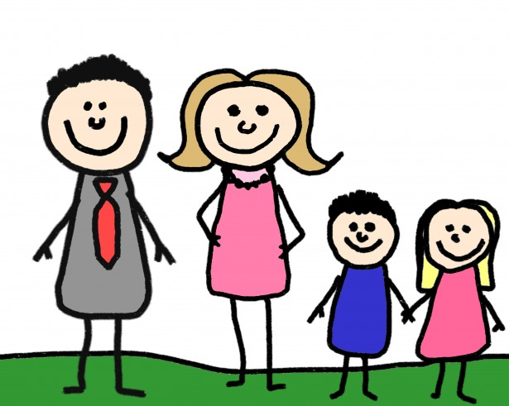
Personal details
My name is Amelia Cieśla. I live in Dębska Wola, Morawica.
I’m thirteen years old. I’m at the seventh grade of a primary school. There are four people in my family, my dad – Marcin, my mum – Monika, my sister – Aleksandra and me. I have got two dogs, Borys and Sara.

Slide 22
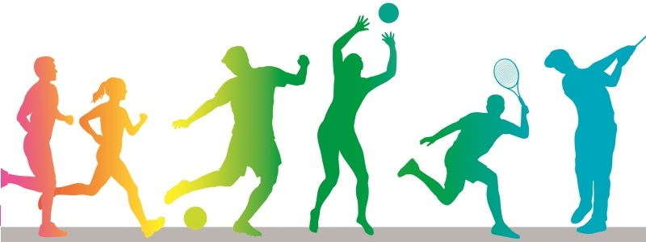
Hobbies and interests
In my free time, I like reading books, playing with my dogs and listening to music. Every Tuesday and Thursday, I go swimming with my friends, because I like to keep fit.

Slide 23
Hi, my names Amelia. I like travelling.

Slide 24
I am in 7th grade. I don't have any siblings, but I do have loving parents. Ania and Martyna are my best friends. I like dancing and taking care of animals. In the future I would like to become a dog hairdresser (gromer). I really like travelling, but I would never leave my country,Poland.

Slide 25
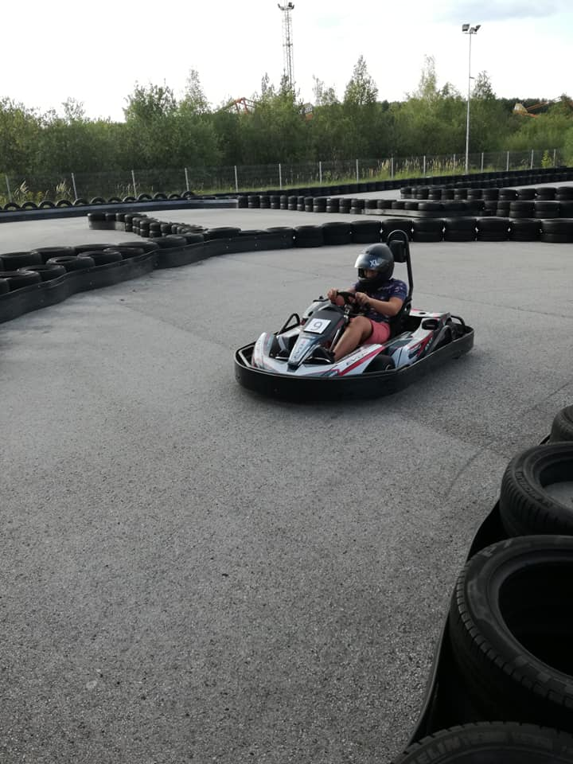
My name is Wiktor, I am 13 years old. I live in Poland. I have two brothers and parents. I like to riding a bike, playing football and listening to music. I have five dogs and one hamster.

Slide 26
Tosia i Weronika

Slide 27
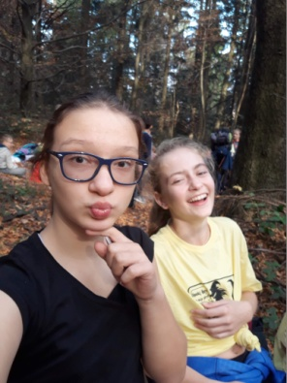
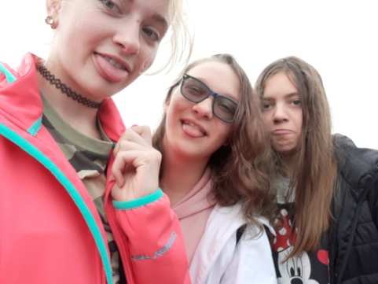
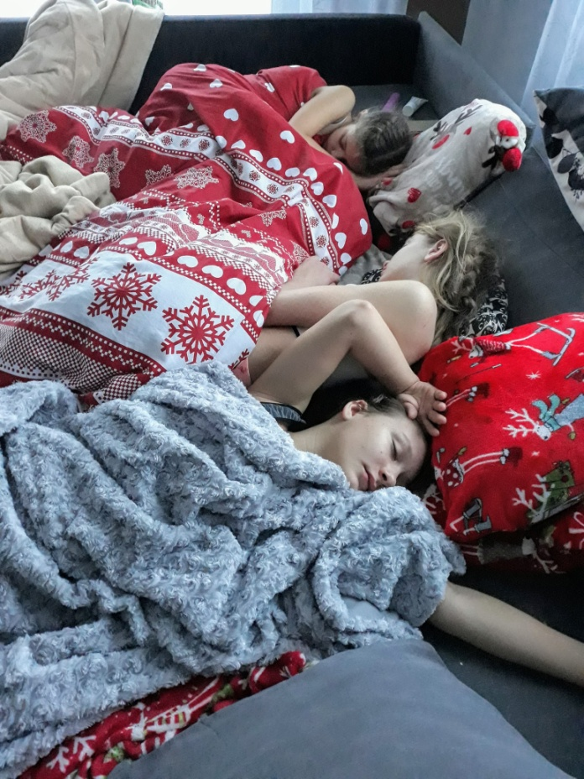
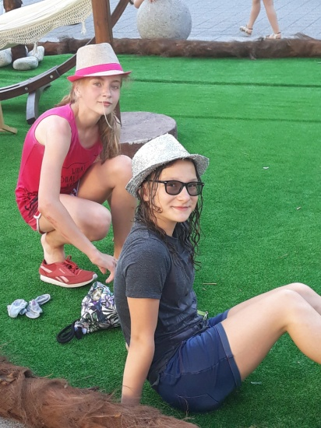
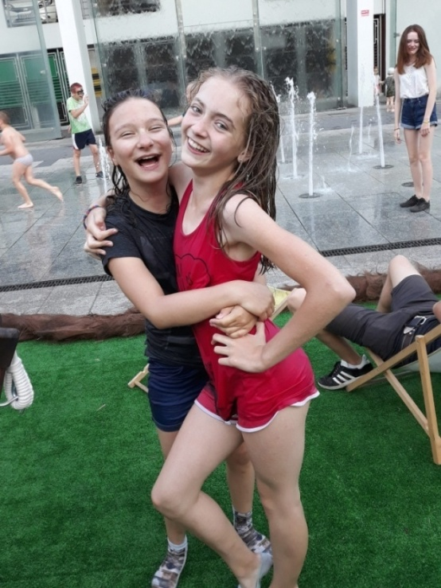
A bit about us!!!
My name is Weronika and I’m 13 years old.
I live in Poland in a small village -Bieleckie Młyny. I’m in 7th grade .
My name Tosia and I’m 12 years old. I live in Poland in small village - Brzeziny. I’m in 7th grade too.

Slide 28
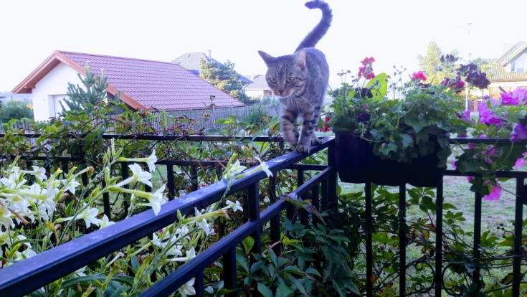
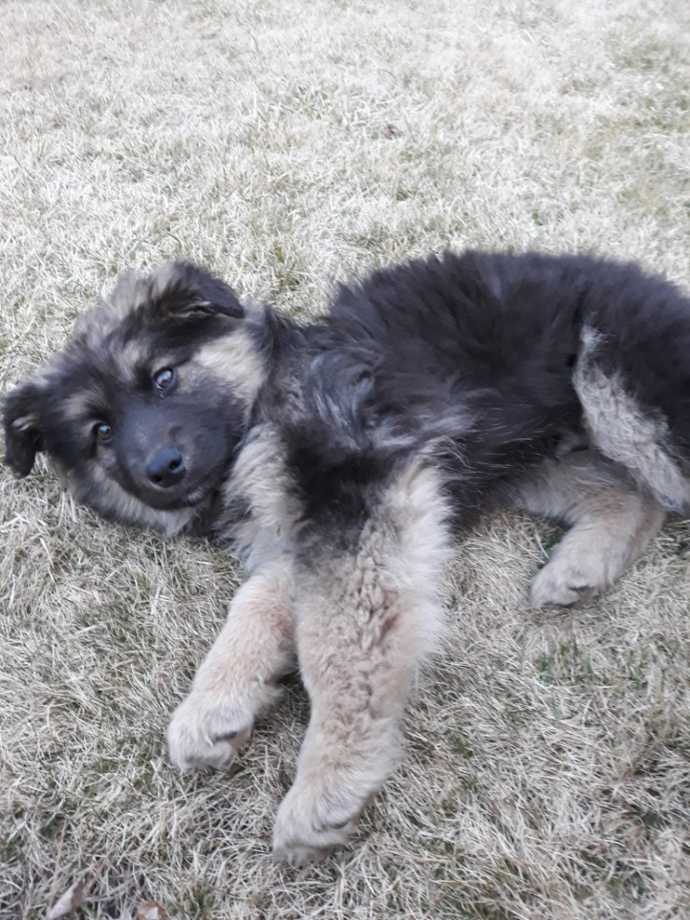
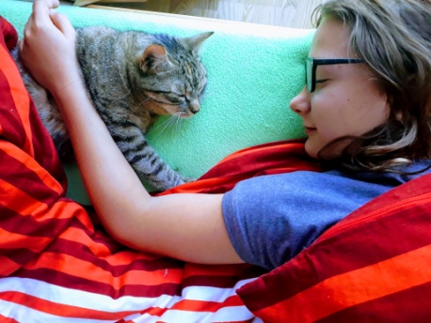
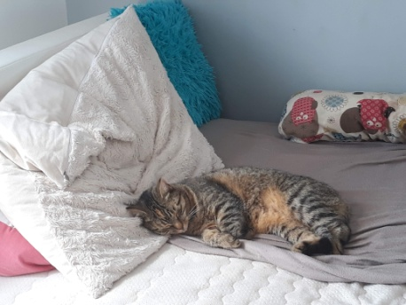
Our families
TOSIA
I live with my mother, her name is Anna. My dad’s name is Rafał and I’ve a brother Ksawer. I have a cat is Star. My mother works as an accountant and my dad is the Mayor. My brother is 2 years old.
WERONIKA
I live with:
my mother - her name is Aneta and
my dad is Sylwester,
my brother - Michał
and my dog is named Nestor.
My mother works as a nurse and my father as an CNC operator. My brother is in high school in 2nd geande.

Slide 29
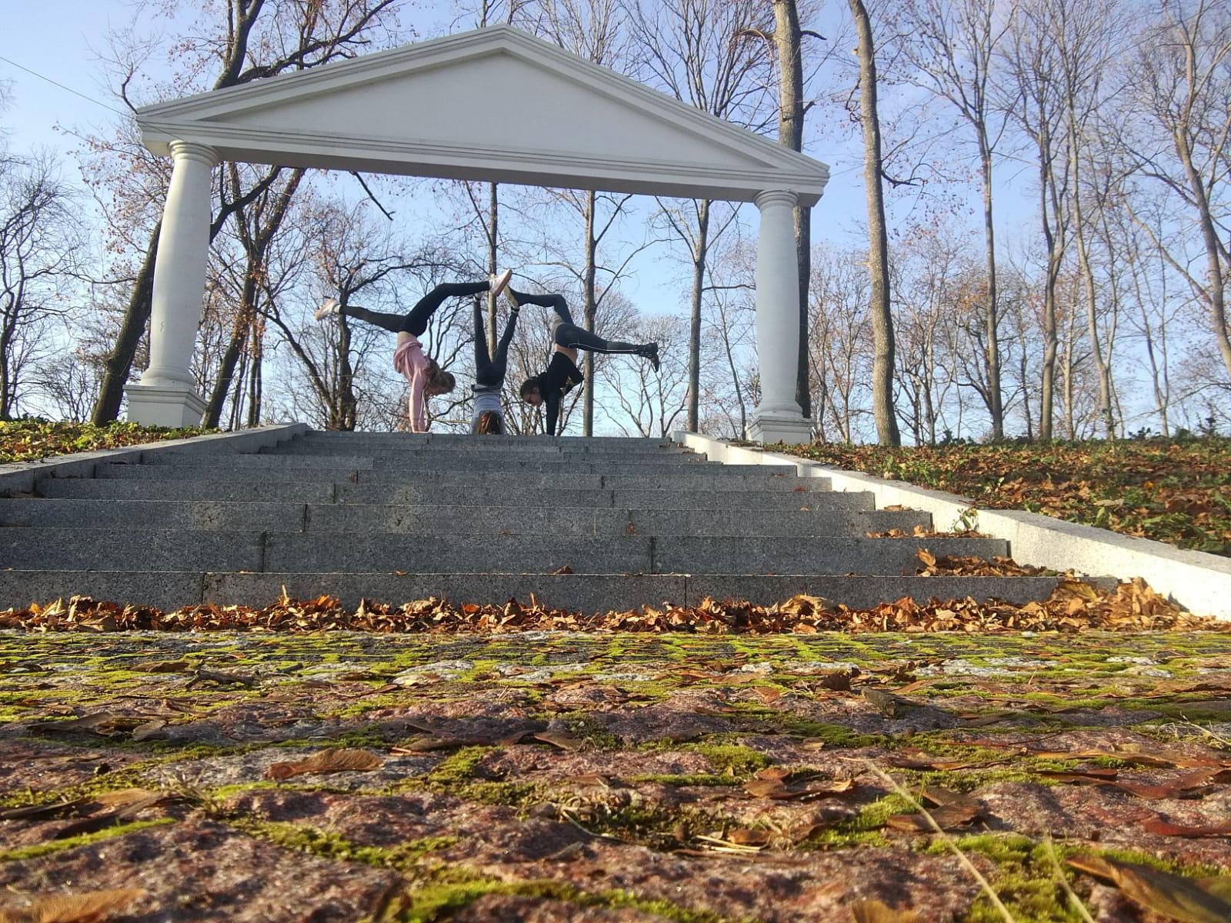
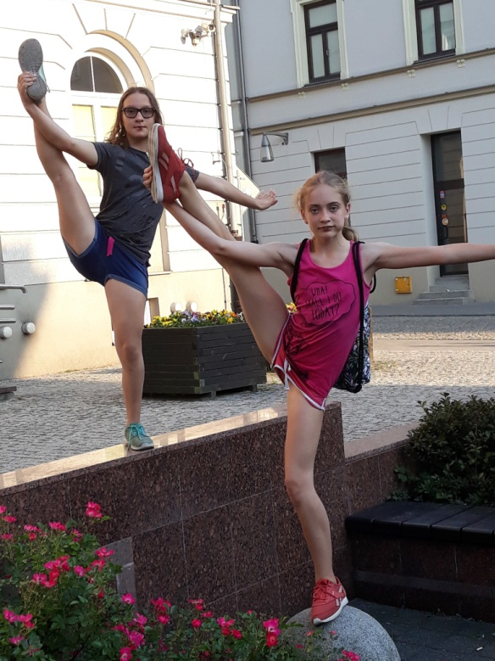
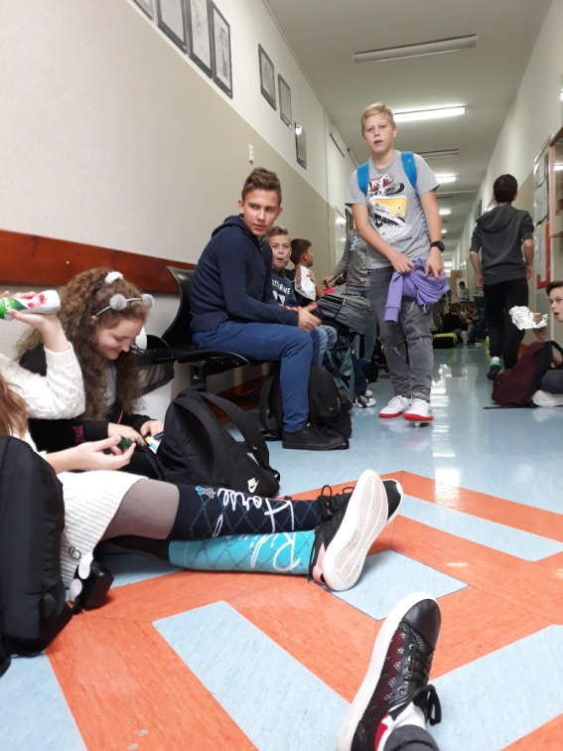
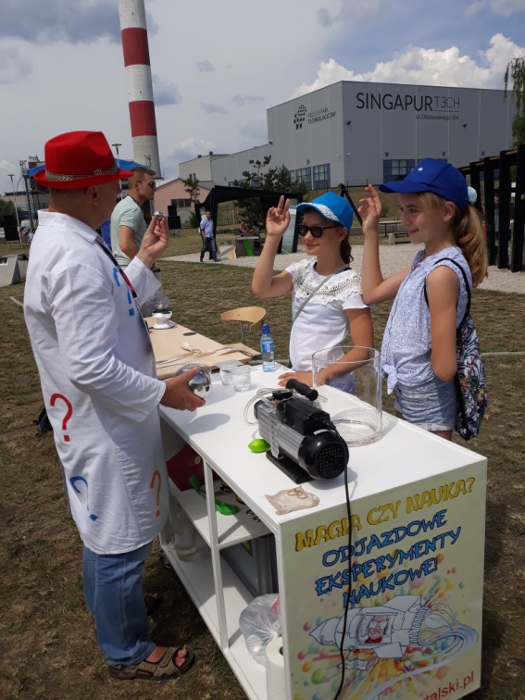
After school
On Monday after school I’ve got a private English lessons. On Wednesday I go to the community center, where I help children to learn. And on Friday I go to dance and gymnastics classes, it takes place in my school.

Slide 30
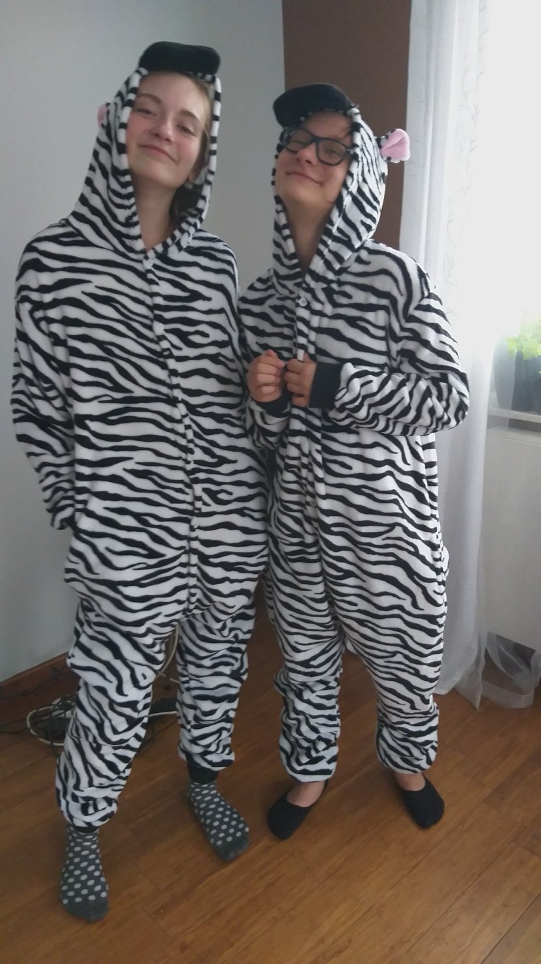
After school - Tosia
On Tusday after school I’ve got a private English lessons too.
On Wednesday me and my friend - Weronika - go to the community center , where we help children to learn.
Twice a week I go to gymnastics sport
and I go swimming on Friday.
Sometimes I roller-skate with my mum. She can do it. She is quite crazy but I love her.

