Slide 1
Christmas in Slovenia

Slide 2
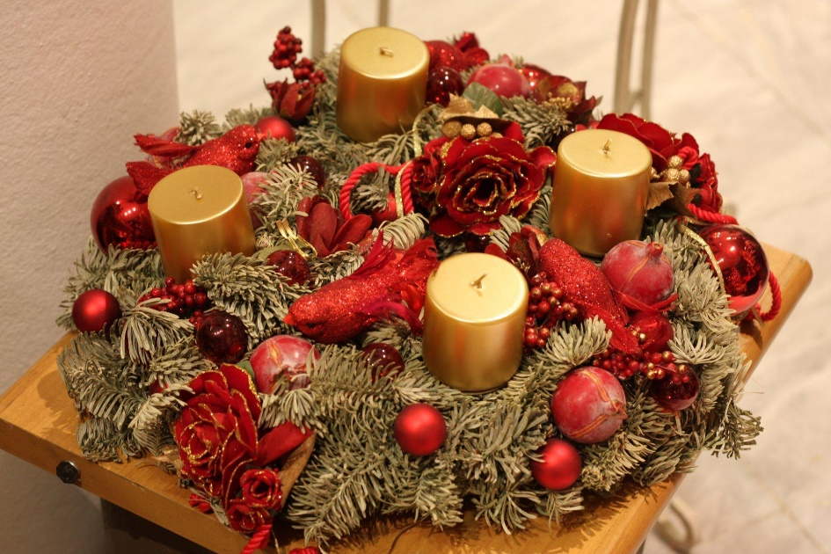
Advent time
Christmas feeling starts at the beginning of December when we buy or make our own Advent wreaths. We usually put it on the table. On the first December Sunday we lit the first candle.

Slide 3
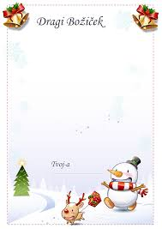
Christmas letters
Before Christmas some children still write letters to Santa Claus telling him what presents they would like to get.

Slide 4
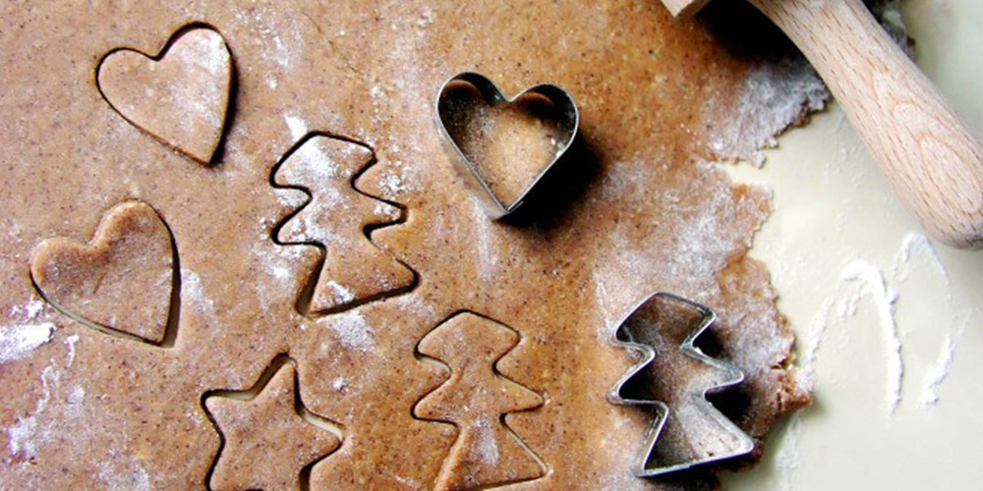
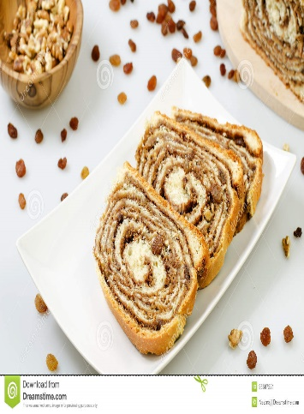
How we prepare for Christmas
My grandmother bakes potica every year and I help her bake cookies. Potica is Slovenian traditional food, it is a traditional Slovene sweet roll with walnuts.
Some people also decorate their houses with a lot of lights.

Slide 5
Christmas Eve
On Christmas Eve we put up a Christmas tree, decorate it with different ornaments and cribs.
On the top we usually put an angel. Many families put nativity scenes next to the tree. Santa Claus leaves presents under the Christmas tree at night.

Slide 6
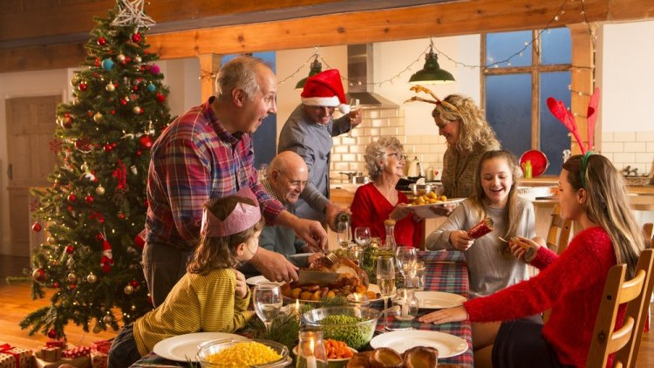
Christmas dinner
On Christmas Eve we have dinner where the whole family gathers and we have fun together.
For Christmas dinner we usually eat beef soup with noodles, roast turkey, boiled beef, roast pork,roastet potatoes, rice, various salads. Potica and biscuits are served as a dessert

Slide 7
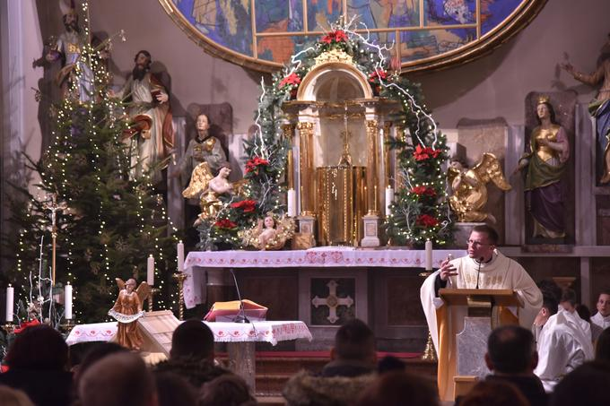
At midnight we go to church, where we sing Christmas carols during the mass. On Christmas morning we are all very happy as we receive gifts.
At CHRISTMAS, on 25th December, we open presents and spend the day with people we love.

Slide 8
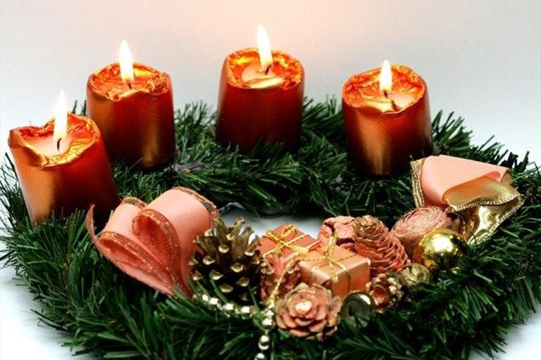
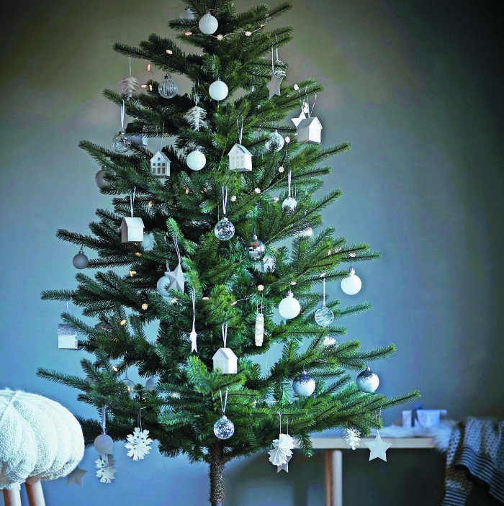
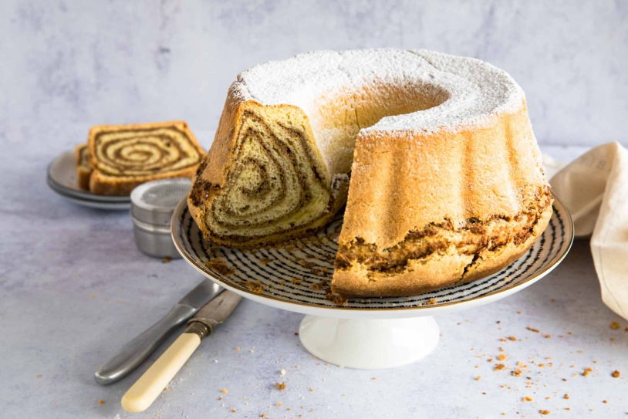
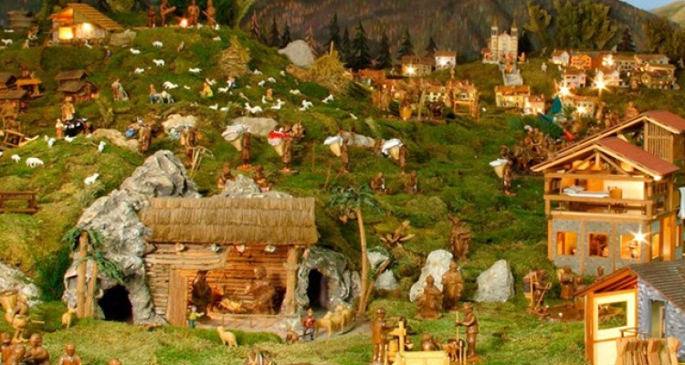
Photographs:
WREATH
CHRISTMAS TREE
POTICA
NATIVITY SCENES

