Slide 2
Slovakia
Žofia Marková 9.A

Slide 3
This is Slovakia
Bratislava capital city
Levice

Slide 4
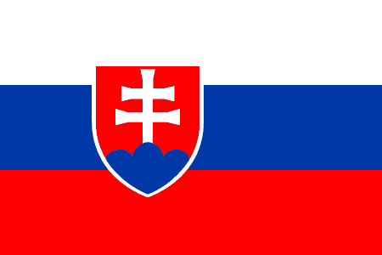
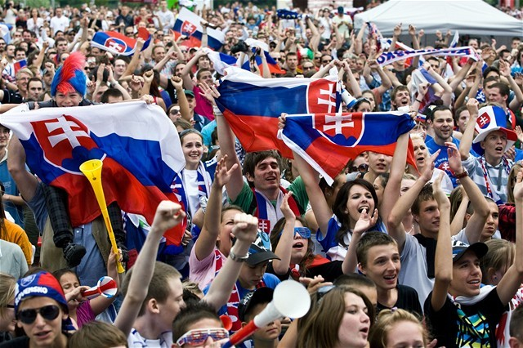
Slovakia
It’s a small country with an area of 49 036 km².
About 5 435 000 inhabitants live here.
This is the Slovak flag

Slide 5
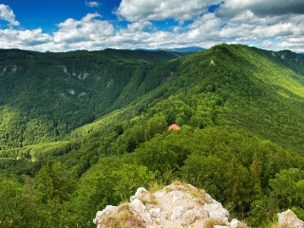
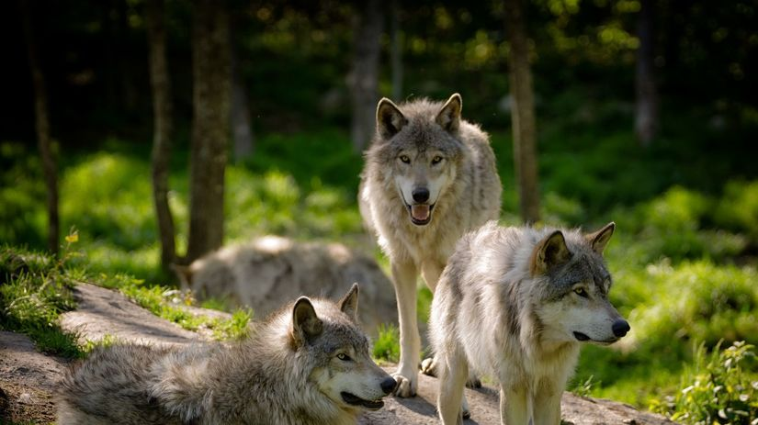
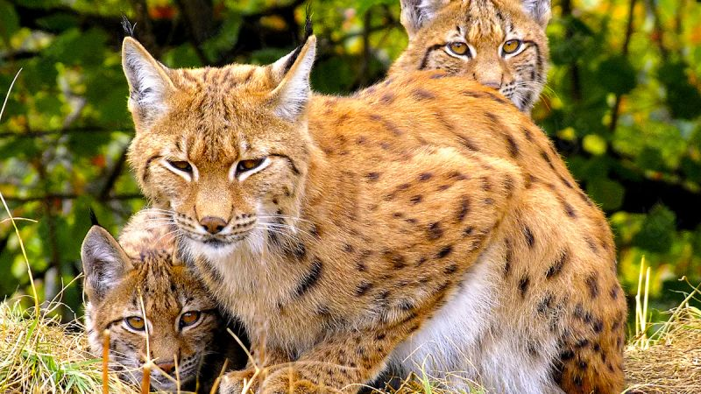
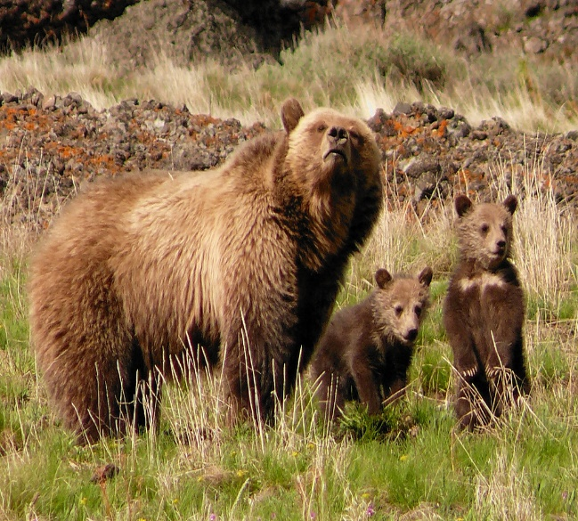
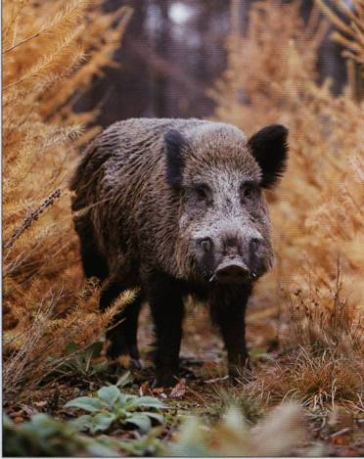
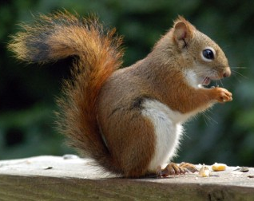
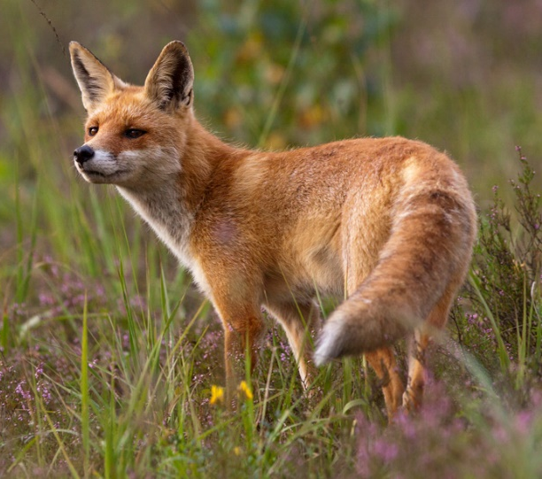
Slovak nature
44% of Slovakia are forests.
In wild nature in Slovakia you can see wild boars, deers, bears, squirrels, foxes, wolves, features, storks, rabbits … and many fish species.

Slide 6
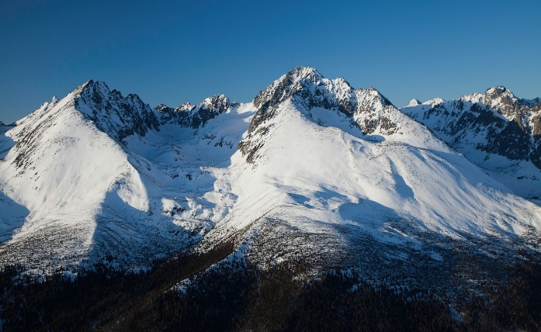
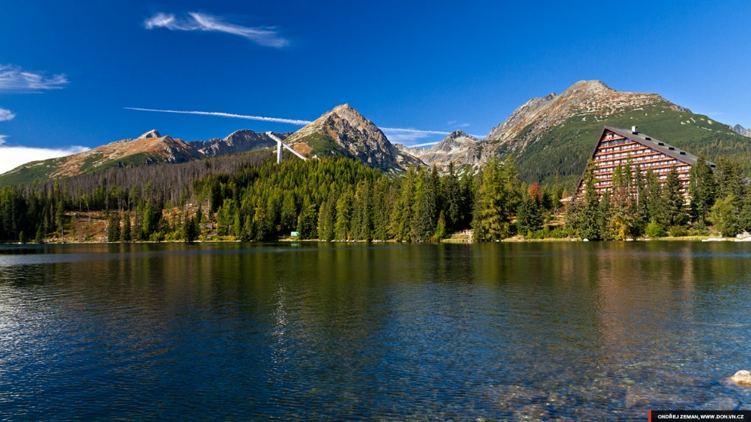
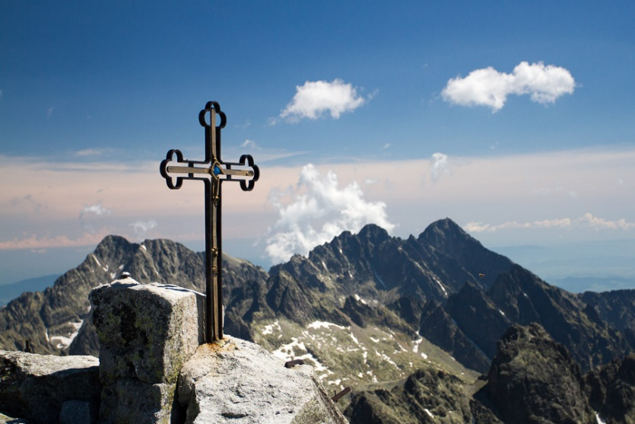
Slovak nature (mountains)
The High Tatras (Vysoké Tatry) are the highest mountians in Slovakia, but also in Poland.
The highest peak is the Gerlach (Gerlachovský Štít), which is 2 655 m high.
Štrbské pleso (Strba tarn)

Slide 7
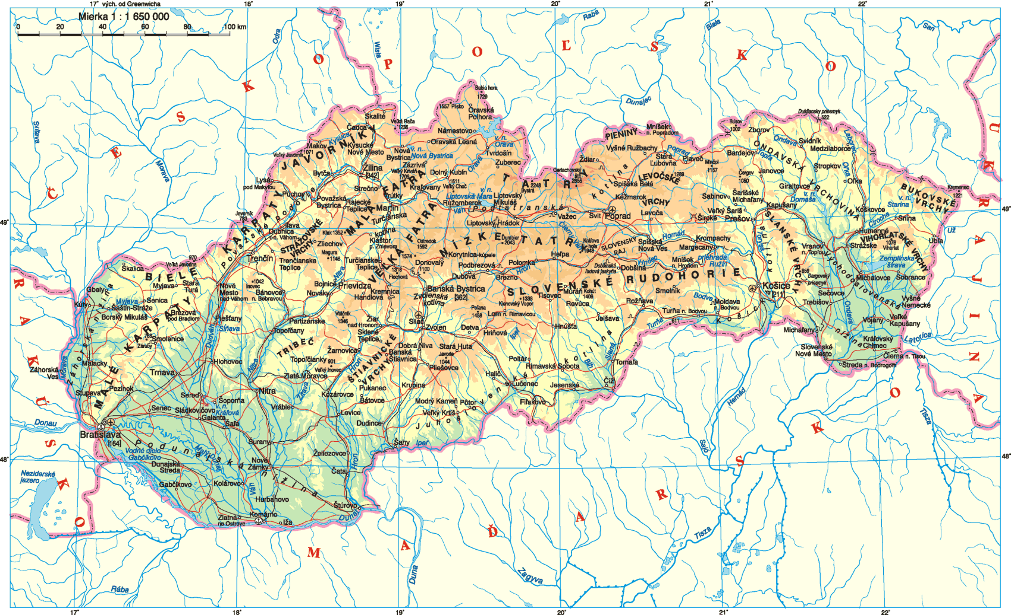
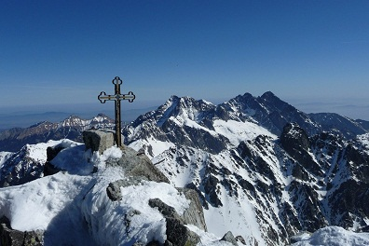

Slide 8
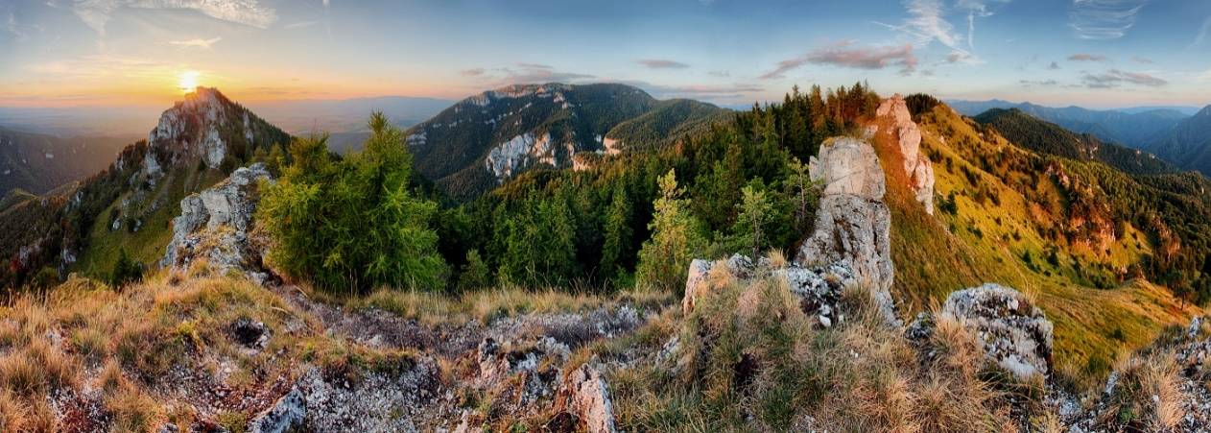
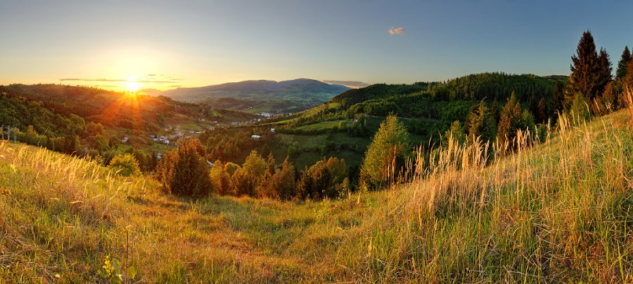
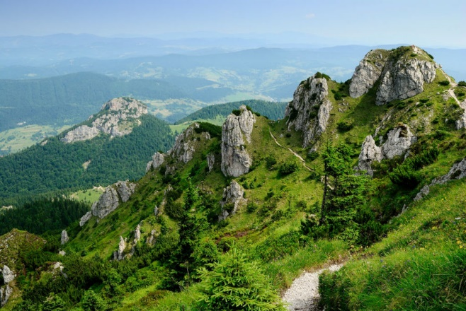
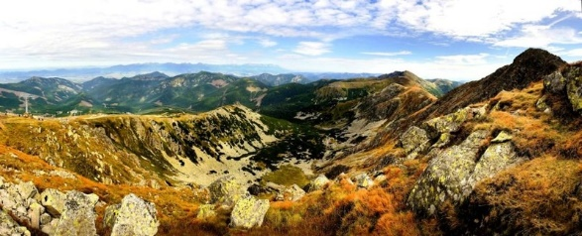
Slovak nature
in Slovakia there are the mountains of Low Tatras (Nízke Tatry), Malá and Veľká Fatra, Poľana and so on.

Slide 10
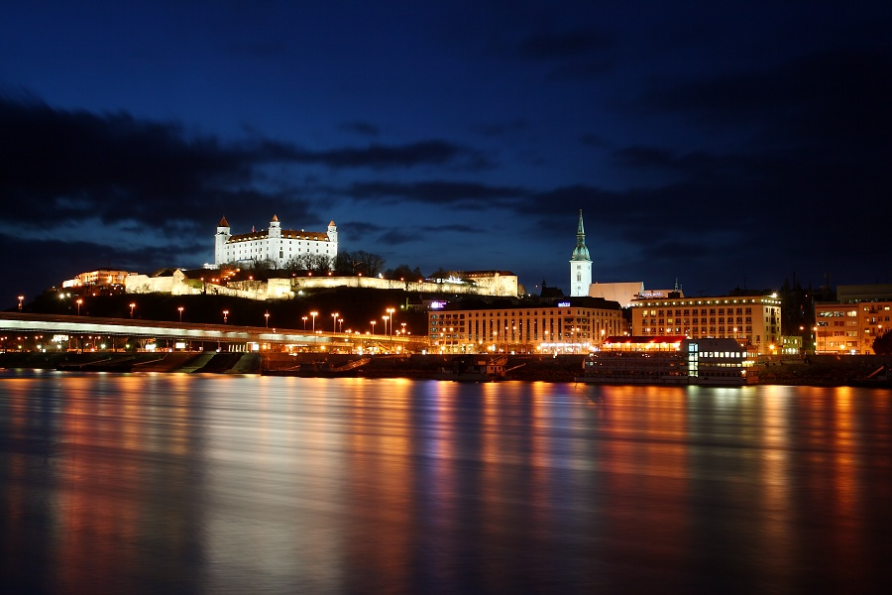
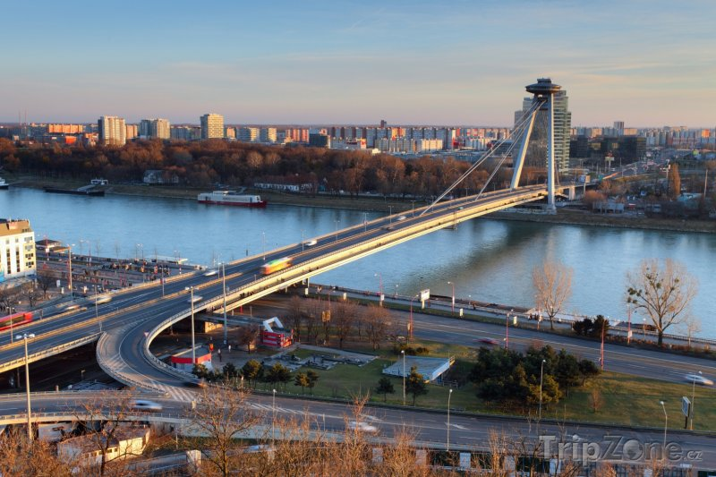
Slovak nature (river)
The longest Central European river Danube runs through our territory.
It passes through Bratislava - the capital of Slovakia.

Slide 12
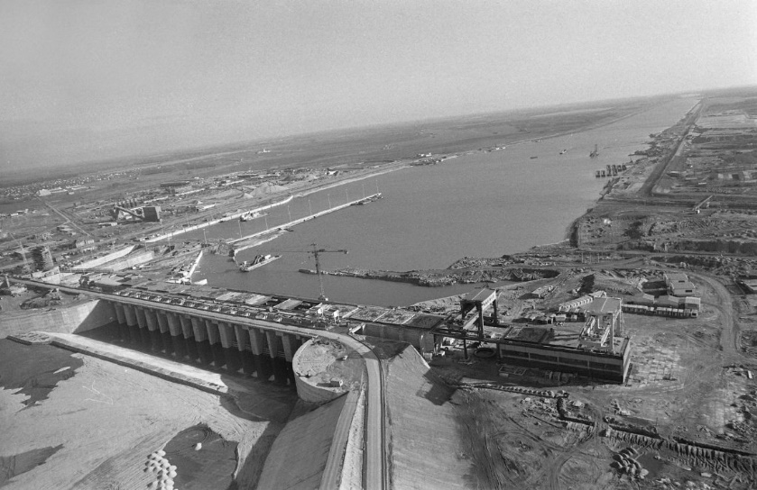
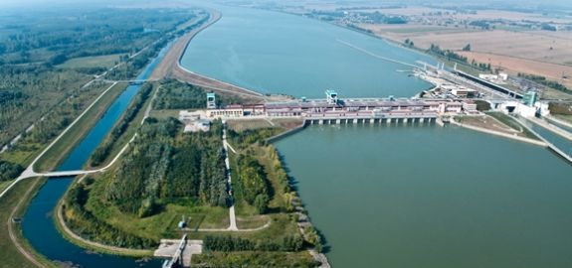
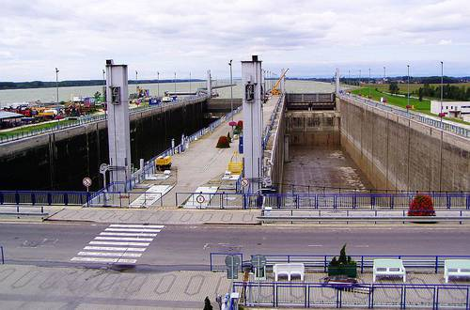
Gabčíkovo – Nagymaros Dam
It is a large barrage project on the Danube.
It is located near Gabčíkovo.

Slide 14
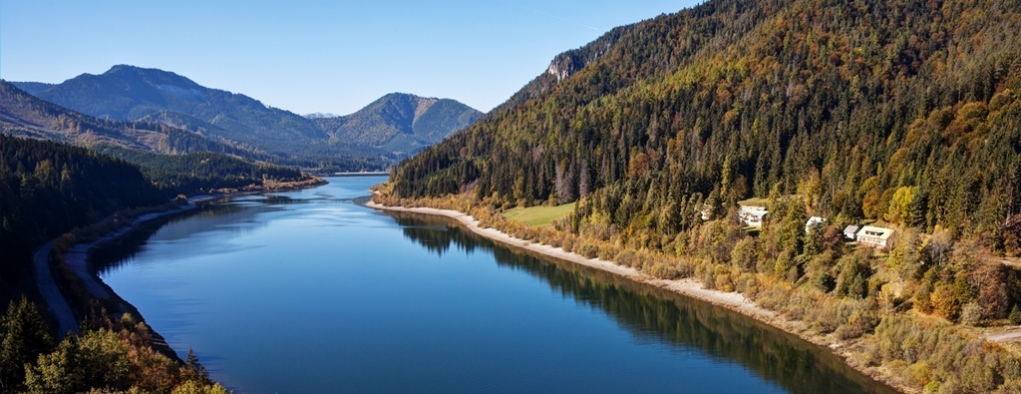
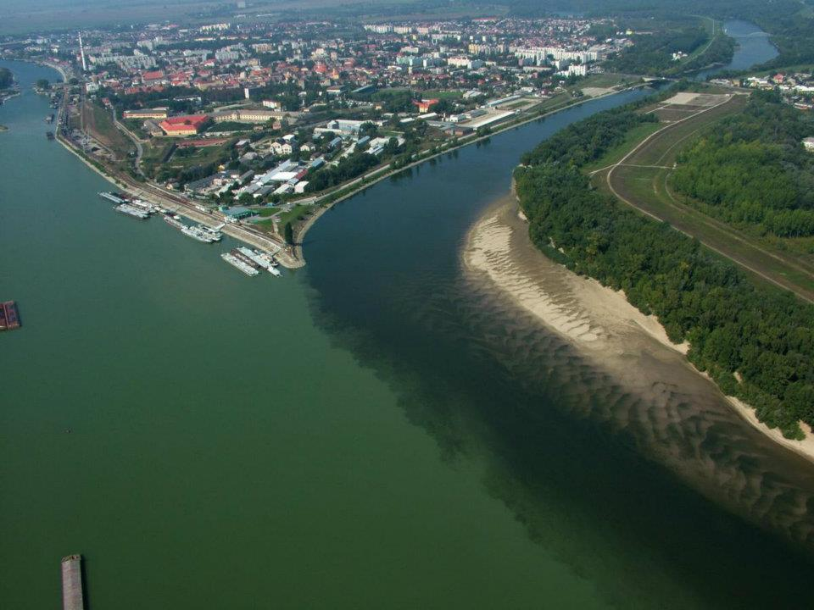
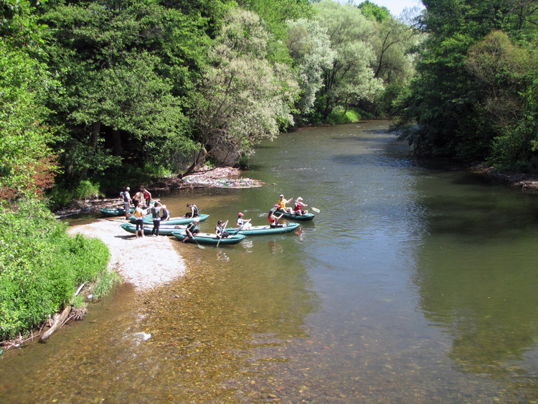
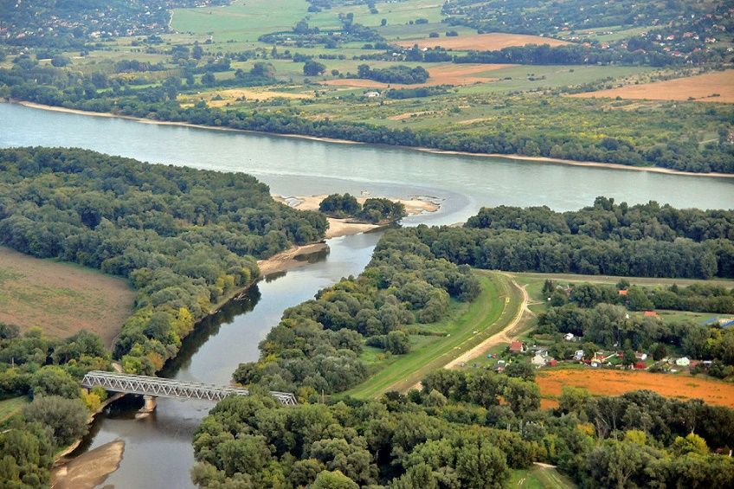
Slovak nature
The longest river is Váh.
Hron is the second longest river.

Slide 15
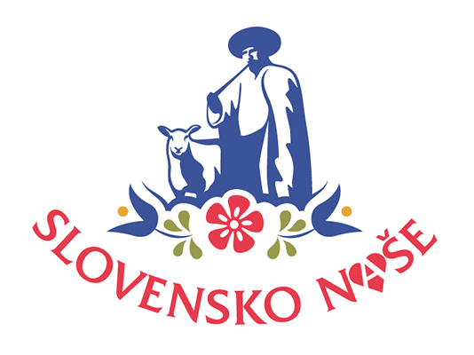
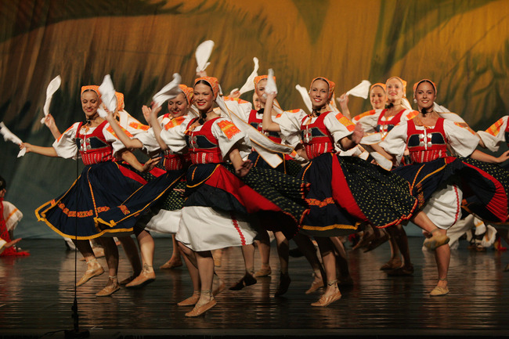
Slovak culture
Folklore
Bratislava castle, Spis castle (Spišský hrad), Orava castle (Oravský hrad)
Vlkolínec, Čičmany
Meal
Habits and traditions
Sport

Slide 16
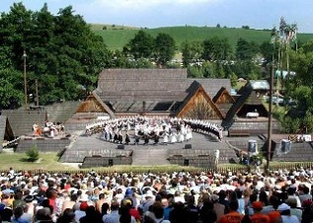
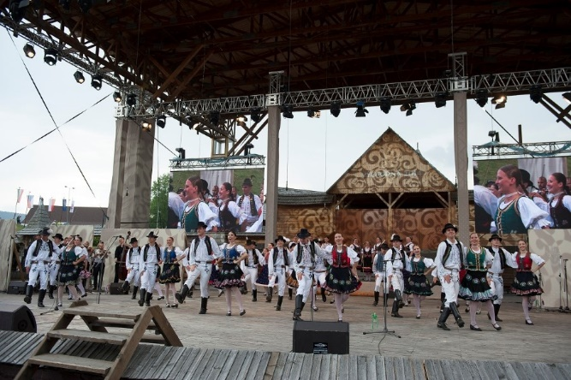
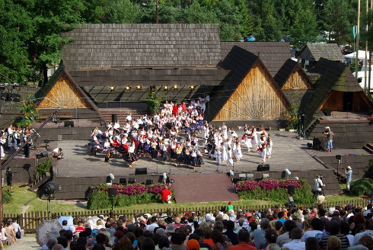
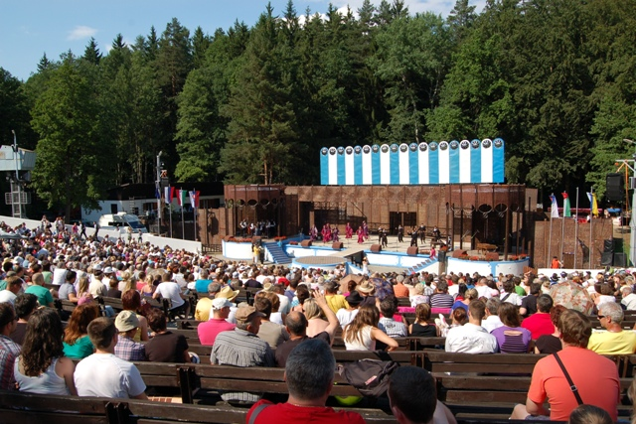
Folklore
The main motives are love, hard work, nature and
festivel events.
The most significant Slovak folklore festivals:
Folklore Festival Východná
Folklore Festival Pod Poľanou in Detva
Jánošík days in Terchová
Myjava International Folklore Festival

Slide 17
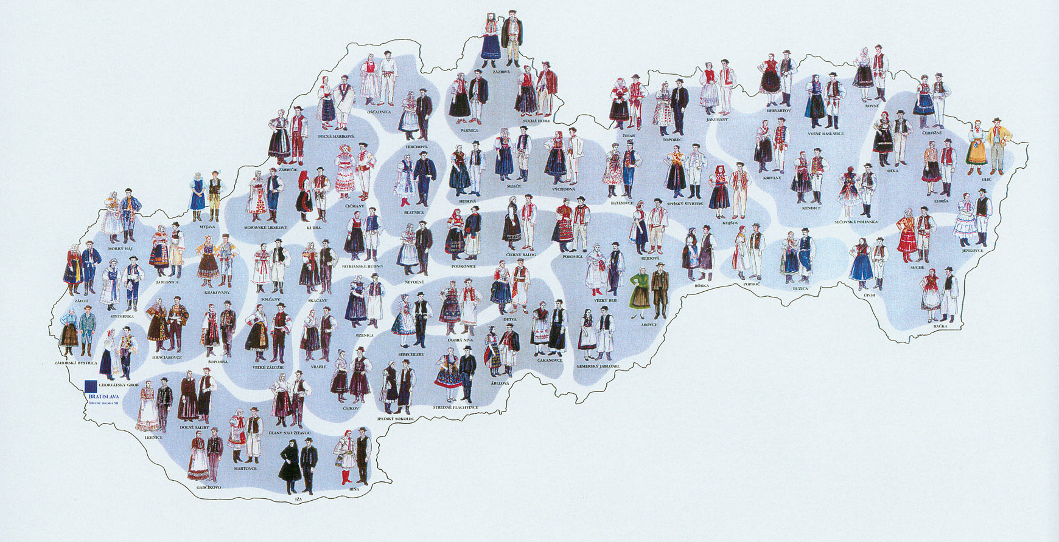
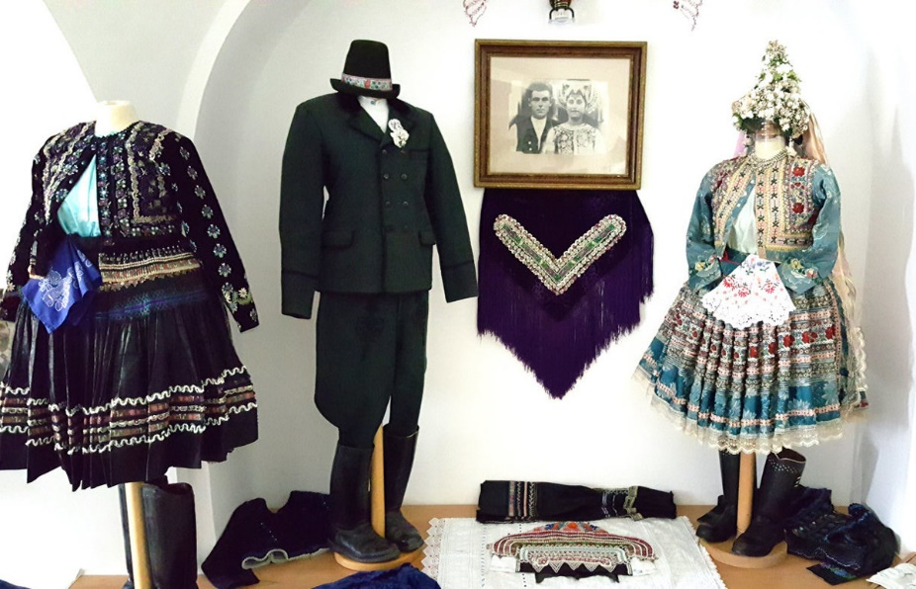
Folklore – folk costumes
In Slovakia there are many types of folk costumes
We are here

Slide 18
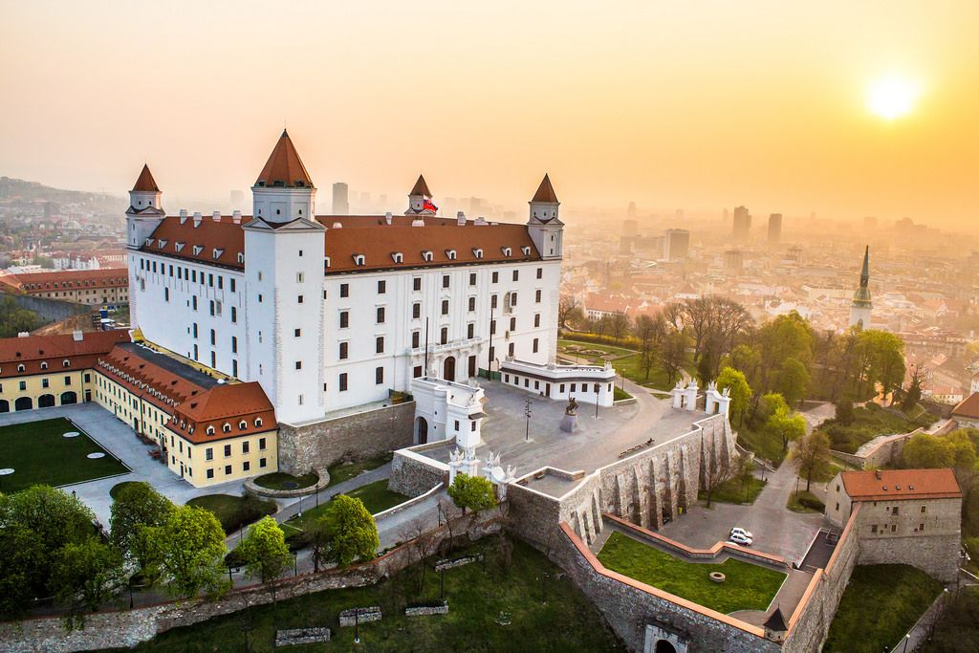
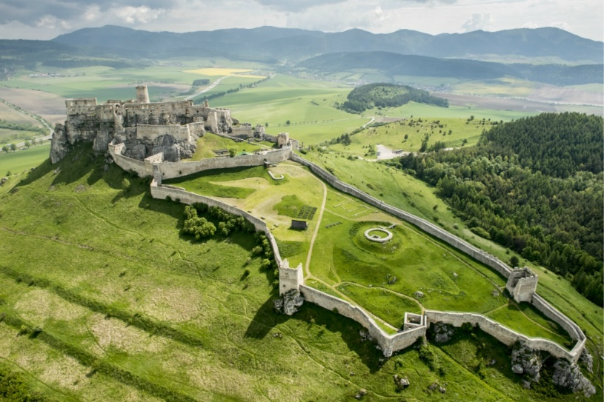
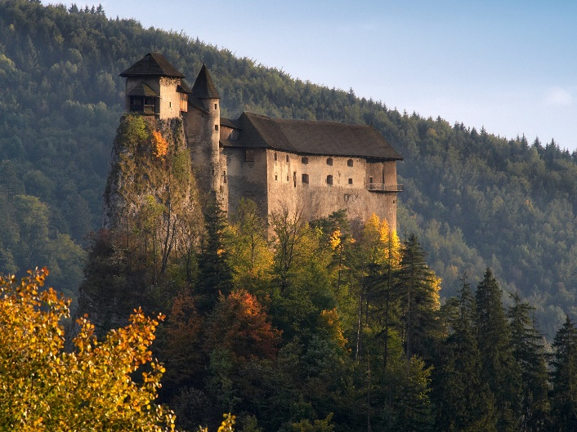
Castles
Bratislava castle
Spiš castle is the largest in Slovakia
Orava castle

Slide 19
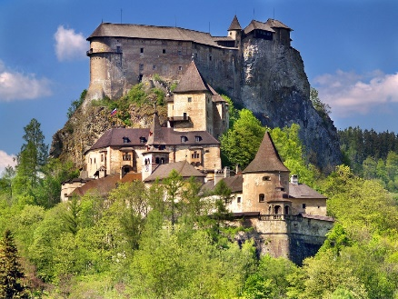
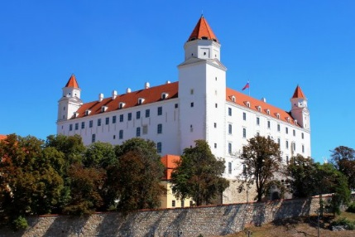
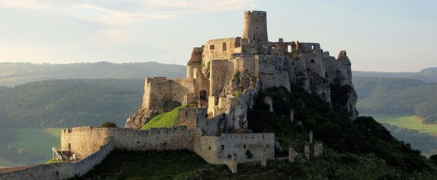

Slide 20
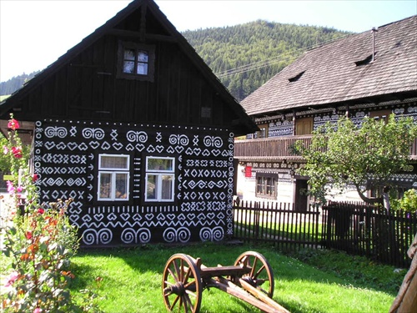
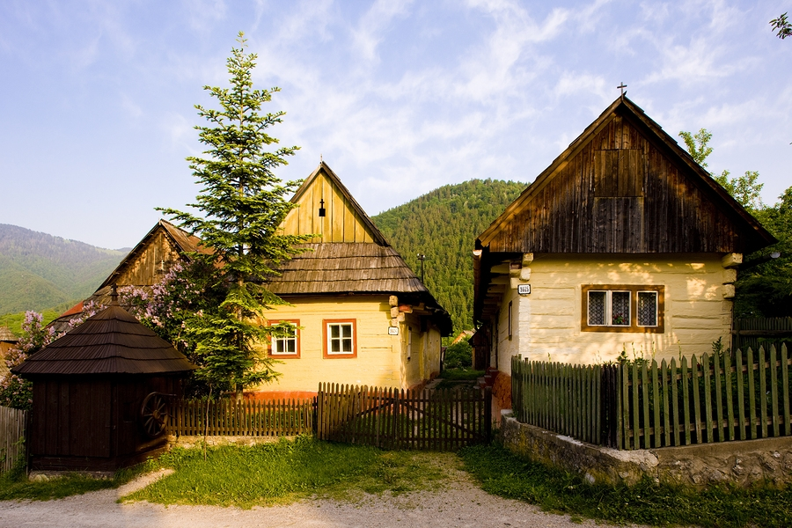
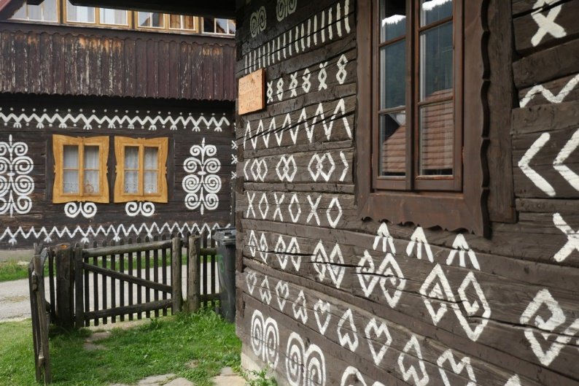
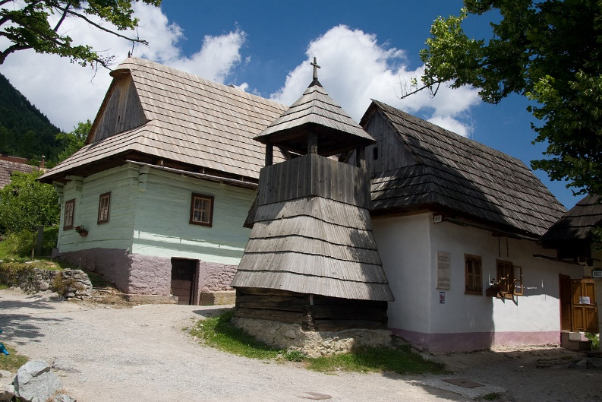
Vlkolínec and Čičmany
Are the settlements with traditional Slovak houses
UNESCO World Heritage is Vlkolínec

Slide 21
Čičmany
Vlkolínec

Slide 22
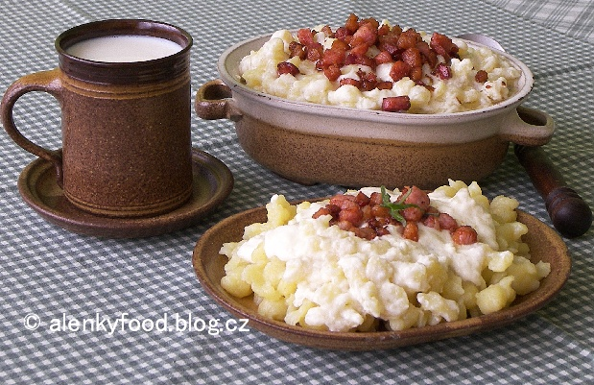
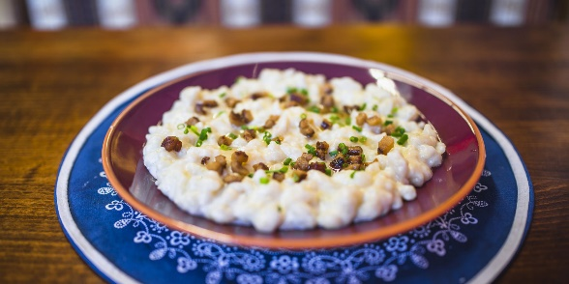
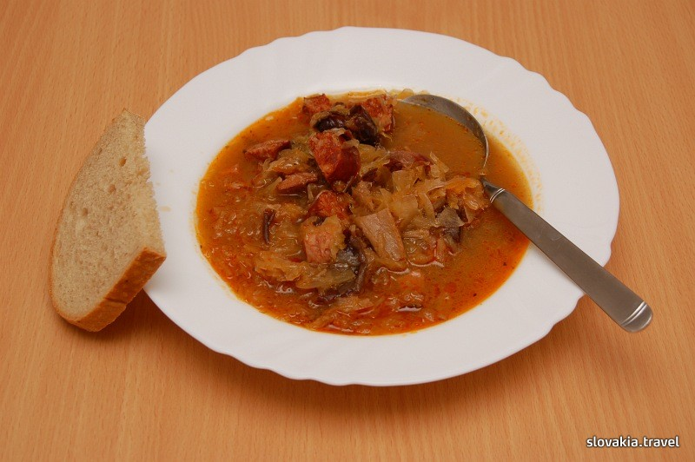
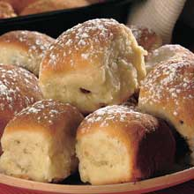
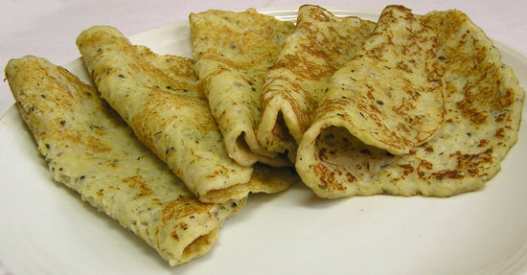
Meal
The most typical Slovak food is potato dumplings with sheep cheese and bacon.
Cabbage soup, potato pancakes, slovak donuts
cakes stuffed with leek, poppy seeds, cottage cheese or nuts

Slide 23
Peter Sagan (Sport)
He was born in 26 January 1990 in Žilina.
He is 3 times world shampion in cycling.
He started cycling when he was 9.

Slide 24
Dominika Cibulková (Sport)
She was born in 6 May 1989 in Bratislava.
She won 10 tourneys.
She plays tennis.

Slide 25
Matej Tóth (Sport)
He was born 10 February 1983 in Nitra.
He is olympic winner in Rio de Janeiro in 2016.
He is an athlete and takes a walk.

Slide 26
Thank you for your attention

