Slide 1
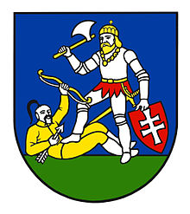
Nitra´s region Levice district
Karolína Hermánová – Hana Tóthová
VIII.B – VIII.A

Slide 2
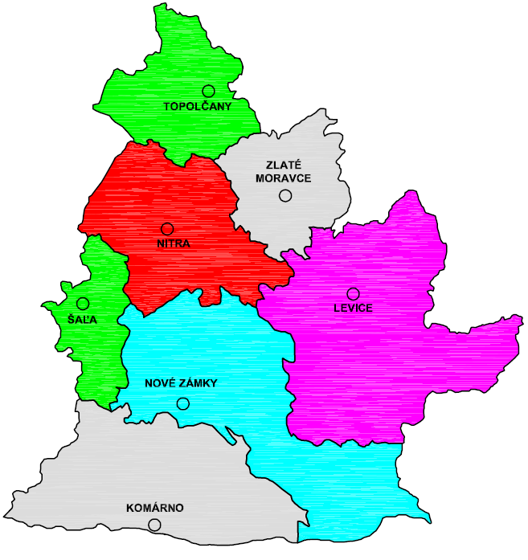
.
Nitra´s region is one of the eight Slovak regions.
It is a region with rich history, lots of thermal springs and quality wine varieties. It belongs to the hottest areas and the most productive agricultural centers of the Slovak Republic. The head of the region is the chairman of the regional council. The regional council consists of 54 deputies.

Slide 3
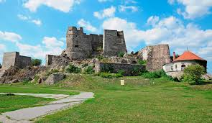
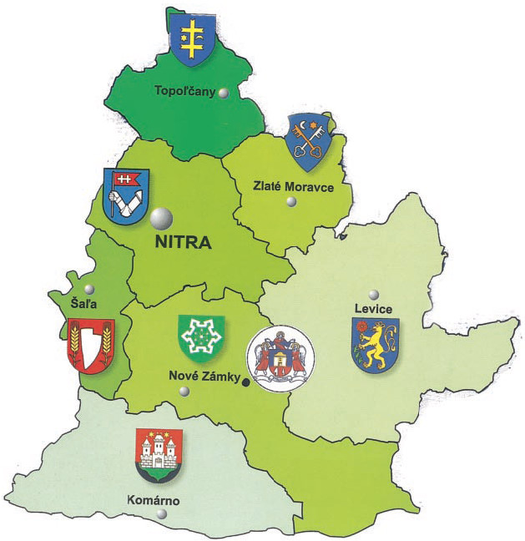
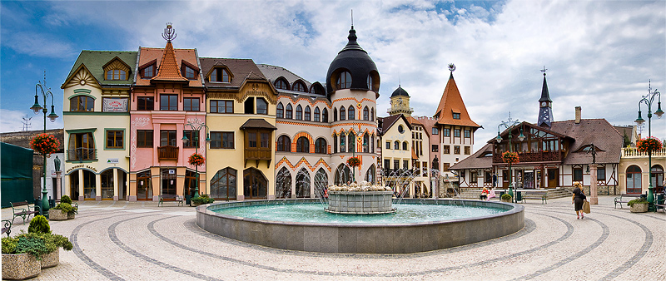
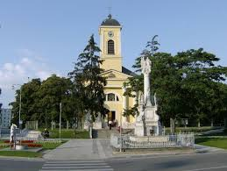
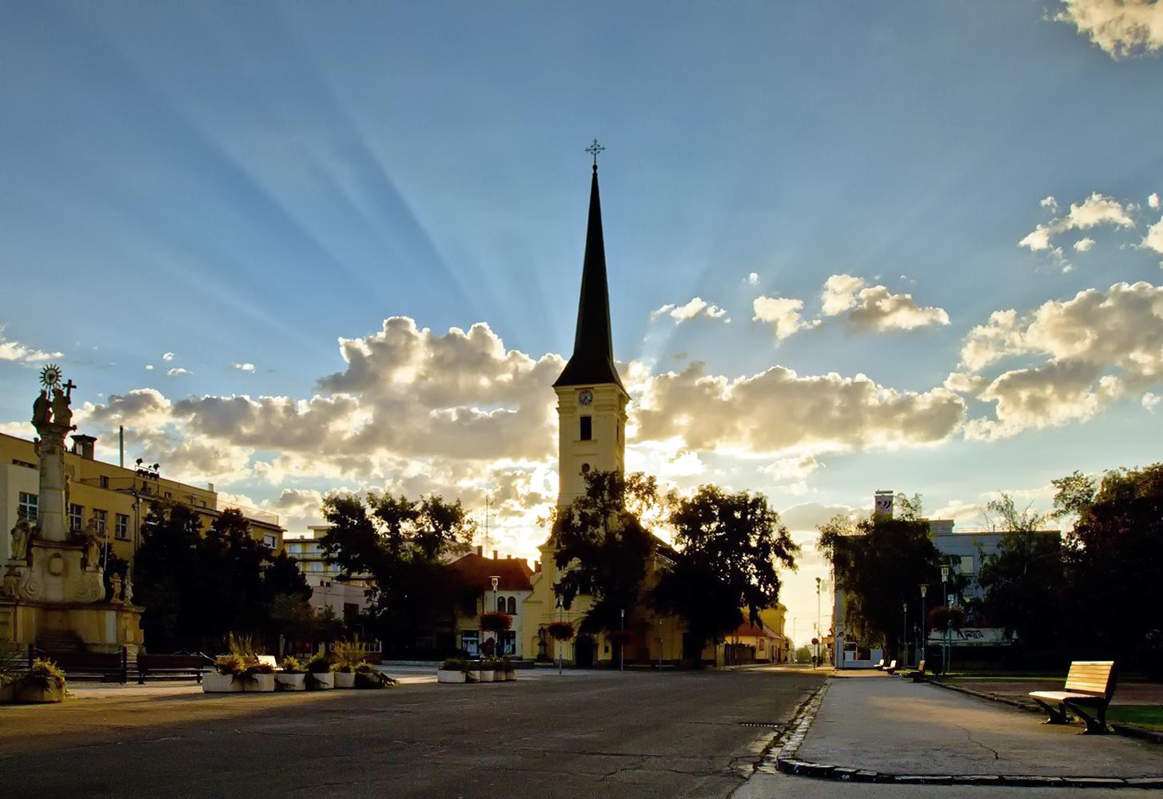
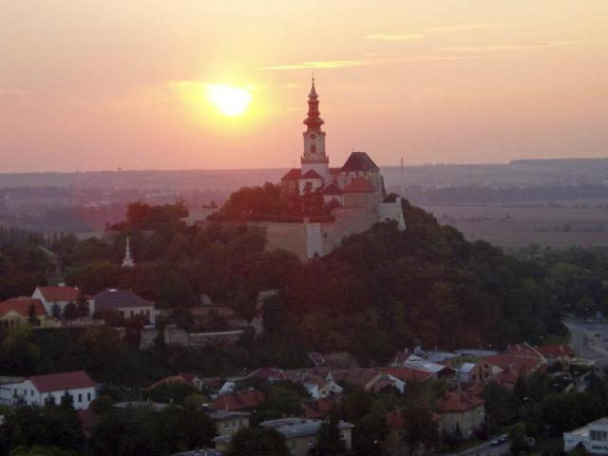
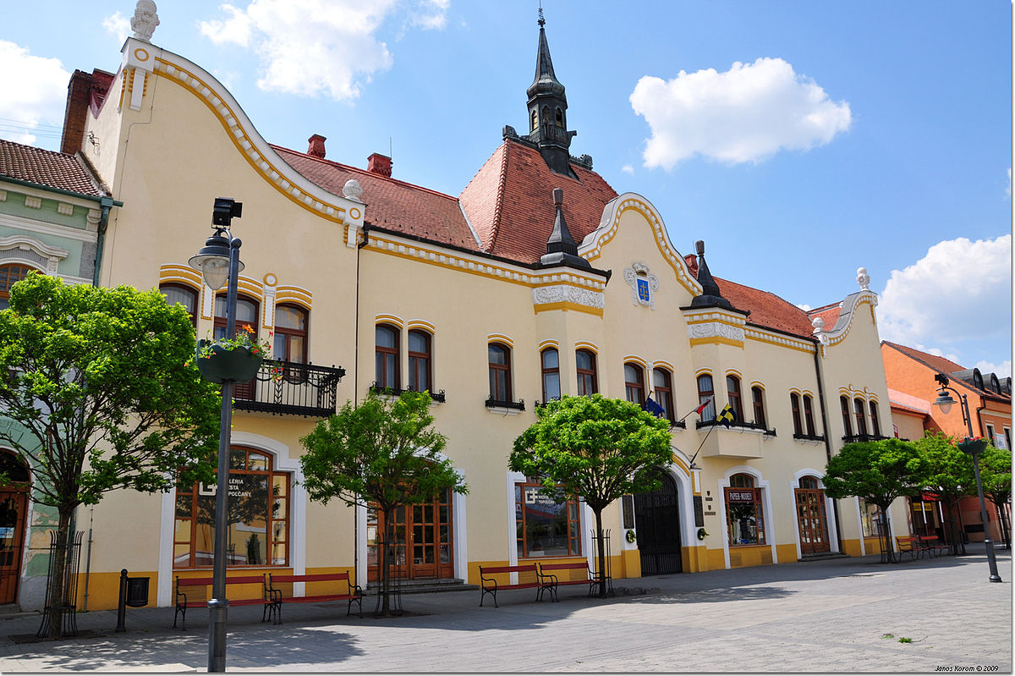
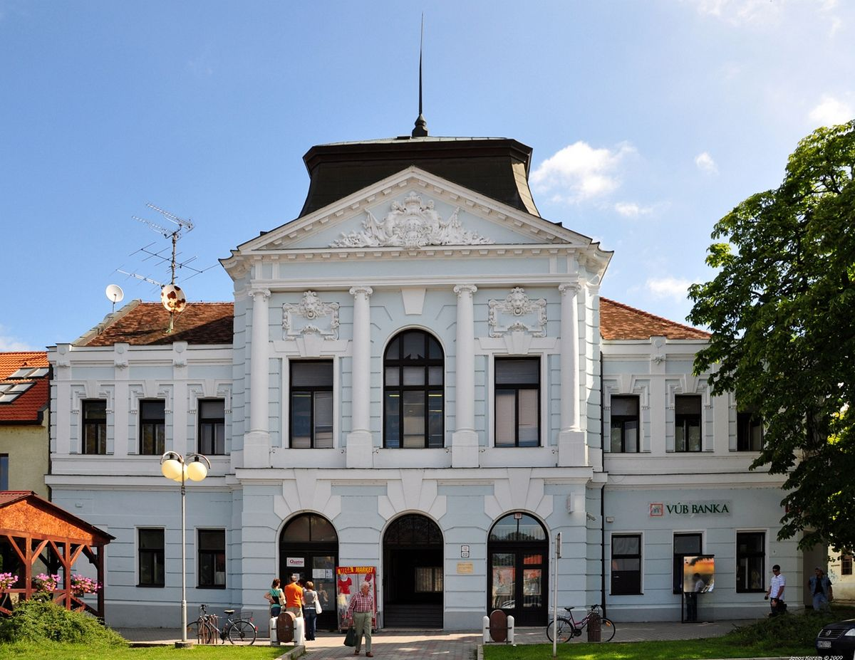
It is divided into 7 districts: Komárno, Levice, Nové Zámky, Šaľa, Nitra, Topoľčany and Zlaté Moravce.

Slide 4
doc. Ing. Milan Belica, PhD. is
Chairman of the Nitra´s region

Slide 5
Thanks for your attention
Presentation of 7 Wonders of Levice district
https://prezi.com/0_xpfarjj9d6/7-wonders-of-levice-district/?utm_campaign=share&utm_medium=copy

