Slide 1
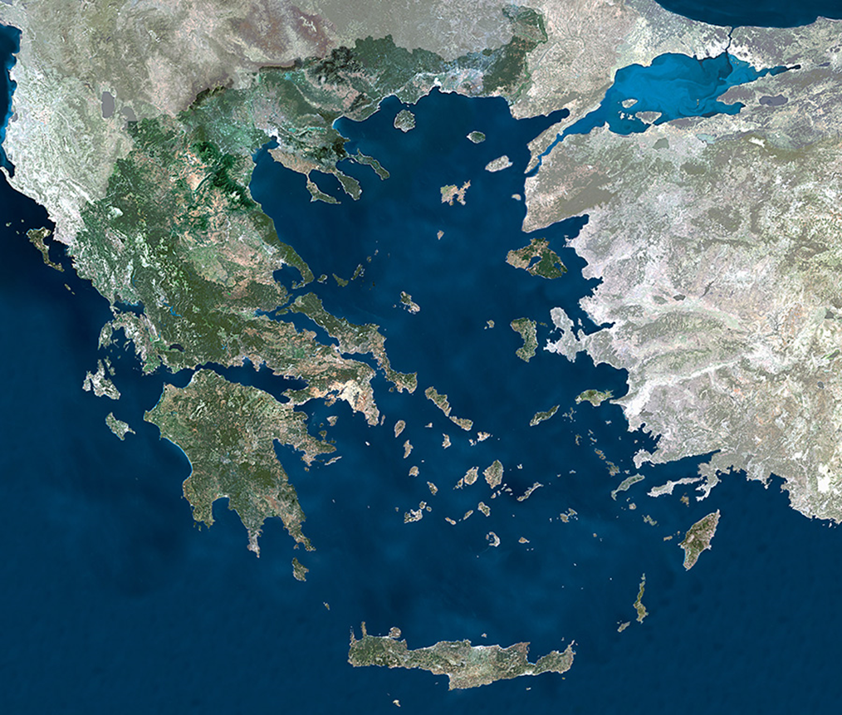
Greece

Slide 2
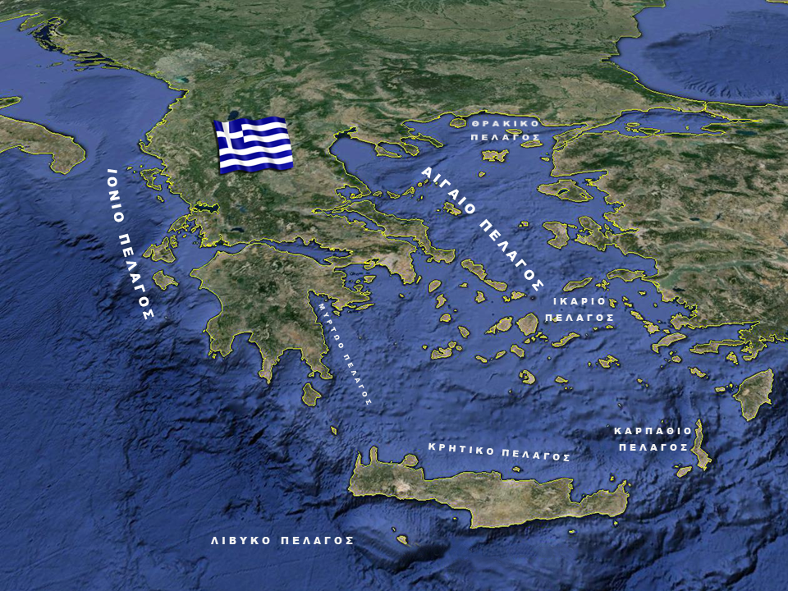
Greece is located in SE Europe and occupies the southern part of the Balkan Peninsula. It is a Balkan country and deep into the waters of the Mediterranean Sea. It is located at the crossroads, between the East and the West. Its islands in the Aegean have been, since ancient times, the bridge, which helped the Greeks to communicate with the peoples of Asia and North Africa and to learn their cultures.

Slide 3
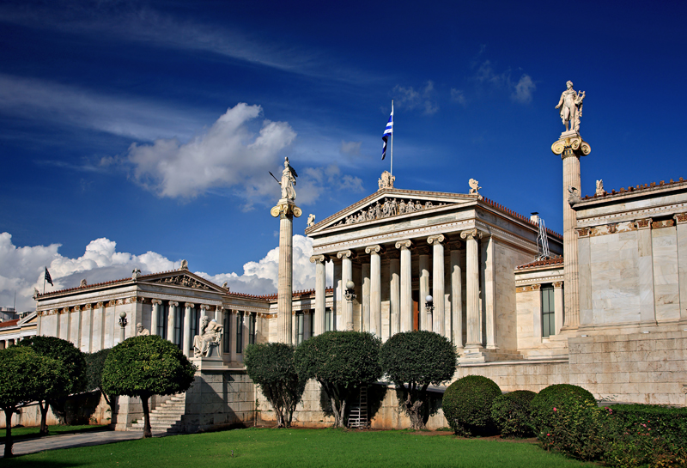
Athens
Athens is the capital and largest city of Greece. It is one of the oldest cities in the world, with its recorded history reaching 3200 BC.

Slide 4
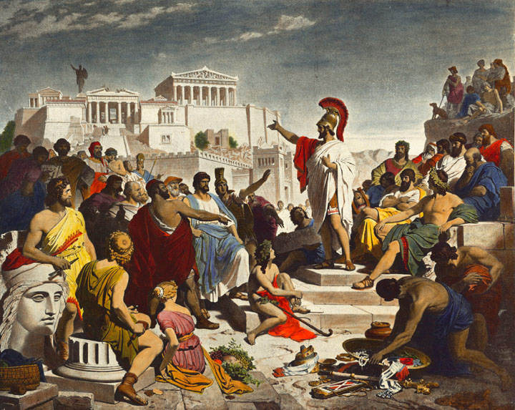
It is the birthplace of democracy that was born in the 5th and 4th centuries BC, at the time of Pericles and is referred to as the cradle of Western civilization

Slide 5
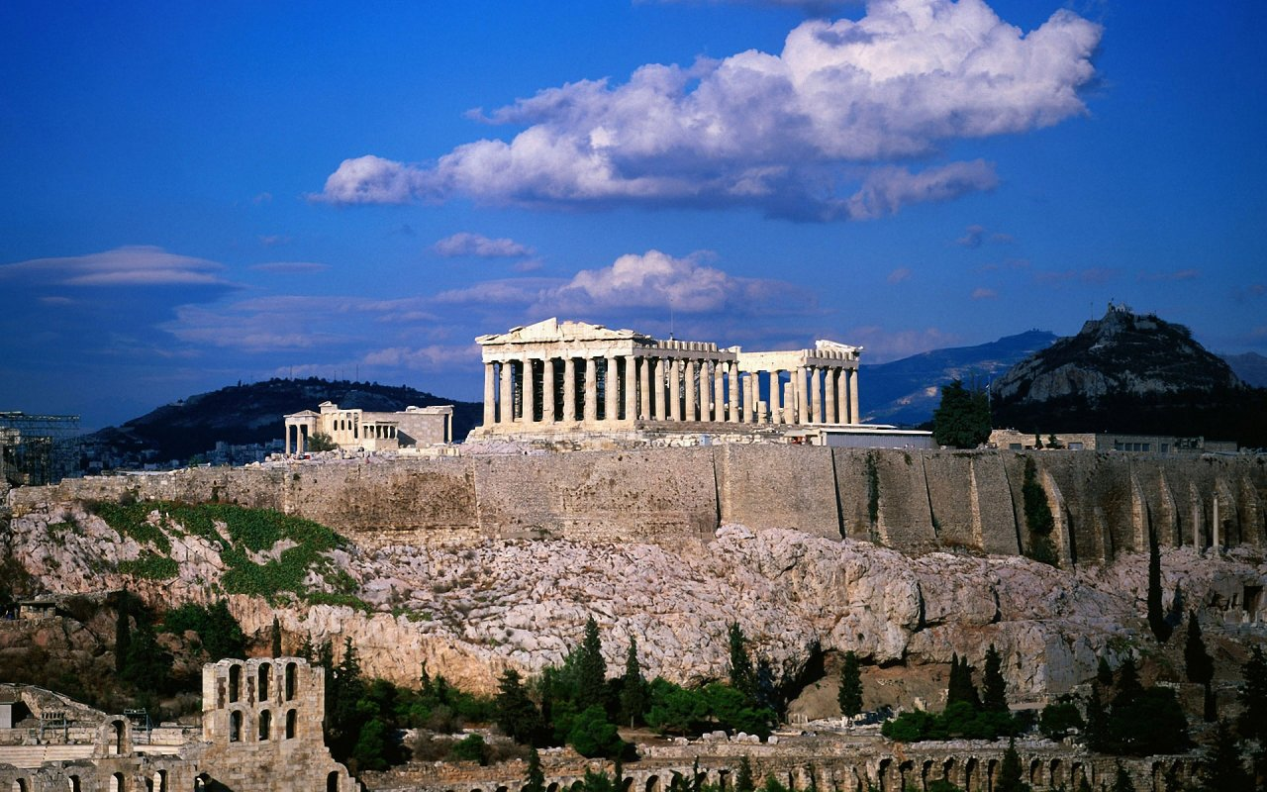
One of the most famous monuments of Athens in the world is the Parthenon. The Parthenon is a temple, built in honor of the goddess Athena, protector of the city of Athens. It was the result of the collaboration of important architects and sculptors in the middle of the 5th century BC.

Slide 6
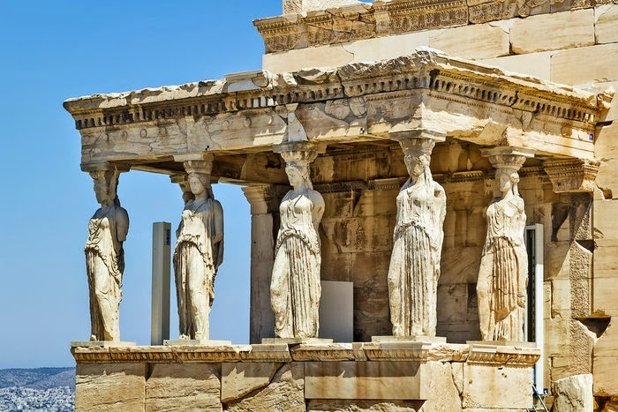
Other temples of Athens are the Erechtheion, an ancient temple on the north side of the Acropolis.

Slide 7
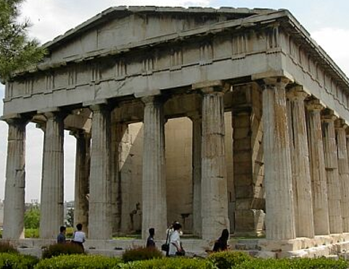
The Temple of Hephaestus is one of the most preserved ancient temples of the Greek space. It was dedicated to God Hephaestus

Slide 8
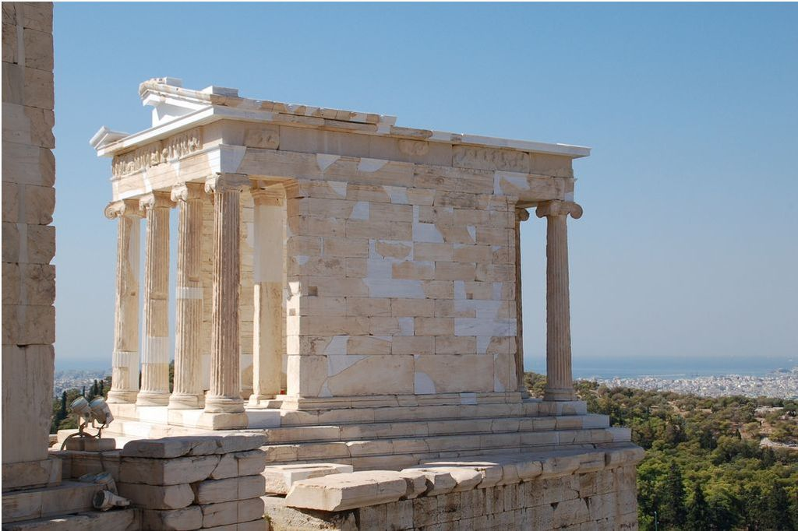
The Temple of Athena Nike is a small Ionic temple on the Acropolis of Athens.

Slide 9
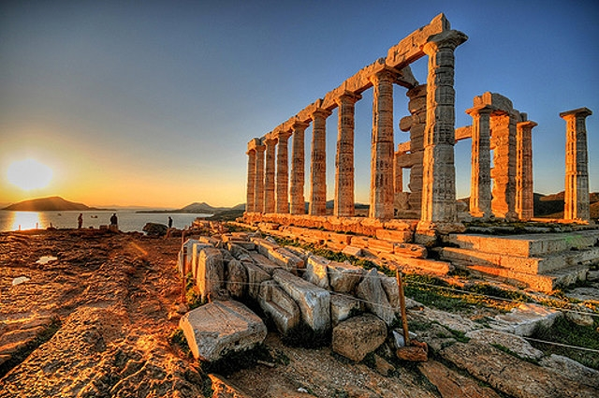
The Temple of Poseidon in Sounio

Slide 10
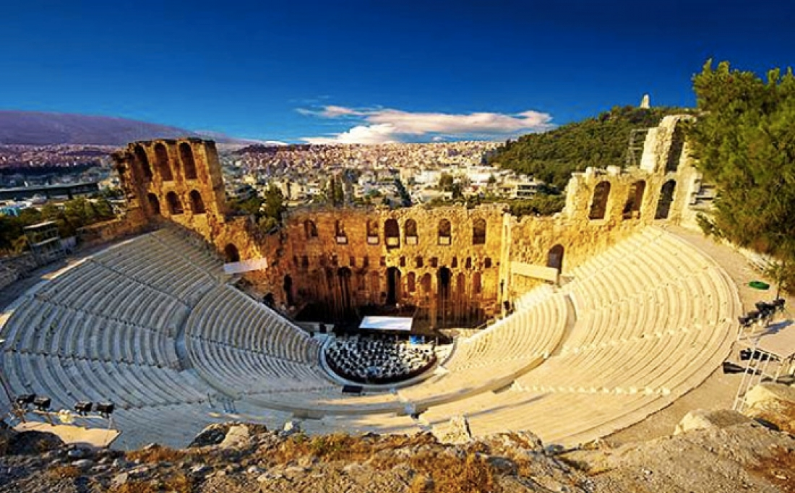
Ancient theaters

Slide 11
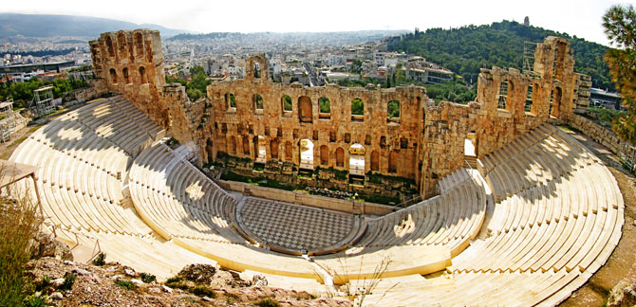
The Odeon of Herodes Atticus is an ancient conservatory of the Roman period, located on the southwest slope of the Acropolis of Athens.

Slide 12
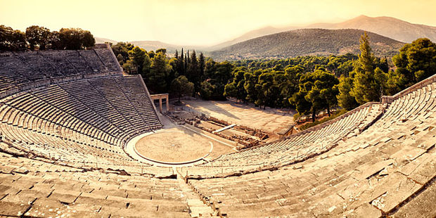
In 340 BC, the ancient architect Polyclitus the Newer built the Epidaurus theater, which is the nicest and best preserved.

Slide 13
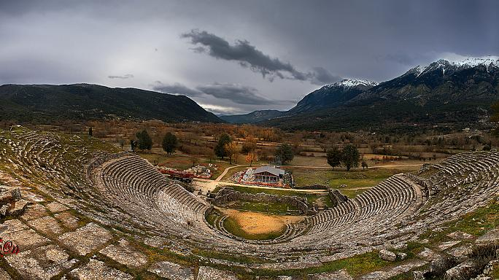
The Ancient Theater of Dodoni was built in the 3rd century BC. on the reign of Pyrros and follows the design of all the Greek theaters.

Slide 14
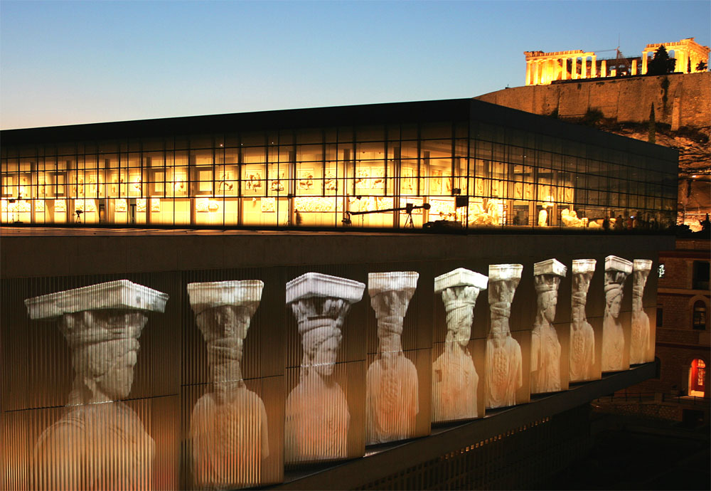
Museums

Slide 15
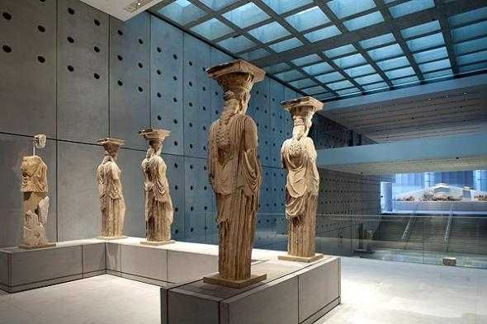
The Acropolis Museum is an archaeological museum centered on the findings of the archaeological site of the Acropolis of Athens. The museum was built to house every object found on the sacred rock of the Acropolis.

Slide 16
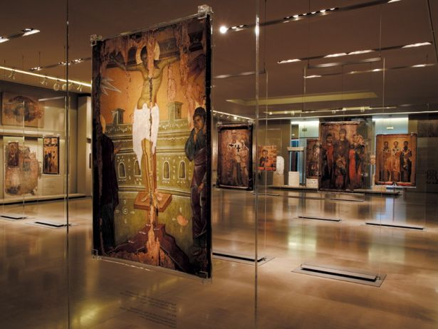
The Byzantine Museum hosts collections of icons, sculptures, frescoes from the Byzantine era.

Slide 17
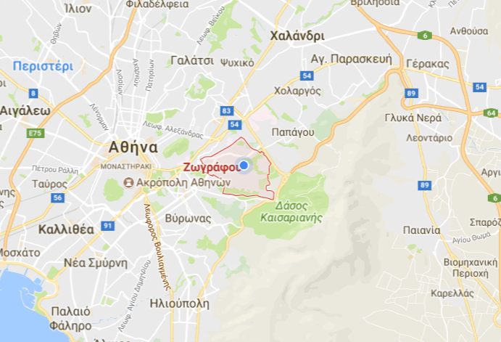
Our Municipality

Slide 18
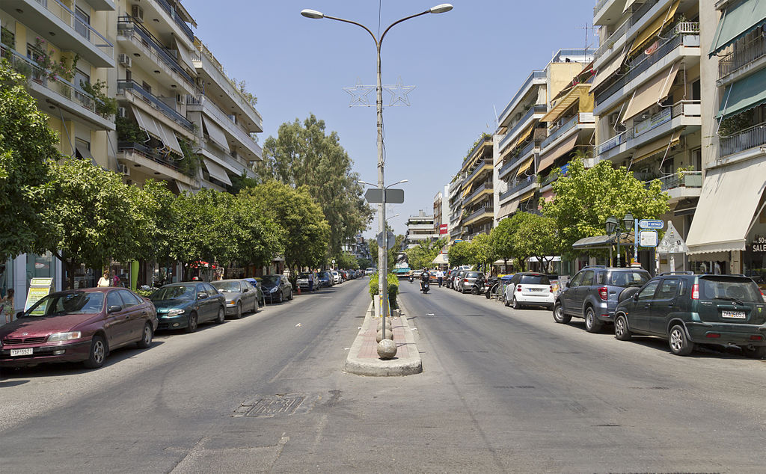
The Municipality of Zografou, with an area of ​​8,517 acres and a population of 71,126 inhabitants, is one of the eastern districts of Athens. It is located 4 km east of the center of Athens, at an altitude of 140 meters, on the northern slopes of Hymettus.

Slide 19
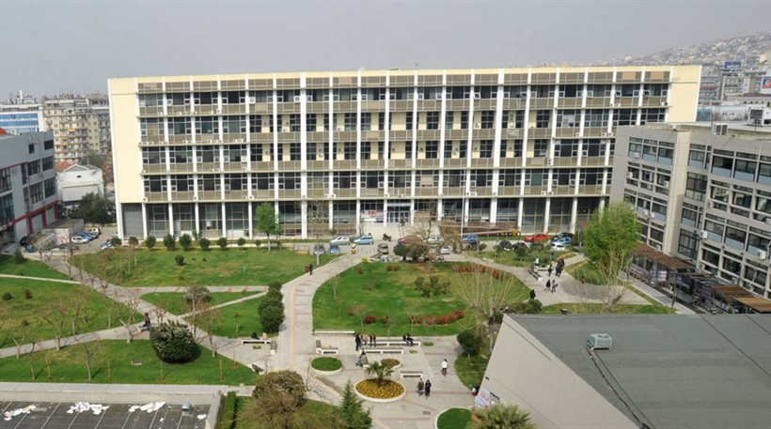
The Zografou campus is the urban complex that includes the building facilities of the National and Kapodistrian University of Athens

Slide 20
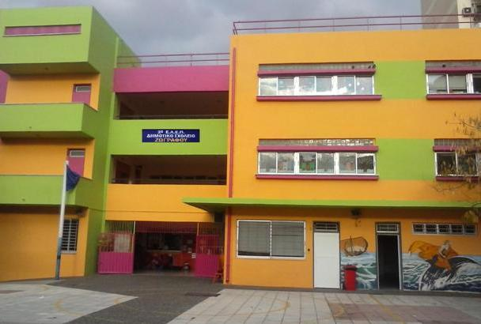
Our school
2nd Primary School of Zografou

Slide 21
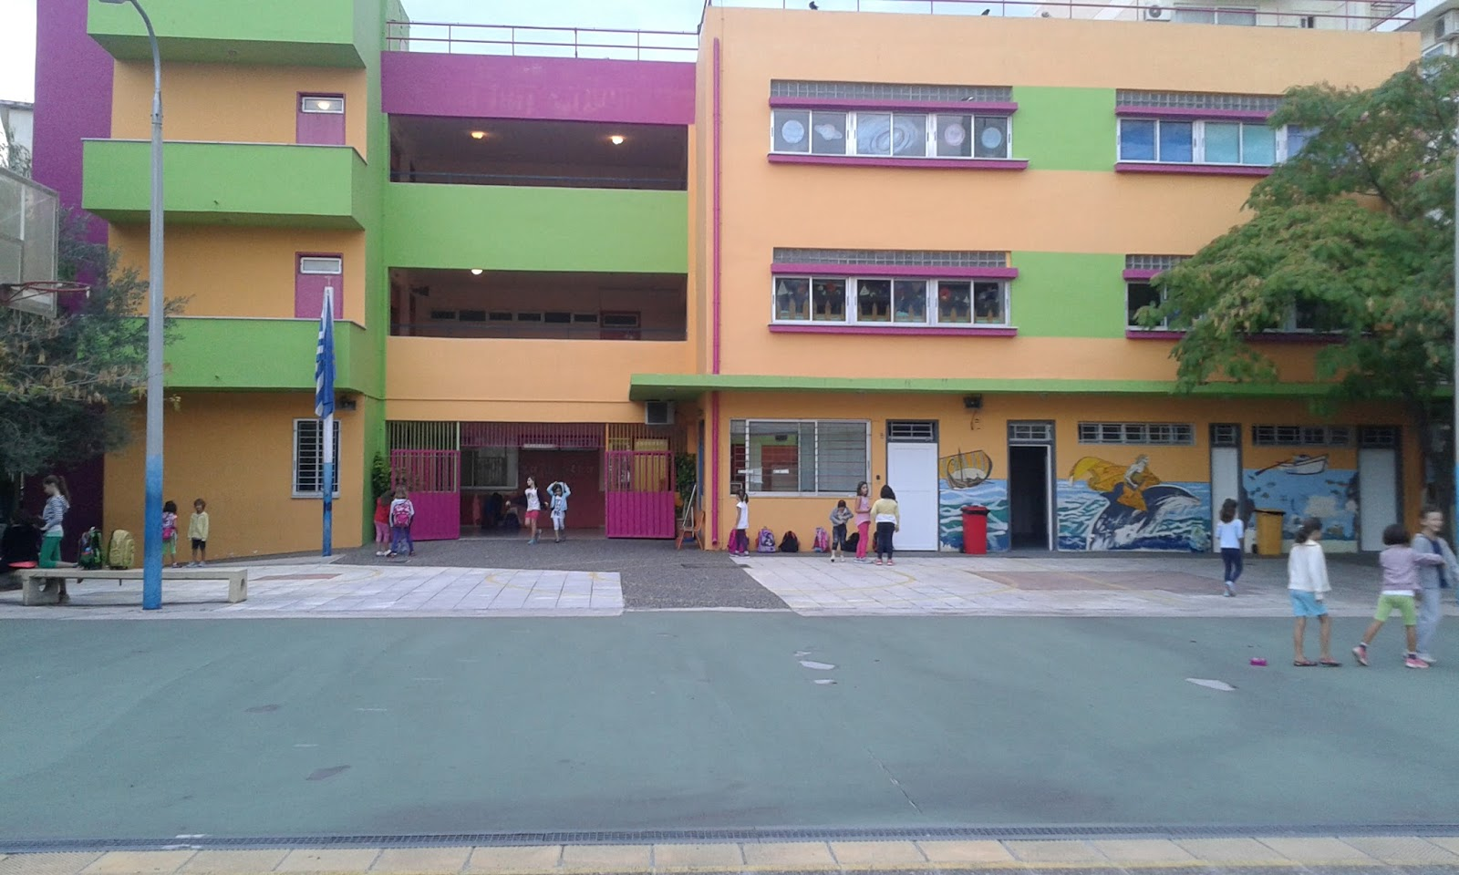
The old building was built in 1930.Our school has a great history. The old building had magnificent architecture, red roof tiles on the roof and was built with white stone. The old school was demolished in 1971 to take its place another. About fifteen years ago, 2nd Zografou changed address. It was moved to a new building, on the 2nd Street of Evonomias Street.

Slide 22
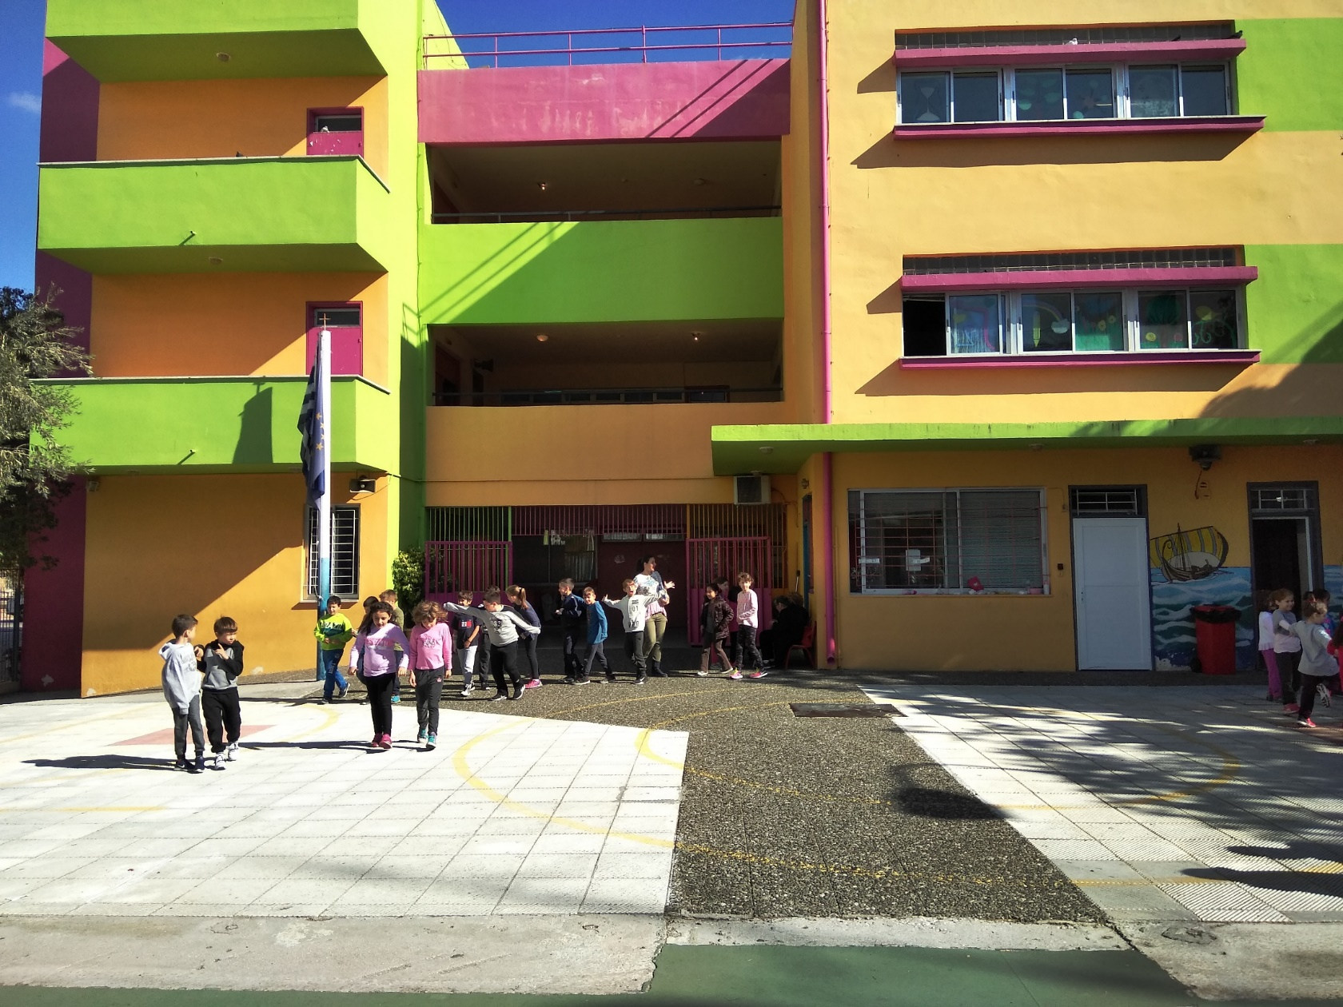
At our school there are 330 students and there is an all day school

Slide 23
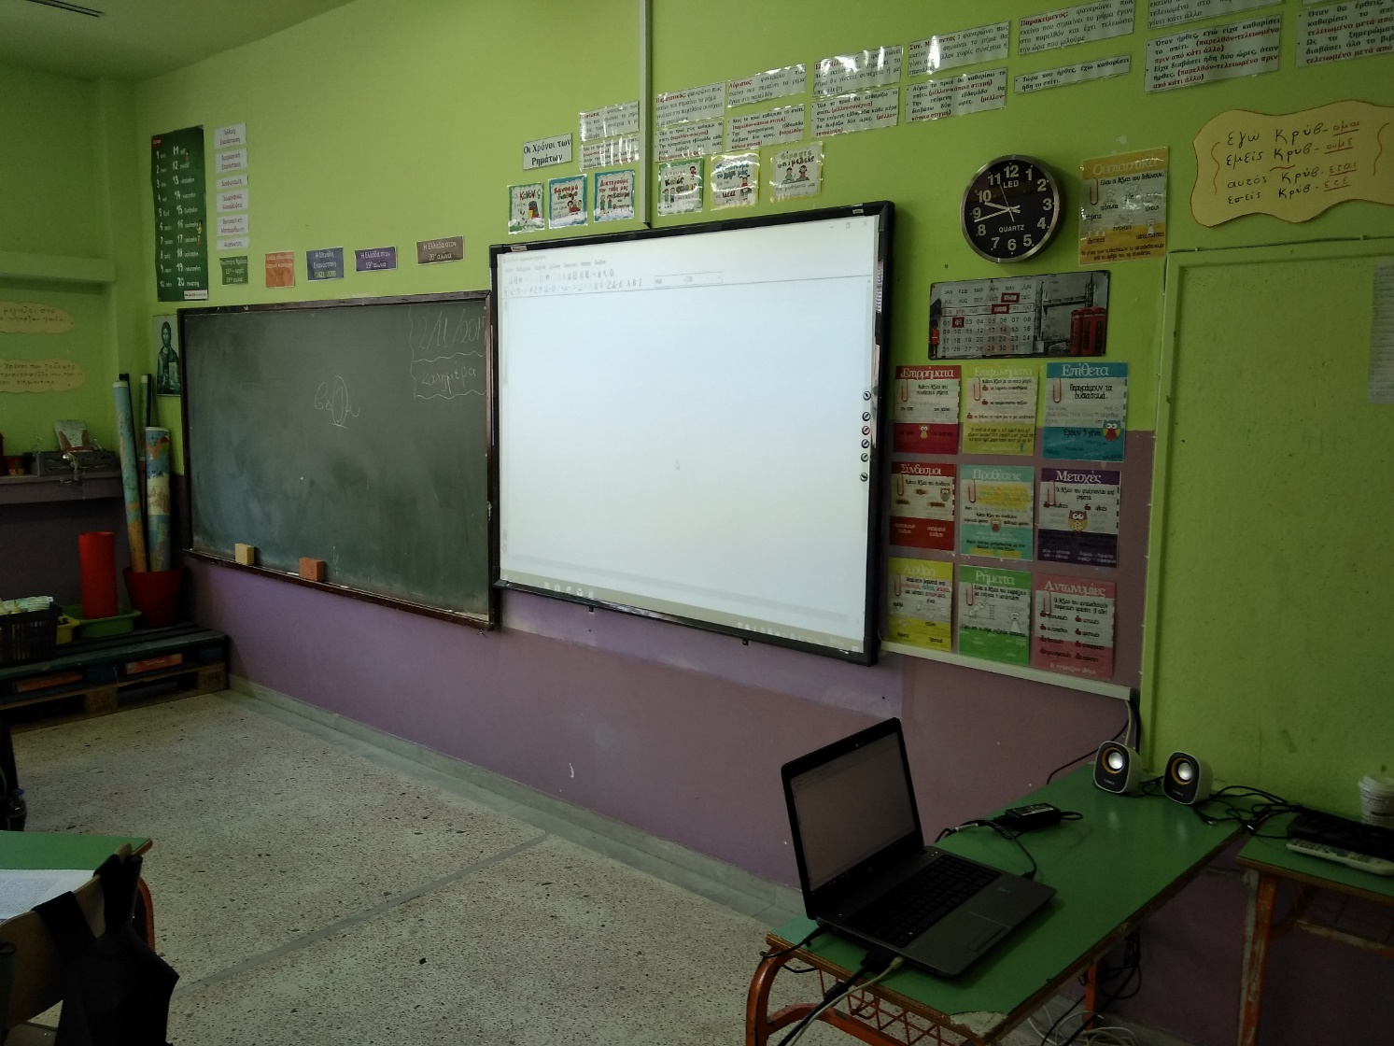
Our school's multi-purpose room is a modern audiovisual room that is used for teaching lessons, but also for organizing events and implementing programs.

Slide 24
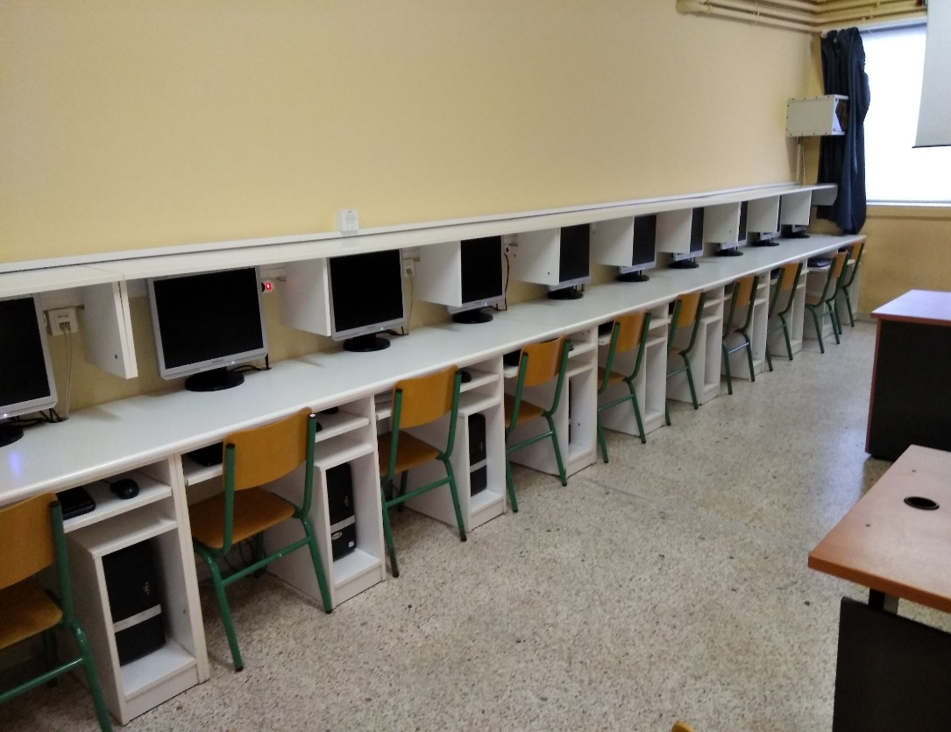
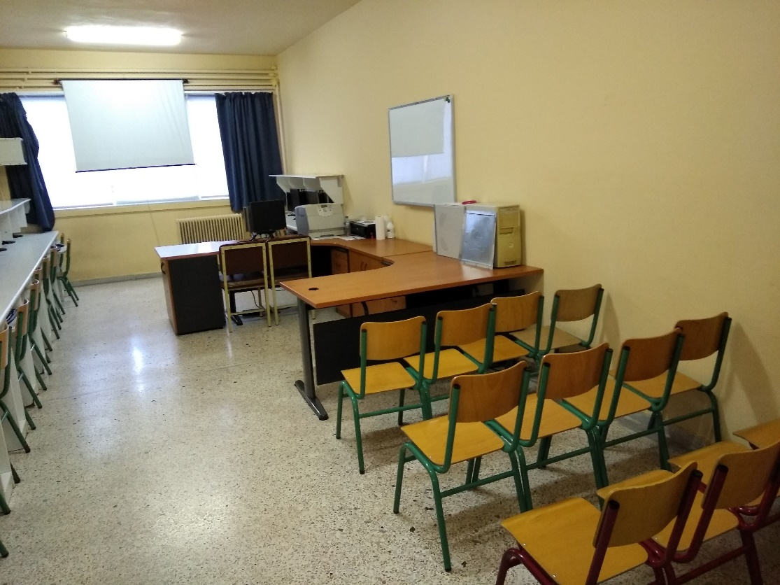
The computer lab of the school is equipped with modern computers, a projector, video and all computers on the internet.

Slide 25
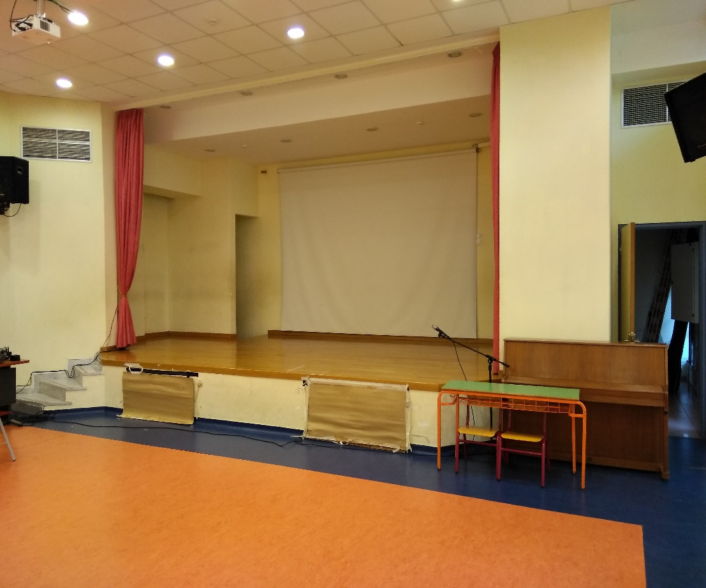
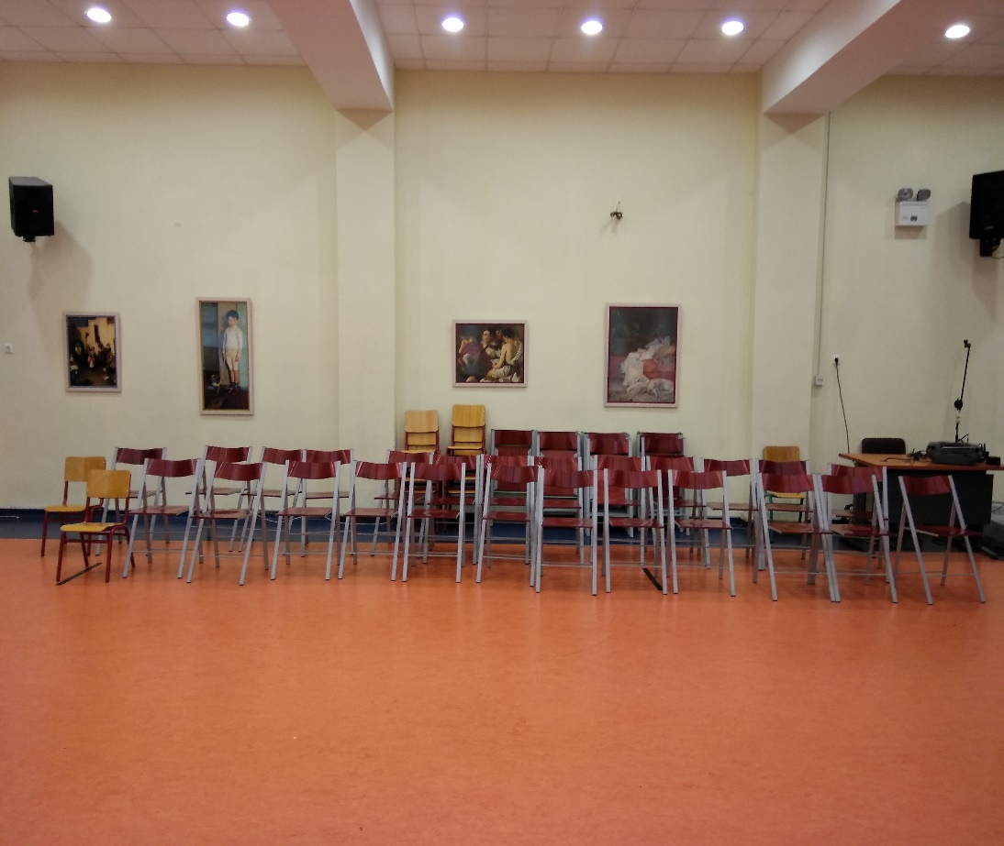
Our school's multi-purpose room is a modern audiovisual room that is used for teaching lessons, but also for organizing events and implementing programs.

