Slide 1
SLOVAKIA
Ema Briediková, Radka Adamcová

Slide 2
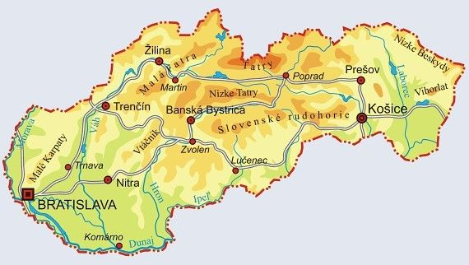
Basic information
Slovakia (Slovak Republic) is a landlock country in the middle of Europe
It’s bordered by Austria, Hungary, Poland, Ukraine and Czech Republic
The area is about 49 036 km²
The population is around 5,4 million
Currency: euro (€)
Hymn: https://www.youtube.com/watch?v=u_Cl5fRPIJc
https://www.youtube.com/watch?v=oBd4HPqMt_w

Slide 3
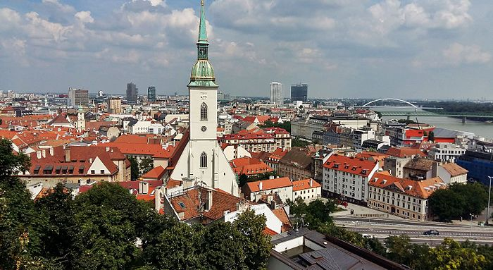
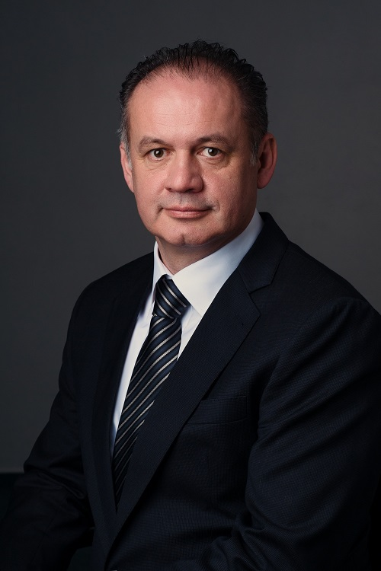
Bratislava- The capital city
Area: 367,6 km²
The population is 421 305
The parliament building and the presidents palace are located here
The president: Andrej Kiska
Landmarks: Saint Martin Cathedral, Bratislava castle, Maximilian's fountain

Slide 4
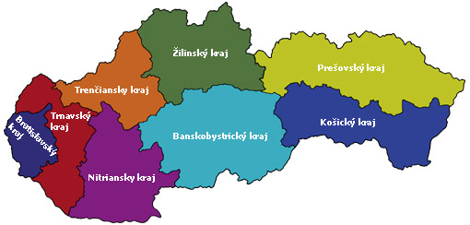
Land
Slovakia is divided into 8 regions
Bratislavský-smallest region
Trenčiansky- lays in the valley of two rivers (Váh and Nitra)
Trnavský- only one region that borders with 3 countries
Nitriansky- rich in termal springs
Žilinský- 4 National parks
Banskobystrický- largest region
Prešovský- second largest region
Košický- UNESCO caves

Slide 5
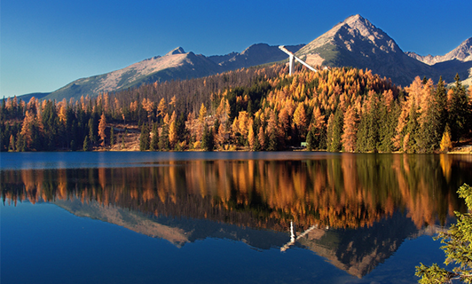
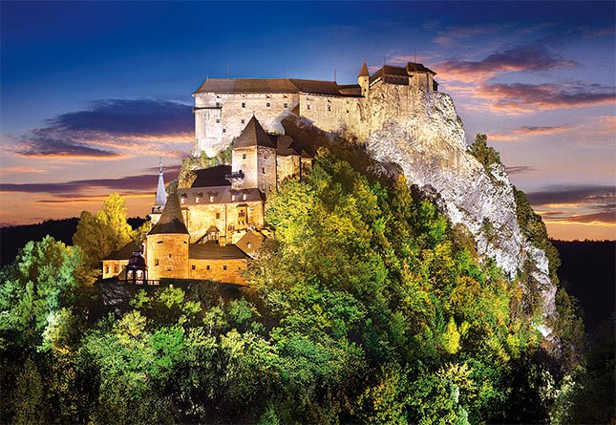
Nature
Mountains: High Tatras (Gerlachovský štít), Low Tatras, Štiavnické vrchy..
Rivers: Dunaj, Váh, Myjava, Hron...
Castles: Bojnice, ruins of Beckov, castle in Bratislava, New and Old castle in Banská Štiavnica, the Castle in Levice and the castle in Orava ..
Caves: Dobšinská ice cave, Demäňovská cave, Driny cave..

Slide 6
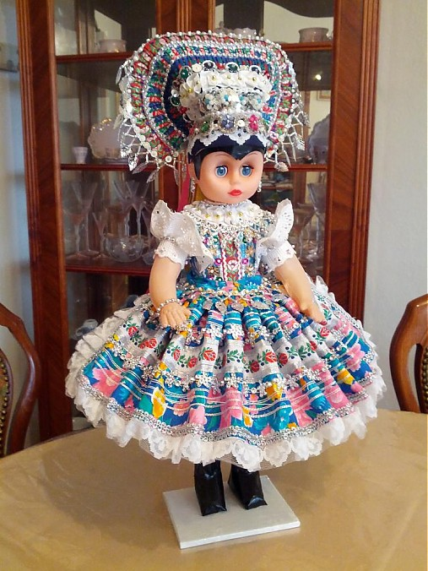
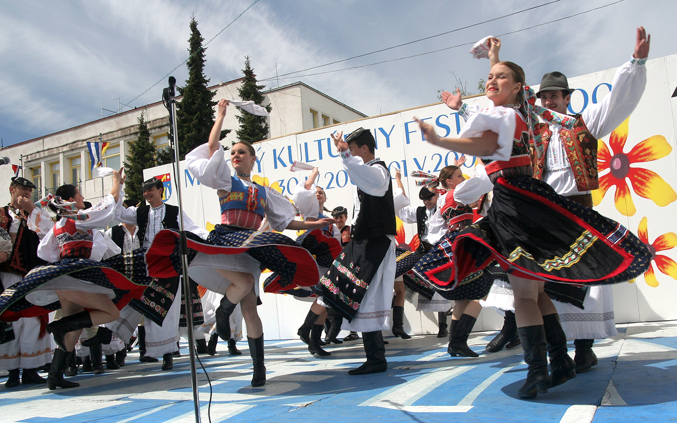
Culture
Rich folklore and folk traditions, each part has its own unique costume
There are many folklore festivals: Myava and Detva
https://www.youtube.com/watch?v=2VXUITOgPhE
https://www.youtube.com/watch?v=b-k-YZHQG_8
https://www.youtube.com/watch?v=8jG7P3NU2aQ

Slide 7
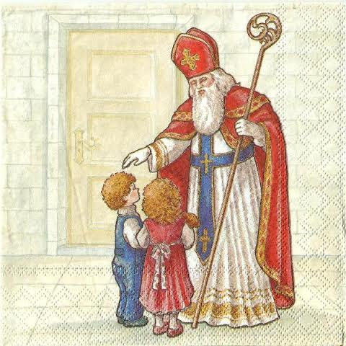
Traditions
Easter- painting eggs for boys, pouring water on girls, gentle whipping with a brich rod
6th December: St. Nikolas puts in boot of good children sweets and the bad kids get onions and coal
Christmas- first meal of our dinner are wafers with honey and garlic we cut open an apple –for good health. Cabbage or pea soup is usually served, followed by fish and potato salad. After dinner we unwrap the gifts under the tree. We finish the night by watching Christmas movies and by singing Christmas carols

Slide 8
Thank you for your attention, hope you are enjoying your stay

Slide 9
http://www.regionzilina.sk/nas-kraj/zakladne-informacie/
http://www.region-bsk.sk/clanok/informacie-o-kraji-126328.aspx
https://www.trnava-vuc.sk/sk/naj-v-kraji
https://www.vucbb.sk/Turista/Zozn%C3%A1mtesaskrajom.aspx
https://web.vucke.sk/sk/
http://www.ssj.sk/sk/mapa-jaskyn
https://slovake.eu/en/intro/slovakia/culture
https://www.tsk.sk/trenciansky-samospravny-kraj.html?page_id=116
https://www.poznajslovensko.sk/regiony-okresy-mesta-obce
http://www.obecsihelne.sk/svaty-mikulas/
https://www.sashe.sk/krojovaneBabiky/detail/babka-v-tekovskom-kroji-1
http://pokec.azet.sk/klub/som-slovak-a-som-nato-hrdy/fotoalbumy/mapa-slovenska/ft-354263088
https://sk.wikipedia.org/wiki/Vlajka_Slovenska
https://sk.wikipedia.org/wiki/Bratislava
http://www.penzion-kamzik.sk/oravsky-hrad-v-celej-svojej-krase
http://pokec.azet.sk/klub/vysoke-tatry

