Slide 1
Public Primary School no 17 of Children’s Friends Radom, POLAND
e-mail psp17@wp.pl
www.psp17.radom.pl

Slide 2
The number of students:
(aged 5-13)
The number of classes:
The number of teachers:
Childrean learn in two buildings.

Slide 3
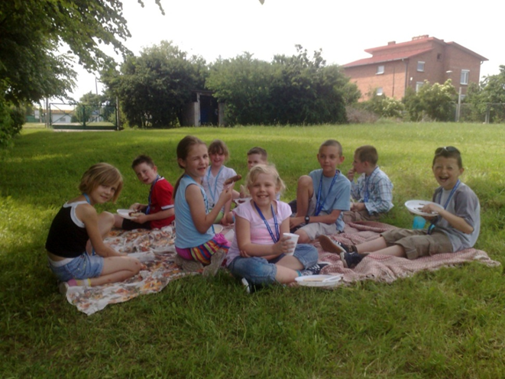
Material Support
The school offers many services for their students.
For those from families of lower status, it offers free meals, textbooks, materials,etc.
School cooperates with
City Center of
Social Assistance.

Slide 4
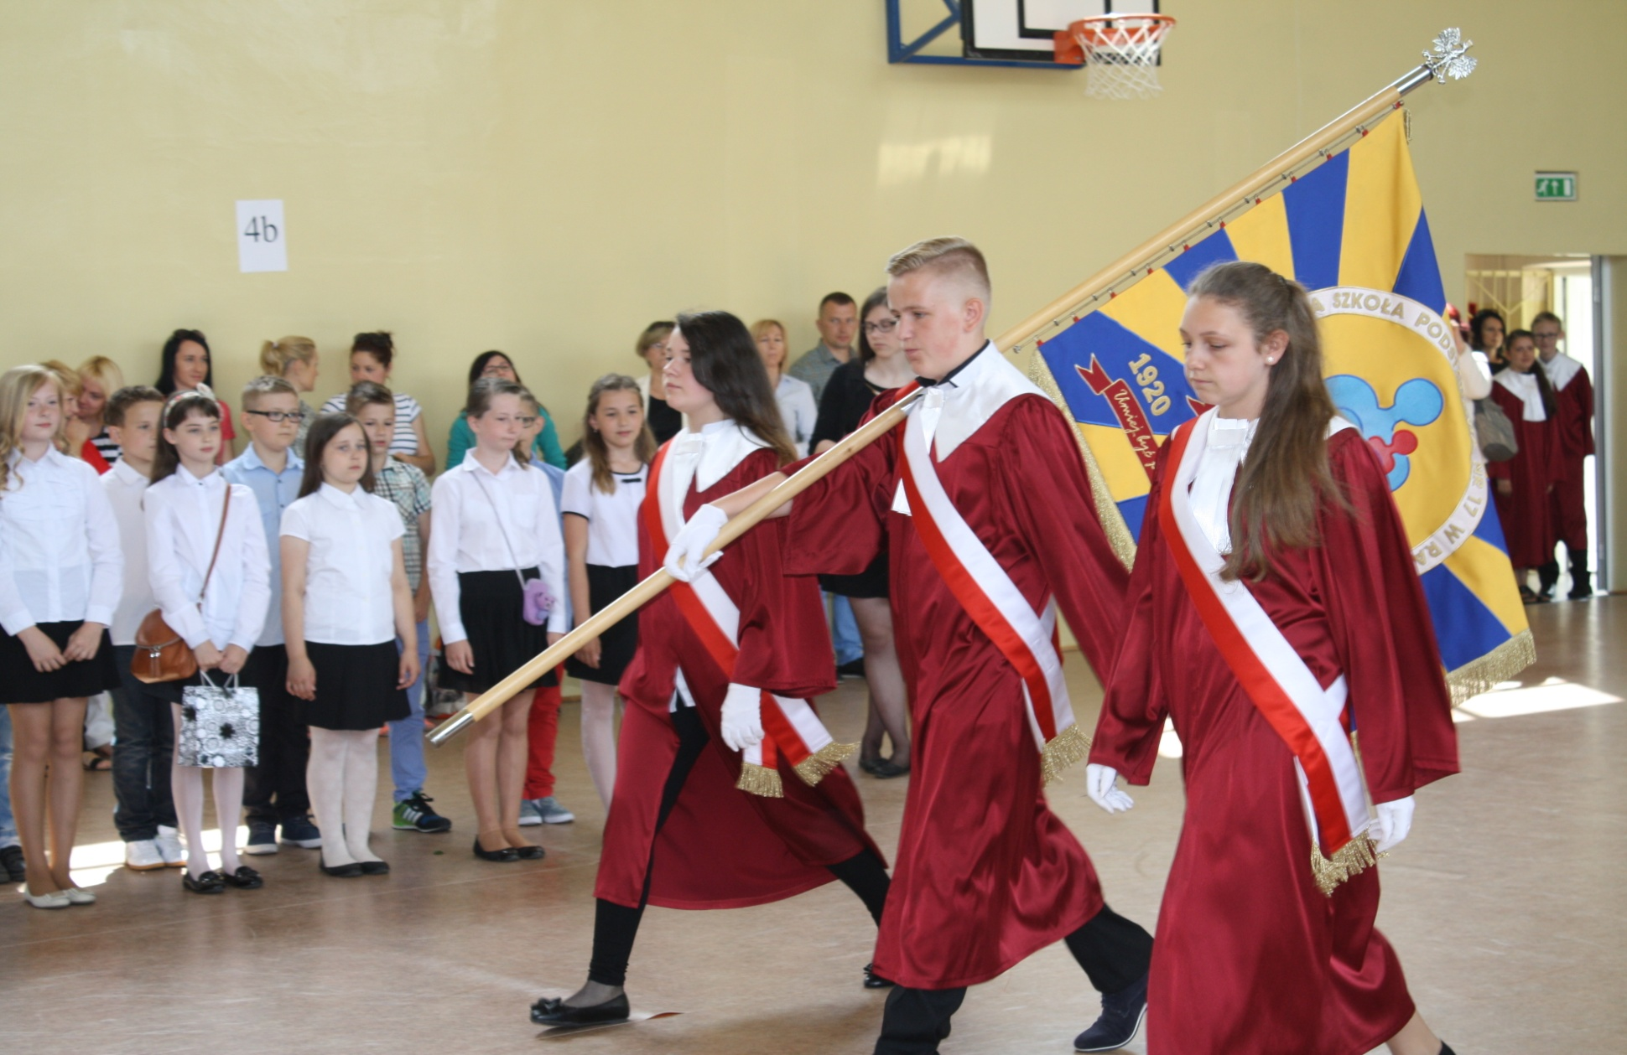
‚
We are school with over 95 years’ tradition

Slide 5
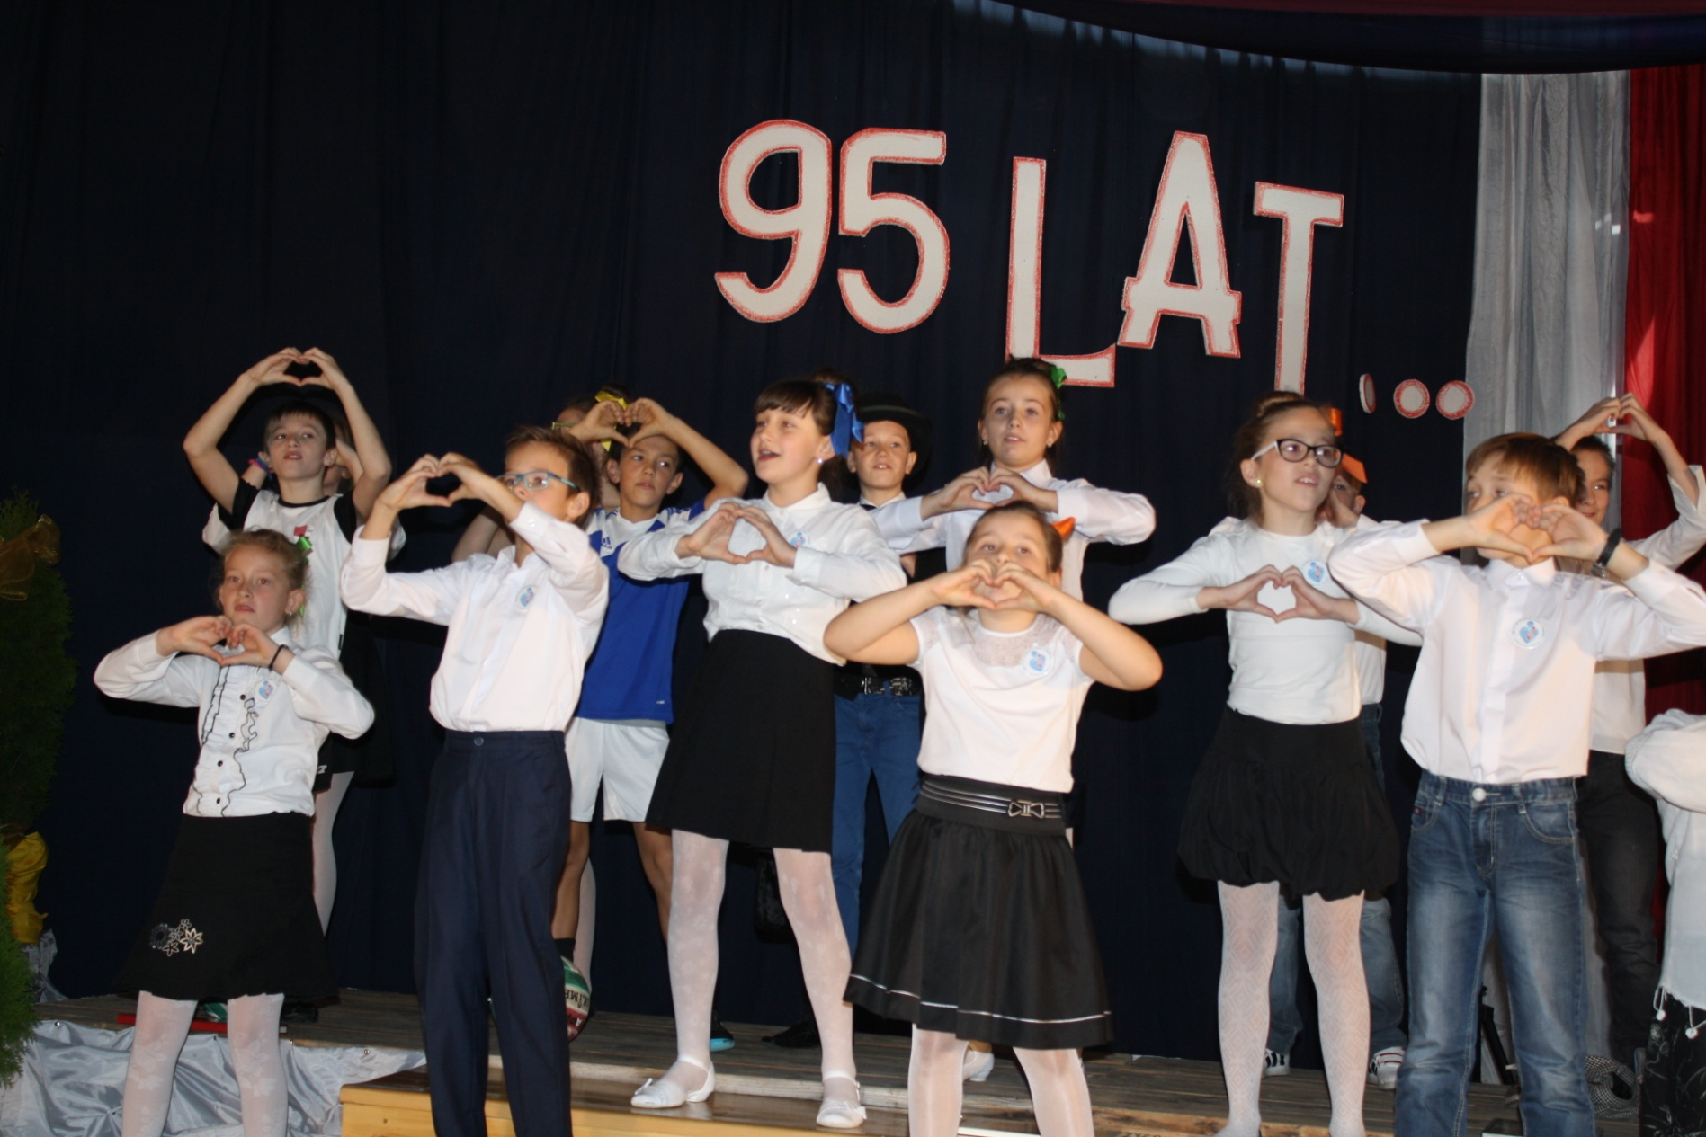
We are a safe school, where every child develops own skills and talents.
Parents are our partners in process of eduction as well as in initiating school projects.

Slide 6
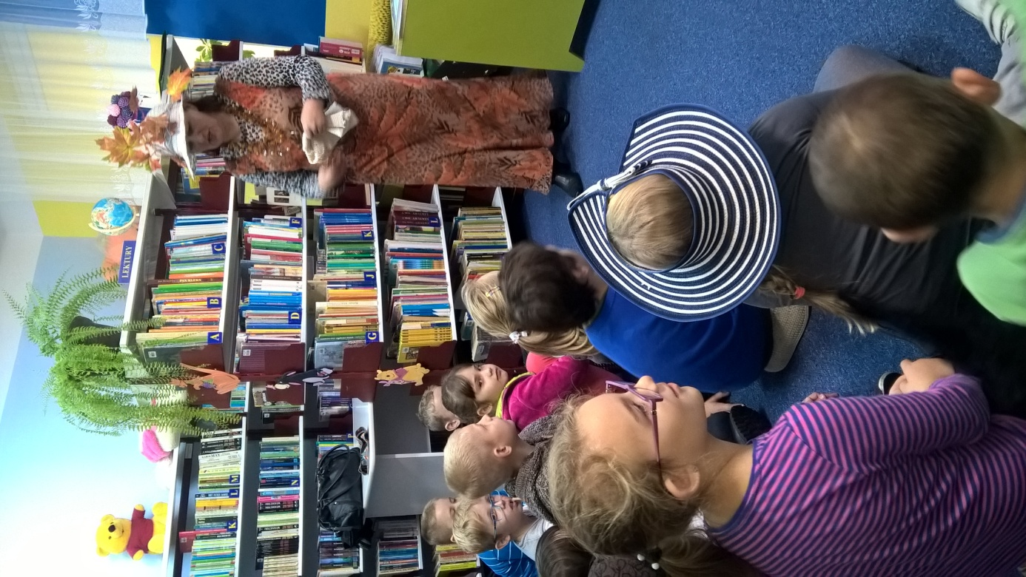
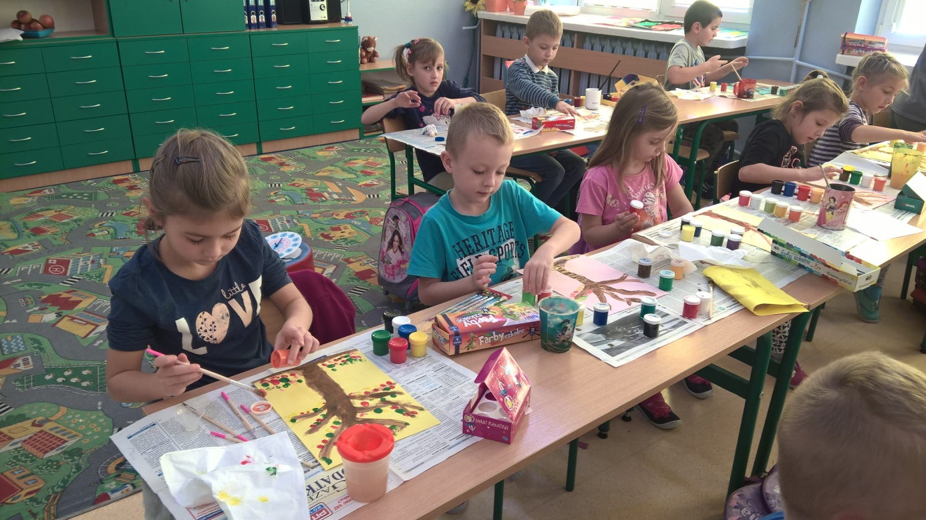
We never get bored!
Our school offer a range of additional activities to develop children’s skills.
It’s open from 6.30 am to 5 pm.

Slide 7
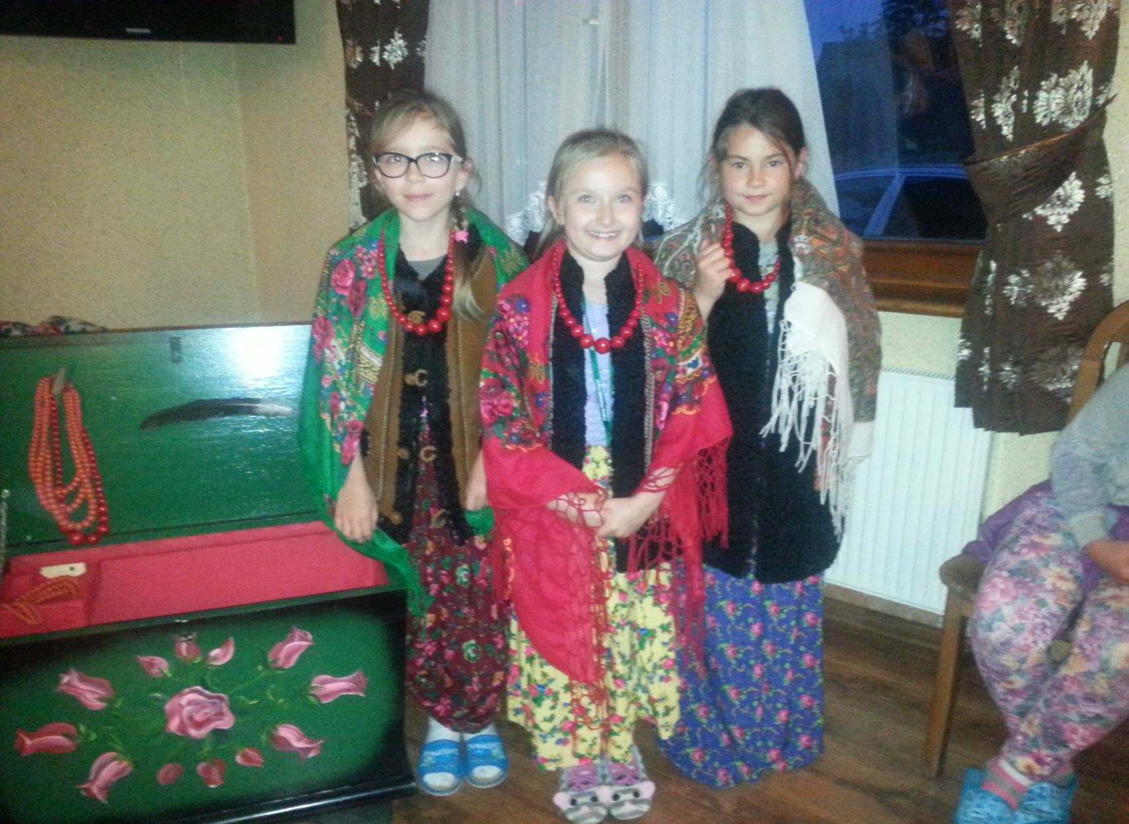
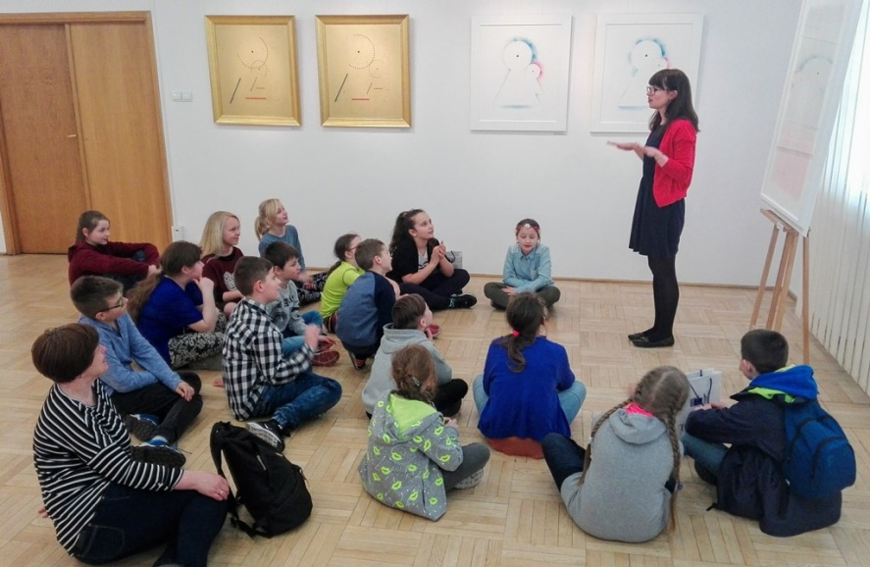
It is very important for us to learn foreign languages, to cooperate in a group and learning ICT
to be self-confident Polish and European but also citizen of the world

Slide 8
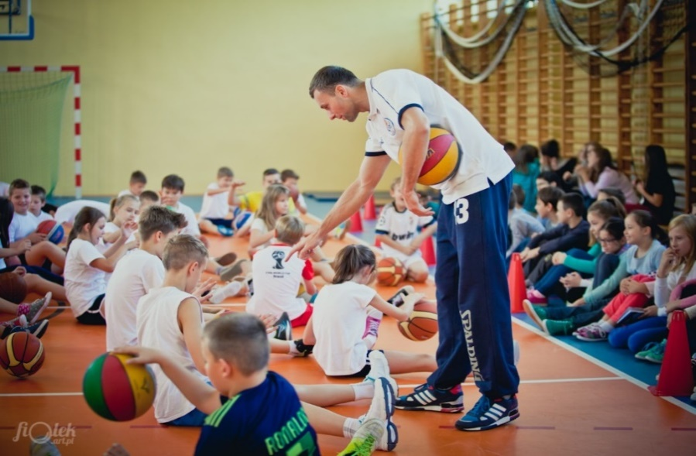
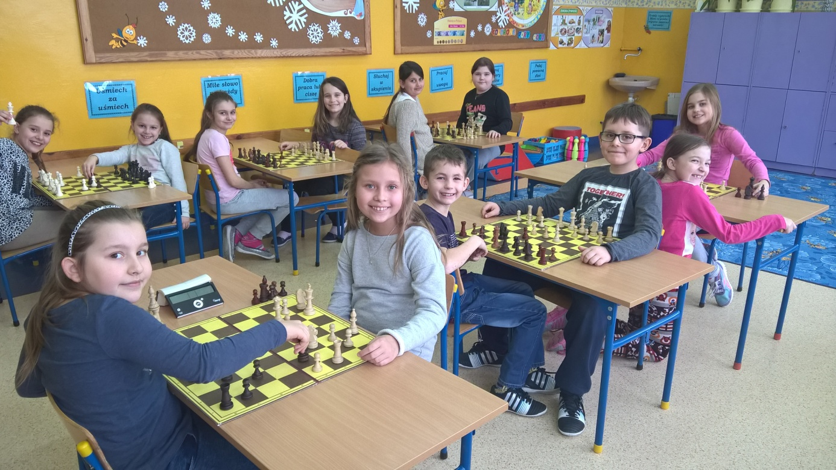
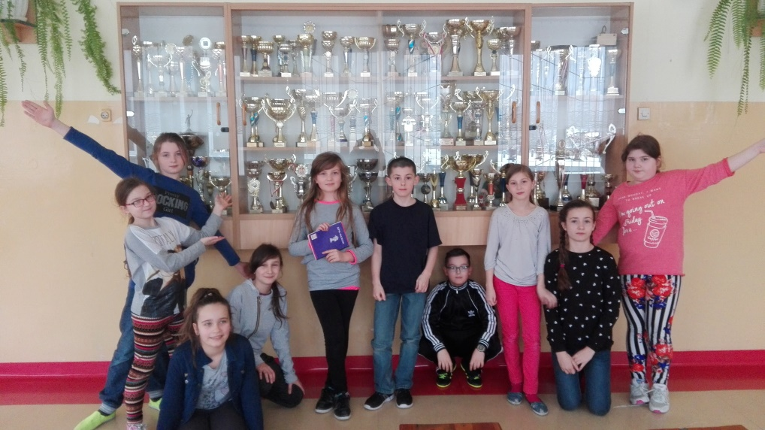
We develop our minds and bodies

Slide 9
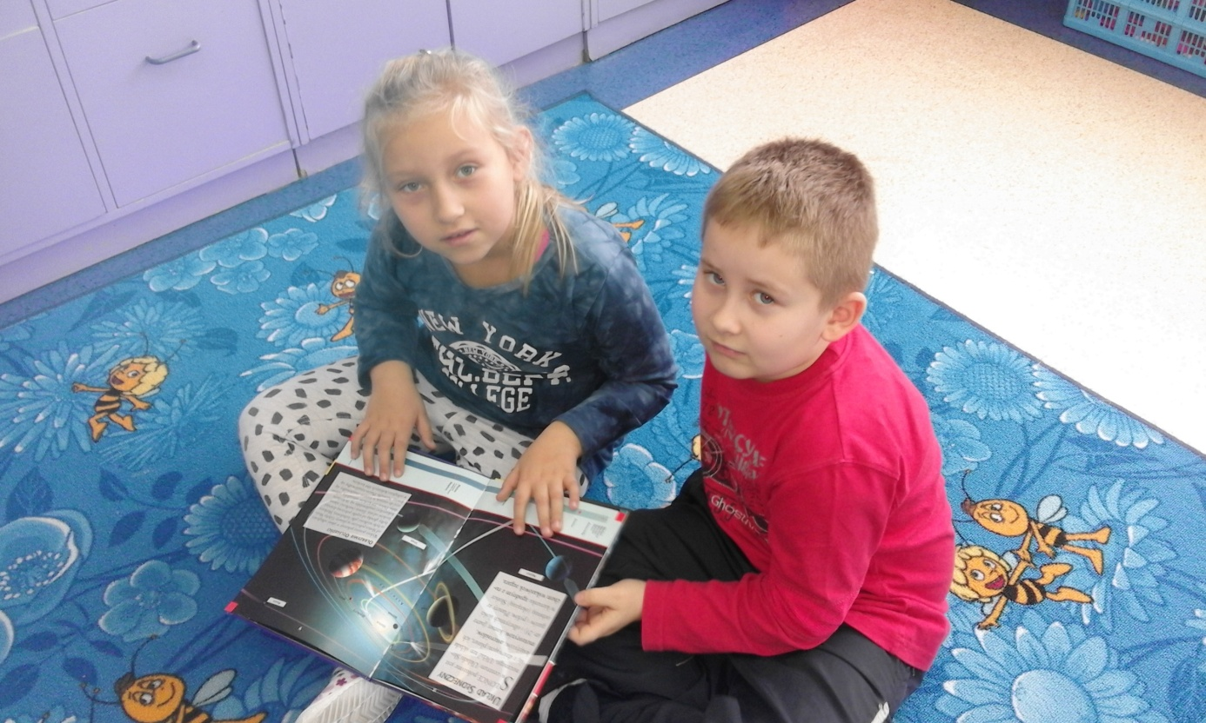
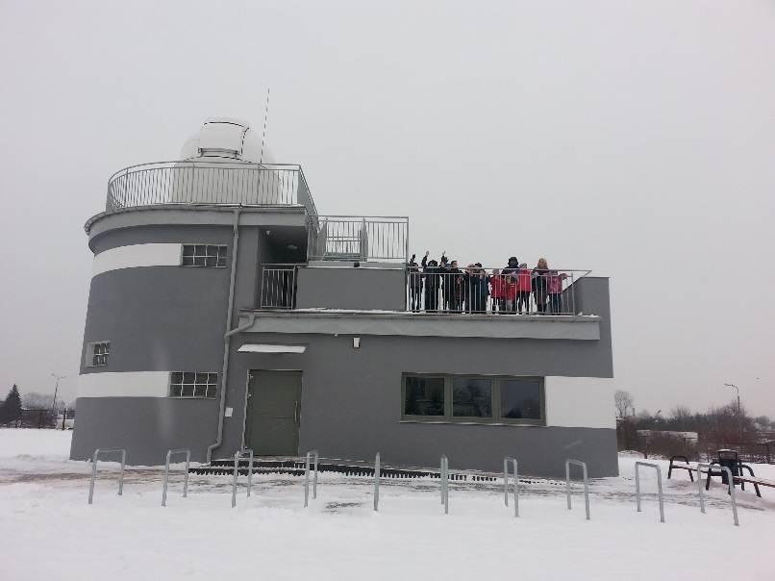
We are close to stars
We can easily reach the stars as we have „Astrobase”- an astronomical center

Slide 10
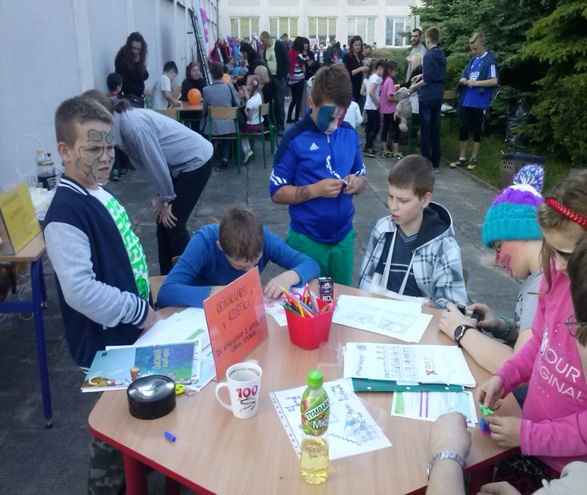
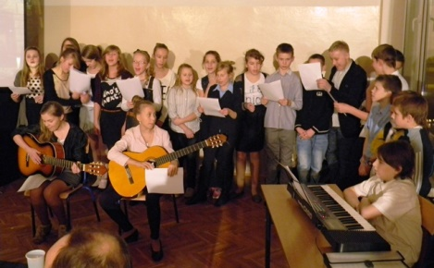
School Actions
Collecting recycling materials
Supporting animal shelter
Family Day
Day of the Earth
European Days
and much moore

Slide 11
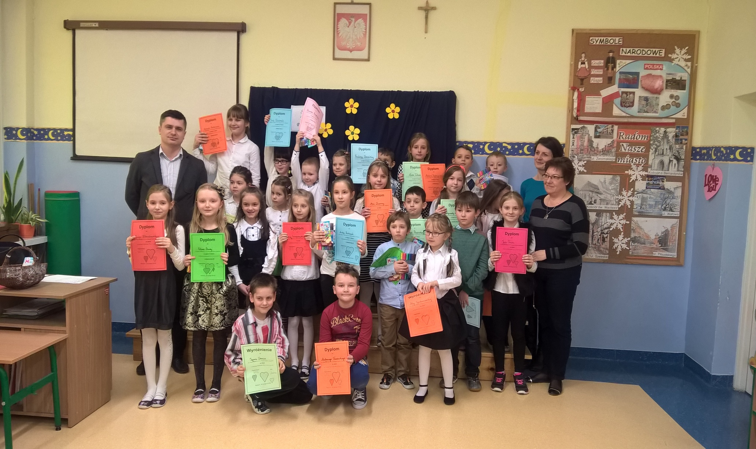
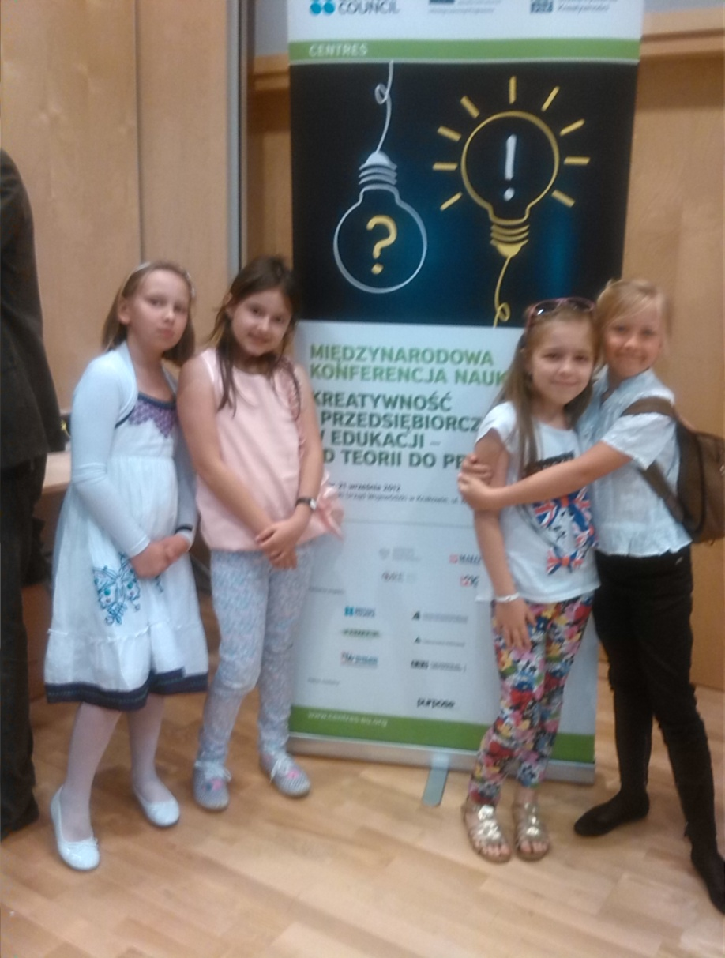
We organise a lot of competitions

Slide 12
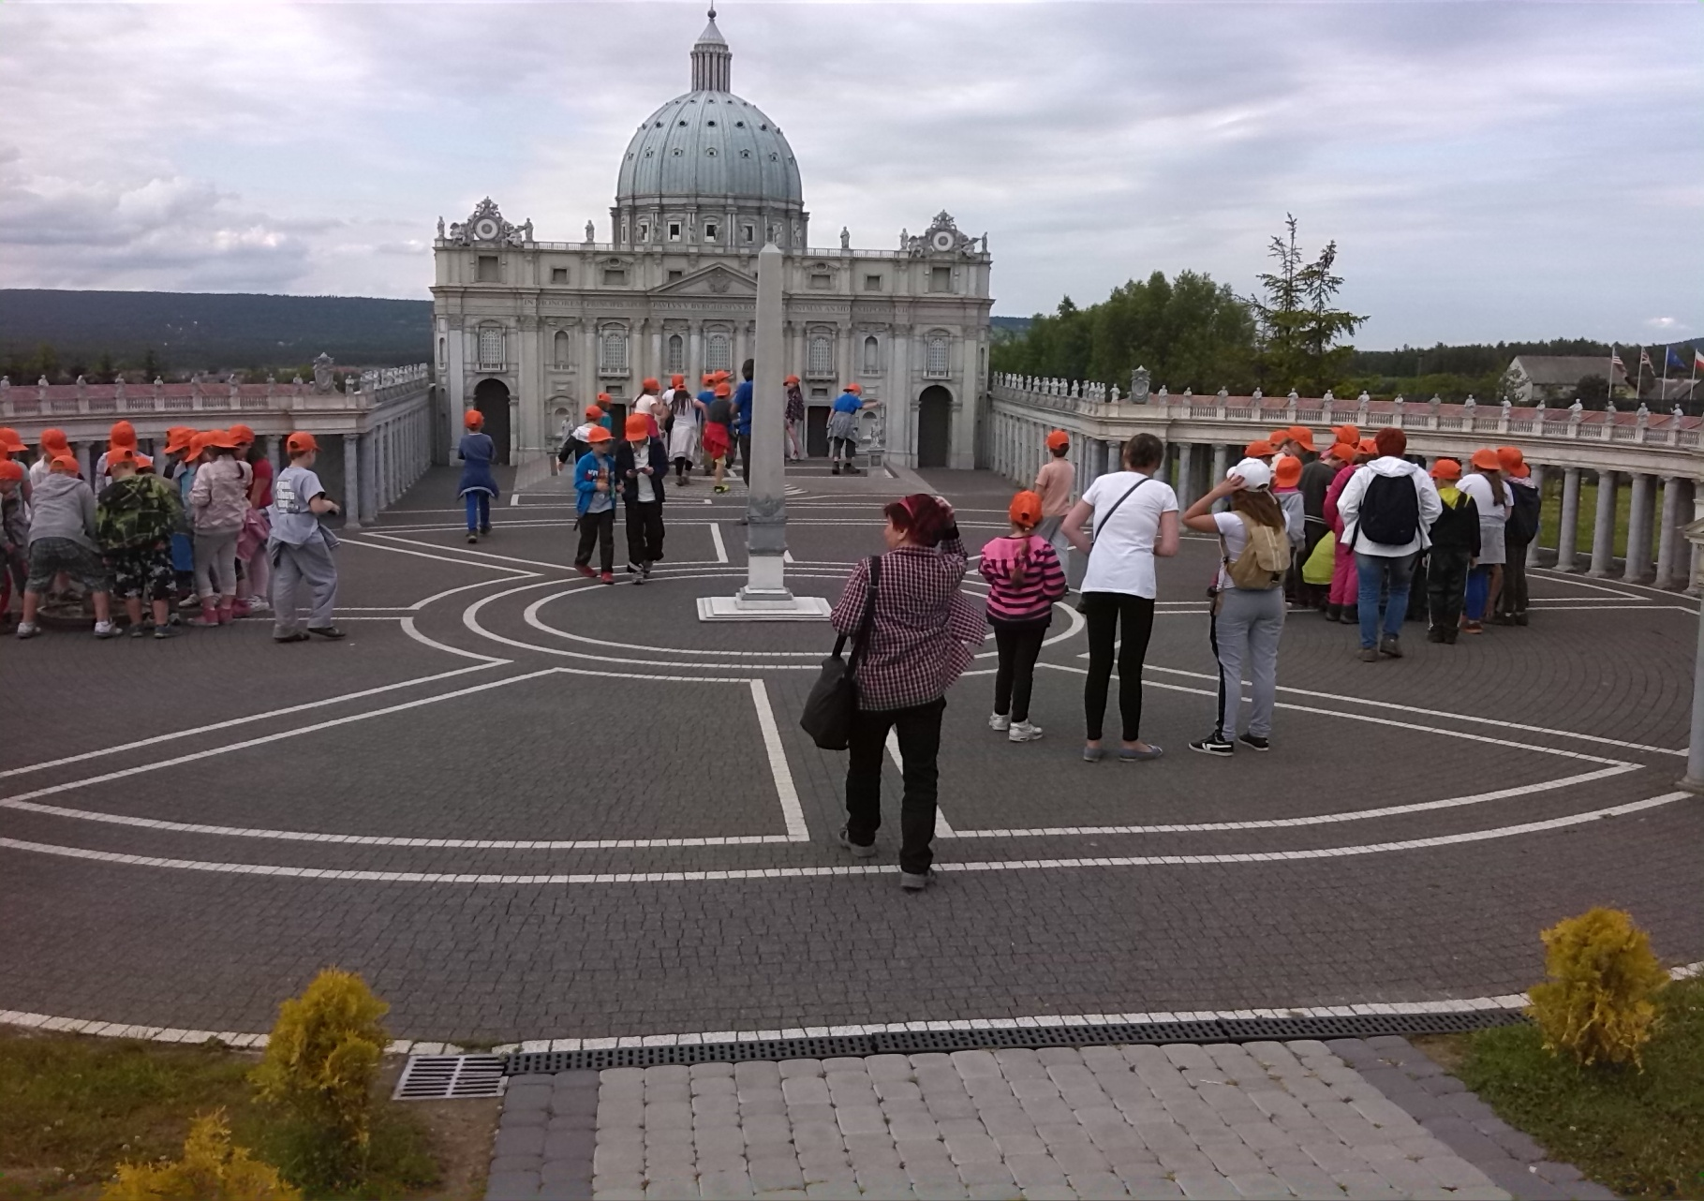
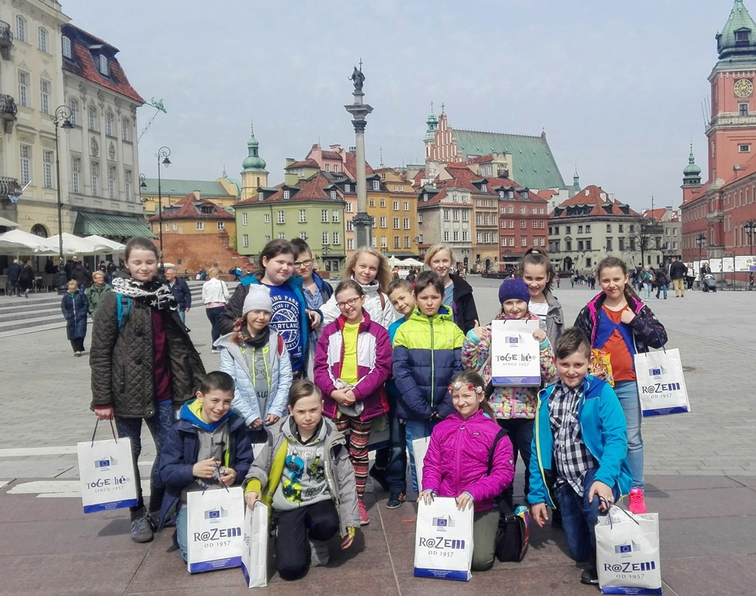
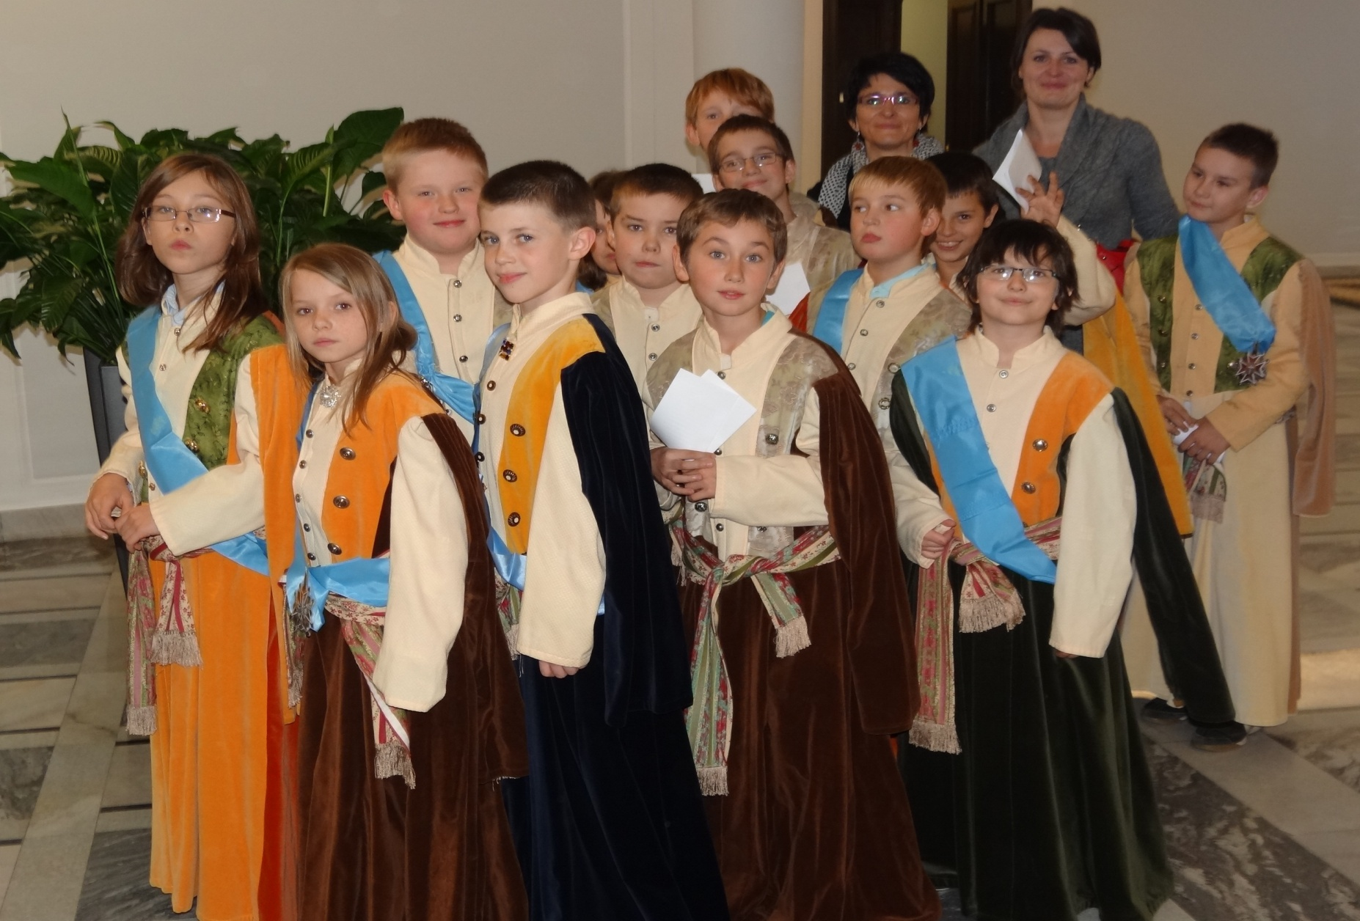
School Trips

Slide 13
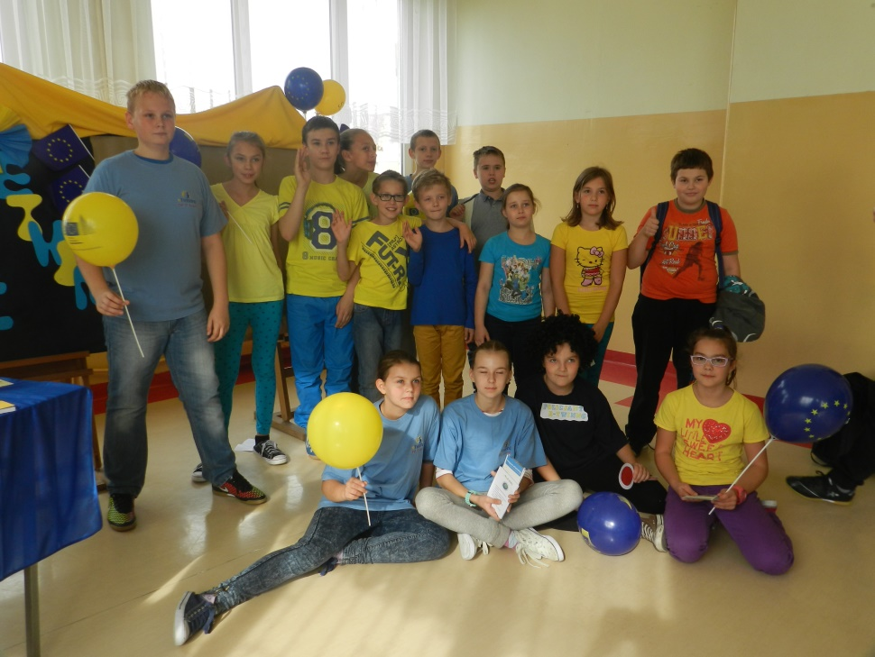
WE ARE LOOKING FORWARD TO MEET YOU ALL IN OUR SCHOOL!
THANK YOU FOR ATTENTION ☺

