Slide 1
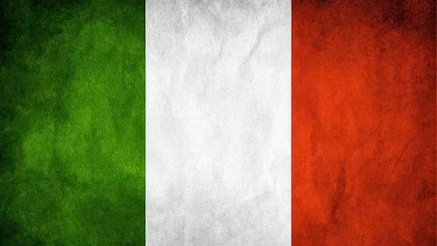
By:Juliana,Gabriel,Jose and Alejandra

Slide 2
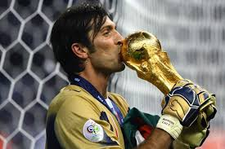
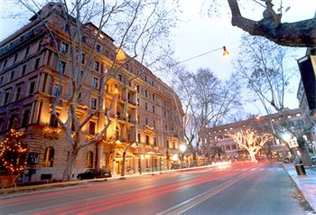
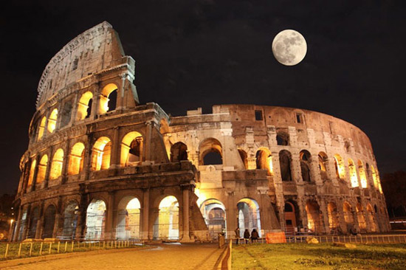
City
The most famous football player is Buffon
The most famous street in italy is Via Vento
The most famous monument are the Colosseum and San Peter basilica in Rome

Slide 3
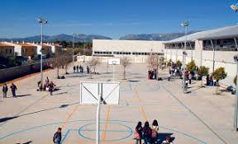
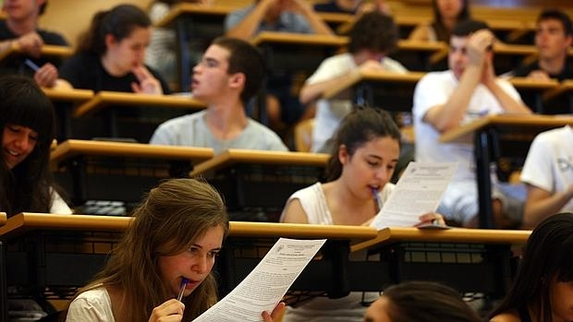
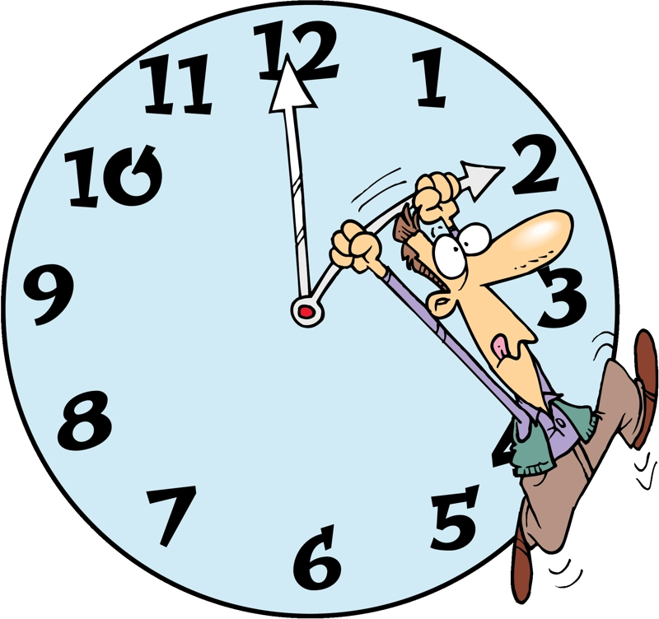
School
They have two break time: at 10 and at 12 am.
They have 11 subjects. Music, Technology, Art, Spanish, Math, Science, History, Geography, English, Italian and P.E.
They finish school at 2 pm

Slide 4
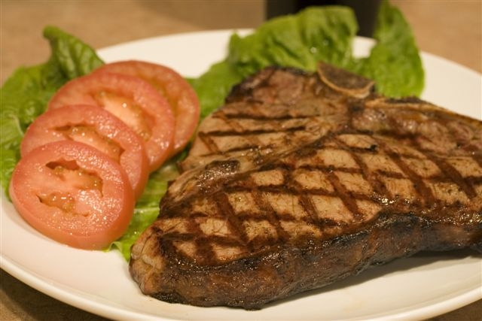
Country
They have different food but one of the most famous is Fiorentina steak
They like pop music

