Slide 1
Information about Italy

Slide 2
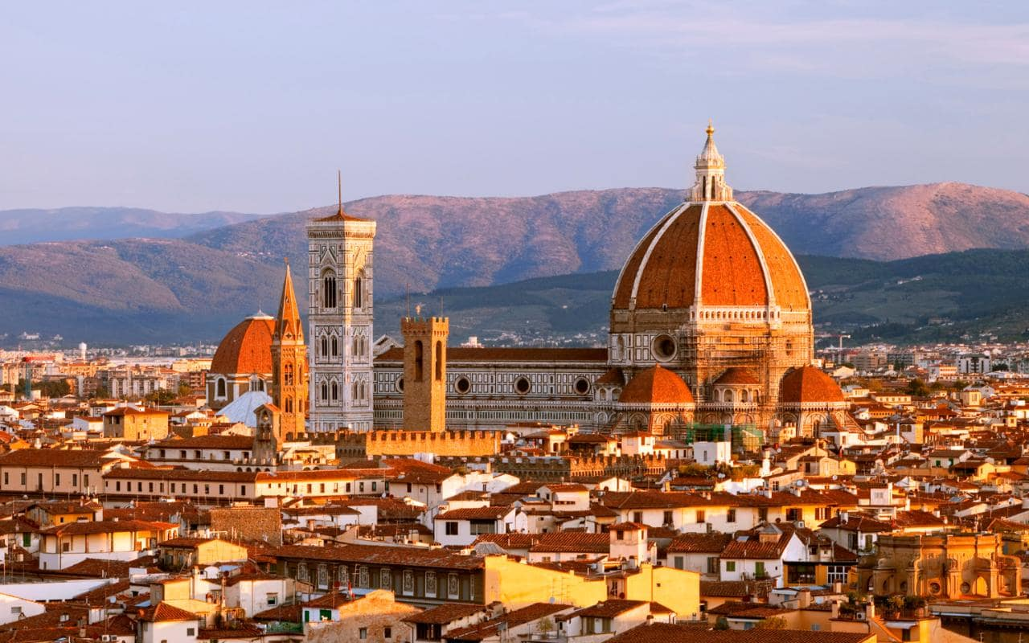
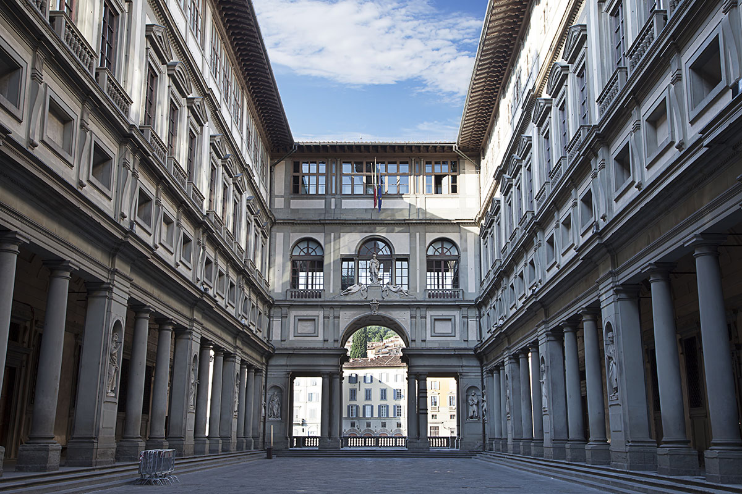
1.CITY
Florence is one of the most important city in Italy.
Uffizi is the most famous museum in Italy.

Slide 3
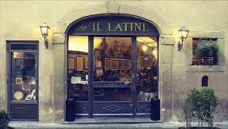
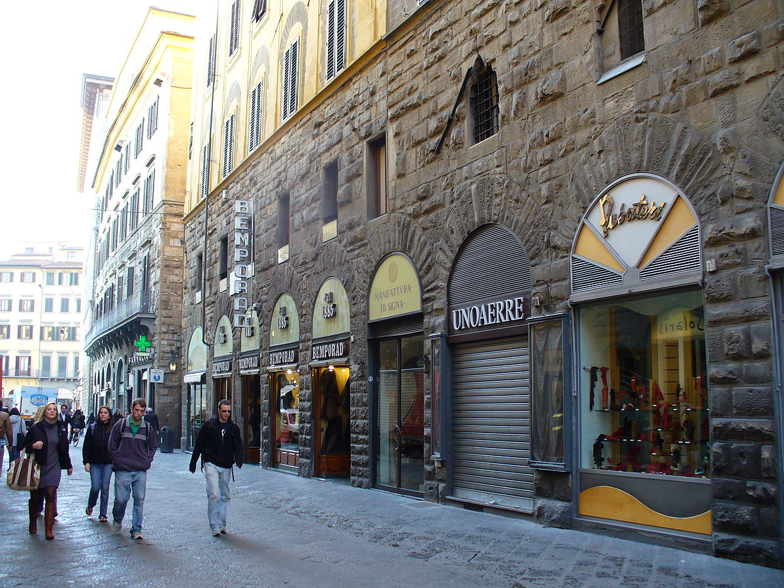
“Il Latini” is the most famous restaurant.
And Via Calzaioli is the most important street in Florence, Italy
CITY

Slide 4
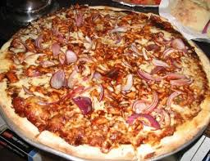
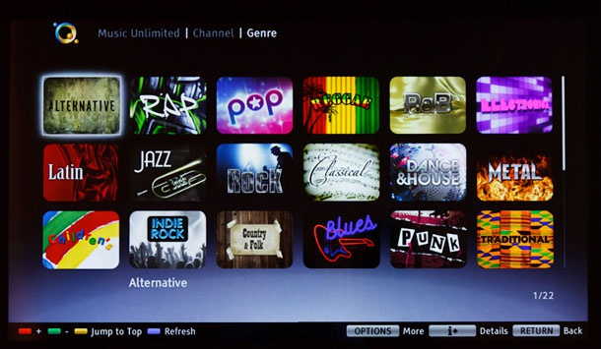
2.COUNTRY
In Italy they have classical, rock, rap, pop, music.
Pasta, pizza and steak are the traditional food in their country.

Slide 5
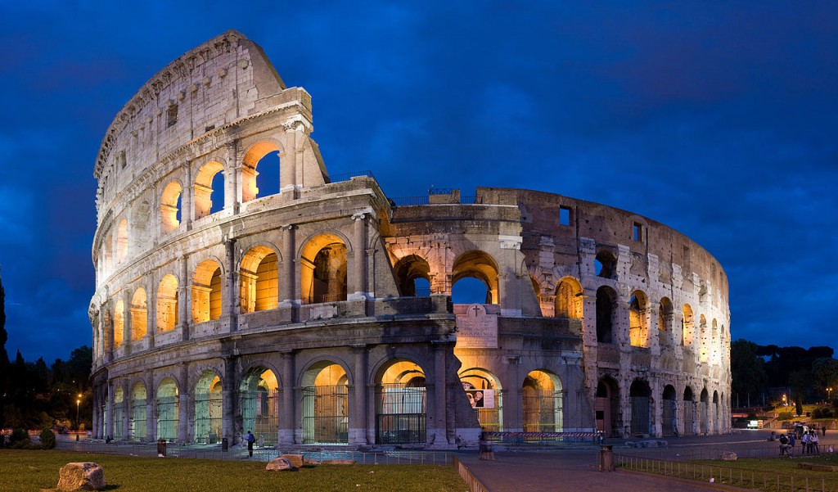
COUNTRY
Rome is the most important city in Italy.
“Tarantella” and “Mazurca” are the traditional Italian dances.
https://youtu.be/CM-B_KL3PFI

Slide 6
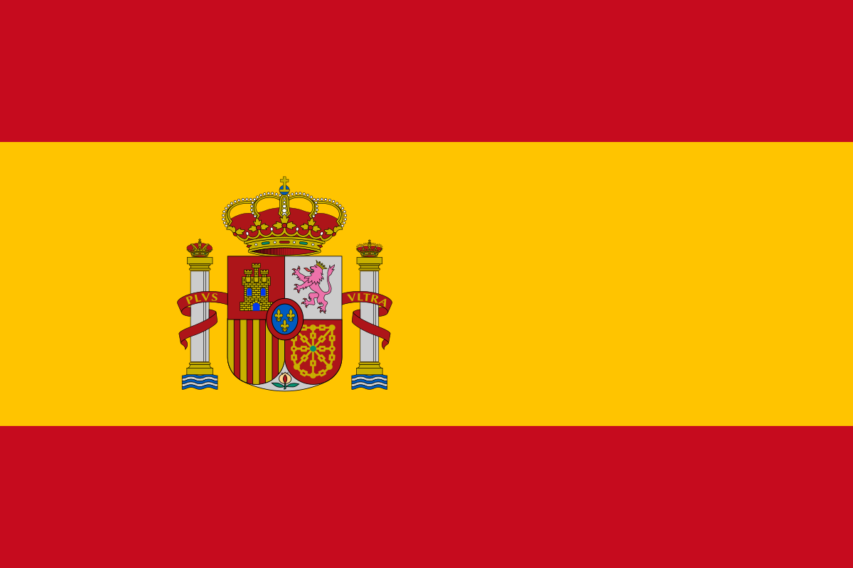
SCHOOL
They study a lot of subjects: English, Italian, Spanish, Math, Science, Music, Art, History, Geography, Technology and P.E.
They learn Spanish at school.

Slide 7
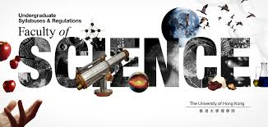
School
Their favourite subjects are Science and Music.
During their break time they eat snacks and they talk to their friends.

