Slide 1
Zagreb, Croatia

Slide 2
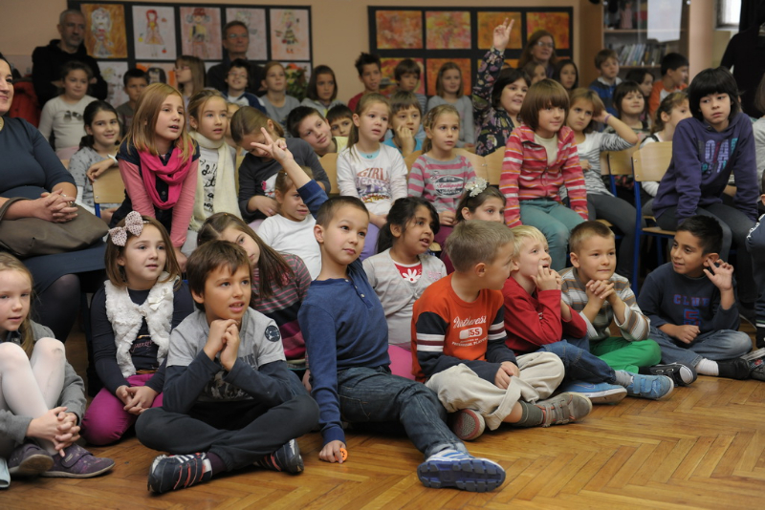
educational system in Croatia is organized for children from the age of six and a half- seven
Primary school lasts 8 years and can be divided into 2 stages:
class teaching (4 years), 1.- 4. grade
subject teaching (4 years), 5.- 8. grade

Slide 3
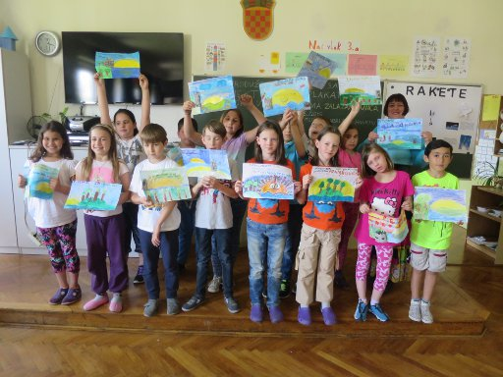
CLASS TEACHING
the same teacher teaches 6 school subjects (Croatian language, Mathematics, Science and Social Studies, Art, Music and PE)
compulsory foreign languages and optional Religious Education are taught by special teachers

Slide 4
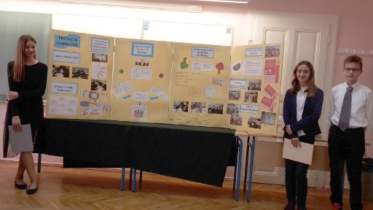
2) SUBJECT TEACHING
from 5th to 8th grade, students attend 12-14 compulsory school subjects (depending on their age), and they can also choose 3 optional subjects (IT, foreign language and/or Religious education)

Slide 5
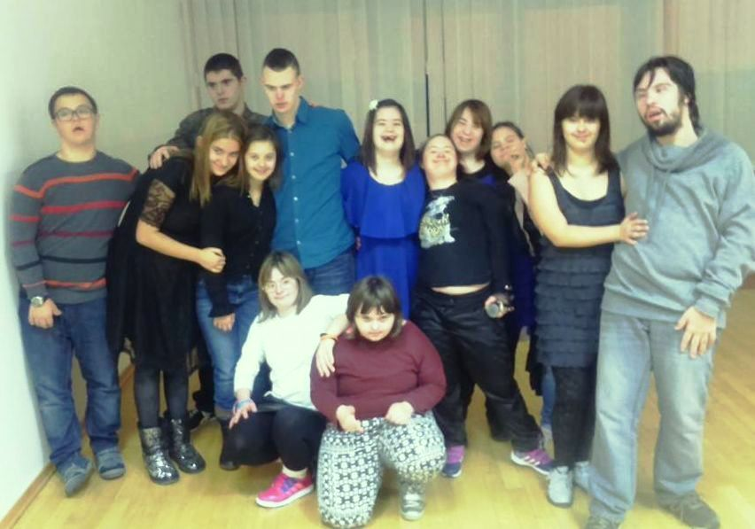
children with special needs, depending on the type of their disabilities and needs, are included in regular classes, or attend special classes with special programmes

Slide 6
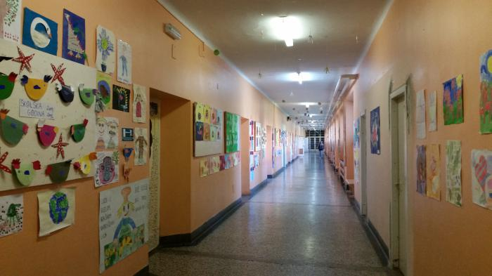
classes last from 8 am to 1 pm
children up to 3rd grade and students in special education classes can attend organised afterschool care (till 4 p.m.)
afterschool care includes lunch, rest, studying, playing, creative and other activities

Slide 7
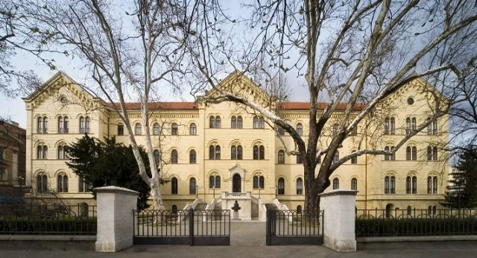
upon finishing primary school, students are able to enrol in vocational schools, art schools or different types of gymnasiums
upon finishing secondary school, students can get employed or continue their education on university level

Slide 8
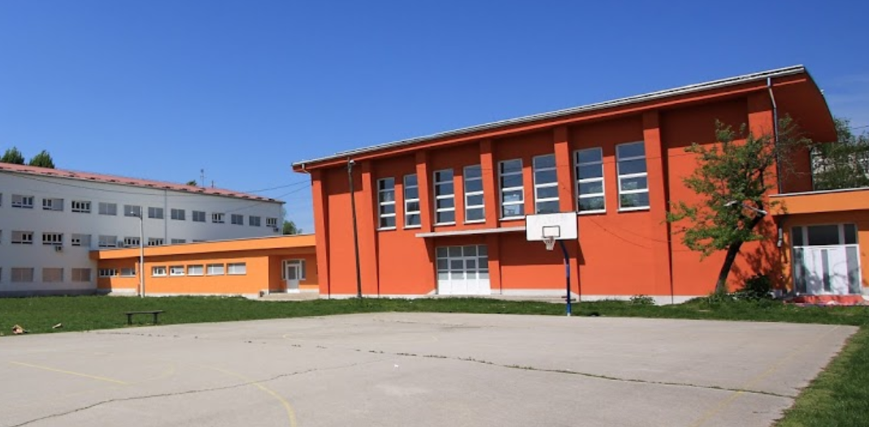
Primary School Grigor Vitez
A positive example of a school with a large number of students with special education needs

Slide 9
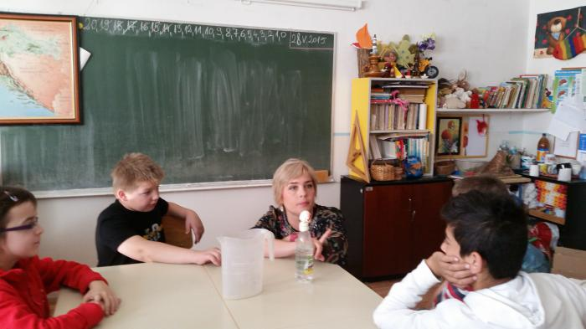
4 types of educational programmes:
regular
customized (mild disabilities, 1. - 8. grade)
special (severe disabilities, 1. - 8. grade)
special (teaching everyday competencies, 14 to 21 y.o.)

Slide 10
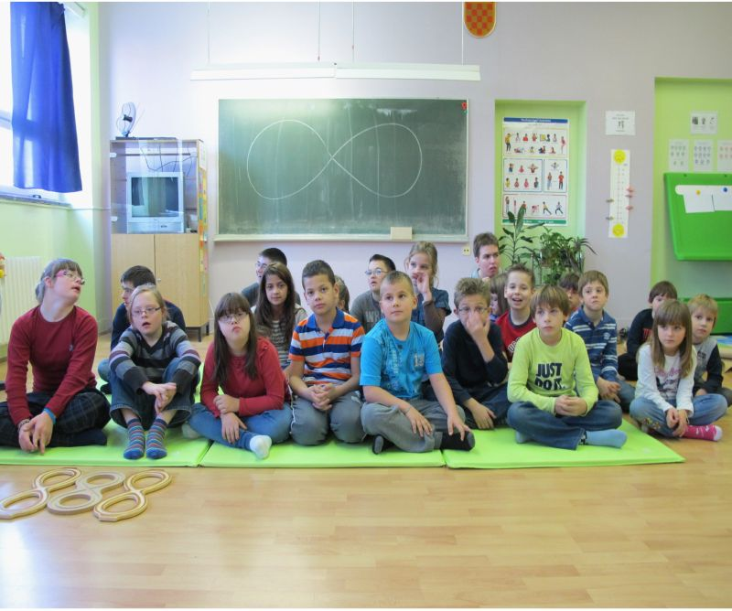
What makes us different
Morning shift + afternoon extended specialized treatment
Full professional team
TEACCH methods
Brain gym
Play attention
Students cooperative
International art project
(„Greats of the Croatian past”)
Professional orientation
program (from 1st grade)
Extended program
for gifted students
Erasmus+ projects
Charitable activities

Slide 11
Brain Gym
for children with different
kinds of disabilities

Slide 12
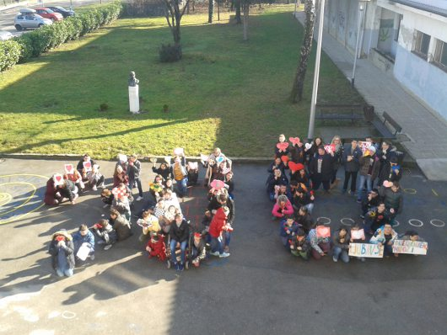
OUR SCHOOL CURRICULUM
In addition to compulsory educational contents, there are many
projects, events, manifestations and celebrations...

Slide 13
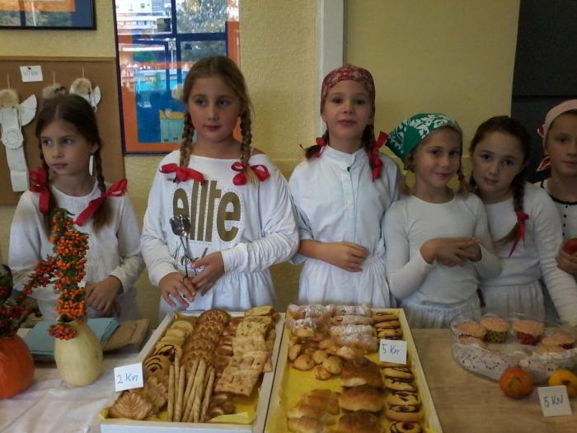
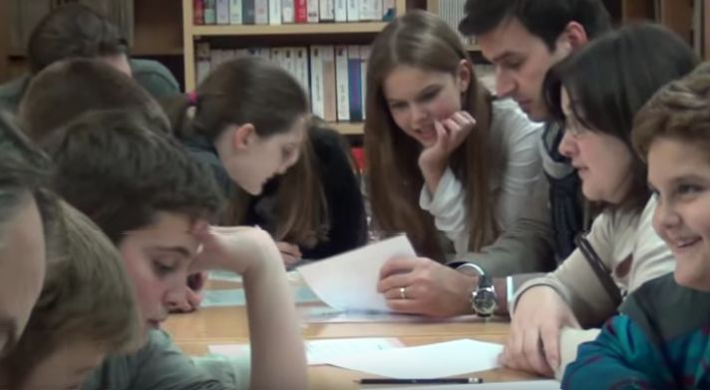
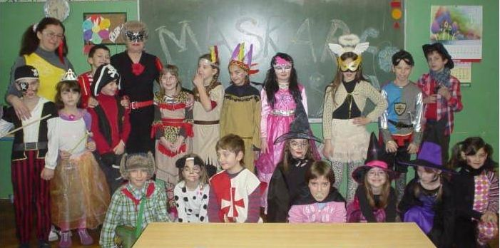
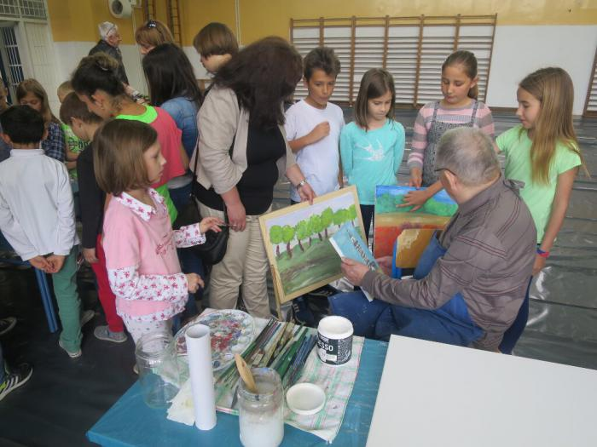
Bread day
Maths Evening
Carnival
Art colony

Slide 14
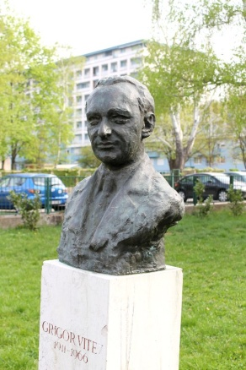
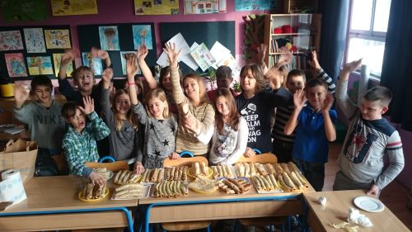
... Theatre Night, Book Night, Pancake Friday, birthday of Grigor Vitez (a famous poet and children’s author by whom our school is named), etc.

Slide 15
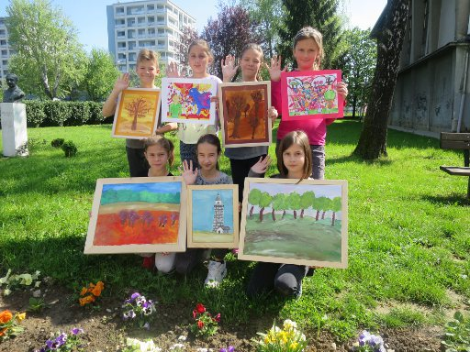
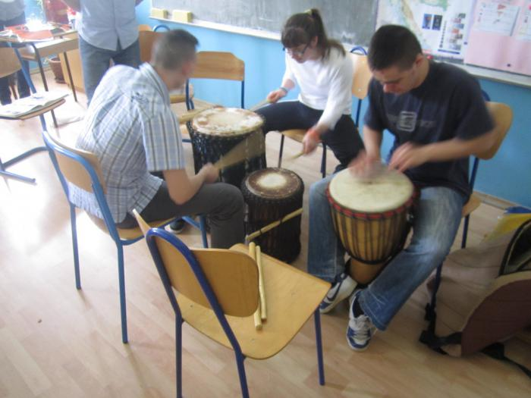
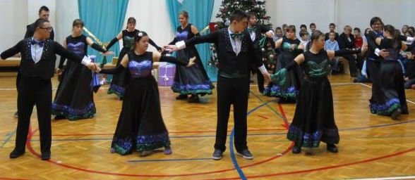
We also organize more than 30 extracurricular activities, such as:
art, dancing, languages, music, drama...

Slide 16
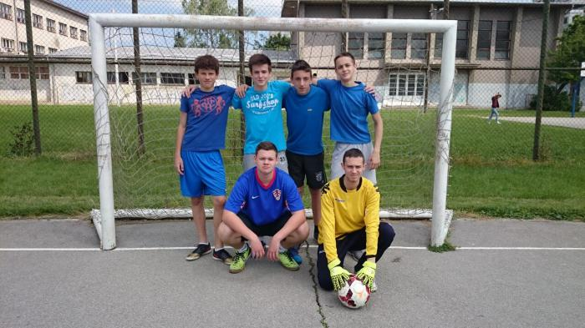
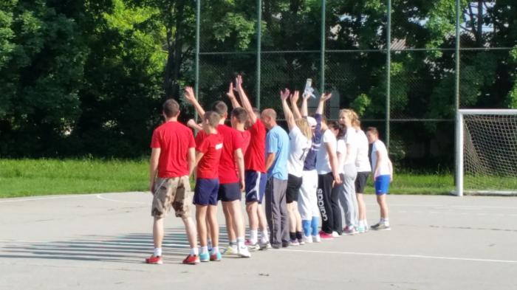
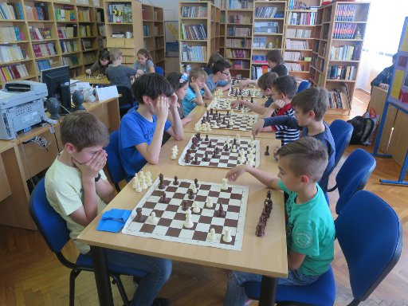
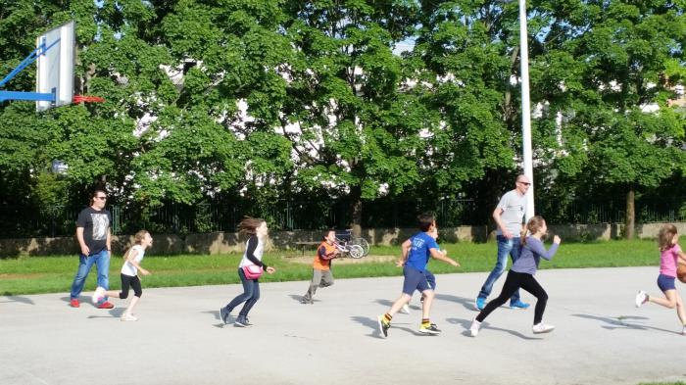
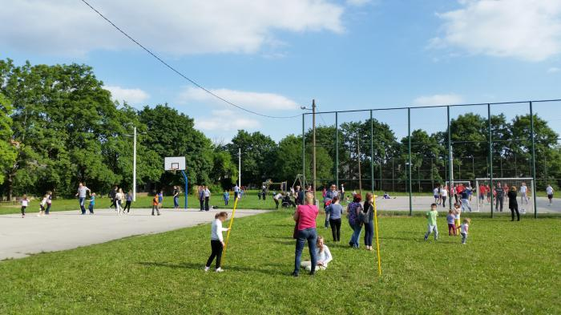
Sports groups: athletics, handball,
hiking, chess...

Slide 17
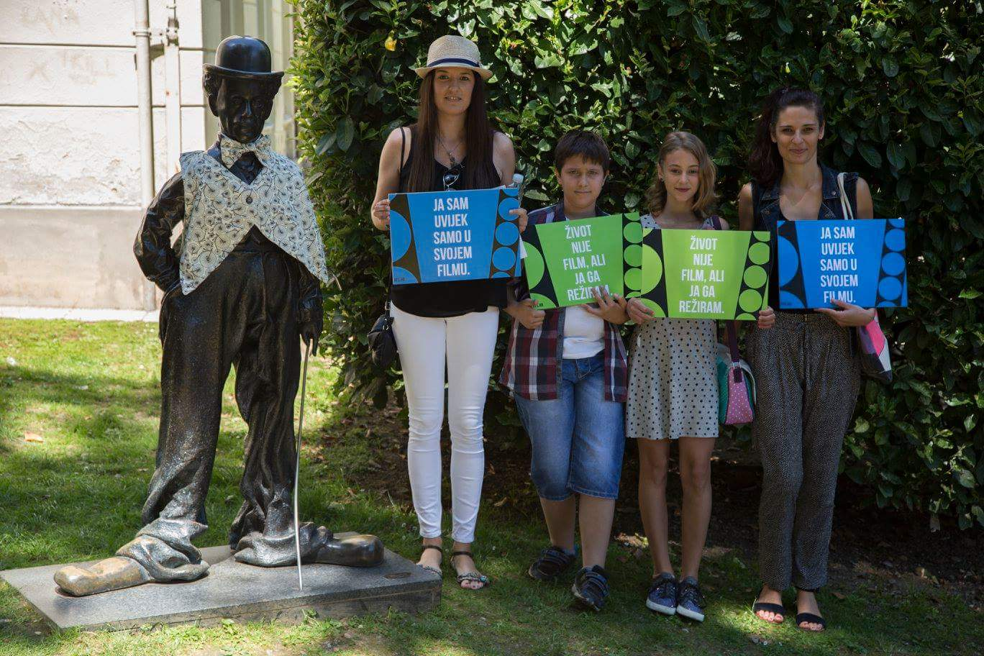
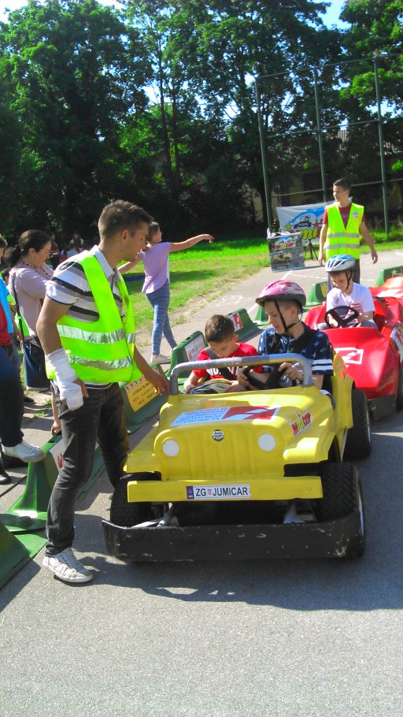
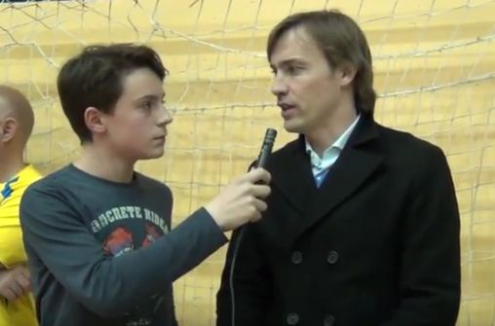
Film group
Young pointsmen
Journalists

Slide 18
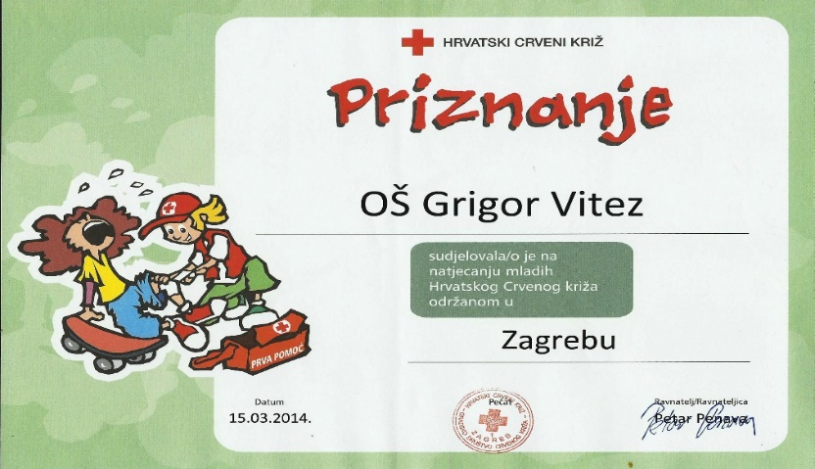
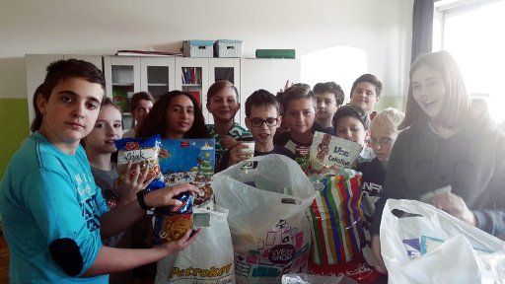
We are extremely proud of our humanitarian work:
during each school year we raise and donate financial and humanitarian aid for students and their families in need. We are also involved in Red Cross, Caritas and UNICEF activities.

