Slide 1
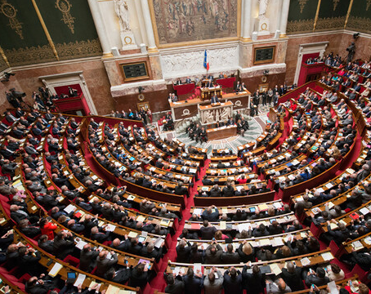
The history of democracy in France through the major democratic laws passed

Slide 2
The French Revolution
The French revolution designates a period of upheaval social and political in France, in its colonies and in Europe at the end of the 18th century. The Bastille Attack the 14th of July 1789 corresponds to the first revolt of poor people.
The Bastille Attack, the 14th of July 1789

Slide 3
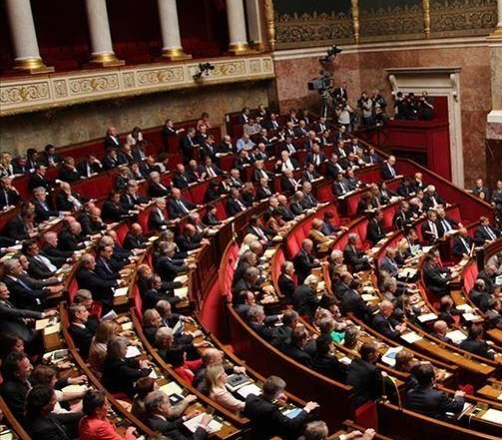
The National Assembly
The Constituent Assembly of 1789 or National Constituent Assembly is the first French Constituent Assembly, instituted by deputies of the General States when they self-established themselves as a "National Assembly" on June 17 1789, a date that is remembered as that of the birth of the representative system.

Slide 4
The Declaration of Human and Citizen Rights
The Declaration of Human and Citizen Rights of 1789 is a fundamental text of the French Revolution, which sets out a set of individual and common natural rights such as freedom and equality at birth, as well as the conditions for their implementation. His last articles were adopted on August 26, 1789

Slide 5
Birth of the First Republic
The First Republic, officially named the French Republic, is the name given by historians to the period corresponding to all the republican regimes of France from September 1792 to May 1804. Led by the French Revolution, the First Republic succeeded the constitutional monarchy which disappeared on August 10, 1792 with the capture of the Tuileries Palace by the sans-culottes.

Slide 6
1794 : The first slavery abolition
August 22, 1791 broke out a great insurrection in the French part of St Domingue of nearly 50,000 slaves who, despite the adoption by the National Assembly of the Declaration of the Rights of Man and of the Citizen according to which "men are born and remain free and equal in rights ”, have not been released. It was in 1794 that the National Convention decided to abolish slavery in the colonies
Free , Abolition of Slavery in the Colonies,engraving 1794

Slide 7
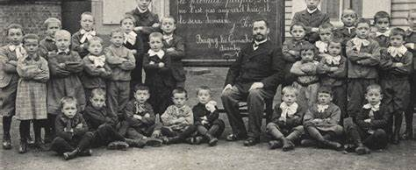
1881-82: Ferry laws on free, mandatory and secular schooling from 6 to 13 years old
The Jules Ferry laws are a pair of laws on primary school in France passed in 1881-1882 under the Third Republic, which make school free (law of 16 June 1881), mandatory primary education and participate in secularizing public education (law of 28 March 1882). They are associated with the name of Jules Ferry, a republican political leader from the early days of the Third Republic, who served as Minister of Public Instruction twice between 1879 and 1883.

Slide 8
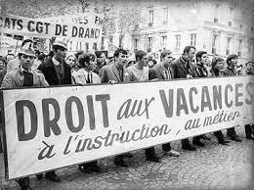
1936: The Social Laws of Popular Front
The Popular Front was a coalition of left-wing parties that ruled France from May 1936 to April 1938. It brought together the three main parties of the left: the SFIO, the Radical Party and the Communist Party (which supported the first two without directly participating in the government), but also a whole nebula of other leftist and anti-fascist movements
The Léon Blum government initiated several important social reforms and is still today one of the essential references in the memory and history of the French left: paid leave (15 days), reduction of working time with the forty-hour week. and the establishment of collective agreements. Compulsory education was increased in 1936 to fourteen years, the links between primary education and high schools were multiplied

Slide 9
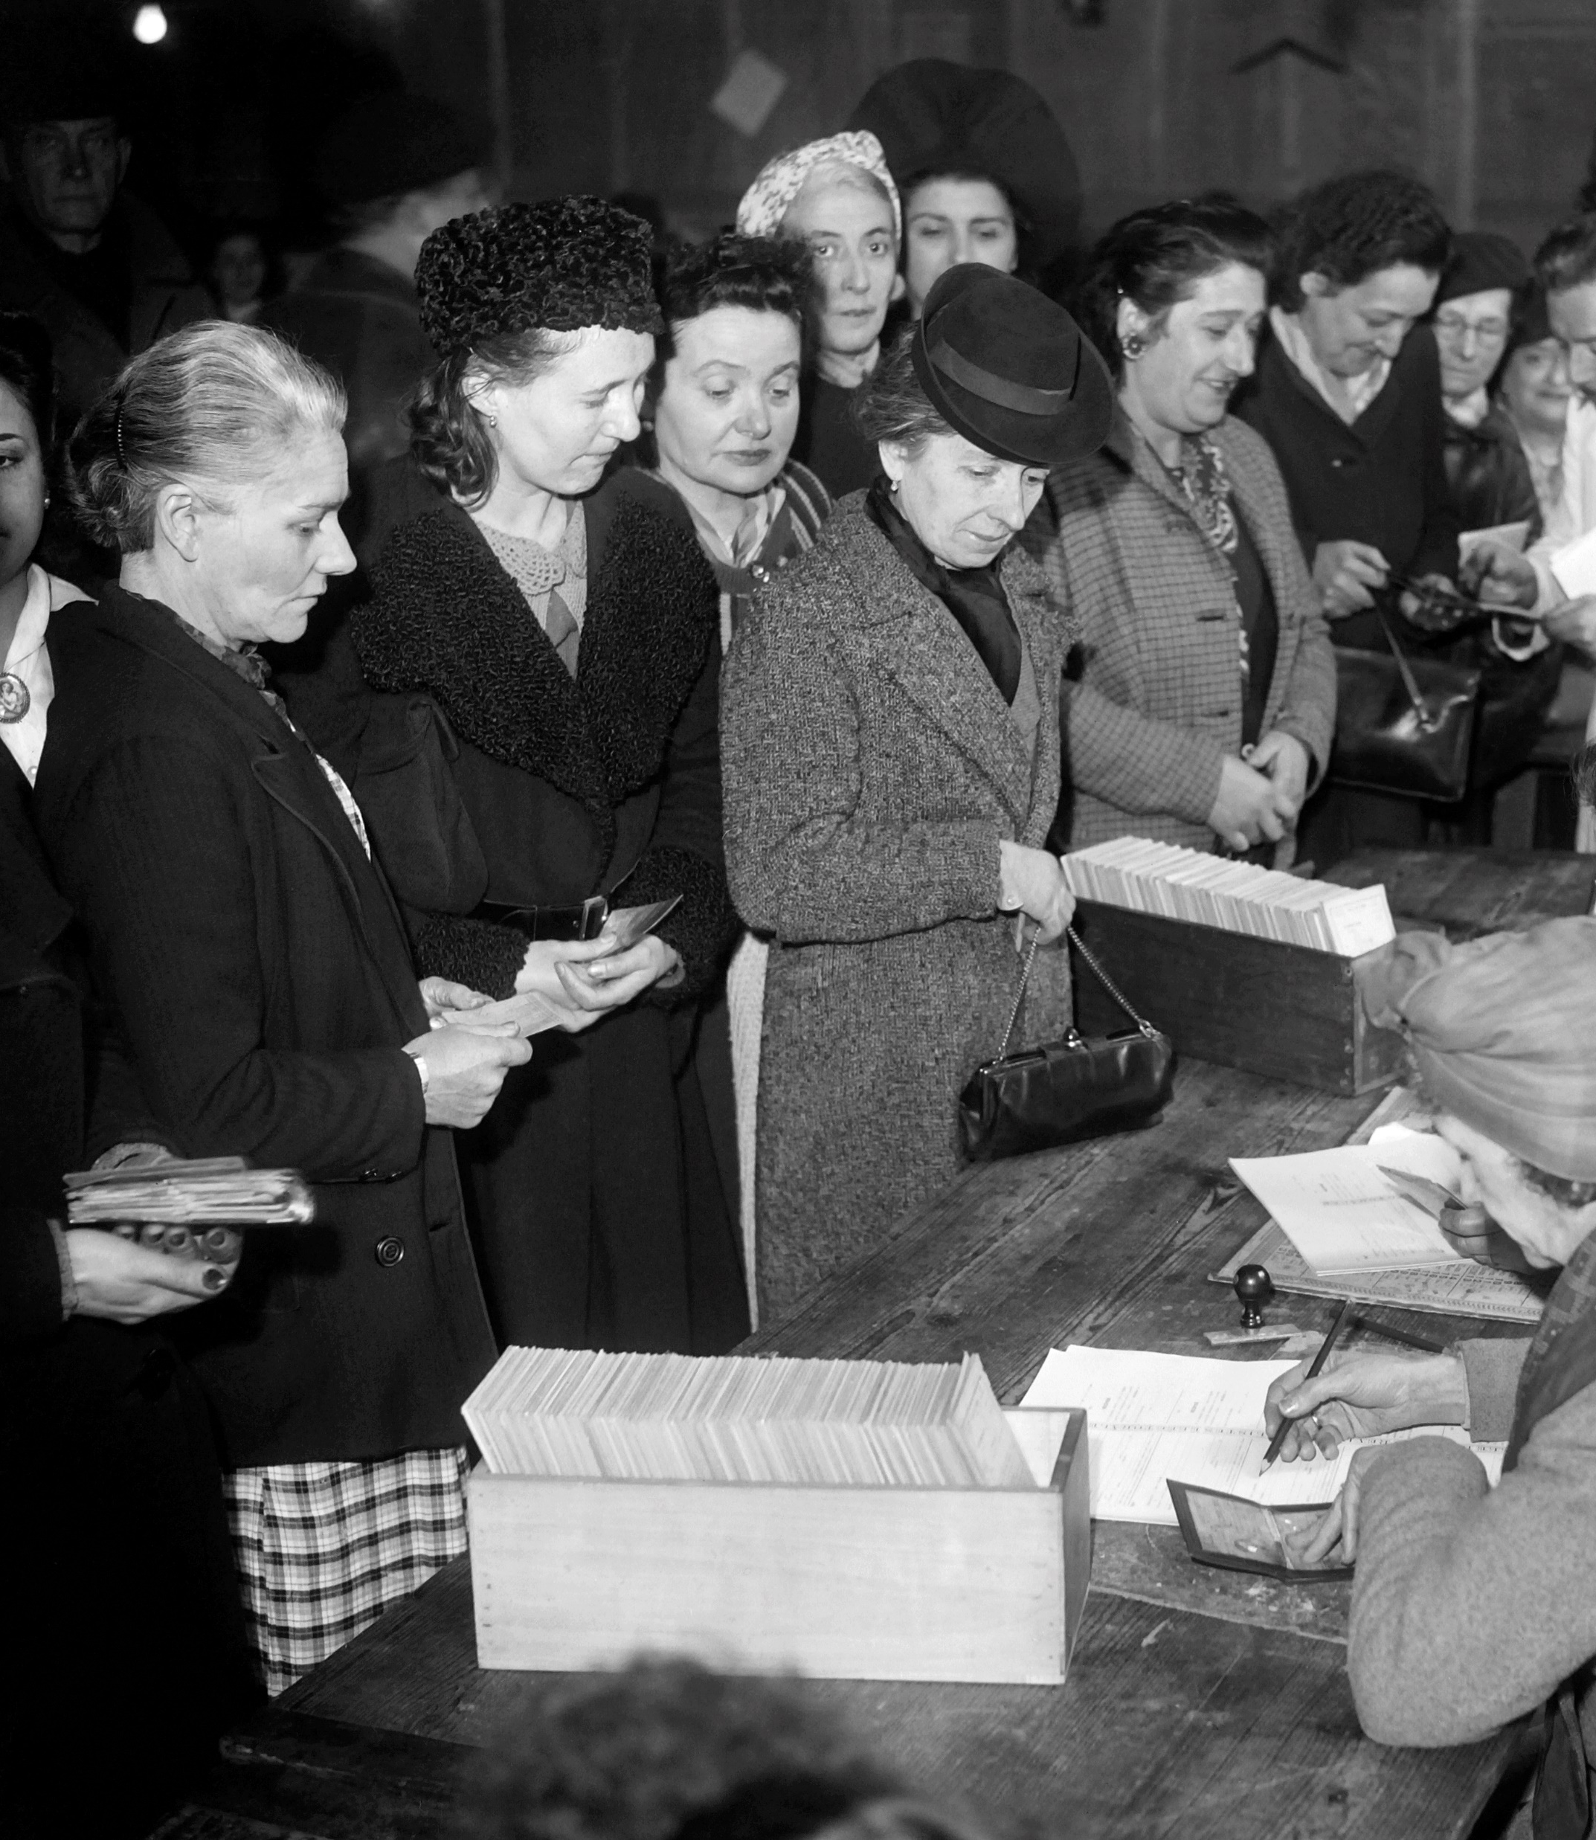
1944, women's right to vote
70 years ago, women voted for the first time in France!
On 21 April 1944, General de Gaulle granted French women the right to vote by order in the provisional government of Algiers. A century passed after the introduction of universal male suffrage in 1848. Women then become "electors and eligible in France under the same conditions as men". On April 29, 1945, these French women exercised this right for the first time in municipal elections.
Denmark (1915), Poland (1917), Serbia (1918) established women's right to vote earlier than France, while Portugal (1976) granted women the right to vote much later because it was a dictatorship.
Women vote for the first time in the first round of municipal elections on April 29, 1945

Slide 10
1945: creation of social security
A social security organization is hereby set up to guarantee workers and their families against risks of any kind likely to reduce or eliminate their earning capacity, to cover maternity expenses and the family expenses they bear . The social security organization is now providing the services provided for by the laws concerning social insurance, the allowance for old salaried workers, work accidents and occupational diseases and family allowances.

Slide 11
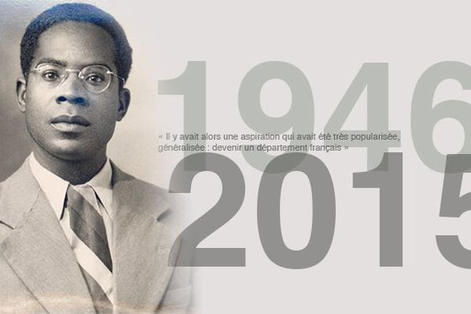
1946: the law on the departmentalization of overseas territories (Guadeloupe, Martinique, Guyana, Réunion)
It was in a favorable post-war context, where elected officials managed to unite many supporters in the euphoria of the Liberation, that in 1946, the colonies of Guadeloupe, Martinique, Réunion and French Guiana are set up as French overseas departments.
The representatives of these “old colonies”, Aimé Césaire, Léopold Bissol, Gaston Monnerville and Raymond Vergès, table three bills in this direction, finally merged into one. With "departmentalization", a word coined for the occasion by Aimé Césaire, the four new departments can participate in the destiny of France "on equality with the metropolitan departments".

Slide 12
1950: Housing Act (moderate rent dwellings)
Low-rent housing organizations in France are public or private organizations that build or manage rental housing for people of modest means. They replaced, under the law of July 21, 1950, the former agencies of Cheap Housing (HBM).
In 2017, there were approximately 800 housing organizations:
264 Public Housing Offices (OPH);
230 social housing enterprises (ESH)
173 cooperative HLM companies;
They manage 4.456 million homes, or 17% of the main residences in France

Slide 13
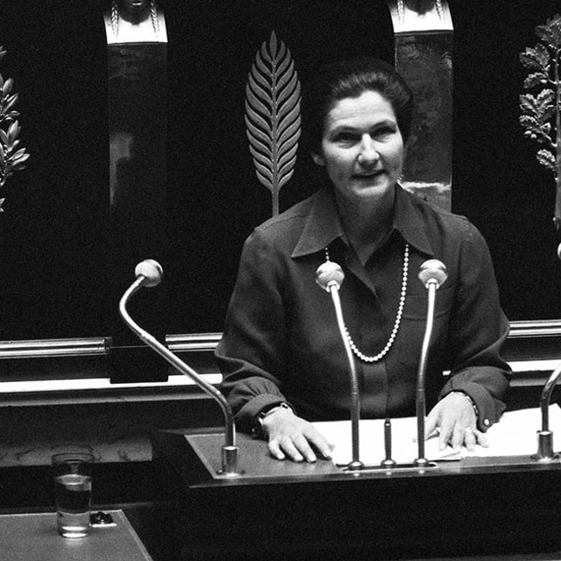
1975: Simone Veil Law on Legalized Medical IVG (voluntary termination of pregnancy).
On November 26, 1974, Simone Veil took to the podium of the National Assembly to defend the law legalizing voluntary termination of pregnancy. It enters the light. She won't get out of it anymore. This woman who was not destined for politics will gain respect and admiration across the divides.
Simone Veil à l’assemblée nationale défendant le projet de loi sur l’IVG en 1975

Slide 14
In France in the seventies, the Mouvement de liberation des femmes (MLF) is an autonomous, non-mixed feminist movement that demands the free disposal of women's bodies and challenges patriarchal society.

