Slide 1
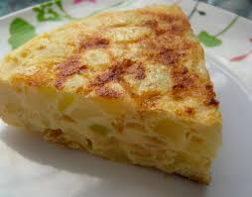
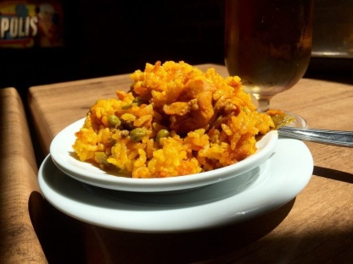
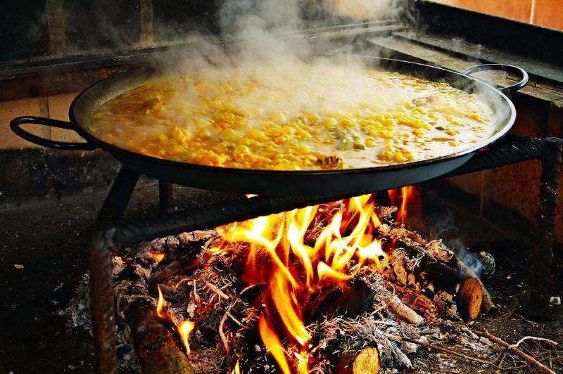
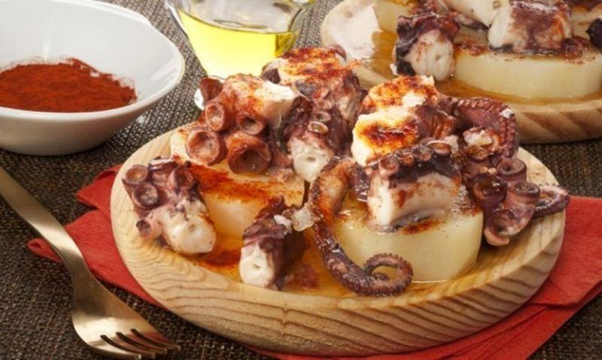
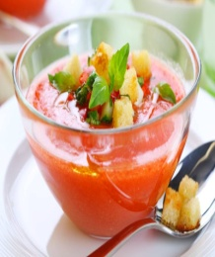
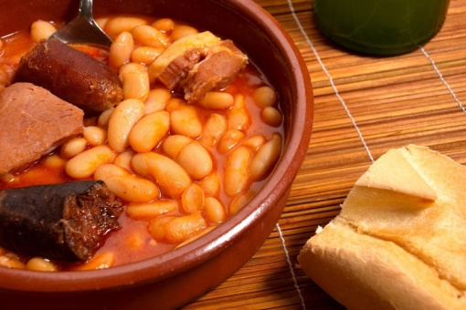
FOODS YOU MUST TRY IN SPAIN
Spanish cuisine is characterized by being rich, varied, simple and with a high quality raw material, among the typical Spanish dishes we highlight the following ones :

Slide 2
PAELLA

Slide 3
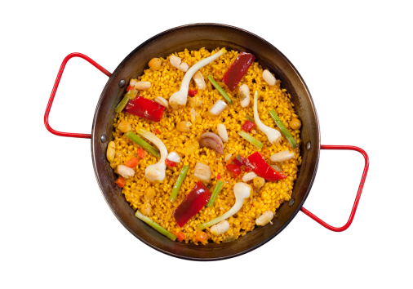
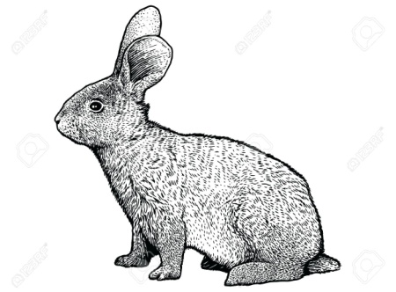
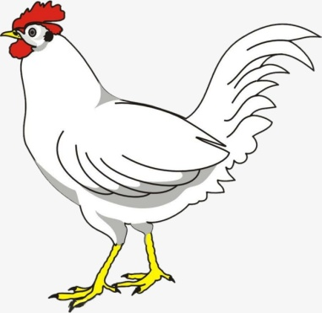
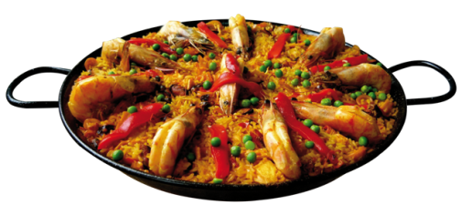
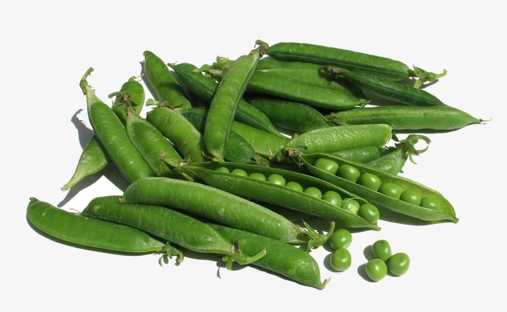
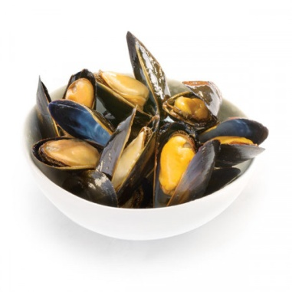
PAELLA
The paella has undoubtedly become our most international dish.
Its name refers to the type of pan that is used to cook the dish in Valencian. The most famous rice in Spain has humble origins , back to the farmers who mixed the food they could find on the countryside : rabbit, chicken, green beans, white beans, snails and all kinds of vegetables

Slide 4
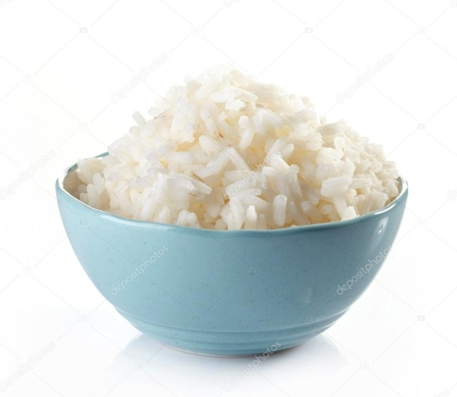
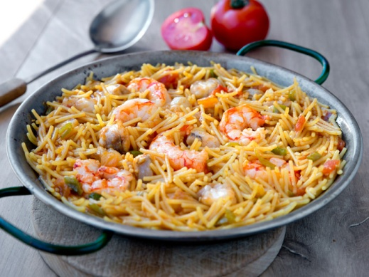
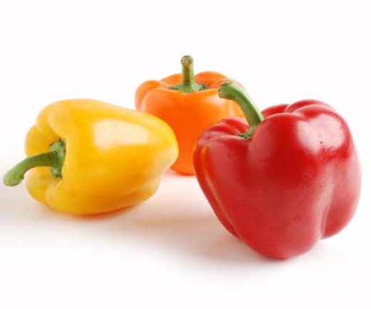
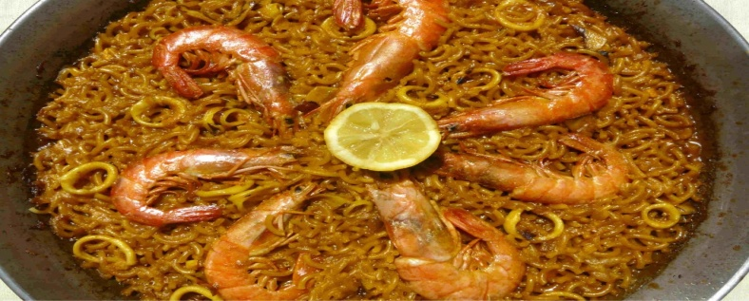
Nowadays, it’s a very a very popular dish and there are other variants, with a sauce of onion, green pepper and tomato with squid,, mussels, chicken, prawns and lobster, to which the rice is added to make slowly with the seafood broth.
A recipe very similar that you can also taste, in the fideuá, with pasta

Slide 5
COCIDO MADRILEÑO

Slide 6
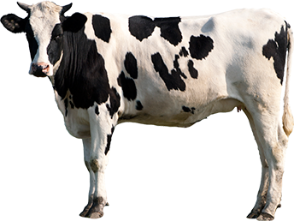
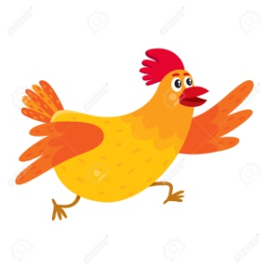
Is one of the main dishes of Madrid. Intended for the lower classes originally, workers or farmers, who made a meal full enough to withstand the hard work of all day.
The cocido( stew) consisting of a first course of noodle soup or the broth resulting from cooking chickpeas with vegetables, usually cabbage or green beans, chicken , beef,bacon, sausage and blood sausage, which they serve as a second course

Slide 7
FABADA

Slide 8
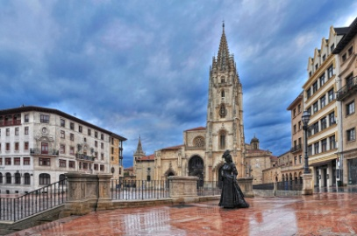
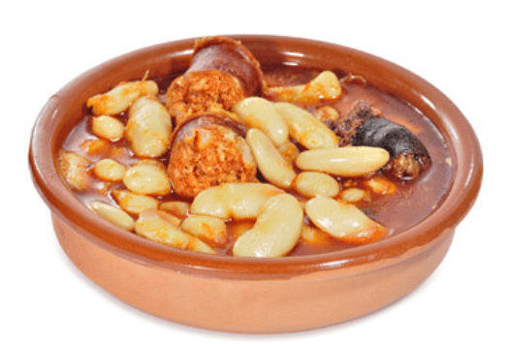
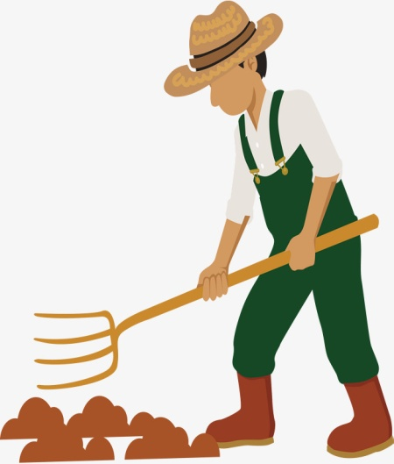
It has its origin in Asturias.
The dish consists of a stew of beans or beans with chorizo, blood sausage, bacon and pork ear

Slide 9
JAMON SERRANO

Slide 10
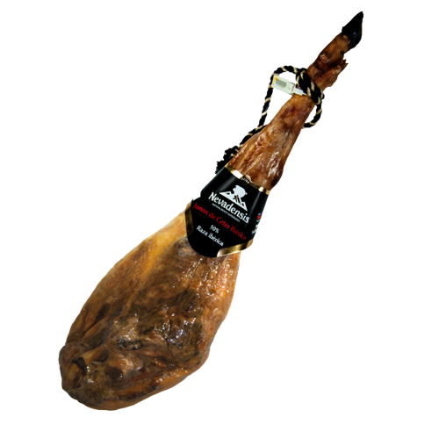
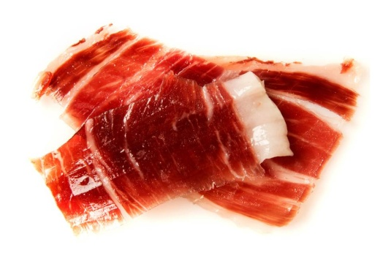
Is the most special food in Spain, something that is only produced here and you will not find anywhere else in the world. So you must live the experience of savoring it.
The serrano ham are the hind legs of the pig, which are salted and cured with the fresh air of the sierra.
The history of the ham is long, existing already in the Roman Empire(there are written references from the second century BC) for the need to preserve meat.

Slide 11
GAZPACHO ANDALUZ

Slide 12
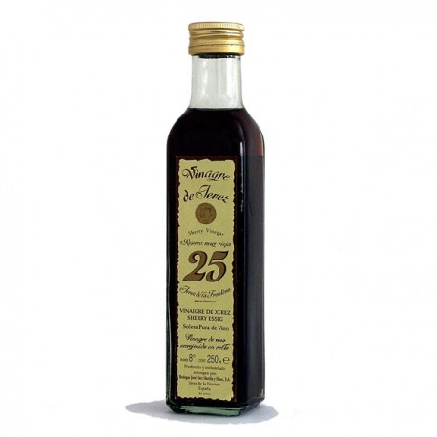
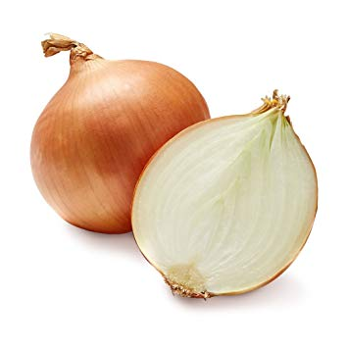
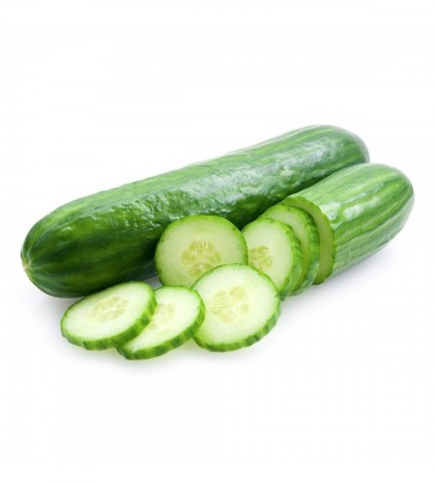
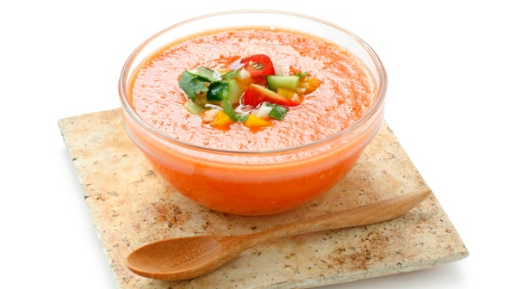
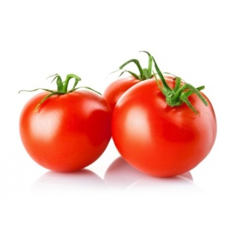
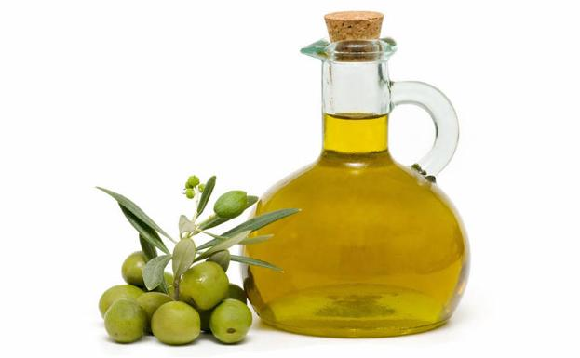
The gazpacho is a cold soup of mashed bread, water, olive oil, vinegar, tomato, cucumber, onion, garlic and green pepper, delicious and refreshing during the summer months. The history of the gazpacho is uncertain, but it is believed that it must exist since the bread is made, as a way to make use of it, since it was dipped with water, and vinegar, oil and salt were added,
T

Slide 13
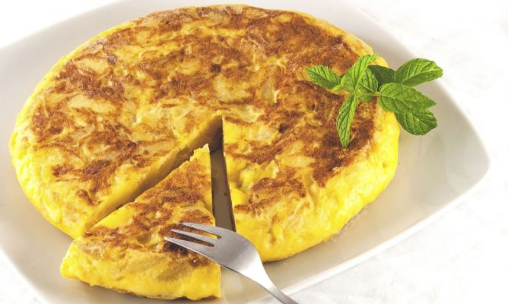
TORTILLA ESPAÑOLA

Slide 14
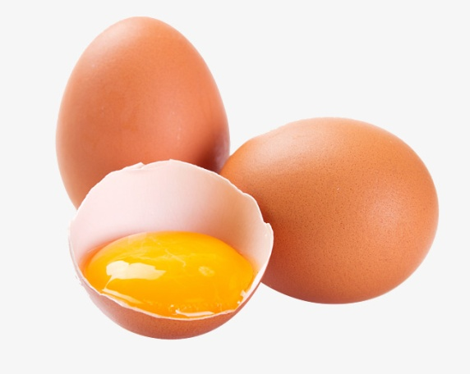
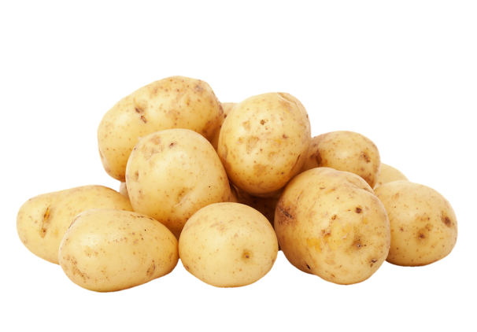
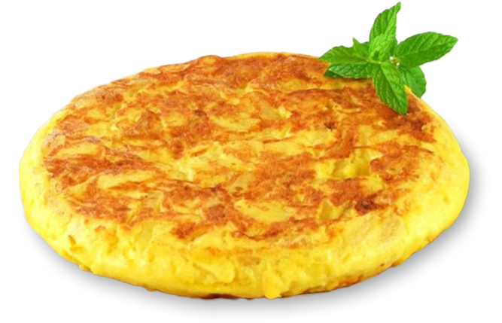
Its preparation is simple, since the potato is fried slowly (at the cooking rate) in olive oil, with or without onion and salt, and drained and mixed with the egg later, to make an omelette. Its origins date back to the year 1798 in the town of Villanueva de la Serena in Badajoz, where two plantation owners, enlightened with the help of local housewives, tried to find cheap food, it is delicious!

Slide 15
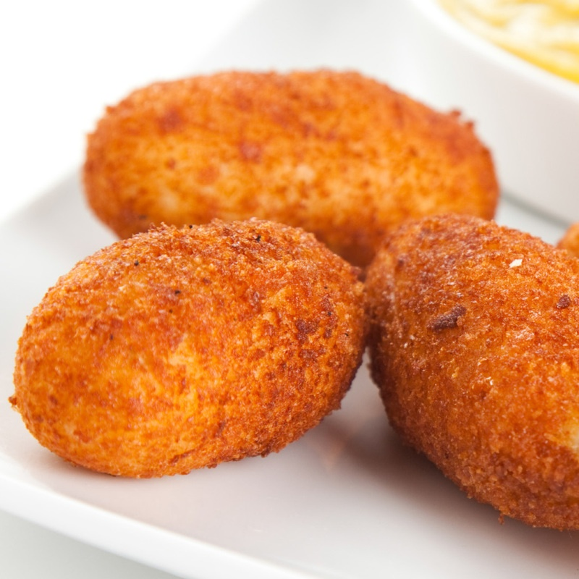
CROQUETAS

Slide 16
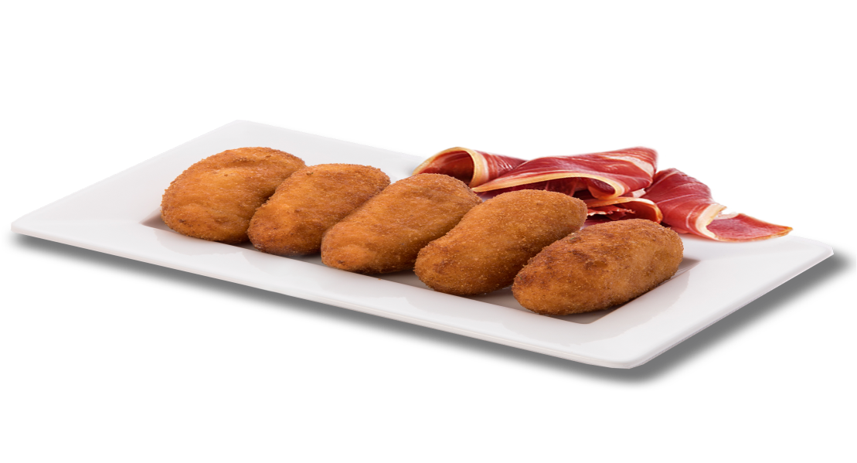
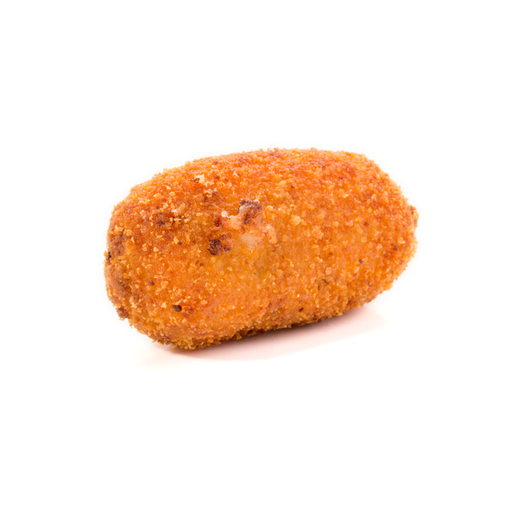
The croquettes are the typical dish that each Spanish assures that his grandmother cooks it better, although in a competition, of course, he would win mine.
😜 The recipe for the croquettes consists of a bechamel (milk and flour) with serrano ham and prawns, which are breaded with egg and bread crumbs before frying, although nowadays they are made with different sweet and savory ingredients.

Slide 17
PULPO A LA GALLEGA

Slide 18
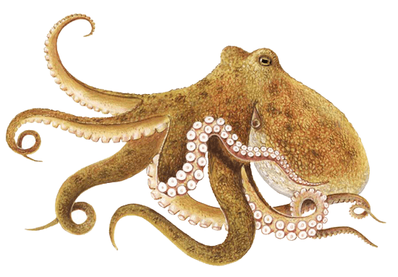
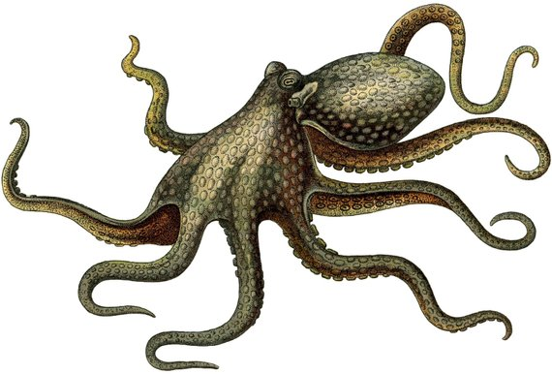
The also known as octopus a la gallega, is a very simple dish, where once again shows the maxim of Spanish cuisine to work with quality food. The octopus is cooked by introducing it for a few seconds in a pot with boiling water, and repeat it up to three times, so the octopus keeps the skin and stays soft, although if it freezes before, you will also get that effect. Serve in slices on a wooden board, with a little olive oil, salt and sweet paprika sprinkled on top.

Slide 19
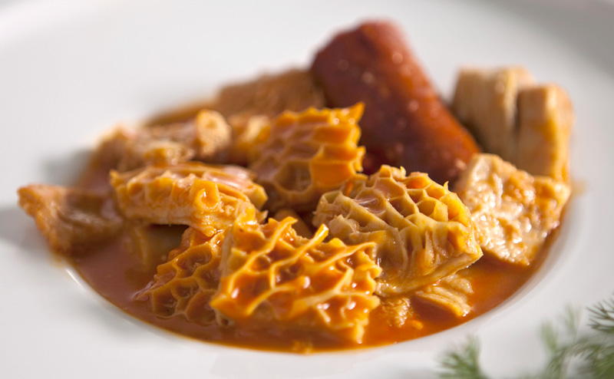
CALLOS

Slide 20
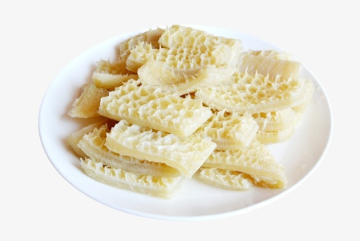
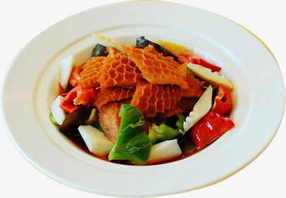
The callos of Madrid is one of those typical winter dishes, strong, rich, rewarding and very traditional, since its recipe dates from the year 1,599. This dish is made of lamb intestines stewed with garlic, onion, paprika, olive oil, bay leaf, chilli pepper, blood sausage, chorizo ​​and salt to taste.

Slide 21
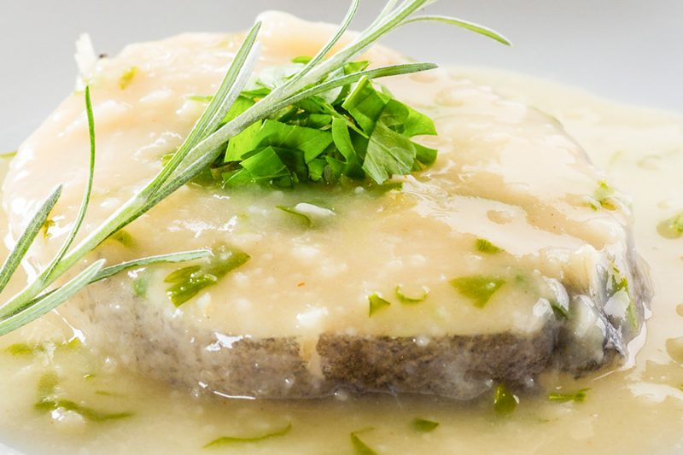
MERLUZA A LA VASCA

Slide 22
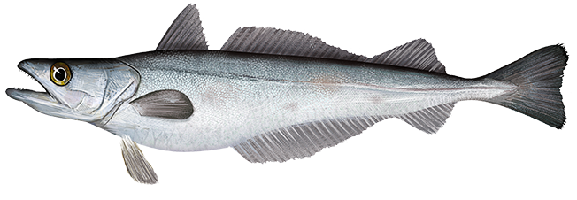
Hake in green sauce, also known as hake a la vasca, is a very healthy typical dish of Spanish cuisine at the same time delicious. Hake is one of the most consumed fish in Europe, very tender and with hardly any spines, which in this case is prepared by letting it cook with a stock of fish, garlic, parsley, clams, olive oil and salt to taste. In addition, the 7,900 km. of Spanish coasts where high quality specimens are caught, together with the fact that Spain is together with Japan, one of the countries with the most fish consumption in the world, will make it easy to find it. I recommend that you also try cod, sardines, sea bream or sea bass.

Slide 23
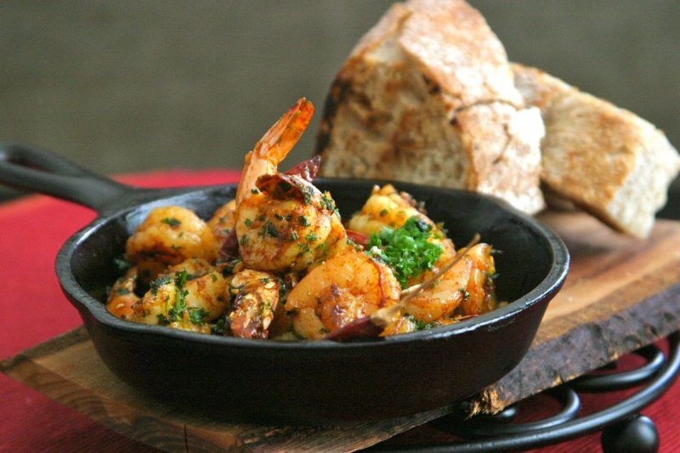
GAMBAS AL AJILLO

Slide 24
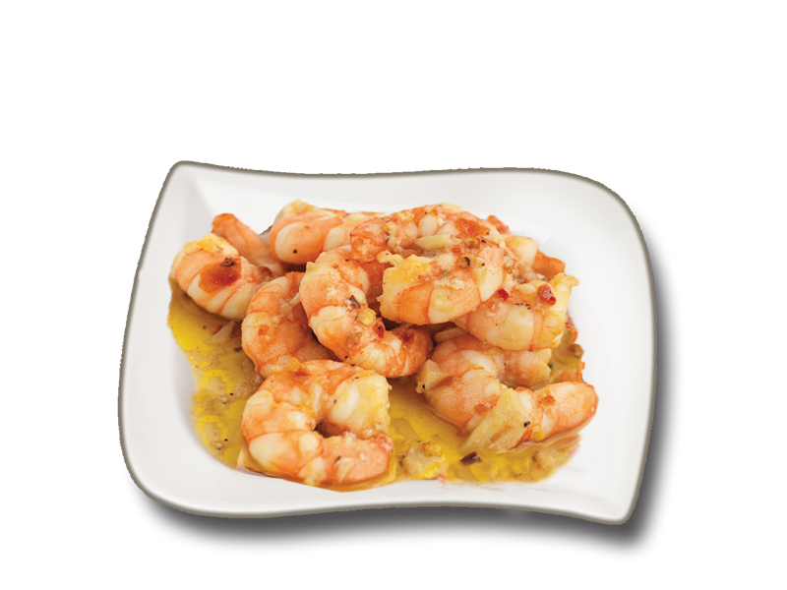
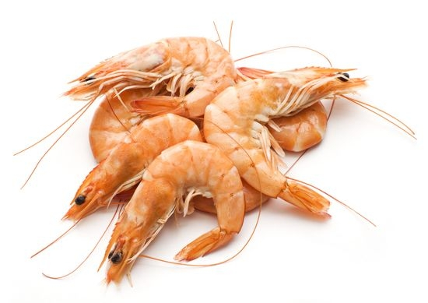
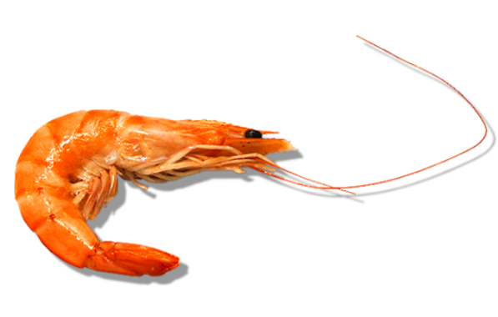
Some delicious garlic prawns are always a good option, and easy to find in bars and restaurants, cooked simply with olive oil, garlic, parsley, chili pepper and salt. As with fish, seafood in Spain is abundant and of great quality, so I advise you to try as far as you can budget, from mussels, clams, prawns or knives to spider crab, lobster and much more.

Slide 25
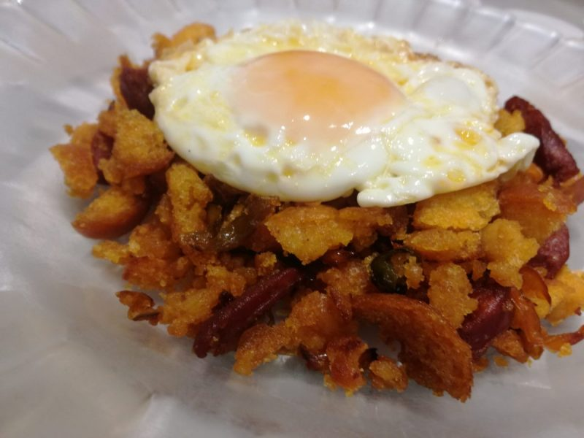
MIGAS EXTREMEÑAS

Slide 26
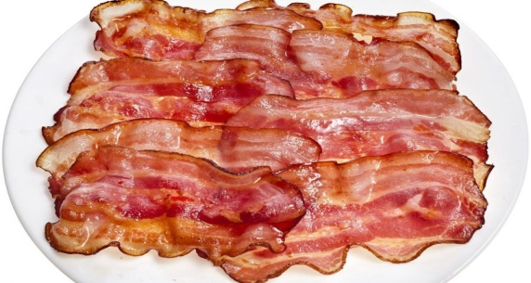
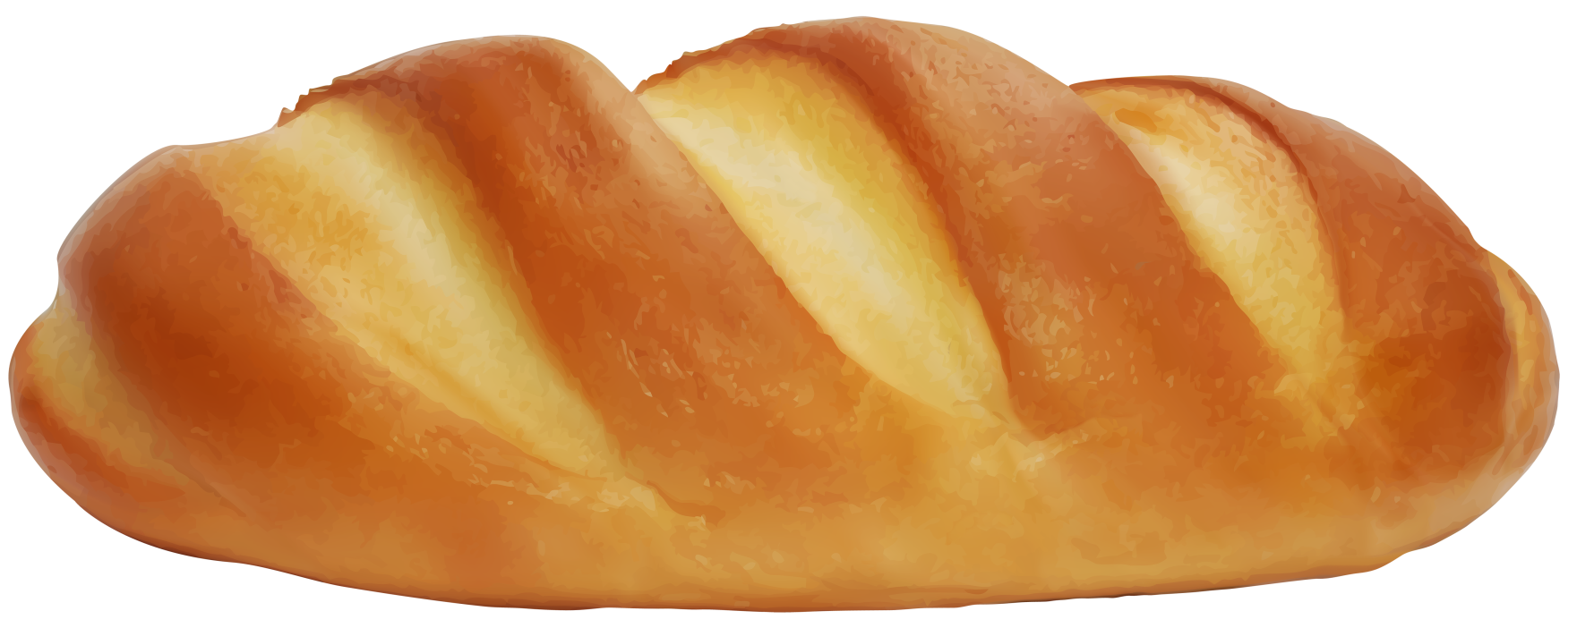
I hope you enjoy a lot of Spanish cuisine, its tapas, its atmosphere, always well accompanied with exquisite wines to serve
Spanish people eat bread with everything, as is the case of migas, a recipe widely spread throughout the Spanish geography. The recipe of migas extremeñas consists of dipping bread from the previous day with water, which then fried with chorizo, bacon, green pepper, garlic, olive oil, paprika and grapes. Depending on the area, they are served with fried eggs and even with sardines. Very rich!

Slide 27
LECHAZO O CORDERO ASADO

Slide 28
The lamb is a lamb that has not stopped being breastfed, which is roasted in a clay pot or in a wood oven, becoming an exquisite dish and much appreciated throughout Spain.

Slide 29
RABO DE TORO

Slide 30
The traditional dish is a stew of bull tail, with onions, carrots, tomatoes, garlic, bay leaves, saffron, olive oil, red wine, pepper and salt to taste, which is a tremendously tender and tasty meat. To suck your fingers!

Slide 31
Spanish cuisine is characterized by being rich, varied, simple and with a high quality raw material, among the typical Spanish dishes we highlight

