Slide 1
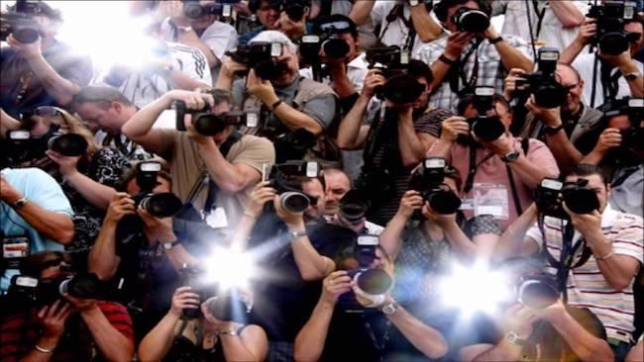
Famous Italian person
By the group of Spain:
Belén
Irene
Laura
Lourdes
Claudia

Slide 2
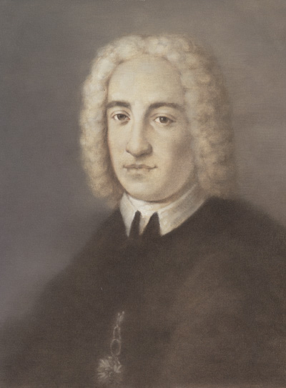
Alessandro Scarlatti
He was born in Palermo, in the Kingdom of Sicily in 1660
Famous Italian composer who played a fundamental role in the history of music
He wrote 11 operas, one of the best known is Tigrane
He died in 1725 ( with 65 years old)

Slide 3
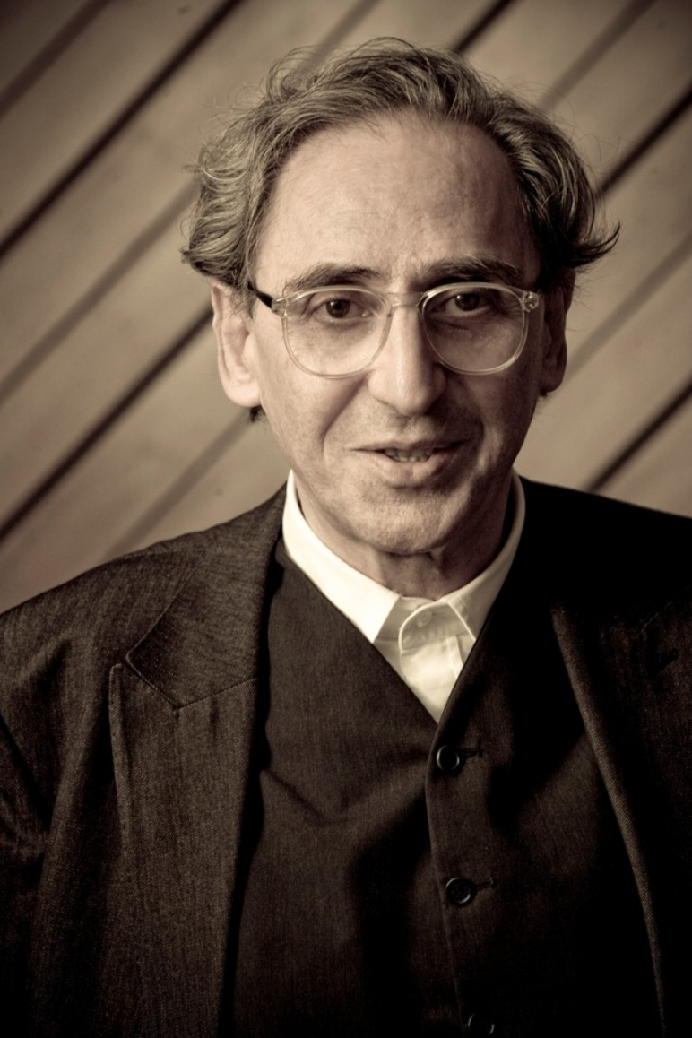
Franco Battiato
Italian singer-songwriter, musician and film director
He was born on an island in Sicily on 1945.
He’s the most eclectic and original of those who have appeared on the Italian cultural scene in recent decades, has gone through multiple musical styles.

Slide 4
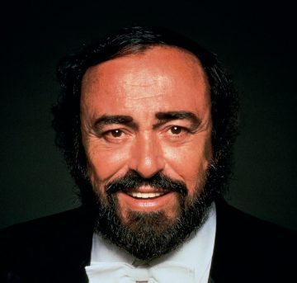
Luciano Pavarotti
He was born in August 1935
Was an Italian lyrical tenor, one of the most famous contemporary singers of recent decades, both in the world of opera.
He died in 2007, with 72 years old.

Slide 5
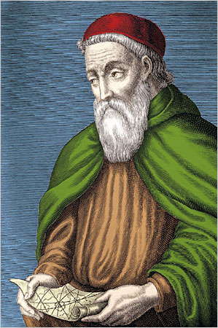
Americo Vespucio
He was born in Florence in 1454, and died in Seville, 58 years later.
He was a Florentine merchant, explorer and cosmographer, naturalized Castilian in 1505.
He participated in at least two voyages of exploration to the New World, a continent that today is called America in his honor.

Slide 6
Laura Pausini
Italian singer-songwriter
She has born in Faenza a province of Ravenna, Italy in May 1974
Who won multiple international awards.
Her career is distinguished by singing in other languages ​​besides Italian
She is considered the most successful and internationally known Italian singer-songwriter.
The "Pantheon Project", from the Massachusetts Institute of Technology, places Pausini in the 201st position out of the 403 highest impact singers

