Slide 1
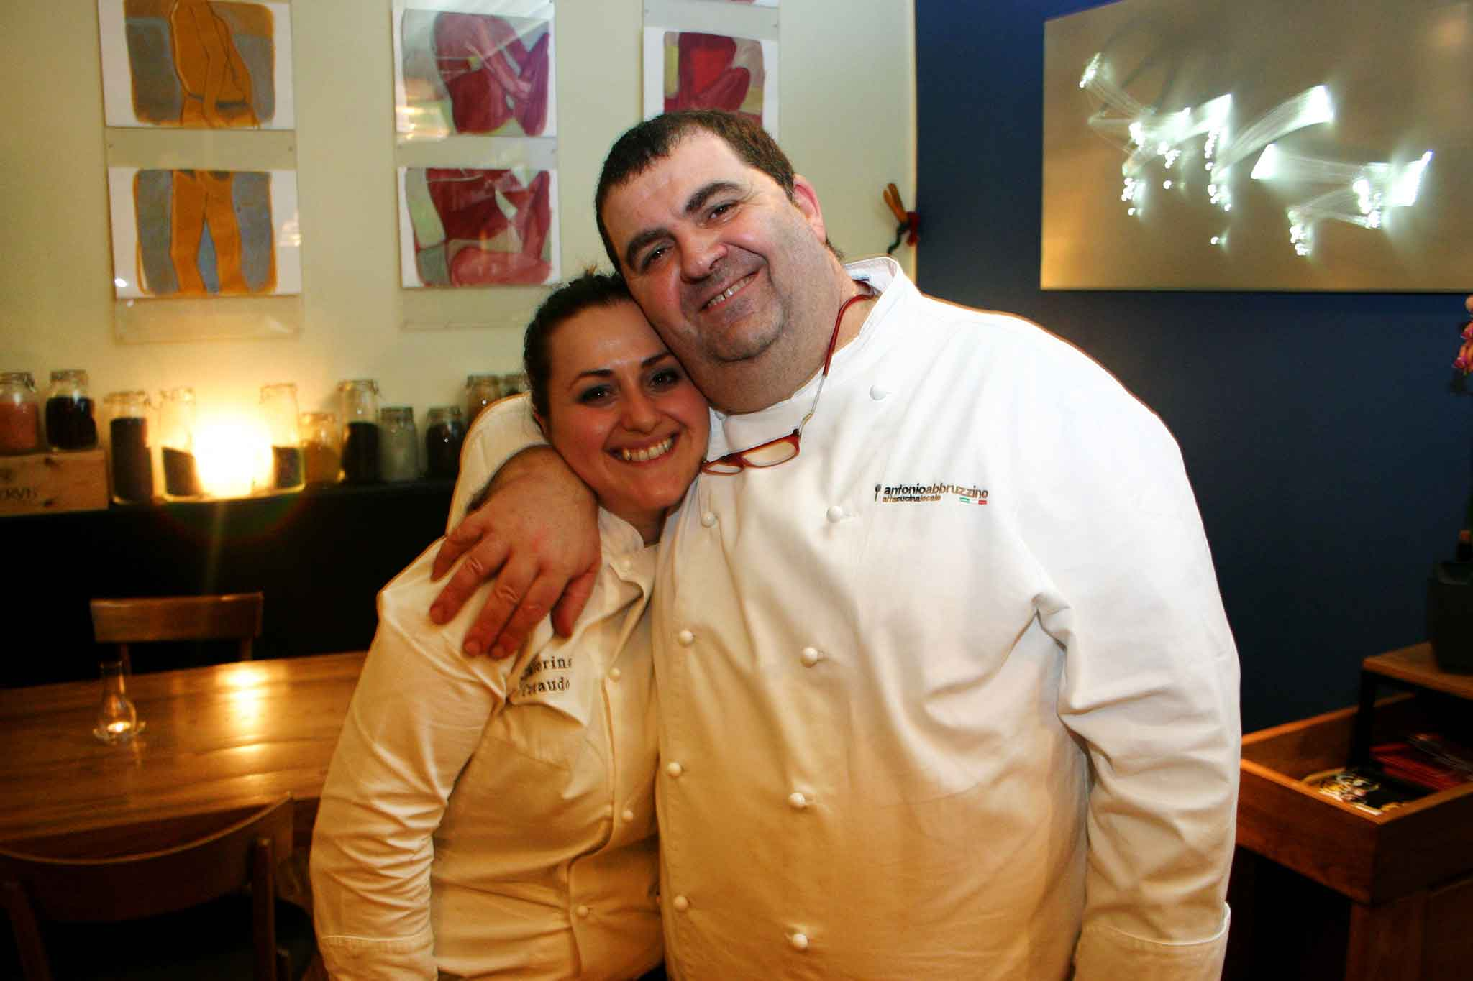
CALABRIA’S STARRY KITCHEN

Slide 2
Delicious Calabria
Geographically Calabria is considered the toe of the italian boot.The landscapes and crops are amazing, and everything from architecture to cooking methods has been shaped by this area’s contact with conquering cultures: Arabic, French,Spanish,Greek. All have left an imprint on the region’s traditions, and whether the influence has been on kitchen techniques or farming or wine production, the end results are deliciously calabrian.

Slide 3
StarryCalabrian Chefs : Antonio Abbruzzino and Caterina Ceraudo
Antonio Abbruzzino and Caterina Ceraudo are two important starry calabrian chefs known all over the world and appreciated from the biggest and famous international critics.
Let’s meet Antonio and Caterina through their delicious recipes and know their personalities and ways of cooking!

Slide 4
ANTONIO ABBRUZZINO
Antonio Abbruzzino grew up in Catanzaro. He was influenced by his mother that had a lot of italian restaurants in Germany. After attending culinary school, he went to Japan, Russia, Turkey, Germany but he wasn’t lucky enough to work with the great chefs of the world so he had to borrow ideas from here and there. Then he decided to open a restaurant in Cantanzaro (Calabria) with his wife Rosetta. Antonio’s restaurant was awarded a Michelin star in 2013. He works with his son Luca and he has brought new ideas to the kitchen. ‘I have to credit him with the star.’ – he says. Luca would become a chef and at the moment he works in his parents’ restaurant. After leaving school he travelled and worked with chefs such as Gennaro Esposito; travelling helps Luca to express himself and find inspiration for his cooking, but he says he would never leave Calabria to work abroad. In 2016 he was named young chef of the year by L’Espresso. Luca and Antonio have different styles but are united by their passion for Calabria’s produce and Antonio's favourite ingredient is Calabria’s famous sweet, red Tropea onion.

Slide 5
MICHELIN’S REVIEWS…
Since 2008 Ristorante Abbruzzino has been at the forefront of the Calabrian food scene, with chef-owners Luca and Antonio Abbruzzino taking the best of local produce and turning it into world-class cuisine. In 2013 the restaurant was awarded a Michelin star – something father Antonio credits to his son Luca’s inventive, creative approach.
Luca returned home to work at the family restaurant after travelling around Italy and abroad; something that shines through in the dishes on offer. Spaghettone is flavoured with black sesame and desserts feature exotic fruits such as loquats, from China. But it’s the combination of Luca’s love for international ingredients combined with his father’s mastery of and dedication to the traditional food of Calabria that led to Ristorante Abbruzzino’s success. You’ll see iconic Calabrian ingredients given just as much care and attention – Tropea onions, bergamot, salted cod and aubergines feature heavily, but each are treated to minimalist modern twists thanks to Luca.
The restaurant itself was completely refurbished by architect Michele Panza in 2016, giving the dining room a simple, elegant atmosphere and drawing all attention to the food itself. Curious diners can watch the kitchen at work through a large window, and in summer customers can choose to eat outside in the beautiful garden at the front of the building, which sits in a quiet residential area of Catanzaro. There are several menus to choose from, including a vegetarian tasting menu, and matching wines come from regional producers across Italy.

Slide 6
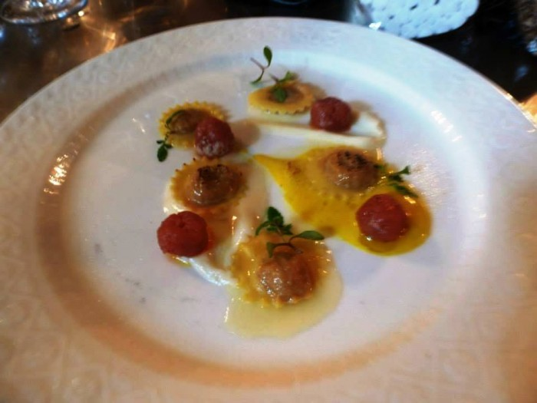
Abbruzzino’s ravioli ripieni
Since 2008 Ristorante Abbruzzino has been at the forefront of the Calabrian food scene, with chef-owners Luca and Antonio Abbruzzino taking the best of local produce and turning it into world-class cuisine. In 2013 the restaurant was awarded a Michelin star – something father Antonio credits to his son Luca’s inventive, creative approach.
Luca returned home to workt the family restaurant after travelling around Italy and abroad; something that shines through in the dishes on offer. Spaghettone is flavoured with black sesame and desserts feature exotic fruits such as loquats,from China. But it’s the combination of Luca’s love for international ingredients combined with his father’s mastery of and dedication to the traditional food of Calabria that led to Ristorante Abbruzzino’s success. You’ll see iconic Calabrian ingredients given just as much care and attention – Tropea onions, bergamot, salted cod and aubergines feature heavily, but each are treated to minimalist modern twists thanks to Luca.
The restaurant itself was completely refurbished by architect Michele Panza in 2016, giving the dining room a simple, elegant atmosphere and drawing all attention to the food itself. Curious diners can watch the kitchen at work through a large window, and in summer customers can choose to eat outside in the beautiful garden at the front of the building, which sits in a quiet residential area of Catanzaro. There are several menus to choose from, including a vegetarian tasting menu, and matching wines come from regional producers across Italy.

Slide 7
INGREDIENTS:
METHOD:
50 g of 00 flour
150 g of hard wheat flour
10 yolks
200 g of meat for meat sauce
5 tomatoes
1 white onion
basil as needed
50 g of minced beef
50 g of fresh whipped cream
30 g of grated parmesan cheese
Extra virgin oil as required
salt and pepper as required
a knob of sage butter as required.
Make a classic ragù, whisk it to get the stuffing for the ravioli. Then, knead the freash pasta with the flour and six yolks. Proceed to form the ravioli. Make a tartar with meat, season with salt, pepper and oil and make some meatballs. To make the sauce, cook the cream on a low light, taking care that it never boils, and melt the cheese. Then, prepare four yolks for the marinade with salt and sugar (1 to 1 ratio) for three hours. Remove from the marinade and sieve to get a cream. Serve the ravioli with meat sauce, seasoned with butter and sage, with the cream; accompanied with the meatballs together with the chilli oil. Finally, to give the idea od 'crust' au gratin, 'burn' the ravioli with blowpipe , if available or gratin quickly in your oven. Decorate with herbs as desired and serve hot.
According to the Michelin Guide, Ceraudo's dishes are ''modern and also not complicated , where the flavour is often balanced by the right doses of acidityand sweetness''.
Those who have tasted them know how much she loves simplicity.
In a region where food is always imagined in great quantities, her style has a flair of intelligence. And of course it represents a nice italian story of feminine entreprise.

Slide 8
Hidden Gems in Calabria Some of the best meals in Italy are found in the Southern region of Calabria. Places like Ristorante Dattilo in Isola Capo Rizzuto and Antonio Abbruzzino in Catanzaro offer one of the best cuisine experiences you could ever have. Calabria is well known for spicy dishes as well as bergamot. These restaurants provide vineyards and olive groves that are cultivated without the use of chemicals and the attacks from parasites are prevented through meteorological screens. Food, wine, tastes and delicacy are combined resulting in an experience that doesn’t just feel like “going to a restaurant” but living an emotion. Here’s what the clients have to say about “Ristorante Dattilo”:
“An unforgettable experience”
This was, without a doubt, one of the best meals I've ever had. Every course in the tasting menu was well thought out, well executed, and incredibly delicious. I love how the menu is based on traditional Calabrian cuisine but with a twist. The service was impeccable as well. Considering all the work and quality that goes into a meal like this, the price was very reasonable. If you're in or around the area, do not miss the chance to have an unforgettable culinary experience here!!
“Top Italian Cuisine”
This is the great place you can choose to deligh your taste buds. An experience you'll not repeat again anywhere else. From the tuna tartare to the pear sorbet in a creamy goat cheese, all you can taste is simply awesome. All to be served with good Italian wine.
“First Michelin star well deserved”
Antonio Abbruzzino and family received their first Michelin star! We are not surprised and would like to warmly congratulate him and his family on this well deserved distinction! We enjoyed a fantastic meal in June 2013 and are looking forward to return soonest. If you are in the south of Italy, do not miss Antonio Abbruzzino's fine food. Highly recommended....

Slide 9
CATERINA CERAUDO
Caterina Ceraudo, 29 years old, was recently awarded the Michelin Chef Woman Prize 2017 thanks to her amazing job at her restaurant Dattilo. Caterina has grown up in a green environment because her father was a forward-thinking entrepreneur who decided to set up a green company. She graduated from Pisa University in Enology and Viticulture and was able to increase the notoriety of her restaurant Dattilo in Crotone (Calabria) which was also celebrated by the New York Times. Her aim is to make the clients happy and her cuisine is a place in continuous evolution. She also wants to open other restaurants in Italy. Since the italian cuisine is becoming even healthier, one of Caterina’s best dishes is a fennel dessert, with no fat and very popular with her clients. She is against all kinds of sex discrimination… She thinks it is necessary to increase the number of women chefs. For this reason, Caterina sees her prize as a sign of encouragement for all the aspiring female chefs in the world.

Slide 10
MICHELIN’S REVIWS…
Caterina Ceraudo, 29 years old, was recently awarded the Michelin Chef Woman Prize 2017 thanks to her amazing job at her restaurant Dattilo.
Caterina’s story is a very interesting one. She is the youngest of three children of Roberto Ceraudo, a forward-thinking entrepreneur who decided to set up a green company, 100 percent sustainable.
Roberto Ceraudo founded his company in the 1980s committed not to use pesticides anymore but to leave the nature to go with its rhythms. Today, the company has become an icon of excellence and good practices, based on a strong green ethics and producing one of the best rosé wines in the world.
Caterina has grown up in this green environment and she is the image of Dattilo, restaurant Ceraudo’s company restaurant. “My final aim is to make the clients happy”, Caterina explained to the Italian newspaper La Repubblica, “and my cuisine should be a place in continuous evolution”.
Caterina is an expert of haute cuisine and this is certainly a difficult business to launch in Crotone, one of the poorest areas of Calabria. Nevertheless, Caterina has no intention to give up to her restaurant. Instead, she is envisaging the opening of other restaurants in Italy.
Since the culinary panorama in Italy is becoming even healthier, one of Caterina’s master plate is a fennel dessert, “basically with no fat and very requested by our clients”, Caterina said.
The young Italian Chef is not only very good at cooking but is also highly educated. She graduated from Pisa University in Enology and Viticulture and was able to increase the notoriety of her restaurant, which was also celebrated by the New York Times.
When commenting on her great achievement, Caterina stated “I’m against all kinds of sex discriminations… I think it is necessary to increase the number of Chef women”. For this reason, Caterina sees her prize as a big sign of encouragement for all the aspiring female chefs in the world.

Slide 11
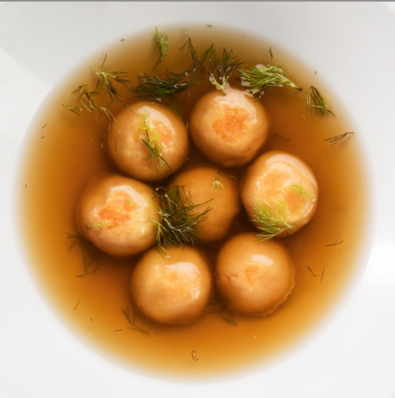
CERAUDO’S SMALL BUTTONS
According to the Michelin Guide, Ceraudo's dishes are ''modern and also not complicated , where the flavour is often balanced by the right doses of acidityand sweetness''.
Those who have tasted them know how much she loves simplicity.
In a region where food is always imagined in great quantities, her style has a flair of intelligence. And of course it represents a nice italian story of feminine entreprise.

Slide 12
INGREDIENTS:
METHOD:
For the dough;
Knead all the ingredients. Put the dough in a vacuum bag and let it stand for 30 minutes.
For the filling;
Hydrate the almonds for 24 hours. Beat and sift the " 'nduja". Put the " 'nduja" and the almonds in a bowl and cream the mixture. Put it into a pastry bag.
Roll out the dough to form two sheets 2cm thick.
Cut the buttons and give them a shape.
For the stock;
Put the potato peelings in a pan, salt and roast them in the oven at 180C for 30 minutes.
Put the peelings with water in a pressure cooker and cook for 40 minutes.
Filter and add salt. Boil the buttons in salt water for 1 minute.
Place the buttons in the middle of a dish and pour over the hot potato stock.
Add some drops of white wine and the fennel beard.
To make the pasta:
700g of 00 flour
300g glour senator hats
600g yolks
1 whole egg
White vinegar
A pinch of salt
For the stuffing:
500g blanched almonds
100g sieved 'nduja
For the potato soup
1kg of potato peel
1l water
Dressing:
white wine
fennel beard.

Slide 13
CERAUDO’S REVIEWS
“It’s beyond!”
We had dinner in this restaurant during our holidays in Calabria. A really positive experience! Because of its high quality food (bio products, olive oil etc.) and traditional dishes. The location is fantastic and cooking is original! The wine is excellent!
“That’s perfect!”
I’ve been in so many restaurants, but I’ve never found a such good and elegant one. It has got a Michelin star and is located in the countryside close to Strongoli. The waiters are really fast and professional! I’ll surely come here again.
“Wonderful!”
The location is stunning in little details and there’s a huge chimney in the hall. The service is good and menu is full of delicacies! The prices are enough accessible, even if it has just got a Michelin star!

