Slide 1
СУ “ВИЧО ГРЪНЧАРОВ”
гр. Горна Оряховица, ул.”Цар Освободител” №6, е-mail: school@vicho-grancharov.eu; тел.0618/ 6-04-59

Slide 2
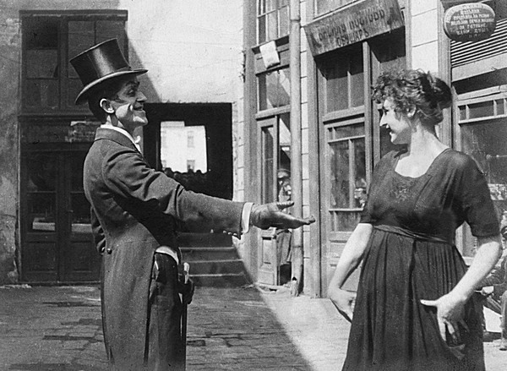
The history of the Bulgarian cinema

Slide 3
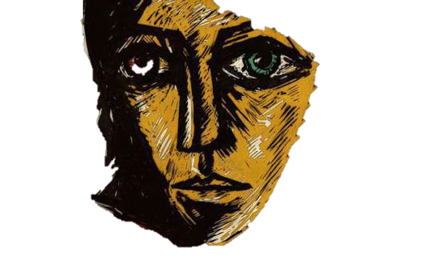
"Blind Vaisha“
"Blind Vaisha" is a short animated film by the animator Teodor Ushev .
The story tells about a girl who sees the past with her left eye and the future with her right eye, and thus finds herself unable to live in the present.
The film is produced by Mark Bertrand for the National film Board of Canada, with participation of ARTE France.
In 2017 , the eight – minute film was nominated for an Academy Award in the category of animated short films along with 4 other nominations.

Slide 4
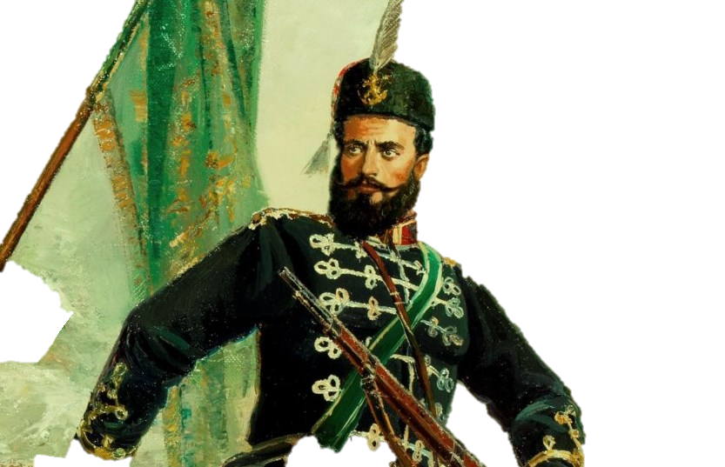
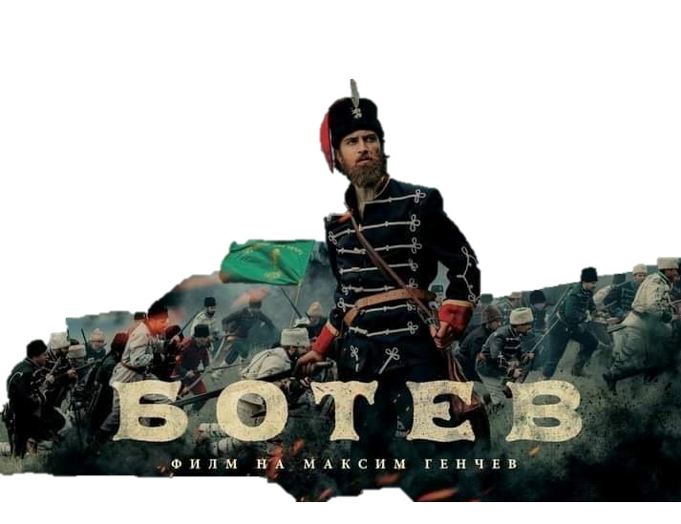
,,Botev‘‘
The movie tells the story of the bulgarian poet and revolutionary- Hristo Botev. A young rebel who swore to fight for the freedom of his country. This movie shows the tough life of the bulgarians during the Ottoman slavery. Hristo Botev is a symbol of liberation and freedom to the bulgarian nation, a figure who have his life for his people.
The movie takes place in 1876, in this year a rebellion was started against the Ottoman empire.
He led a handful of young men rebels in 1876. The young revolutionaries gather in Giurgiu, on free Romanian land, and draw up a plan for the liberation of enslaved Bulgaria.

Slide 5
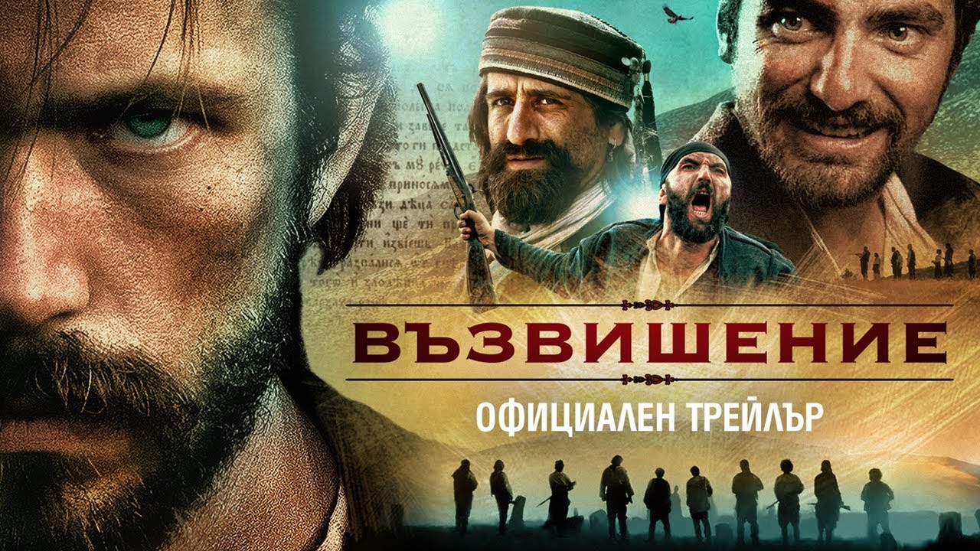

Slide 6
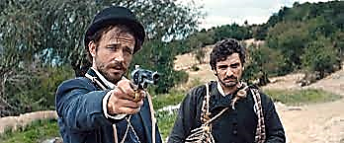
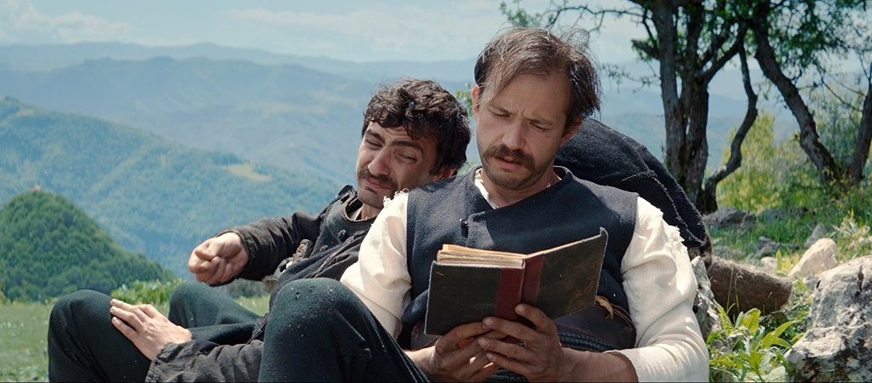
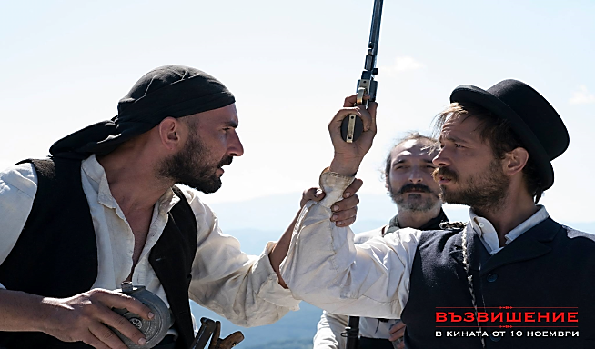
,,Възвишение‘‘ / „Ascension“
‚,Ascension‘‘ is a Bulgarian-Macedonian historical film from 2017 based on the novel of the same name by the writer Milen Ruskov. The director of the film is Viktor Bozhinov.
The story is a mixture of historical facts and fiction. In 1872, Dimitar Obshti and his associates carried out the Arabakonash robbery. Among the group that did the robbery are Gicho (Alek Alexiev) and Asencho (Stoyan Doichev). The two were tasked by the revolutionaries to find and deliver a letter to Vasil Levski. The search turns into a real adventure and trial for the two.

Slide 7
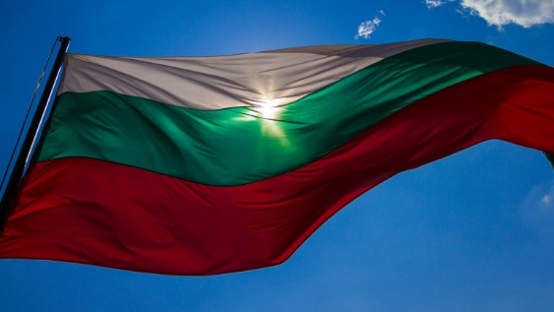
Thank you for your attention!
Made by: The Bulgarian team

