Slide 1
OFF THE MAIN HIGHLIGHTS training on: audio RECORDING, EDITING, SHARING
Trainer: Šárka Opatová
Gymnázium Děčín, the Czech Republic

Slide 2
GREAT TRAINING CONTENT ☺
1. ROLE OF AUDIO IN OUR PROJECT slide 3
2. RECORDING IN A VOICE RECORDER – with a mobile phone s.4-6
RECORDING OFFLINE IN YOUR COMPUTER
A) recording in Windows slide 3-7
B) recording in POWERPOINT slide 8-10
2. RECORDING ONLINE slide 11-20
A) SOUNDCLOUD APP – with a mobile phone
B) SOUNDCLOUD website – with a computer/laptop
4. AUDACITY – recording, editing in an audio software slide 21-
5. PRACTICAL TRIAL

Slide 3
Audio Recording In Our Project
FOR:
Google My Maps markers – every marker will have an audio e.g. information about the place / cultural experience the marker is about / there can be an interview with a local person about the place
For the Twinspace – greeting / messages / instruction / feedback on an activity
Journal that students / teachers write about their work in the project – an entry can be an audio, it is quicker to speak than to write
Dissemination sources
e.g. a school‘s website / project website

Slide 4
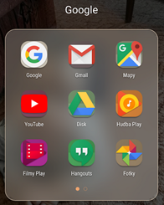
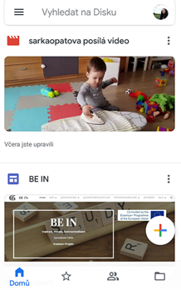
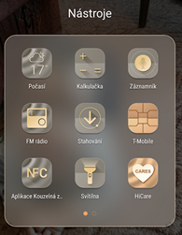
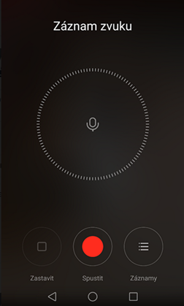
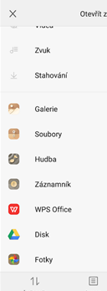
RECORDING WITH YOUR MOBILE PHONE RECORDER
2. Tap on the red dot to START. Tap on the square to STOP. Name it.
1. Tools – Tap on RECORDER

Slide 5
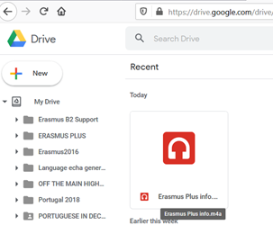
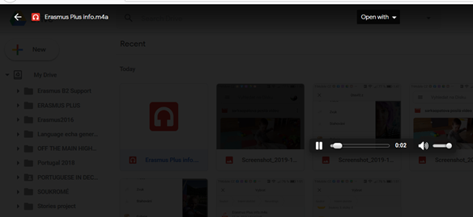
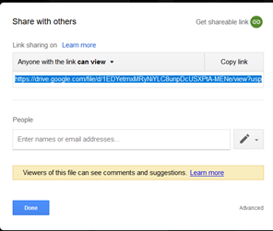
Your audio is in Google Drive.
Click on it 2x to PLAY IT.
3. It is playing.
4. Share it with a link.
„Erasmus Plus info“ audio in my Google disk:
https://drive.google.com/file/d/1EDYetmxMRyNiYLC8unpDcUSXPtA-MENe/view?usp=sharing

Slide 6
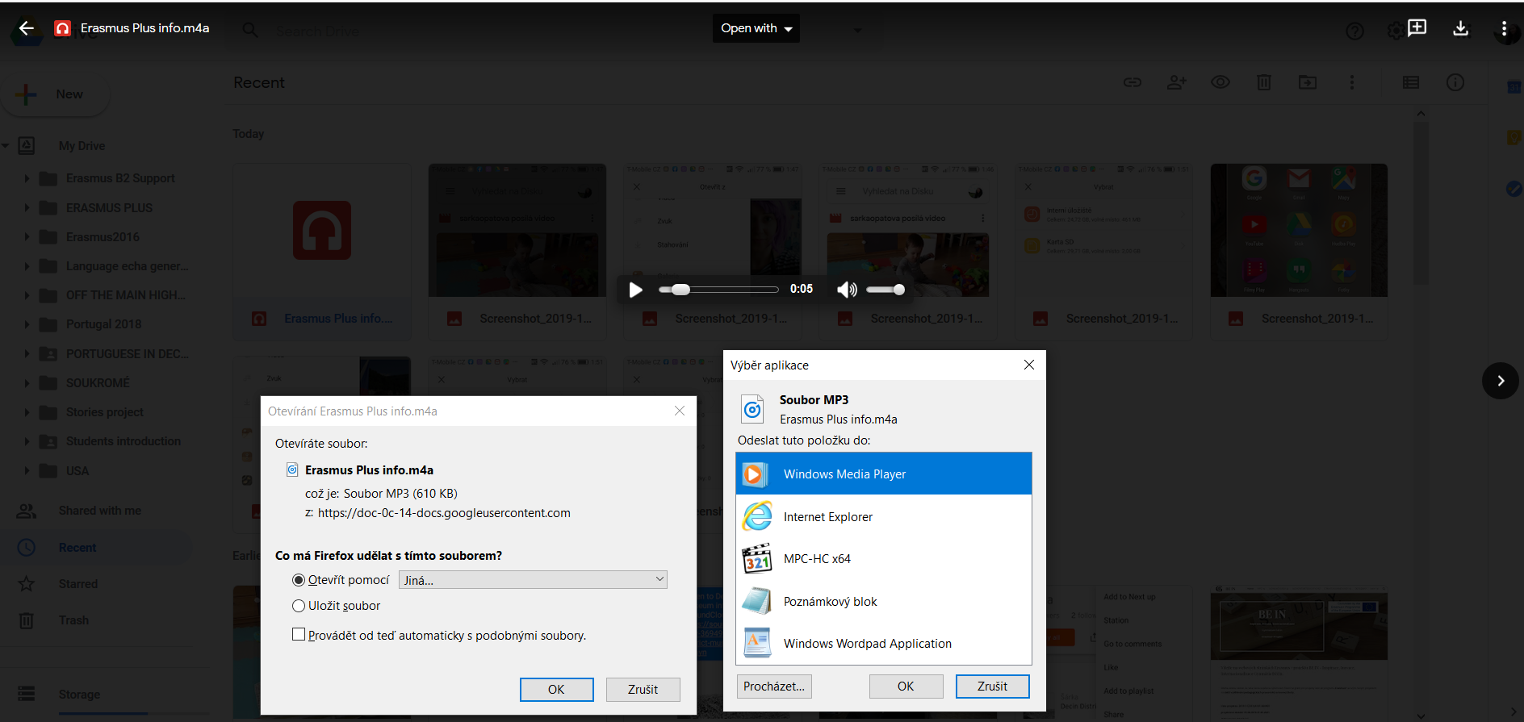
Download it to your computer from the Google Drive in just 3 STEPS.
1.
2.
3.

Slide 8
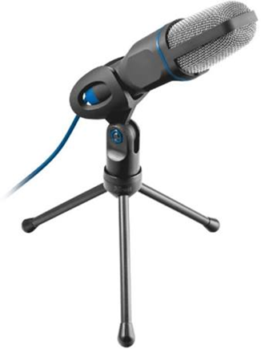
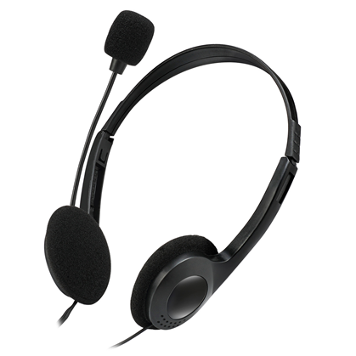
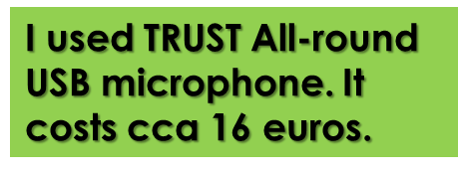
RECORDING AN AUDIO IN WINDOWS
Recording with a laptop – you do not need a microphone.
Recording in a desktop computer – you will need a microphone, e.g. earphones with a microphone.
1. Click on VOICE RECORDING
2. Click on the MICROPHONE and START speaking. Click to STOP it.
For a laptop:

Slide 9
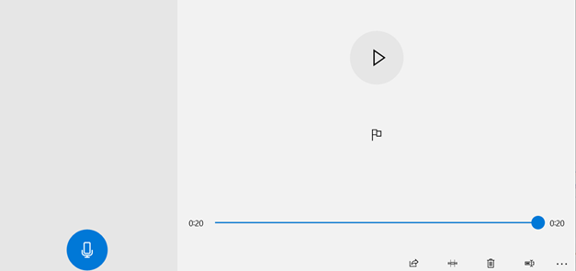
Here is your audio.
Set the microphone.
Open the location of the file.
.
Name it.
Click to CUT THE VIDEO
- You can make it shorter.

Slide 10
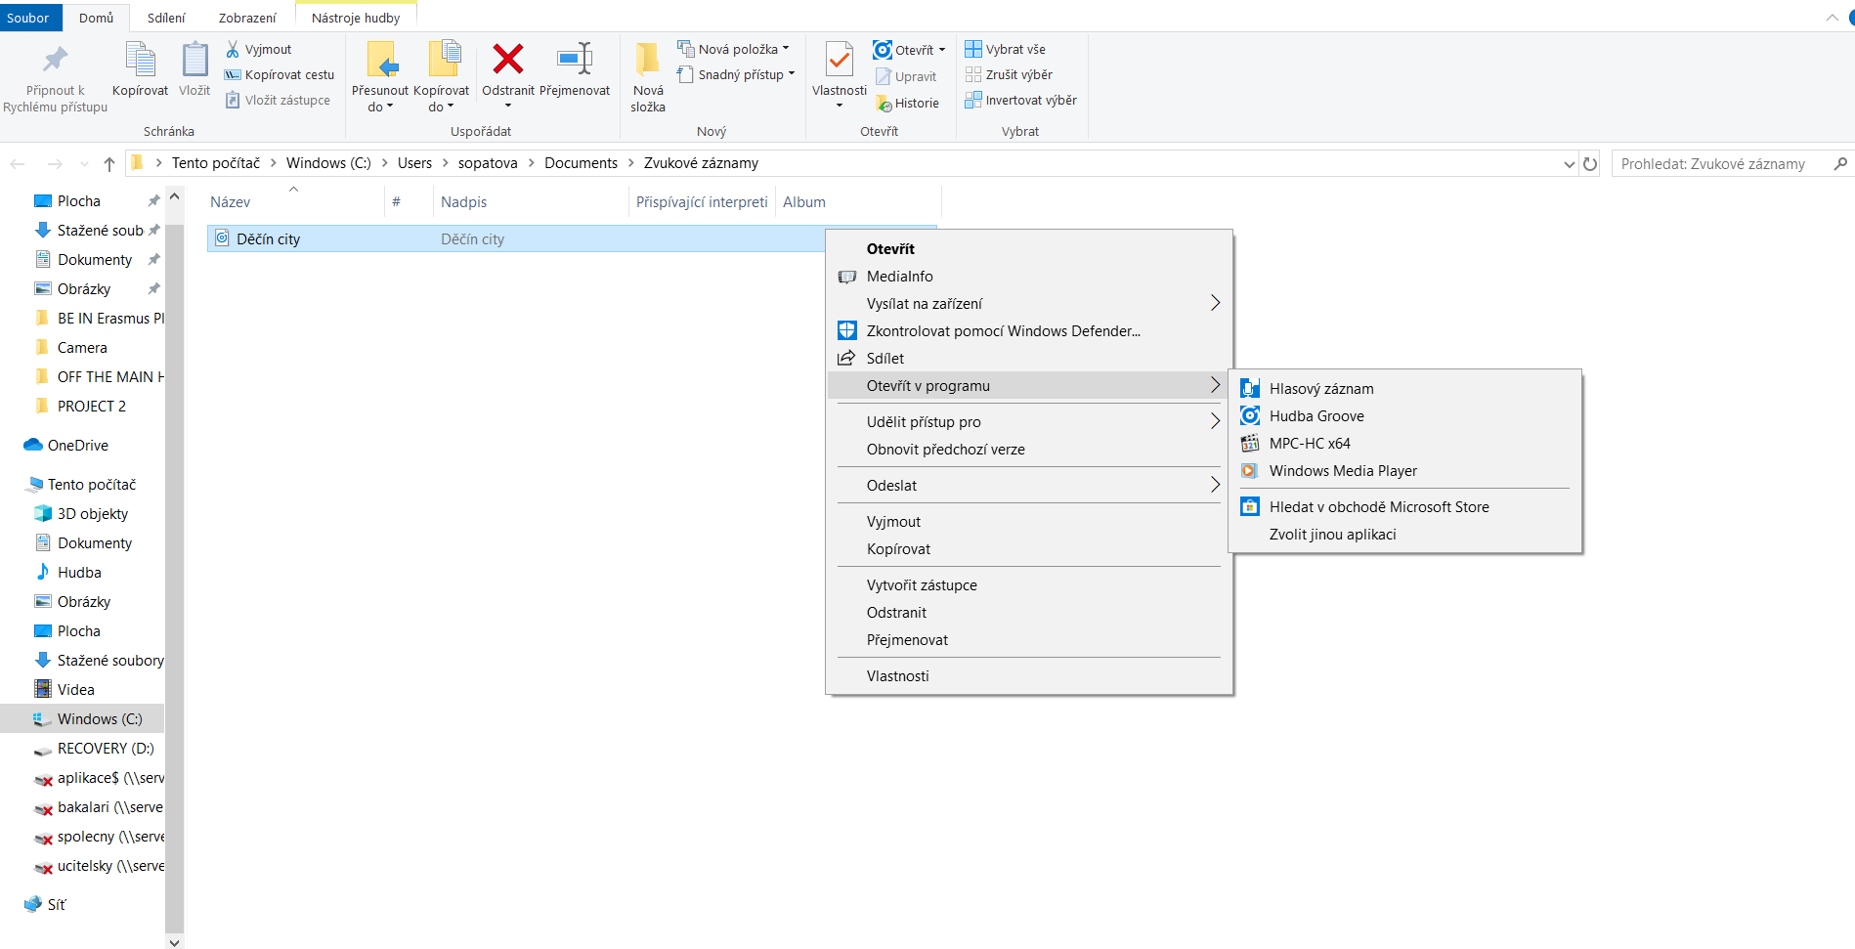
This is an audio recorded in Windows.
The audio file

Slide 12
Audio Recording in POWER POINT
click on INSERT
Click on SOUND
Click on RECORD AUDIO
A table will appear:
Record audio
Name:
Total length
5. Name your audio.
6. Click on the red dot. • to start recording. You may need a microphone, but a laptop does not need it.
7. The blue square  shows it is recording.
Total lenght: seconds
8. Click on OK to stop it.
9. A symbol with your audio will appear.
10. Click on it and listen to your audio.

Slide 13
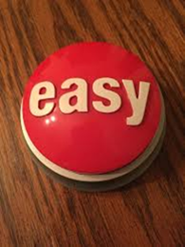
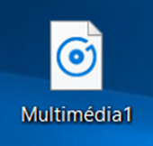
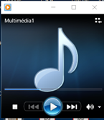
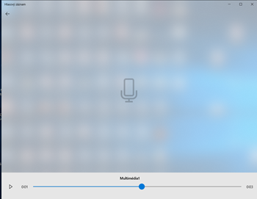
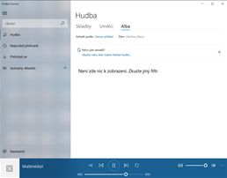
SAVING THE AUDIO YOU HAVE CREATED IN POWERPOINT
Click on the symbol of your audio with the RIGHT part of the MOUSE.
Click on the option ‚Save multimedia as..‘
Click on the option where you want to have it in the computer. e.g. screen / folder
Give it a name.
You can play it in:
Media Player Voice Recording Music Groove
You can upload the audio from your computer to e.g.
youtube /
google disk
and share it.
* Twitter takes a video format, but not just audio. But you can share an audio from soundcloud. It means to upload it to soundcloud and than share through a link.

Slide 15
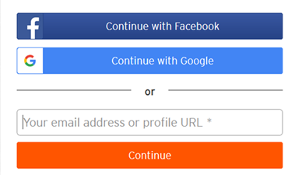
SIGN UP/IN 
A website for music streaming
/ audio uploading and sharing.
You can use it on your computer or
as an app in your mobile phone.
3 hours upload time for free
format like WAV, FLAC, AIFF, or ALAC. OGG, MP2, MP3, AAC, AMR, and WMA.
The max file size is 4GB
https://soundcloud.com/

Slide 16
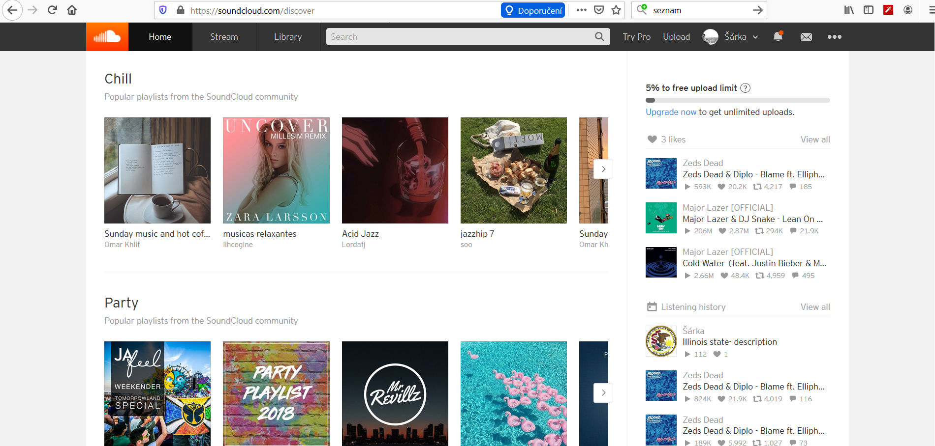
This appears after you sign in
Your name

Slide 17
S
Download an app to your mobile phone
– It is for free. (Appstore or GooglePlay)
- Quick installation.
- You can record an audio.
- You can listen to it in the app or in your online soundcloud account from a laptop/computer.

Slide 18
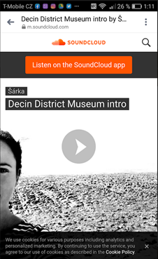
Sharing the audio in the SOUNDCLOUD app
Tap on SHARE
You can share it through Messenger, Whatsapp, save it to Google Disc, send an email
The
person will tap on the link and see this 

Slide 19
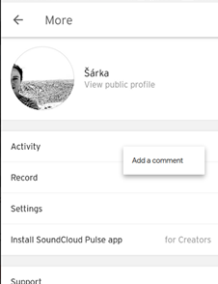
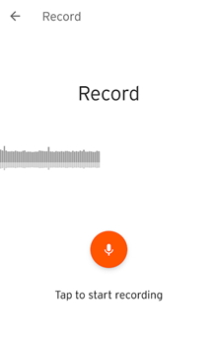
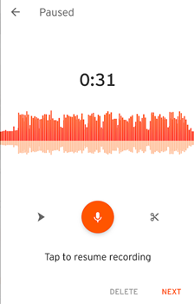
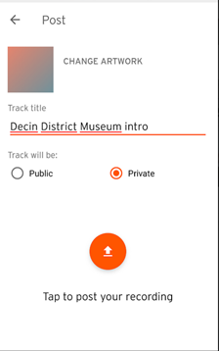
Recording in the soundcloud app
1. Tap on RECORD
2. Tap to START/STOP RECORDING
3. Tap to RESUME if you
want to add something
4. Name it / make it private/ post it = save it
Length in seconds

Slide 20
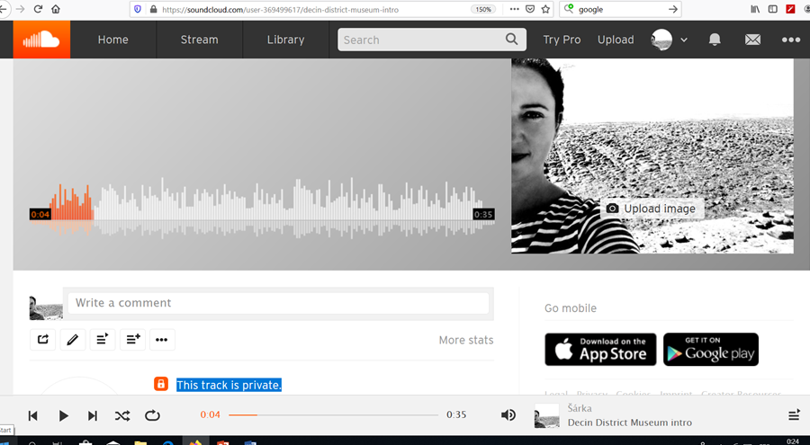
Now you can find your audio recorded in the app also in your soundcloud account in a computer – is is easier to manipulate than in a mobile phone.
You can upload an image to it, otherwise there iwill be your profile image.
share
Screenshot of sharing options
Play the track.
Your track is private/public.

Slide 21
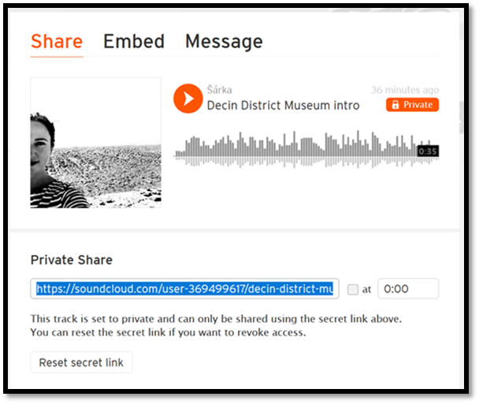
Link will be sent to a soundcloud user, not an e-mail !
LINK
https://soundcloud.com/user-369499617/decin-district-museum-intro/s-mhayn

Slide 22
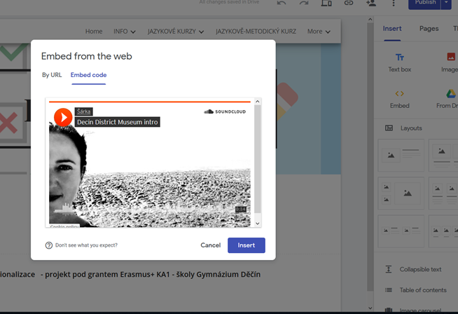
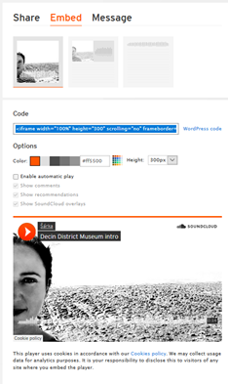
Embed the audio to a website /blog
1. Copy the EMBED CODE
2. Go to your website.
3. Insert the EMBED CODE.
* It can be done through the audio URL (link) too☺

Slide 23
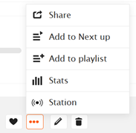
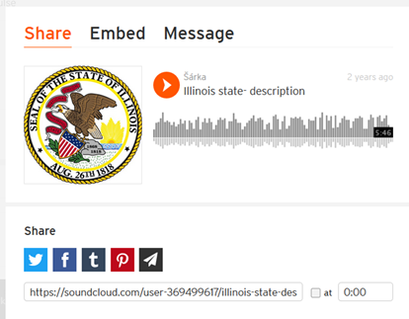
SHARING AN UPLOADED TRACK
When it is PUBLIC
Click on TRACKS 2. Click on . . . At your track 3. SHARE YOUR TRACK
via Twitter, Facebook, e-mail
Only for public mode there will appear these options.

Slide 25
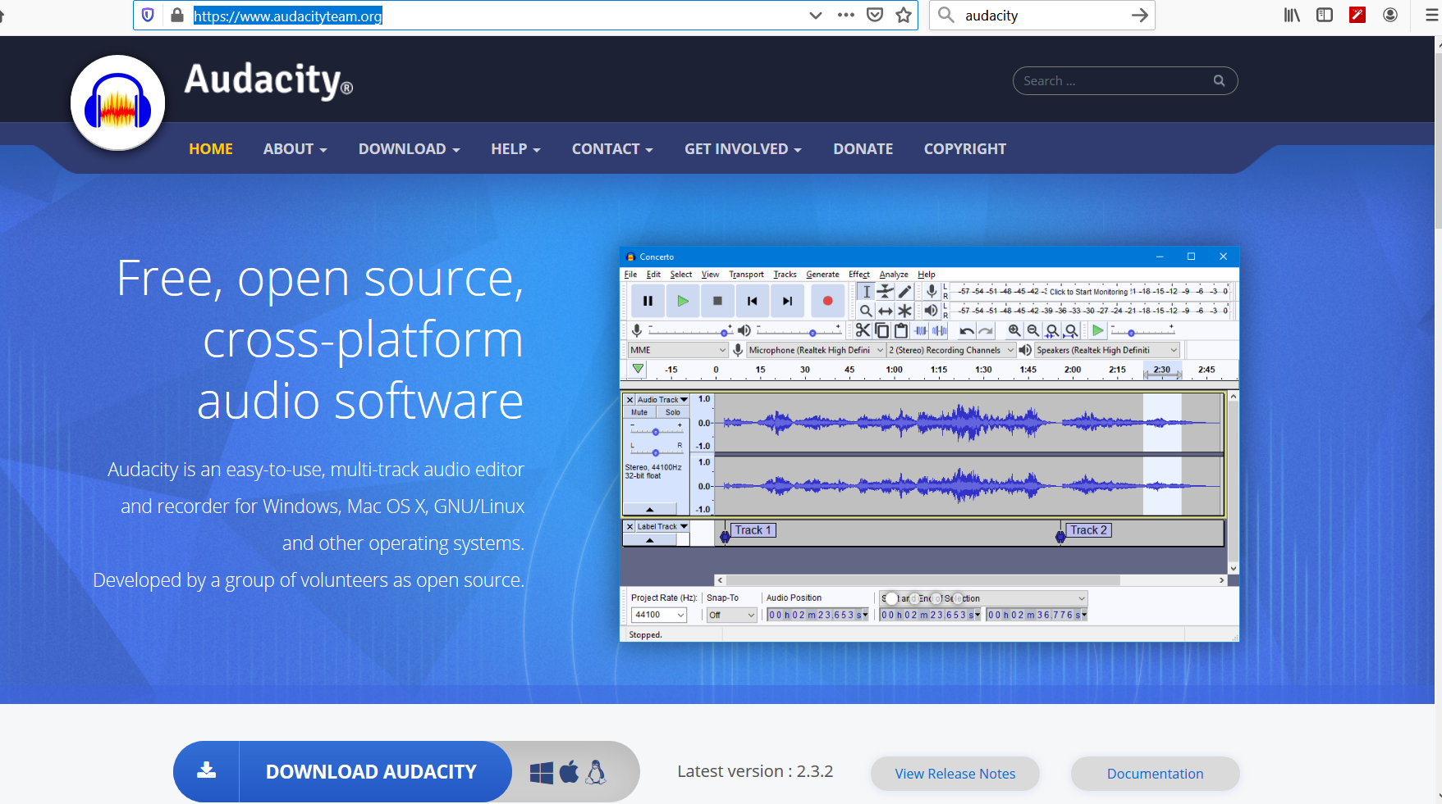
https://www.audacityteam.org/

Slide 26
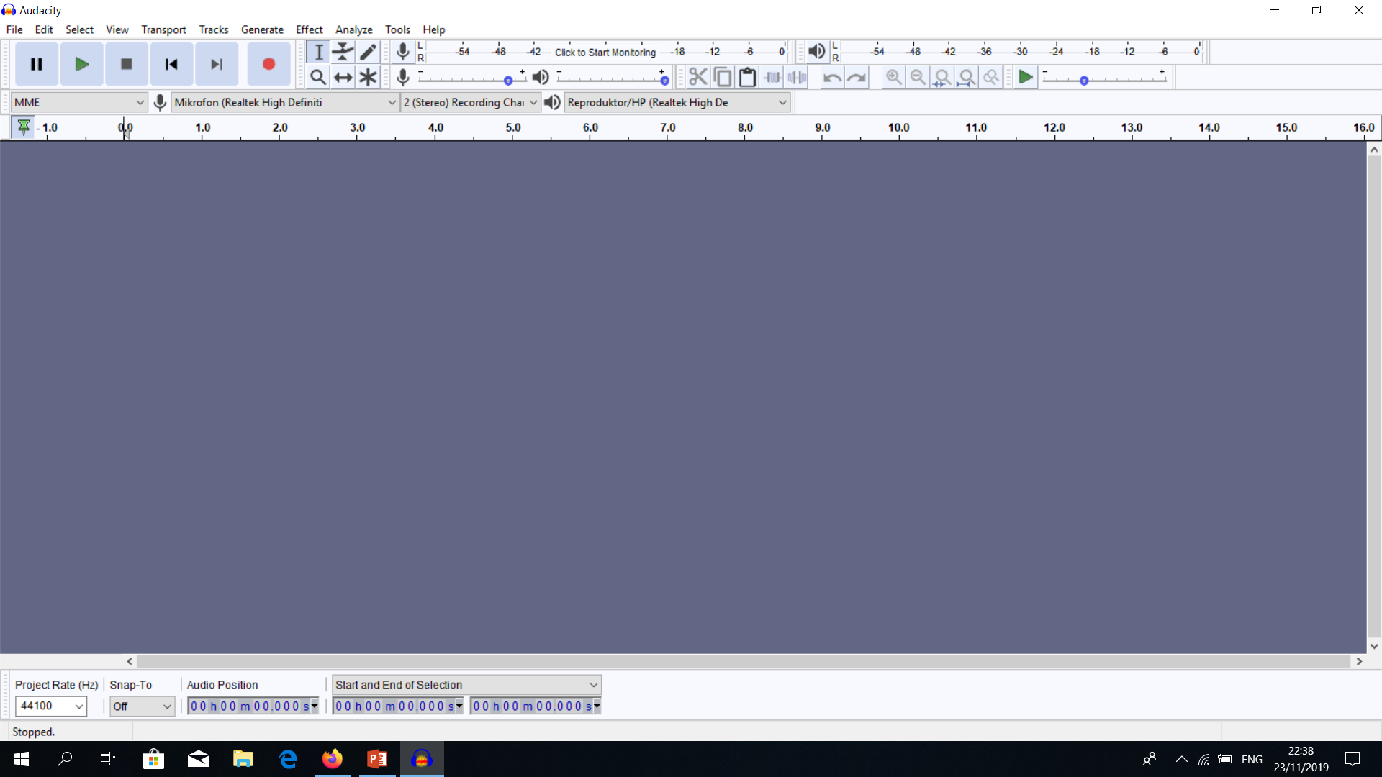
cursorr
PLAY
RECORD
Before recording, set up the volume so that it is loud enough.
STOP
PAUSE
SKIP to START and SKIP to END
TUTORIAL BEGINNER https://www.youtube.com/watch?v=aCisC3sHneM

Slide 27
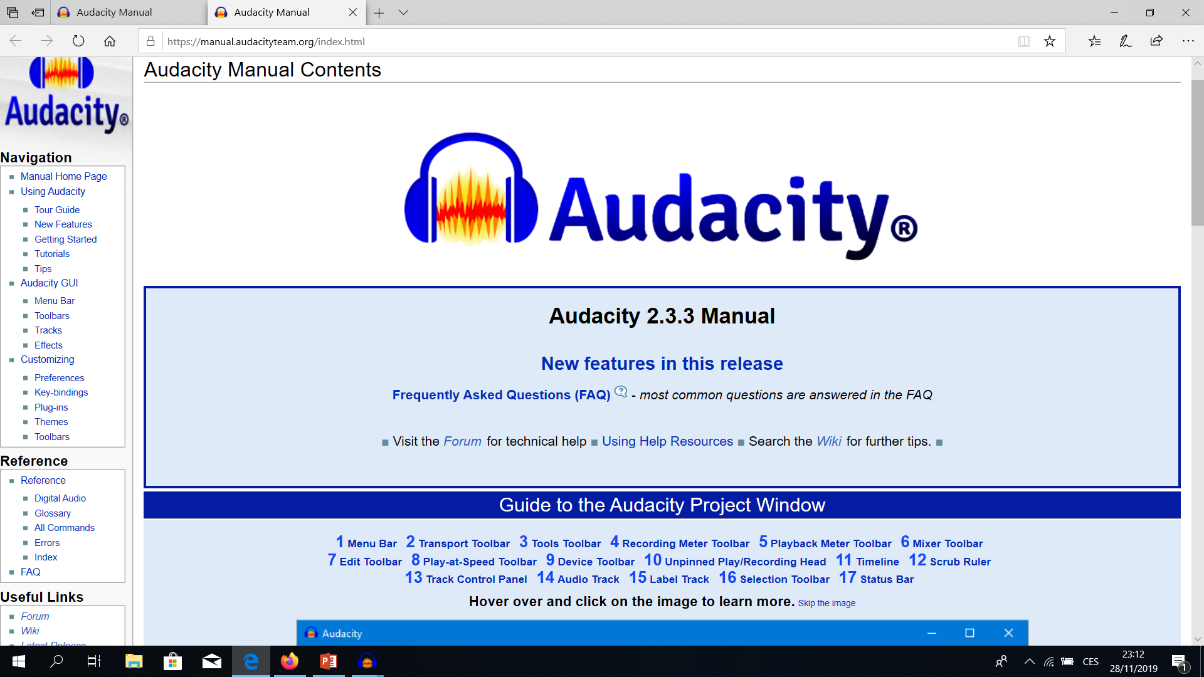
https://manual.audacityteam.org/index.html

Slide 28
AUDACITY EDITING AND MIXING TUTORIAL
Video: https://www.youtube.com/watch?v=8ClwSNm362E

Slide 30
FOR YOUR ATTENTION.
Obrigado pela atenção.
Bedankt voor uw aandacht.
Ačiū už dėmesį.
Obrigado pela atenção.
Děkuji Vám za pozornost.

Slide 31
Off THE MAIN HIGHLIGHTS – audio recording training
Date: 28 November, 2019
Place: Gymnázium Děčín, the Czech Republic, Děčín
Trainer: Šárka Opatová, project coordinator and Erasmus Plus Club co-leader

Slide 32
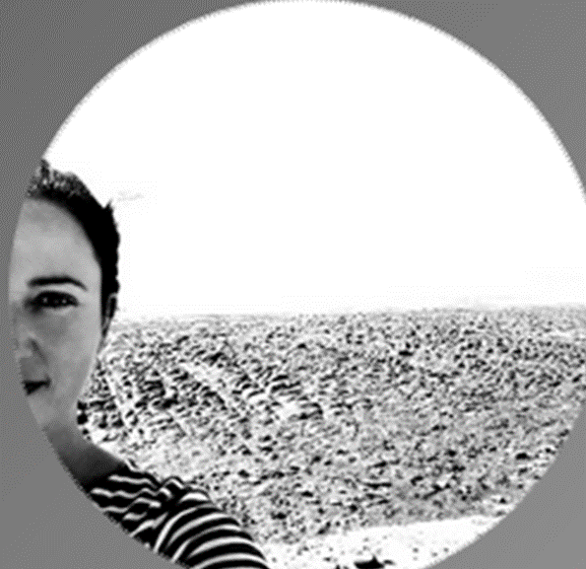
Enjoy the silence ☺

