Slide 1
The Safety on the internet
Off the main highlights, Czechia, February 2020

Slide 2
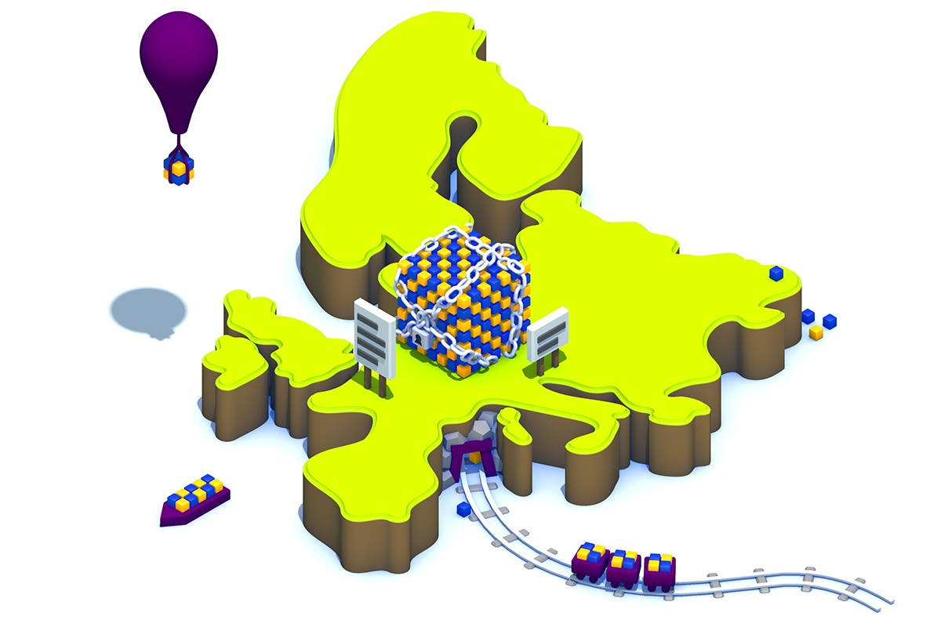
GDPR

Slide 3
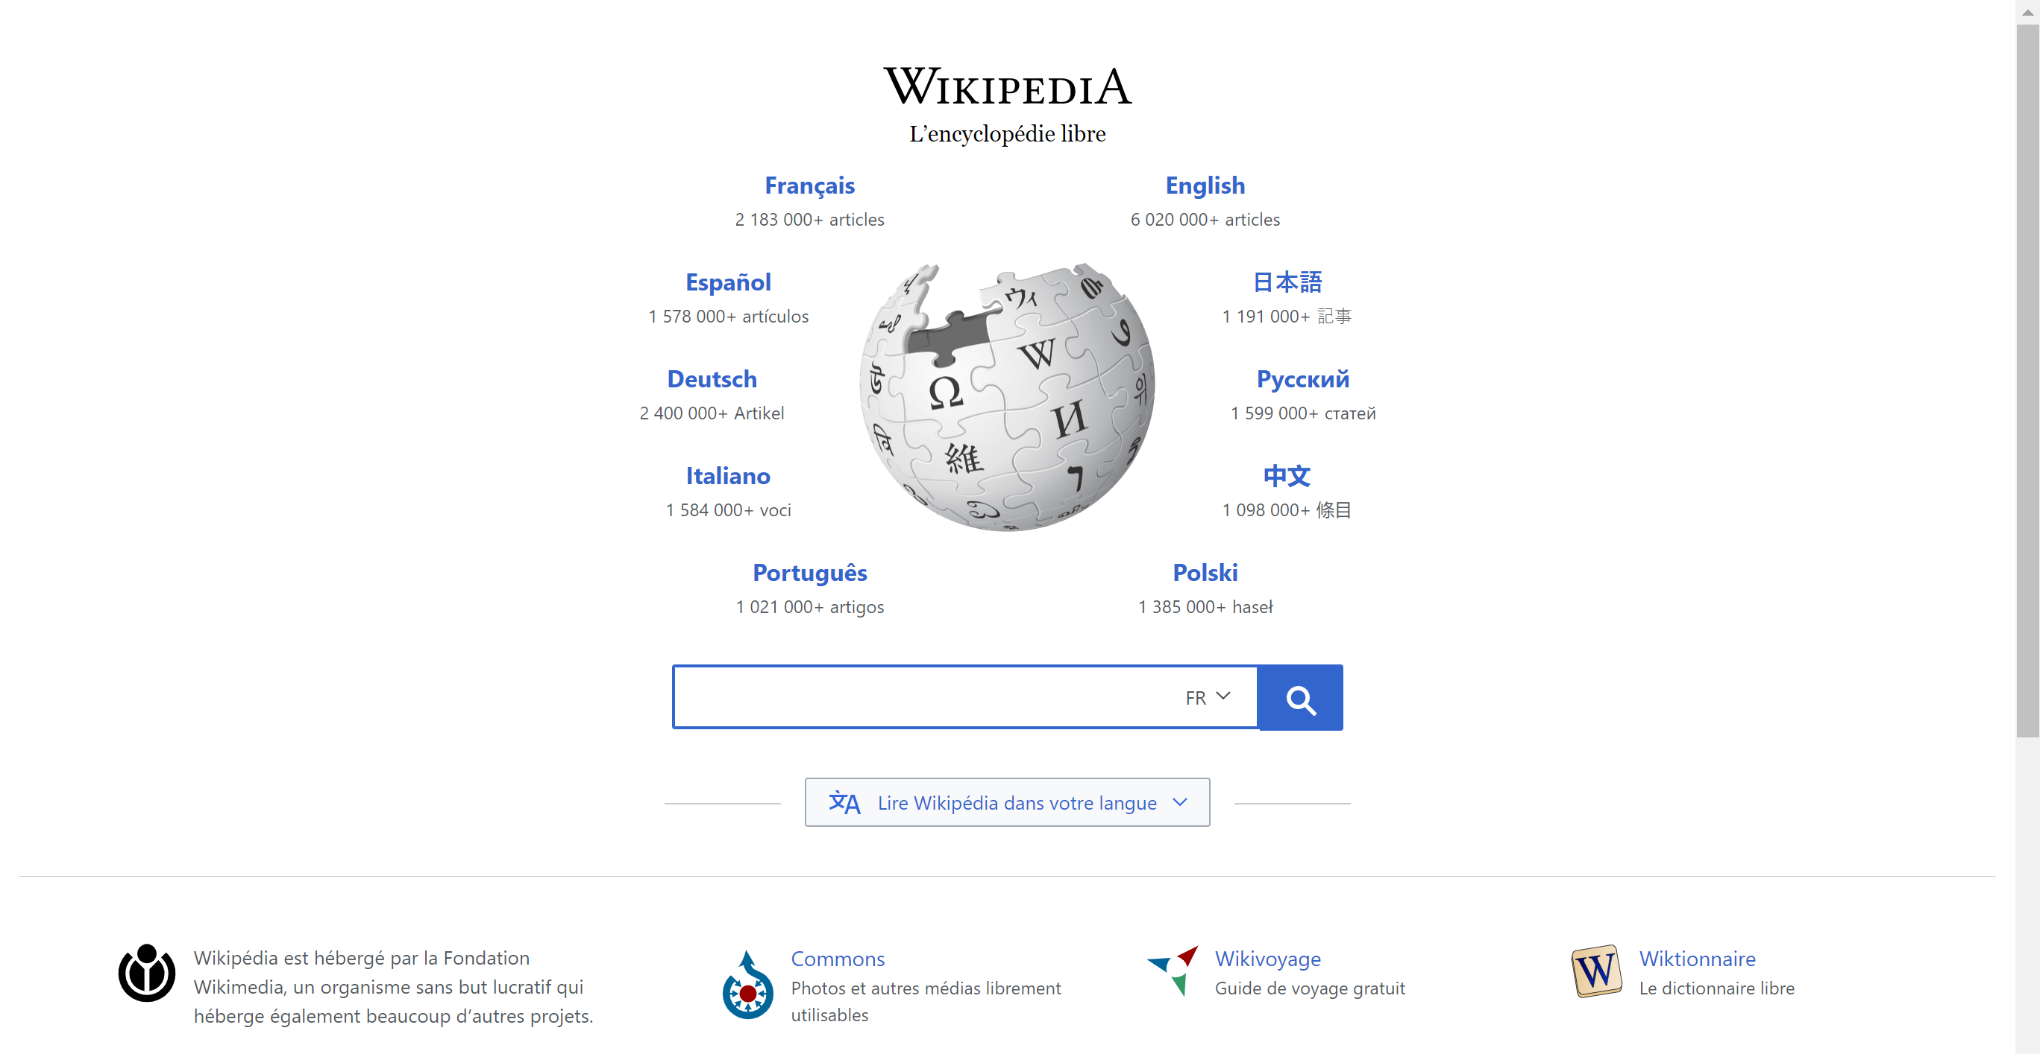
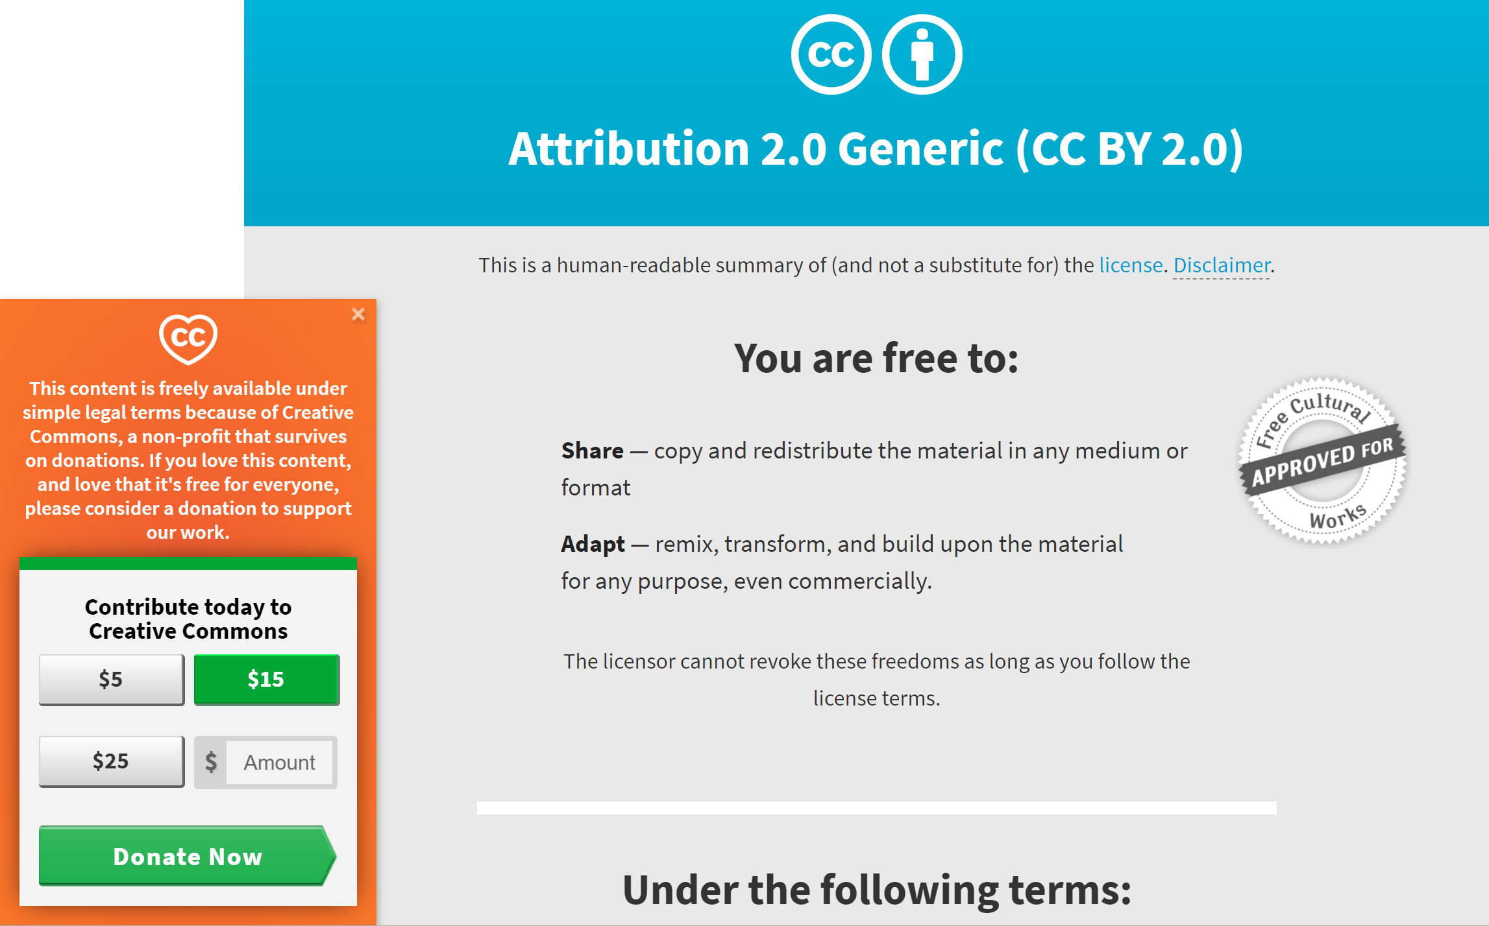
Copyright Directive

Slide 4
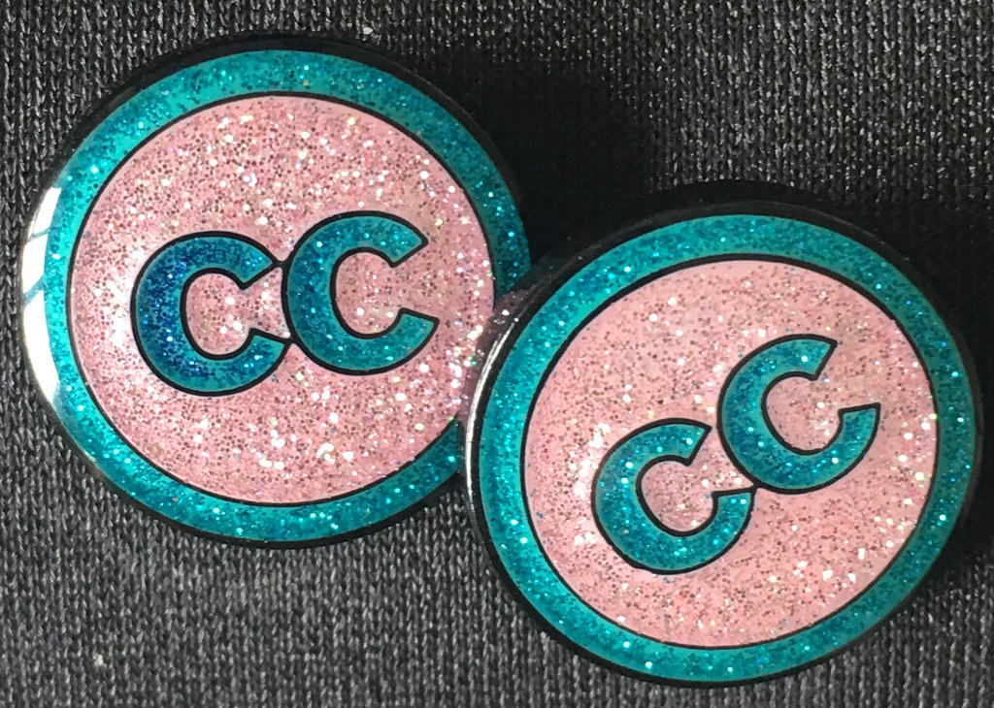
Creative commons

Slide 5
Cookies

Slide 6
SOURCES
<p style="font-size: 0.9rem;font-style: italic;"><img style="display: block;" src="https://farm5.staticflickr.com/4778/27070157078_59dcdf251a.jpg" alt="GDPR & ePrivacy Regulations"><a href="https://www.flickr.com/photos/160103778@N03/27070157078">"GDPR & ePrivacy Regulations"</a><span> by <a href="https://www.flickr.com/photos/160103778@N03">dennis_convert</a></span> is licensed under <a href="https://creativecommons.org/licenses/by/2.0/?ref=ccsearch&atype=html" style="margin-right: 5px;">CC BY 2.0</a><a href="https://creativecommons.org/licenses/by/2.0/?ref=ccsearch&atype=html" target="_blank" rel="noopener noreferrer" style="display: inline-block;white-space: none;margin-top: 2px;margin-left: 3px;height: 22px !important;"><img style="height: inherit;margin-right: 3px;display: inline-block;" src="https://search.creativecommons.org/static/img/cc_icon.svg" /><img style="height: inherit;margin-right: 3px;display: inline-block;" src="https://search.creativecommons.org/static/img/cc-by_icon.svg" /></a></p>
<p style="font-size: 0.9rem;font-style: italic;"><img style="display: block;" src="https://mir-s3-cdn-cf.behance.net/project_modules/max_1200/5333fd29445169.55f30be4b69c8.jpg" alt="Data protection"><a href="https://www.behance.net/gallery/29445169/Data-protection">"Data protection"</a><span> by <span>Kristiaan der Nederlanden</span></span> is licensed under <a href="https://creativecommons.org/licenses/by-nc/4.0/?ref=ccsearch&atype=html" style="margin-right: 5px;">CC BY-NC 4.0</a><a href="https://creativecommons.org/licenses/by-nc/4.0/?ref=ccsearch&atype=html" target="_blank" rel="noopener noreferrer" style="display: inline-block;white-space: none;margin-top: 2px;margin-left: 3px;height: 22px !important;"><img style="height: inherit;margin-right: 3px;display: inline-block;" src="https://search.creativecommons.org/static/img/cc_icon.svg" /><img style="height: inherit;margin-right: 3px;display: inline-block;" src="https://search.creativecommons.org/static/img/cc-by_icon.svg" /><img style="height: inherit;margin-right: 3px;display: inline-block;" src="https://search.creativecommons.org/static/img/cc-nc_icon.svg" /></a></p>
<p style="font-size: 0.9rem;font-style: italic;"><img style="display: block;" src="https://mir-s3-cdn-cf.behance.net/project_modules/1400/fde6a635007481.5920afec9e488.jpg" alt="Alooma - Modern Data Plumbing"><a href="https://www.behance.net/gallery/35007481/Alooma-Modern-Data-Plumbing">"Alooma - Modern Data Plumbing"</a><span> by <span>Eden Vidal</span></span> is licensed under <a href="https://creativecommons.org/licenses/by-nc-nd/4.0/?ref=ccsearch&atype=html" style="margin-right: 5px;">CC BY-NC-ND 4.0</a><a href="https://creativecommons.org/licenses/by-nc-nd/4.0/?ref=ccsearch&atype=html" target="_blank" rel="noopener noreferrer" style="display: inline-block;white-space: none;margin-top: 2px;margin-left: 3px;height: 22px !important;"><img style="height: inherit;margin-right: 3px;display: inline-block;" src="https://search.creativecommons.org/static/img/cc_icon.svg" /><img style="height: inherit;margin-right: 3px;display: inline-block;" src="https://search.creativecommons.org/static/img/cc-by_icon.svg" /><img style="height: inherit;margin-right: 3px;display: inline-block;" src="https://search.creativecommons.org/static/img/cc-nc_icon.svg" /><img style="height: inherit;margin-right: 3px;display: inline-block;" src="https://search.creativecommons.org/static/img/cc-nd_icon.svg" /></a></p>
<p style="font-size: 0.9rem;font-style: italic;"><img style="display: block;" src="https://live.staticflickr.com/8066/8179662807_c6084b4fcb_b.jpg" alt="Creative Commomns Licenses"><a href="https://www.flickr.com/photos/32778871@N06/8179662807">"Creative Commomns Licenses"</a><span> by <a href="https://www.flickr.com/photos/32778871@N06">BockoPix</a></span> is licensed under <a href="https://creativecommons.org/licenses/CC0/1.0/?ref=ccsearch&atype=html" style="margin-right: 5px;">CC0 1.0</a><a href="https://creativecommons.org/licenses/CC0/1.0/?ref=ccsearch&atype=html" target="_blank" rel="noopener noreferrer" style="display: inline-block;white-space: none;margin-top: 2px;margin-left: 3px;height: 22px !important;"><img style="height: inherit;margin-right: 3px;display: inline-block;" src="https://search.creativecommons.org/static/img/cc_icon.svg" /><img style="height: inherit;margin-right: 3px;display: inline-block;" src="https://search.creativecommons.org/static/img/cc-cc0_icon.svg" /></a></p>

Slide 7
sources
<p style="font-size: 0.9rem;font-style: italic;"><img style="display: block;" src="https://farm1.staticflickr.com/815/41043576871_c606a9a5d3.jpg" alt="Gru’s Plan Meme Dump"><a href="https://www.flickr.com/photos/158011776@N05/41043576871">"Gru’s Plan Meme Dump"</a><span> by <a href="https://www.flickr.com/photos/158011776@N05">Daily LOL Pics</a></span> is licensed under <a href="https://creativecommons.org/licenses/by/2.0/?ref=ccsearch&atype=html" style="margin-right: 5px;">CC BY 2.0</a><a href="https://creativecommons.org/licenses/by/2.0/?ref=ccsearch&atype=html" target="_blank" rel="noopener noreferrer" style="display: inline-block;white-space: none;margin-top: 2px;margin-left: 3px;height: 22px !important;"><img style="height: inherit;margin-right: 3px;display: inline-block;" src="https://search.creativecommons.org/static/img/cc_icon.svg" /><img style="height: inherit;margin-right: 3px;display: inline-block;" src="https://search.creativecommons.org/static/img/cc-by_icon.svg" /></a></p>
<p style="font-size: 0.9rem;font-style: italic;"><img style="display: block;" src="https://live.staticflickr.com/8066/8179662807_c6084b4fcb_b.jpg" alt="Creative Commomns Licenses"><a href="https://www.flickr.com/photos/32778871@N06/8179662807">"Creative Commomns Licenses"</a><span> by <a href="https://www.flickr.com/photos/32778871@N06">BockoPix</a></span> is licensed under <a href="https://creativecommons.org/licenses/CC0/1.0/?ref=ccsearch&atype=html" style="margin-right: 5px;">CC0 1.0</a><a href="https://creativecommons.org/licenses/CC0/1.0/?ref=ccsearch&atype=html" target="_blank" rel="noopener noreferrer" style="display: inline-block;white-space: none;margin-top: 2px;margin-left: 3px;height: 22px !important;"><img style="height: inherit;margin-right: 3px;display: inline-block;" src="https://search.creativecommons.org/static/img/cc_icon.svg" /><img style="height: inherit;margin-right: 3px;display: inline-block;" src="https://search.creativecommons.org/static/img/cc-cc0_icon.svg" /></a></p>
<p style="font-size: 0.9rem;font-style: italic;"><img style="display: block;" src="https://live.staticflickr.com/855/30064665718_d43727c1b8_b.jpg" alt="CC lapel pins"><a href="https://www.flickr.com/photos/143825674@N02/30064665718">"CC lapel pins"</a><span> by <a href="https://www.flickr.com/photos/143825674@N02">hj_dewaard</a></span> is licensed under <a href="https://creativecommons.org/licenses/by/2.0/?ref=ccsearch&atype=html" style="margin-right: 5px;">CC BY 2.0</a><a href="https://creativecommons.org/licenses/by/2.0/?ref=ccsearch&atype=html" target="_blank" rel="noopener noreferrer" style="display: inline-block;white-space: none;margin-top: 2px;margin-left: 3px;height: 22px !important;"><img style="height: inherit;margin-right: 3px;display: inline-block;" src="https://search.creativecommons.org/static/img/cc_icon.svg" /><img style="height: inherit;margin-right: 3px;display: inline-block;" src="https://search.creativecommons.org/static/img/cc-by_icon.svg" /></a></p>
<p style="font-size: 0.9rem;font-style: italic;"><img style="display: block;" src="https://mir-s3-cdn-cf.behance.net/project_modules/max_1200/9b0ade65856391.5b02f270e7c5d.jpg" alt="Social Media Ads"><a href="https://www.behance.net/gallery/65856391/Social-Media-Ads">"Social Media Ads"</a><span> by <span>Nimit Gupta</span></span> is licensed under <a href="https://creativecommons.org/licenses/by-nc-nd/4.0/?ref=ccsearch&atype=html" style="margin-right: 5px;">CC BY-NC-ND 4.0</a><a href="https://creativecommons.org/licenses/by-nc-nd/4.0/?ref=ccsearch&atype=html" target="_blank" rel="noopener noreferrer" style="display: inline-block;white-space: none;margin-top: 2px;margin-left: 3px;height: 22px !important;"><img style="height: inherit;margin-right: 3px;display: inline-block;" src="https://search.creativecommons.org/static/img/cc_icon.svg" /><img style="height: inherit;margin-right: 3px;display: inline-block;" src="https://search.creativecommons.org/static/img/cc-by_icon.svg" /><img style="height: inherit;margin-right: 3px;display: inline-block;" src="https://search.creativecommons.org/static/img/cc-nc_icon.svg" /><img style="height: inherit;margin-right: 3px;display: inline-block;" src="https://search.creativecommons.org/static/img/cc-nd_icon.svg" /></a></p>

