Slide 1
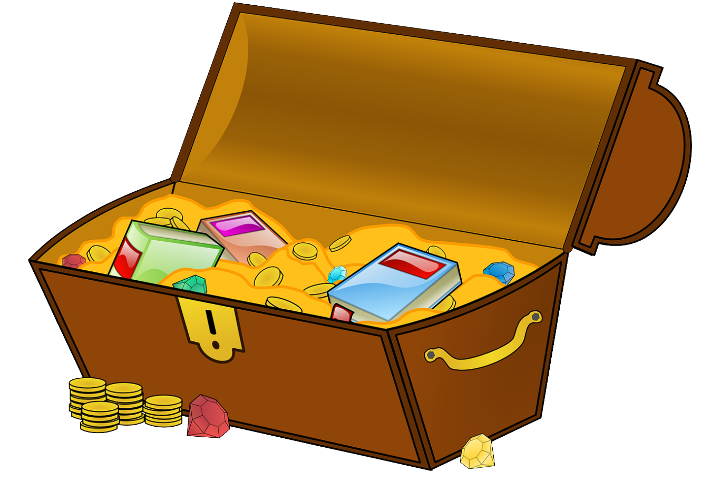
Treasure Hunt training
OFF THE MAIN HIGHLIGHTS
Trainer: Šárka Opatová
School: Gymnázium Děčín, Czechia

Slide 2
CONTENT
1. ROLE OF TREASURE HUNTS IN OUR PROJECT slide 3
2. QR CODES slide 4 – 10
3. TREASURE HUNT APP slide 11-14
4. OUR TREASURE HUNT APP slide 15 – 20
5. HP REVEAL APP slide 21-22
6. WALLAME APP slide 23
PAID:
7. SEPPO APP – this one is paid – 1 month free trial slide 24

Slide 3
Role of Treasure Hunts in Our Project
TH = a game in which the players are given a series of clues (= pieces of information) to direct them to a hidden prize
TREASURE HUNT will be used during MOBILITIES – choose A or B option or combine
A) „to get to the spot with an app, host pupils function as GUIDES (there will be 'a treasure' too - prepared by the hosts.“
B) After getting to the spot, there can start the reasure hunt for the hidden treasure.
TREASURE will be something interesting about the place, e.g. a document, old photo+ some local product(s) to taste.
Each team can prepare the treasure hunt with a different app. (suggestion)
The apps can be used for other fun stuff during mobilities or project work.
I hope that the apps will be of use to the teachers for their normal classroom too.

Slide 4
NO INTERNET CONNECTION REQUIRED
QR TREASURE HUNT GENERATOR – go to
https://www.classtools.net/QR/
It was developed by Russel Tarr.
I have learned about it from a great website FREE TECHNOLOGY FOR TEACHERS:
https://www.freetech4teachers.com/2011/07/qr-code-treasure-hunt-generator.html
* QR treasure hunts get students moving and learning/revising at the same time.

Slide 5
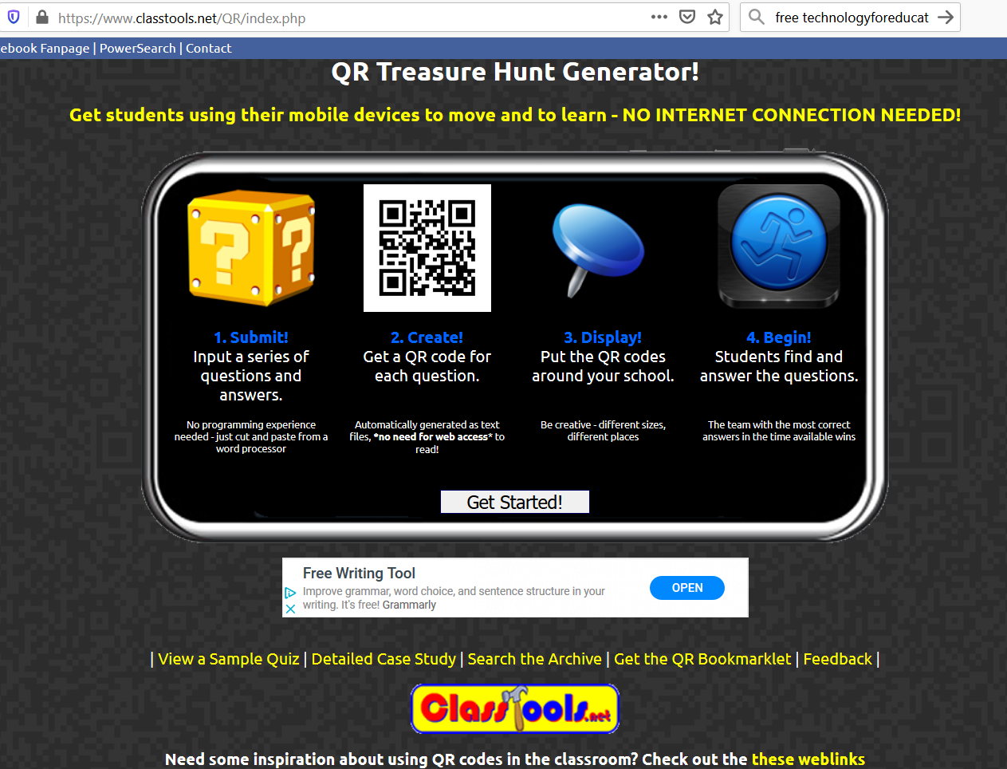
https://www.classtools.net/QR/index.php
1. Click on Get Started
2. Name the quiz.
3. Type in min. 5 questions and answers.
4. Put there a password for a possible change.

Slide 6
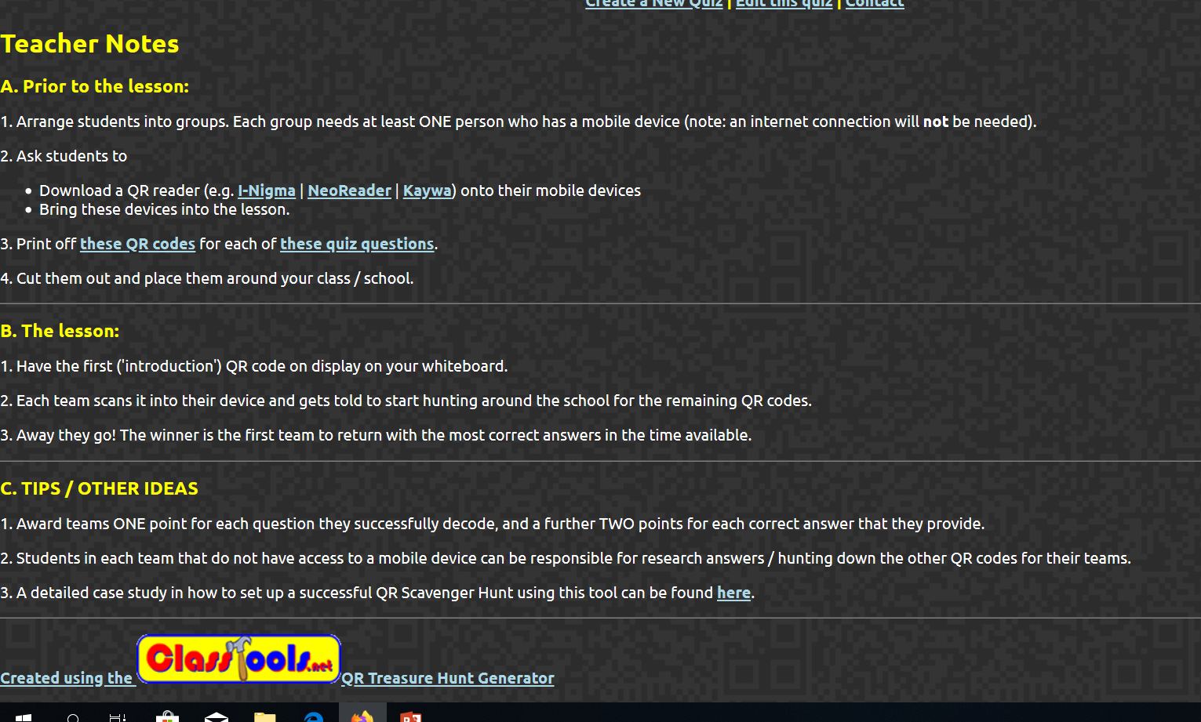
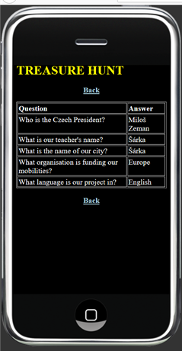

Slide 7
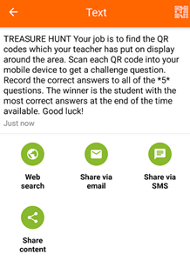
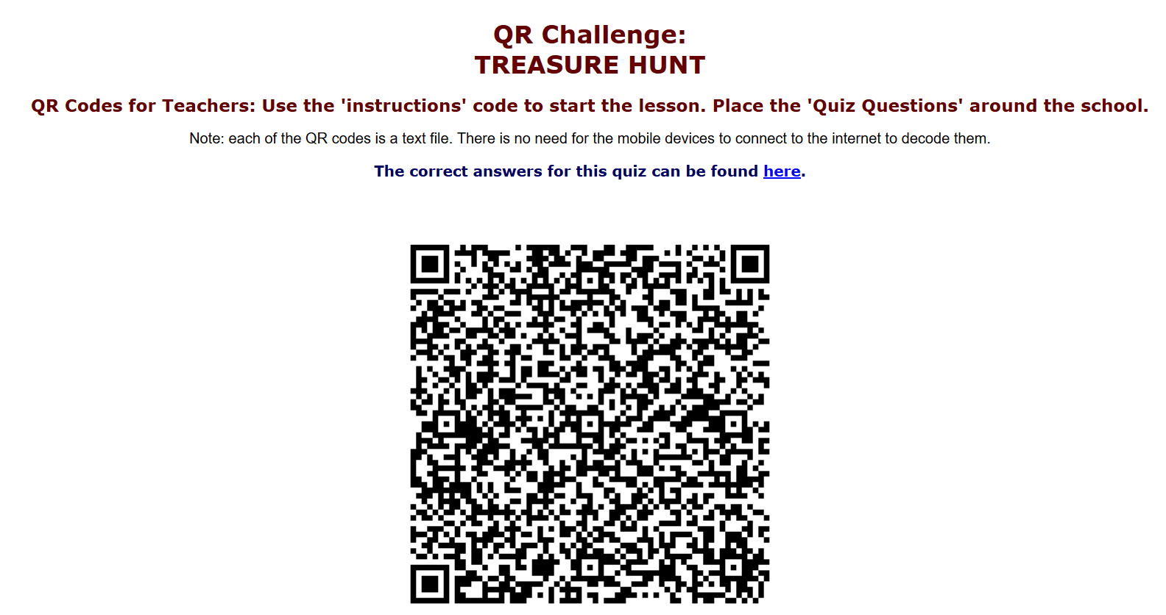
Name of my QUIZ
In our MOBILITY treasure hunt the QR codes can be placed at the spot beforehand, in several metres parametre, and the answers can create a puzzle that tells the location of the treasure. SS can run individually, each with a mobile. / can be different versions
This appears when you scan the QR code with the QR reader.

Slide 8
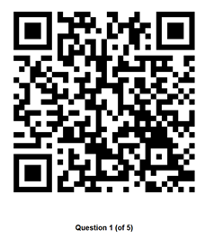
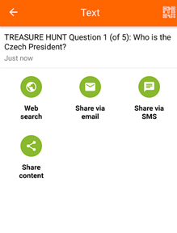
Students scan the printed QR code with the QR code reader in their mobile phone.
The question will appear in their mobile phone. They can write down their answer or voice record it with their mobile phone.

Slide 9
Using the QR to get to the next location
The QR codes needn‘t be used just for looking for the treasure at the spot.
The QR codes can contain instructions how to get to the next location. So the journey to the spot can be divided into several sections. Each CLUE can give some instructions.

Slide 10
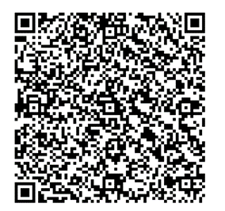
TEACHERS TRAINING ACTIVITY Nr1 – you need to have a QR code reader in your mobile phone.
https://www.classtools.net/QR/17-3BbLC
! First letters of the answers make a word
That shows the location of the treasure.
So you need to make the word.

Slide 11
It is FOR FREE so
there are
Ads. Played rather ONLINE.
It is an outdoor game and an indoor game depending on where you hide the clues. You need to install it to your mobile phone.
https://play.google.com/store/apps/details?id=com.kidapps.treasurehunt&hl=en_US

Slide 12
Players try to find the treasure by following CLUES, one by one. There can be 5 or 10 hiding places. CLUES can be description of the hiding places „ I am green and give apples.‘ OR direct descriptions: ‚Go to the window in the back of the classroom.‘ Give a CODE to each spot (e.g. names of writers). Write the codes on pieces of paper and hide them at the hiding places. Hide the treasure at the last place.

Slide 13
1. Tap on Game Master.
2. Tap on Create New Game.
Number of CLUES 5 or 10

Slide 14
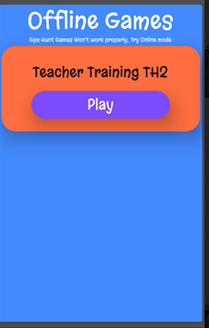
TEACHERS TRAINING ACTIVITY Nr.2:
Choose ONLINE or OFFLINE MODE (when created by your mobile).
Open the Hunt app and choose Player and enter the Game Code. The aktivity is only in IT3 classroom.

Slide 15
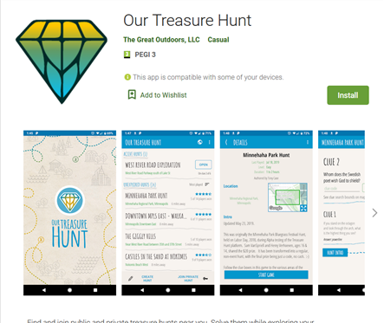
https://play.google.com/store/apps/details?id=com.ourtreasurehunt&hl=en_US
Download the app,
Put there your:
Email
Name, surname, password.
You can create the hunt also on a desktop computer. It is easier.

Slide 16
Very nice visually, with added sound.
HUNT CREATION GUIDE from the authors:
https://docs.google.com/document/d/e/2PACX-1vR92f8l06UYob_rhoKmNZOfirla3chxdtLCnYmgSNG0Js1tpJTZvRkgz98qaY2u27mGLodEi6WdmX5e/pub

Slide 18
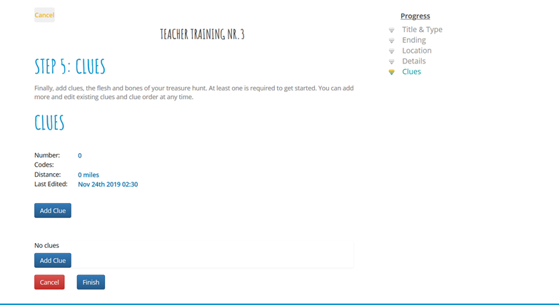

Slide 19
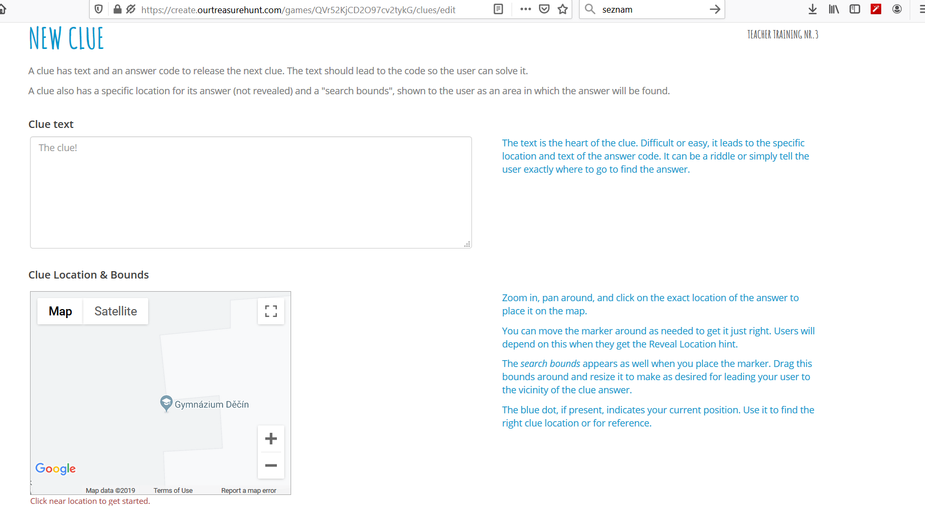

Slide 20
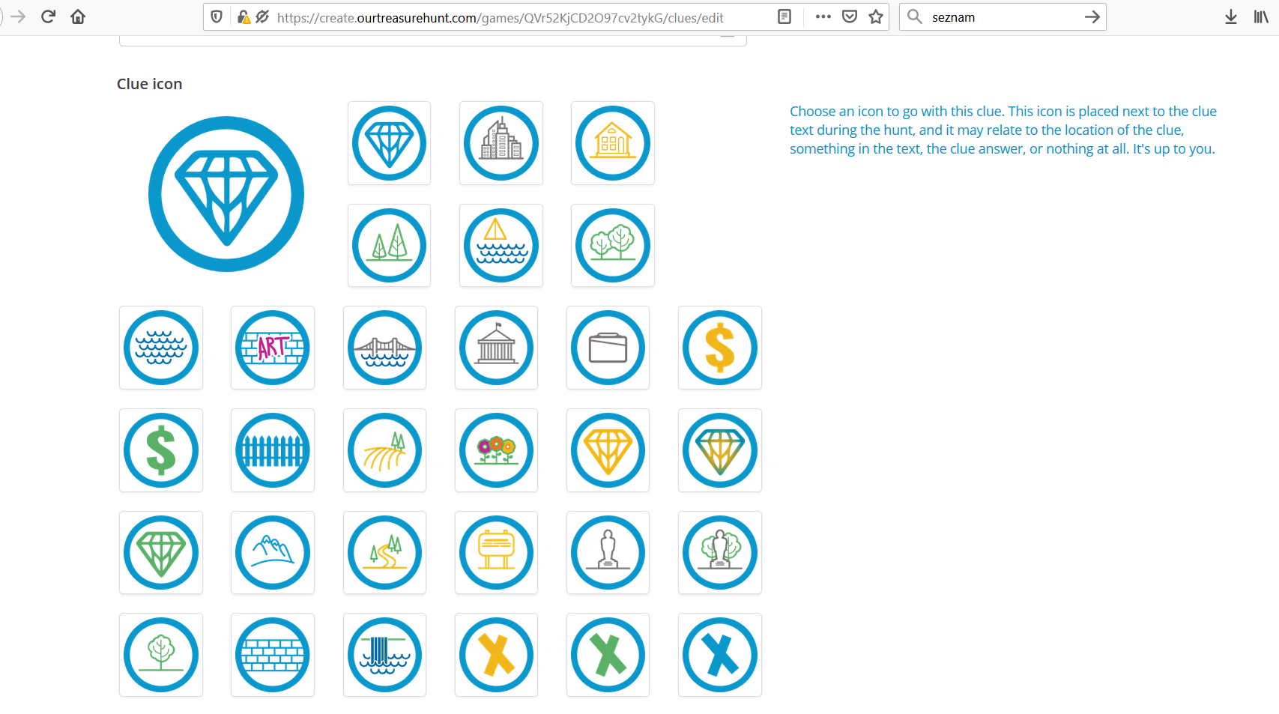

Slide 21
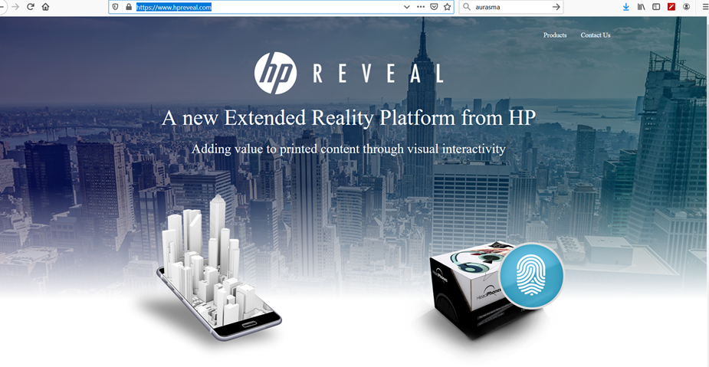
HP REVEAL APP (previously Aurasma)
https://www.hpreveal.com/
Download the app for free / Create an account – name, password
Create an aura = 1. take a photo of text /object that will be seen in reality (= it will be scanned by the app) 2. Select an overlay = text/object/video that will appear when scanning the text/photo from point You can record it through the app1 (from your device) 3. Position it in your photo 4. Name it 5. Save it.
https://www.youtube.com/watch?v=PFD805-YPdA tutorial
* There used to be a desktop computer HP Reveal studio, it stopped in July.
** teaching with AURASMA = HP TREVEAL tutorial
https://www.youtube.com/watch?v=uHIxYpBW7sc

Slide 22
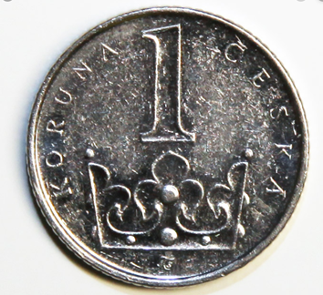
Teacher Training Number 4
I. TRY MY 2 AURAS
1. Find in this classroom two pictures of old postcards from the last century.
2. Scan the pictures with the HP Reality app.
3. Read or listen to the content that will appear☺
II. MAKE YOUR AURA.
1. Take a picture of a coin/banknote (google). Scan it with the app. Leave the pic open on the screen of your computer.
2. The OVERLAY will be a picture of what you can buy with it in your country. Scan it (google pic)- either as a photo or a video how you pronounce it.
See my example with the Czech coin 1 crown before starting.

Slide 23
https://play.google.com/store/apps/details?id=com.wallame&hl=en_US

Slide 24
- The map of the selected area works as a game board. The teacher creates the game tasks, which the students solve in teams using mobile devices. - You can have a free month trial. - The game cab be played in the school or outdoors. - Online and offline modes. / Give player the PIN code. They log in at https://play.seppo.io PIN code of the game can be found in the game participants section on the left of your screen. Click the button which has a human icon on it. MANUAL in SEPPO: https://seppo.io/manual TUTORIAL basics video : https://www.youtube.com/watch?v=H2uzqPRwJjw
https://seppo.io/en/

Slide 25
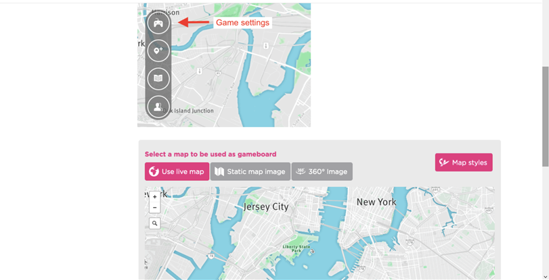
Gamemap selection can be found in the game settings. You have three options to choose from: a live map, a static map and a 360° image map.
https://seppo.io/manual/before-a-game/how-do-i-choose-or-change-the-gameboard/

Slide 26
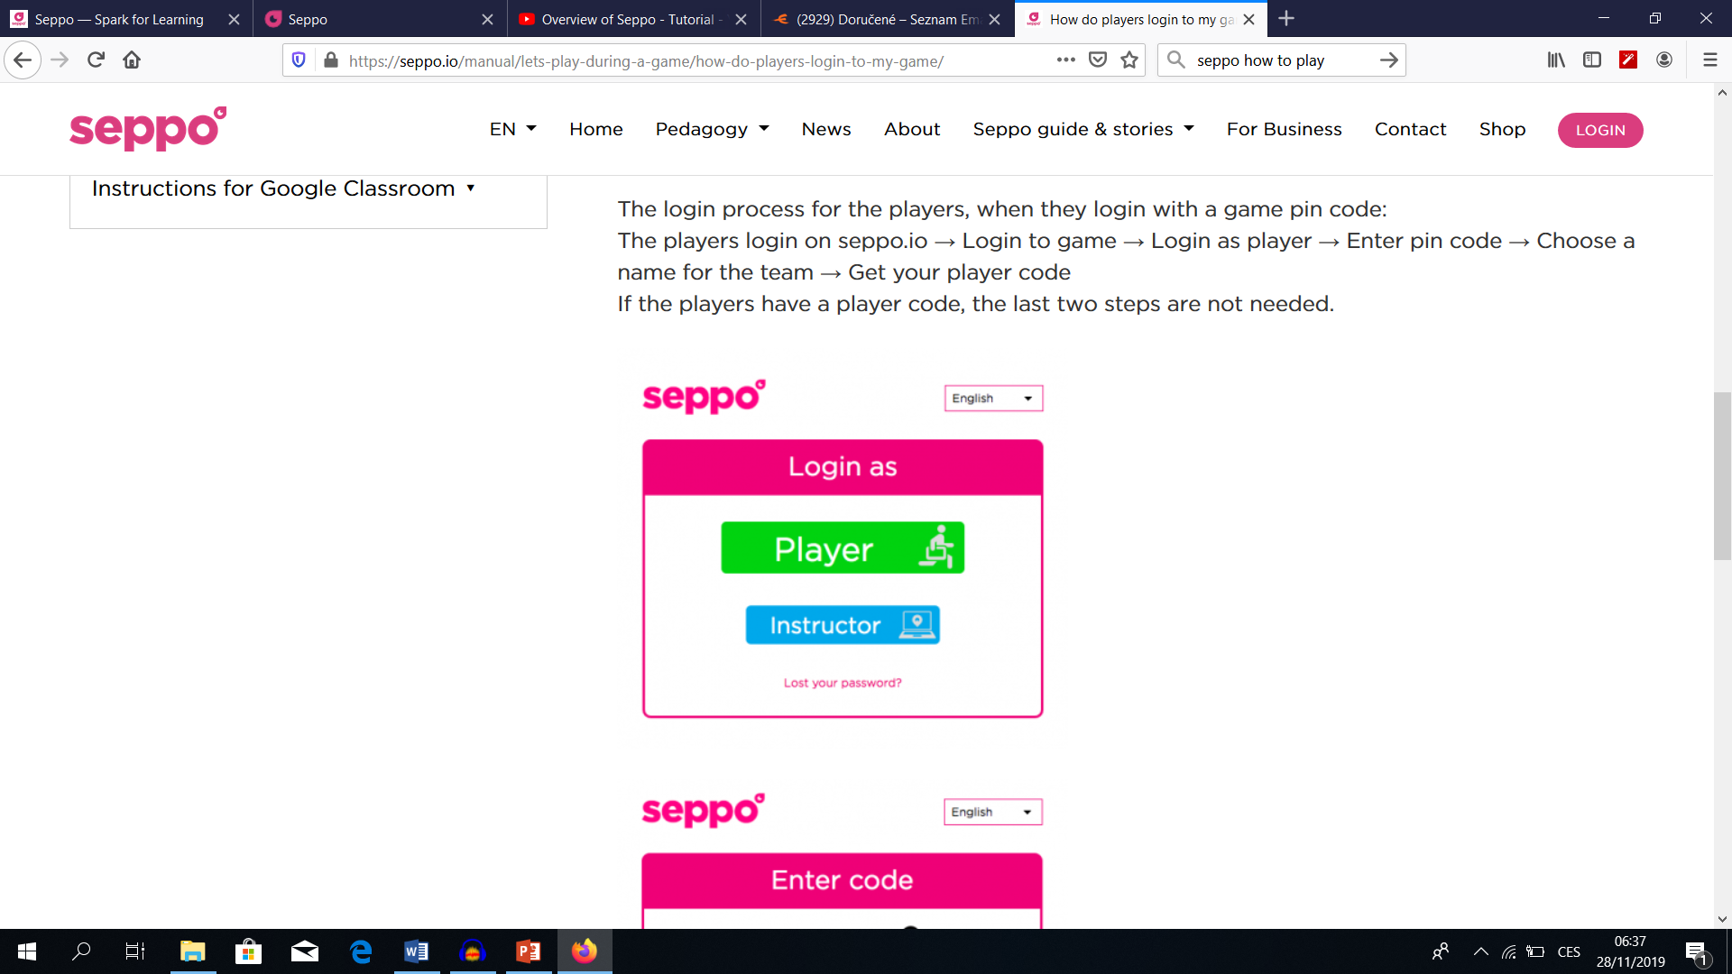
https://seppo.io/manual/lets-play-during-a-game/how-do-players-login-to-my-game/

Slide 27
Do you have any experience / tips concerning treasure hunt apps?

Slide 28
OFF THE MAIN GIGHLIGHTS Treasure Hunt Training
Date: 28th November, 2019
Place: Gymnázium Děčín, Czechia
Trainer: Šárka Opatová

