Slide 1
ENVIRONMENT
OŠ VLADIMIRA Nazora pribislavec, croatia
7th grade
Ms Word – environment
Created for the etwinning project Where is my green environment?

Slide 2
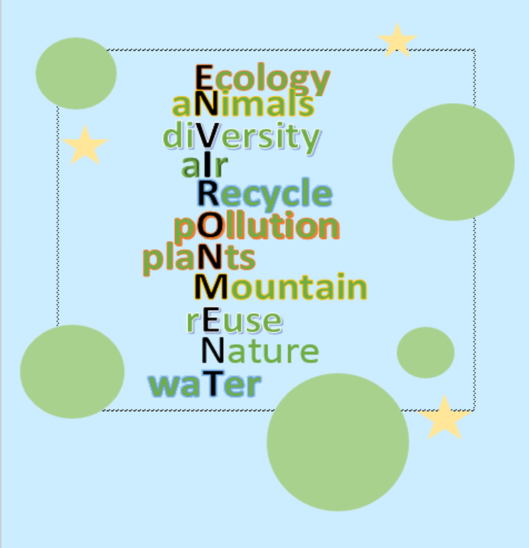
Aleksandar

Slide 3
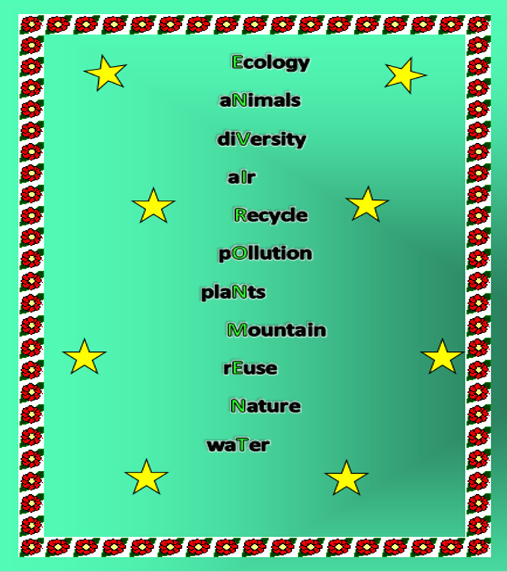
Adela

Slide 4
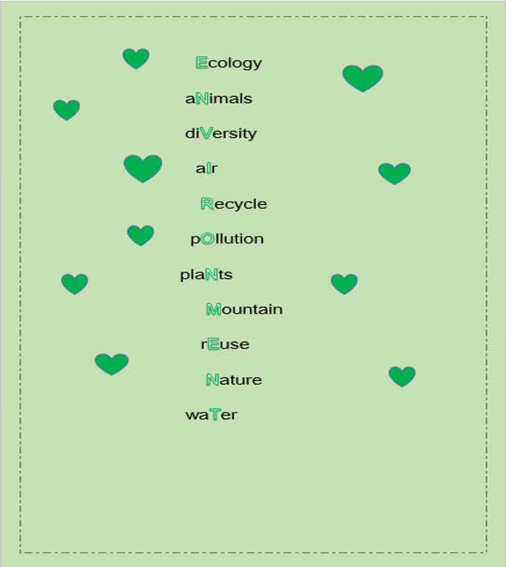
Gabrijela

Slide 5
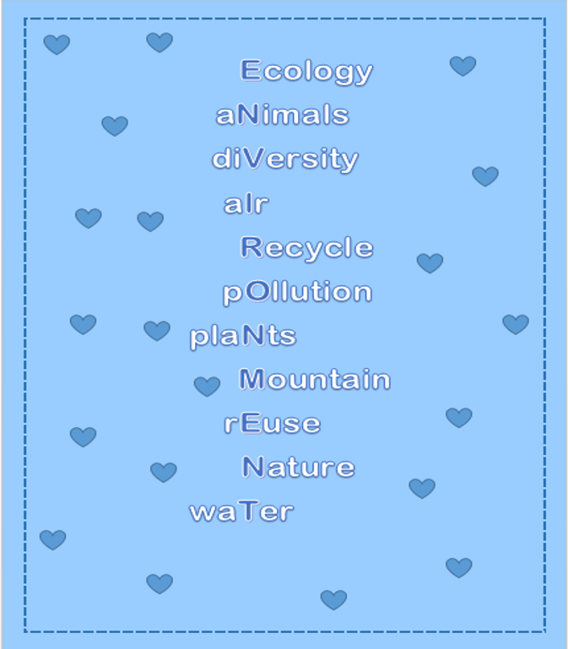
Izabella

Slide 6
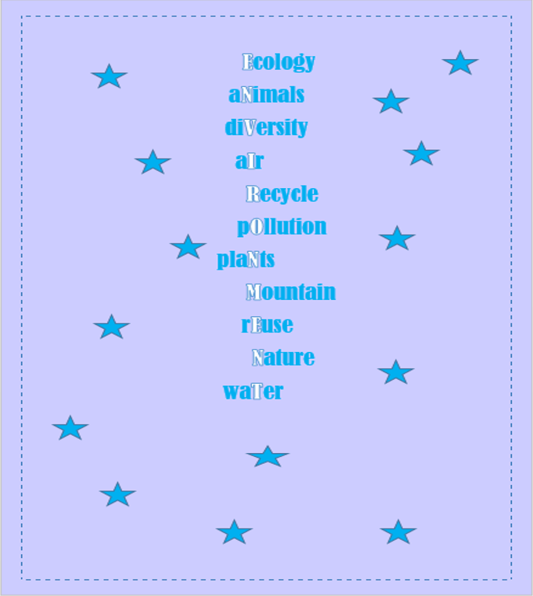
Martina

Slide 7
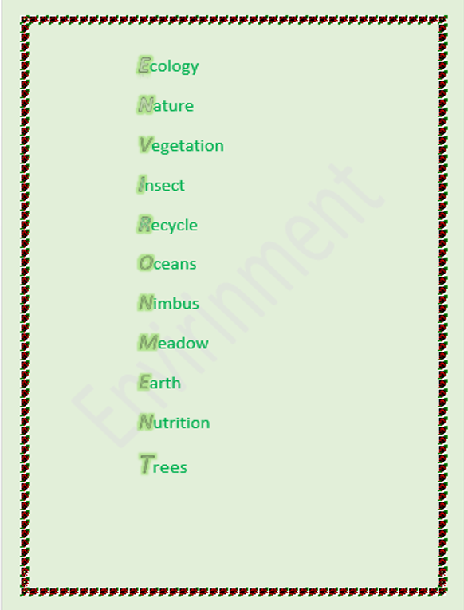
Matija

Slide 8
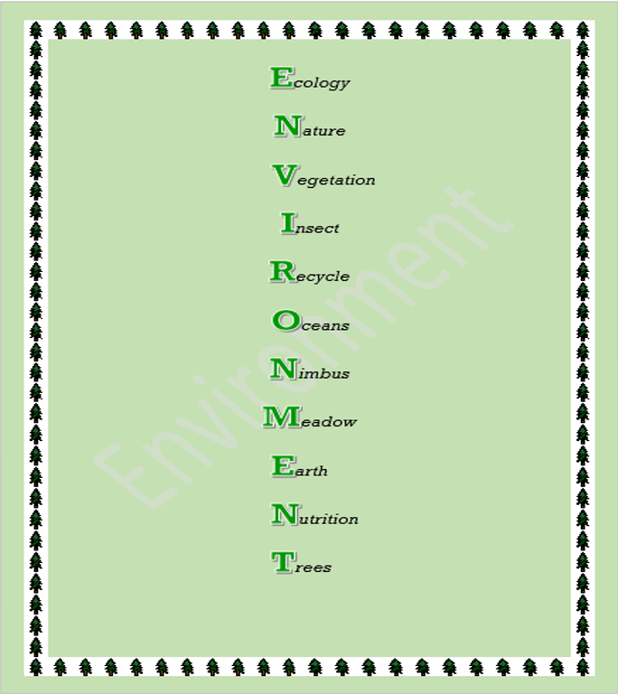
Mihael

Slide 9
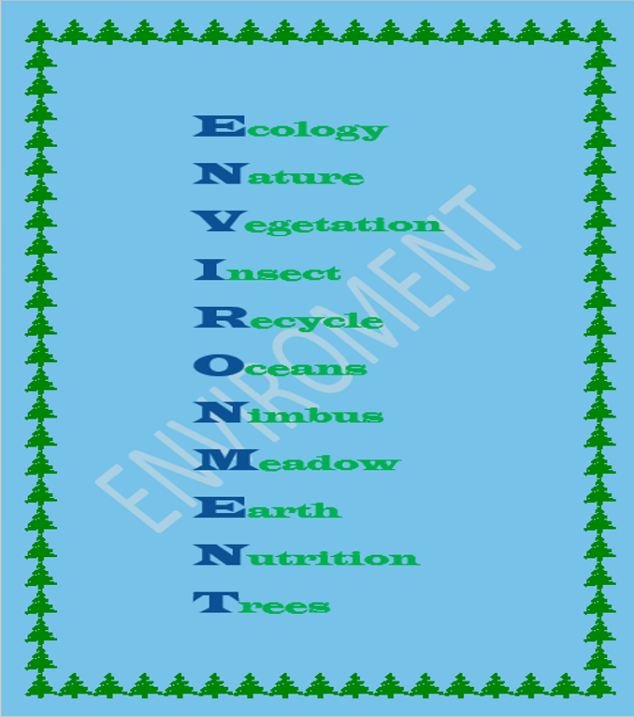
Mirjam

Slide 10
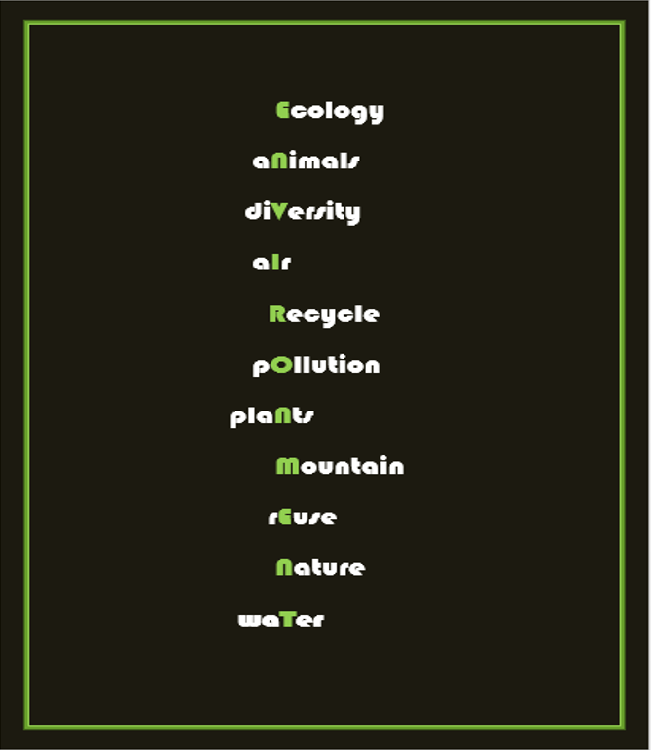
Patrik

Slide 11
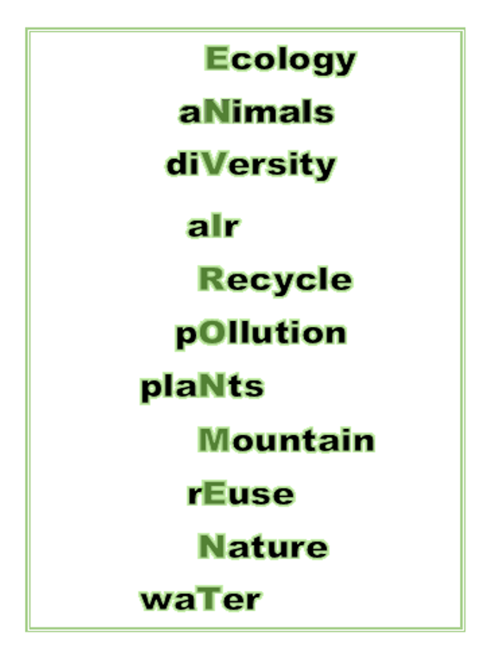
Rocca

Slide 12
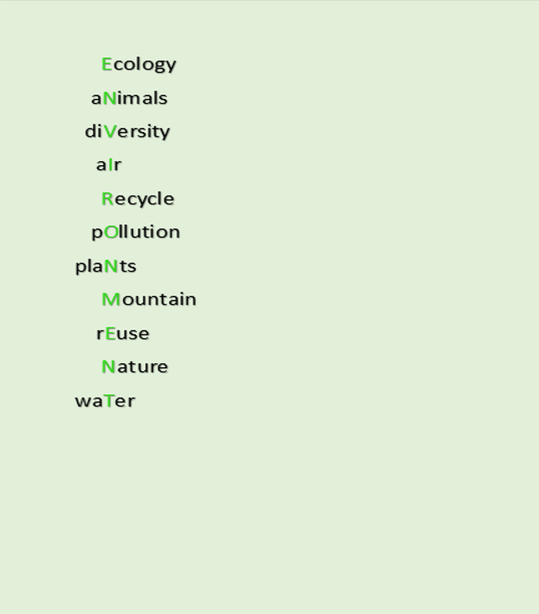
Simona

Slide 13
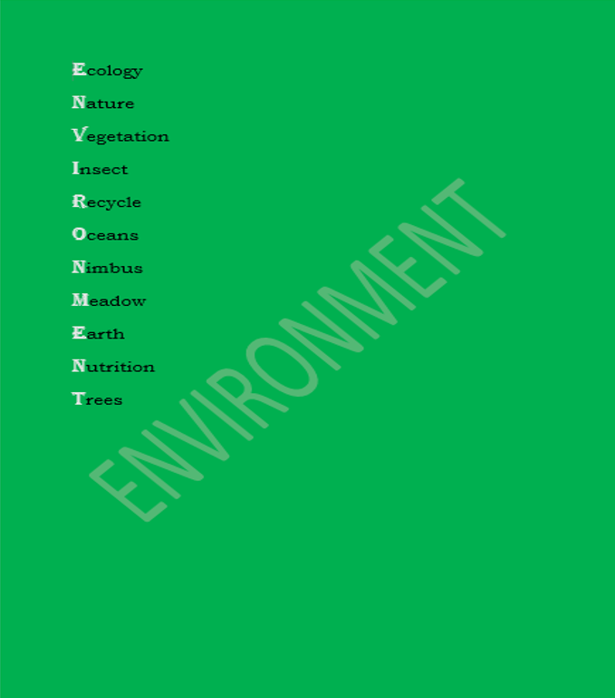
Tena

