Slide 1
MOLISE …ONE OF THE FIRST AREA POPULATED IN ITALY

Slide 2
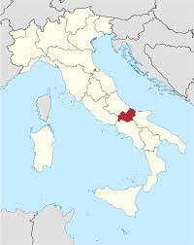
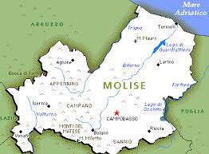
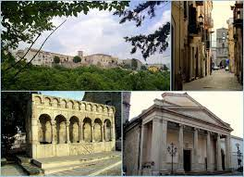
Isernia, an Italian town in the south central region of Molise,has a very ancient history... there are archaeological remains underneath the whole city,"
Isernia, known as Aesernia in the ancient world, was the home of an Italic people named the Samnites. It later became a Roman colony. The town was partially destroyed during World War II but was rebuilt.

Slide 3
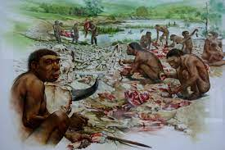
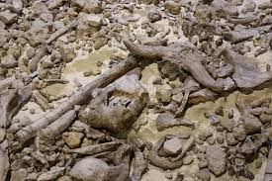
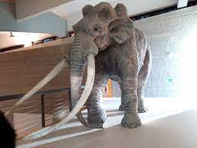
Thepaleolitic museum 600,000 YEARS AGO IN MOLISE…
https://www.youtube.com/watch?v=TnxIRoSKbBc
https://www.youtube.com/watch?v=1bVFPBcWXUE

Slide 4
THE OLDEST HUMAN TOOTH IN ITALY IS IN MOLISE
The human tooth found in Isernia La Pineta in 2014, dating back to about 600,000 years.

Slide 5
There is a lot of information that a small tooth can provide us. An international research team, headed by the University of Ferrara, has studied it in detail thanks to the most advanced laboratory analyzes and the most modern technologies. It is a deciduous upper incisor of a child of 5-6 years, belonging to a different species from ours. From the analysis of a chemical element contained in the tooth enamel it was possible to understand that the mother of the child must not have moved much from the site, probably for reasons related to pregnancy and the care of the baby.

Slide 6
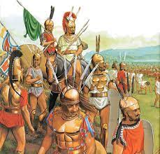
Samnites
http://www.sanniti.info/smpeople.html
http://www.italia.it/en/media/video/molise-the-land-of-the-samnites.html

Slide 7
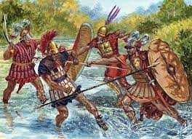
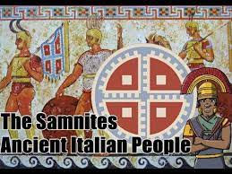
Ancient Italian people
Four cantons formed a Samnite confederation: Hirpini, Caudini, Caraceni, and Pentri. The league probably had no federal assembly, but a war leader could be chosen to lead a campaign. Although allied with Rome against the Gauls in 354 BC, the Samnites were soon involved in a series of three wars (343–341, 327–304, and 298–290) against the Romans. Despite a spectacular victory over the Romans at the Battle of the Caudine Forks (321), where a Roman army was forced to march under the yoke, the Samnites were eventually subjugated.
https://www.britannica.com/topic/Samnite-people

Slide 8
The smallest temple was built around the III century BC by Italic temples layout, having a squared base called podium. It had one single cella and a pronaos, allegedly a tetrastyle, and an on-ramp in the middle of the front side. It's surrounded by an ambulatory enclosed by a retaining wall.
PIETRABBONDANTE

Slide 9
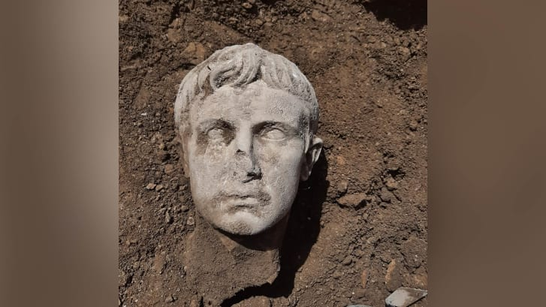
A 2,000-year-old marble head of Augustus, Rome's first emperor, has been discovered in Isernia.
On the 6th of May 2021

Slide 10
The sculpture was discovered while renovating Isernia's historic city walls - built during the imperial Rome period
The head is likely to have been detached from a statue that was more than 2 meters (6 feet 7 inches), Colombo said. It is made from the same Lunigiana marble used by the Italian Renaissance artist Michelangelo, and it depicts a young Augustus Octavian, who became Rome's first emperor in 27 BC.

Slide 11
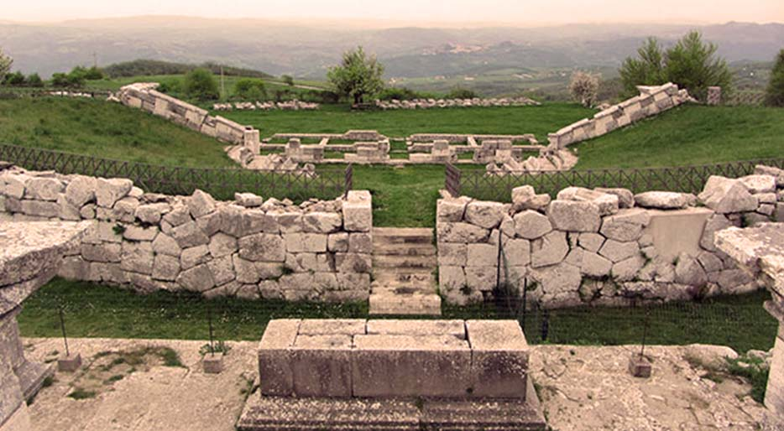
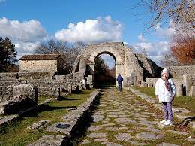
SAEPINUM
AN ANCIENT ROMAN TOWN

Slide 12
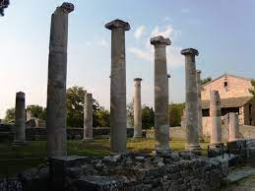
Saepinum
Saepinum was established by an ancient civilisation called Samnites, and the Romans conquered it in 293 BC.

