Slide 1
Should cars be banned from cities?
an amazing presentation
by group 2

Slide 2
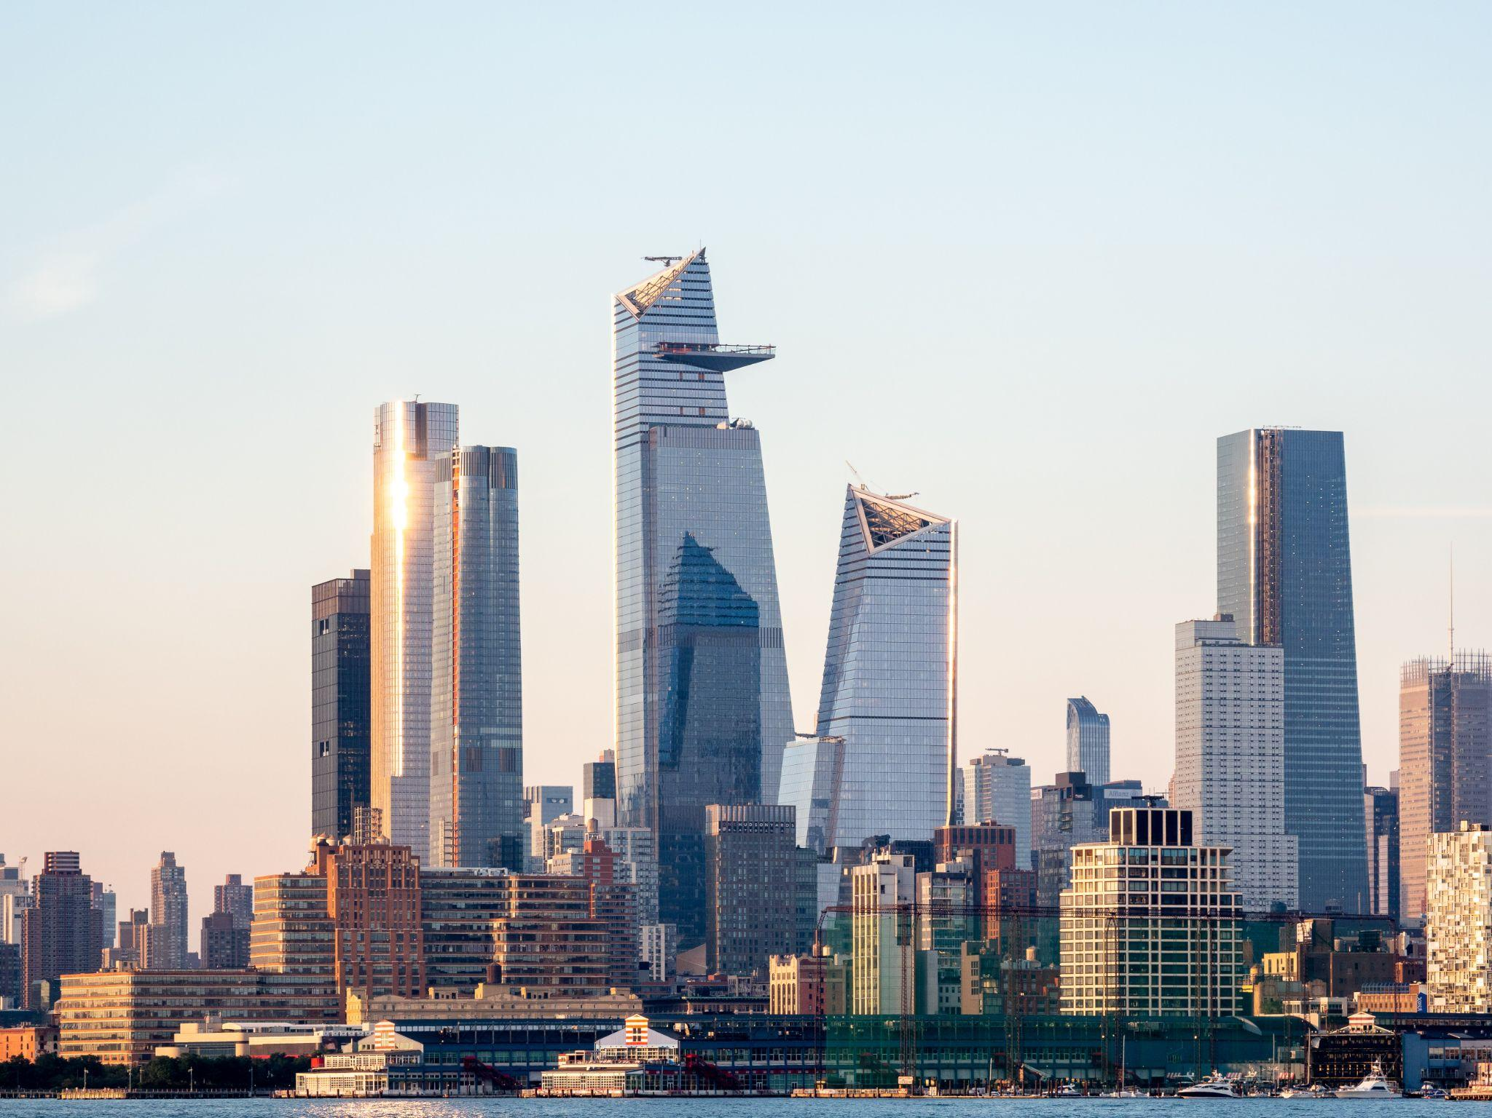
Introduction
In modern society, the need for private transport has never been as little, public transportation systems are sophisticated and easier to use than ever before and there for the question rises whether or not private transport is still a necessity in modern metropolises.

Slide 3
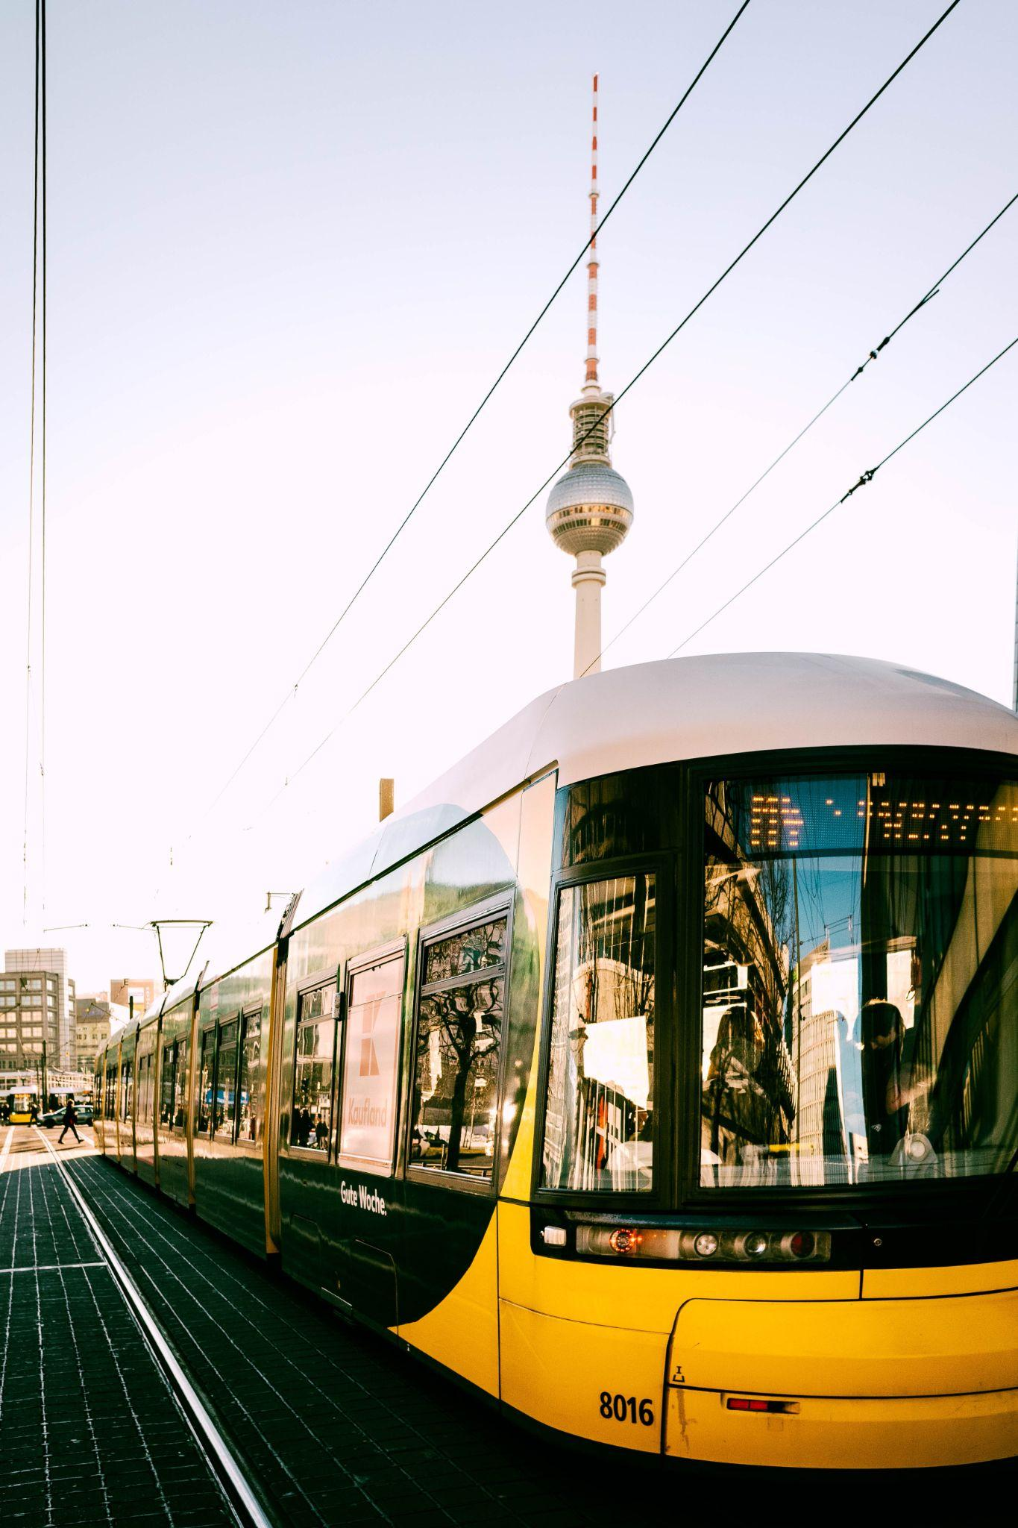
Public transport
In many cities around the world public transport is not only easier to use but it is also in many cases more time efficient and cheaper than using a private form of transportation.
Public transport is not for everyone, for example, the people who live in small villages are not able to use public transport, so they need to move to the big cities by their cars.

Slide 4
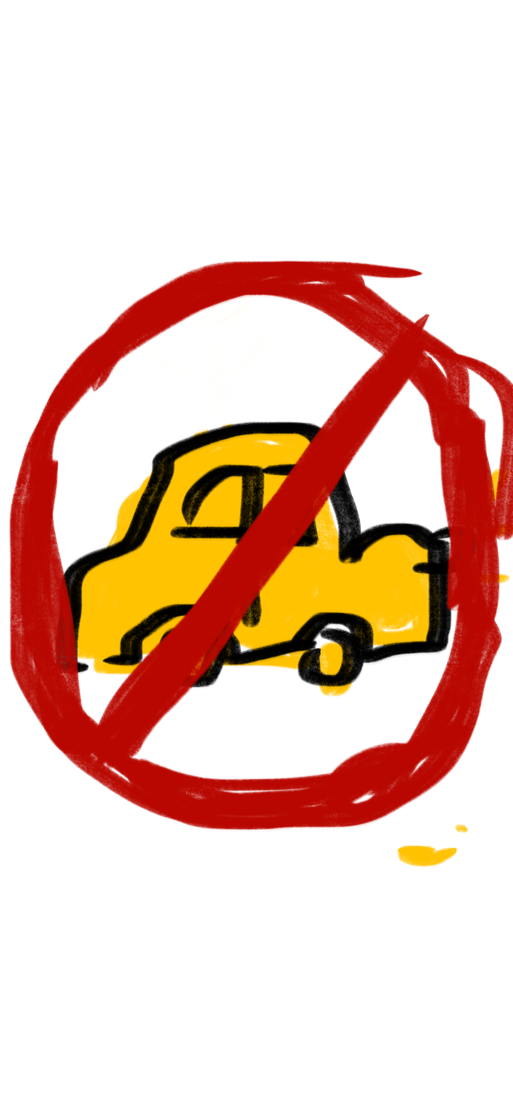
is there a need for cars?
The need for cars in cities is certainly there, but, in the city centers, where the quality of air can be lower, it is important to keep traffic as low as possible.
As pollution in the air rises, people with health problems are at an increased risk for heart and lung disease, for example, public health should outweigh the individual need for private transportation.

Slide 5
so, will we ever be able to ban cars?
If many people sign or even agree with the petition we think that we will be able to ban the cars. But there is a bunch of people who thinks that they can’t live without cars. But we still have a hope that with a good motivation we will be able to ban cars.

Slide 6
Thank you for your attention !
Amazing group 2 <3

