Slide 1
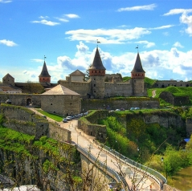
Kamianets-Podilskyi fortress
For hundreds of years a beautiful fortress rises above the two banks of the River Smotrych. The fortress is part of the reserve.

Slide 2
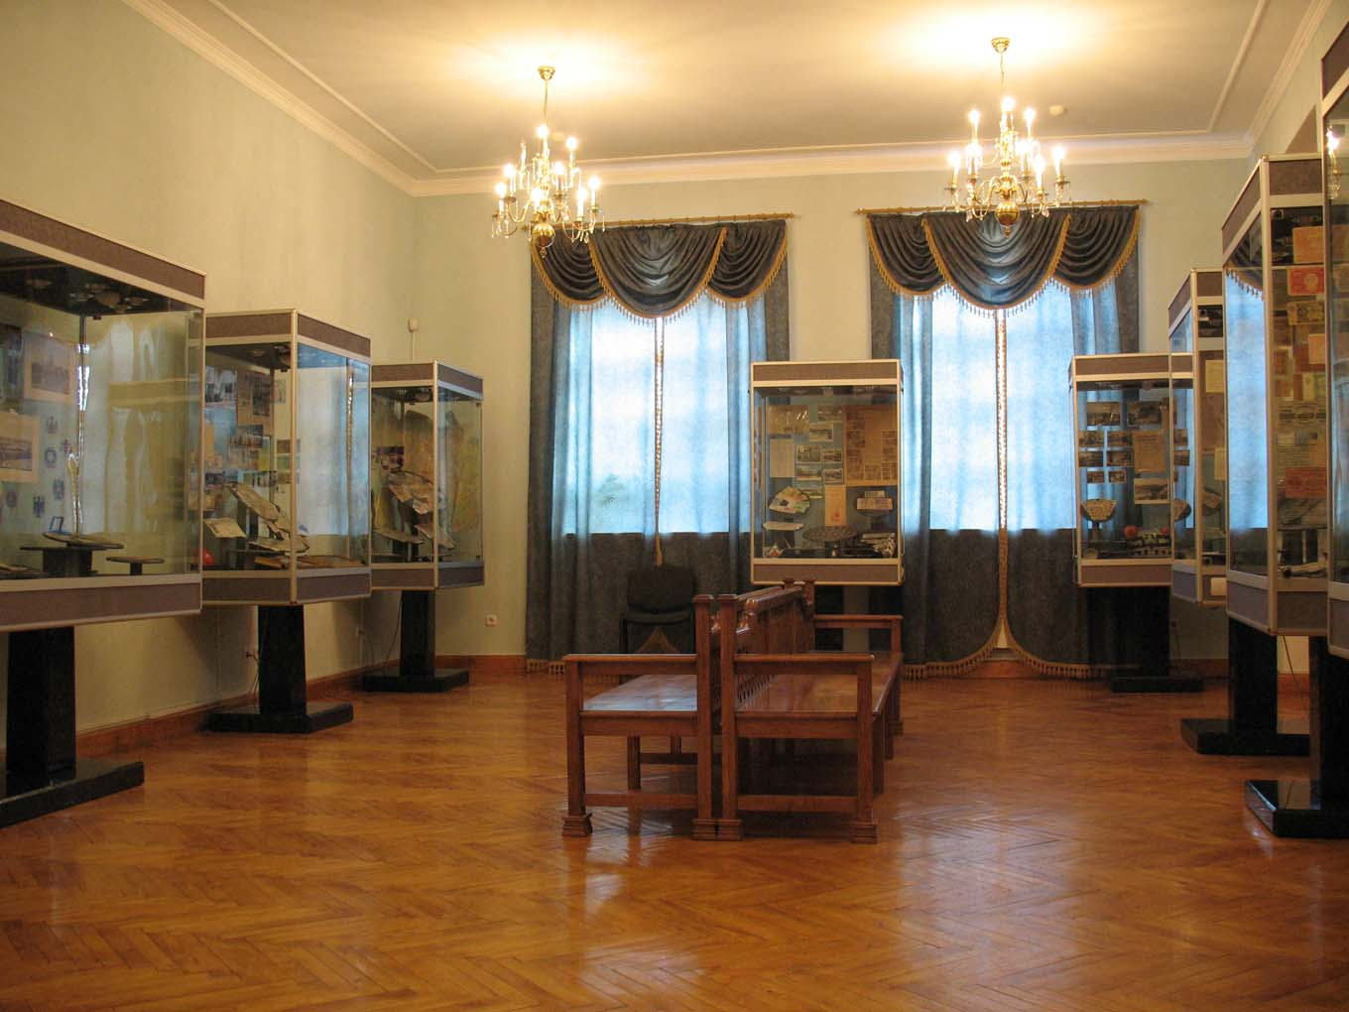
The museum contains ancient Roman coins (denarius of the 2nd century AD), silver coins which were in circulation in Europe, particularly in Podolia (part of Ukraine) in the 15th-18thcenturies.

Slide 3
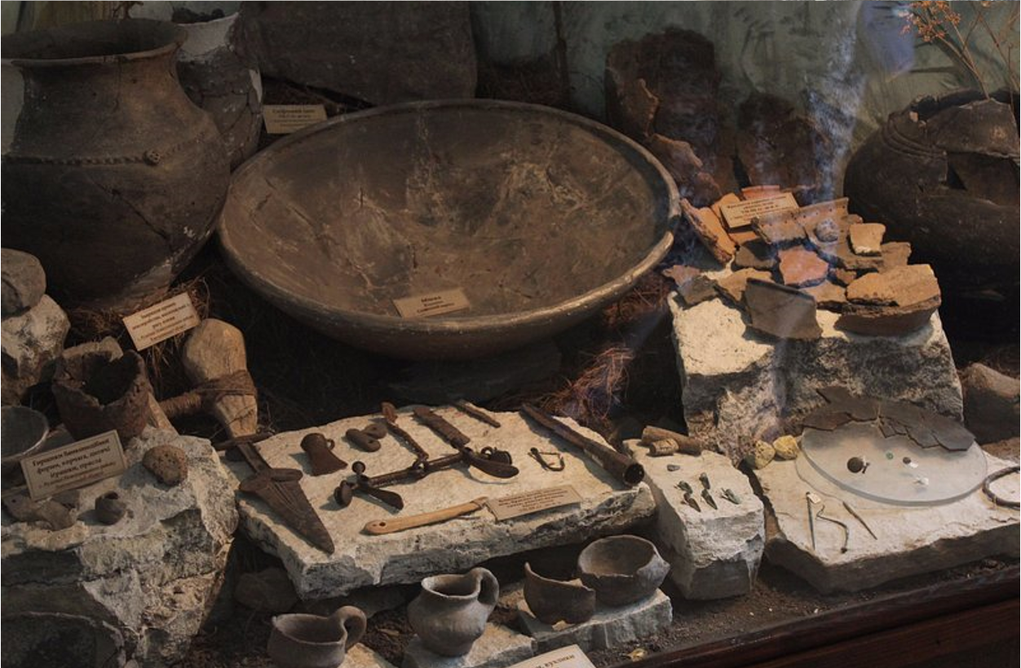
Archeological finds

Slide 4
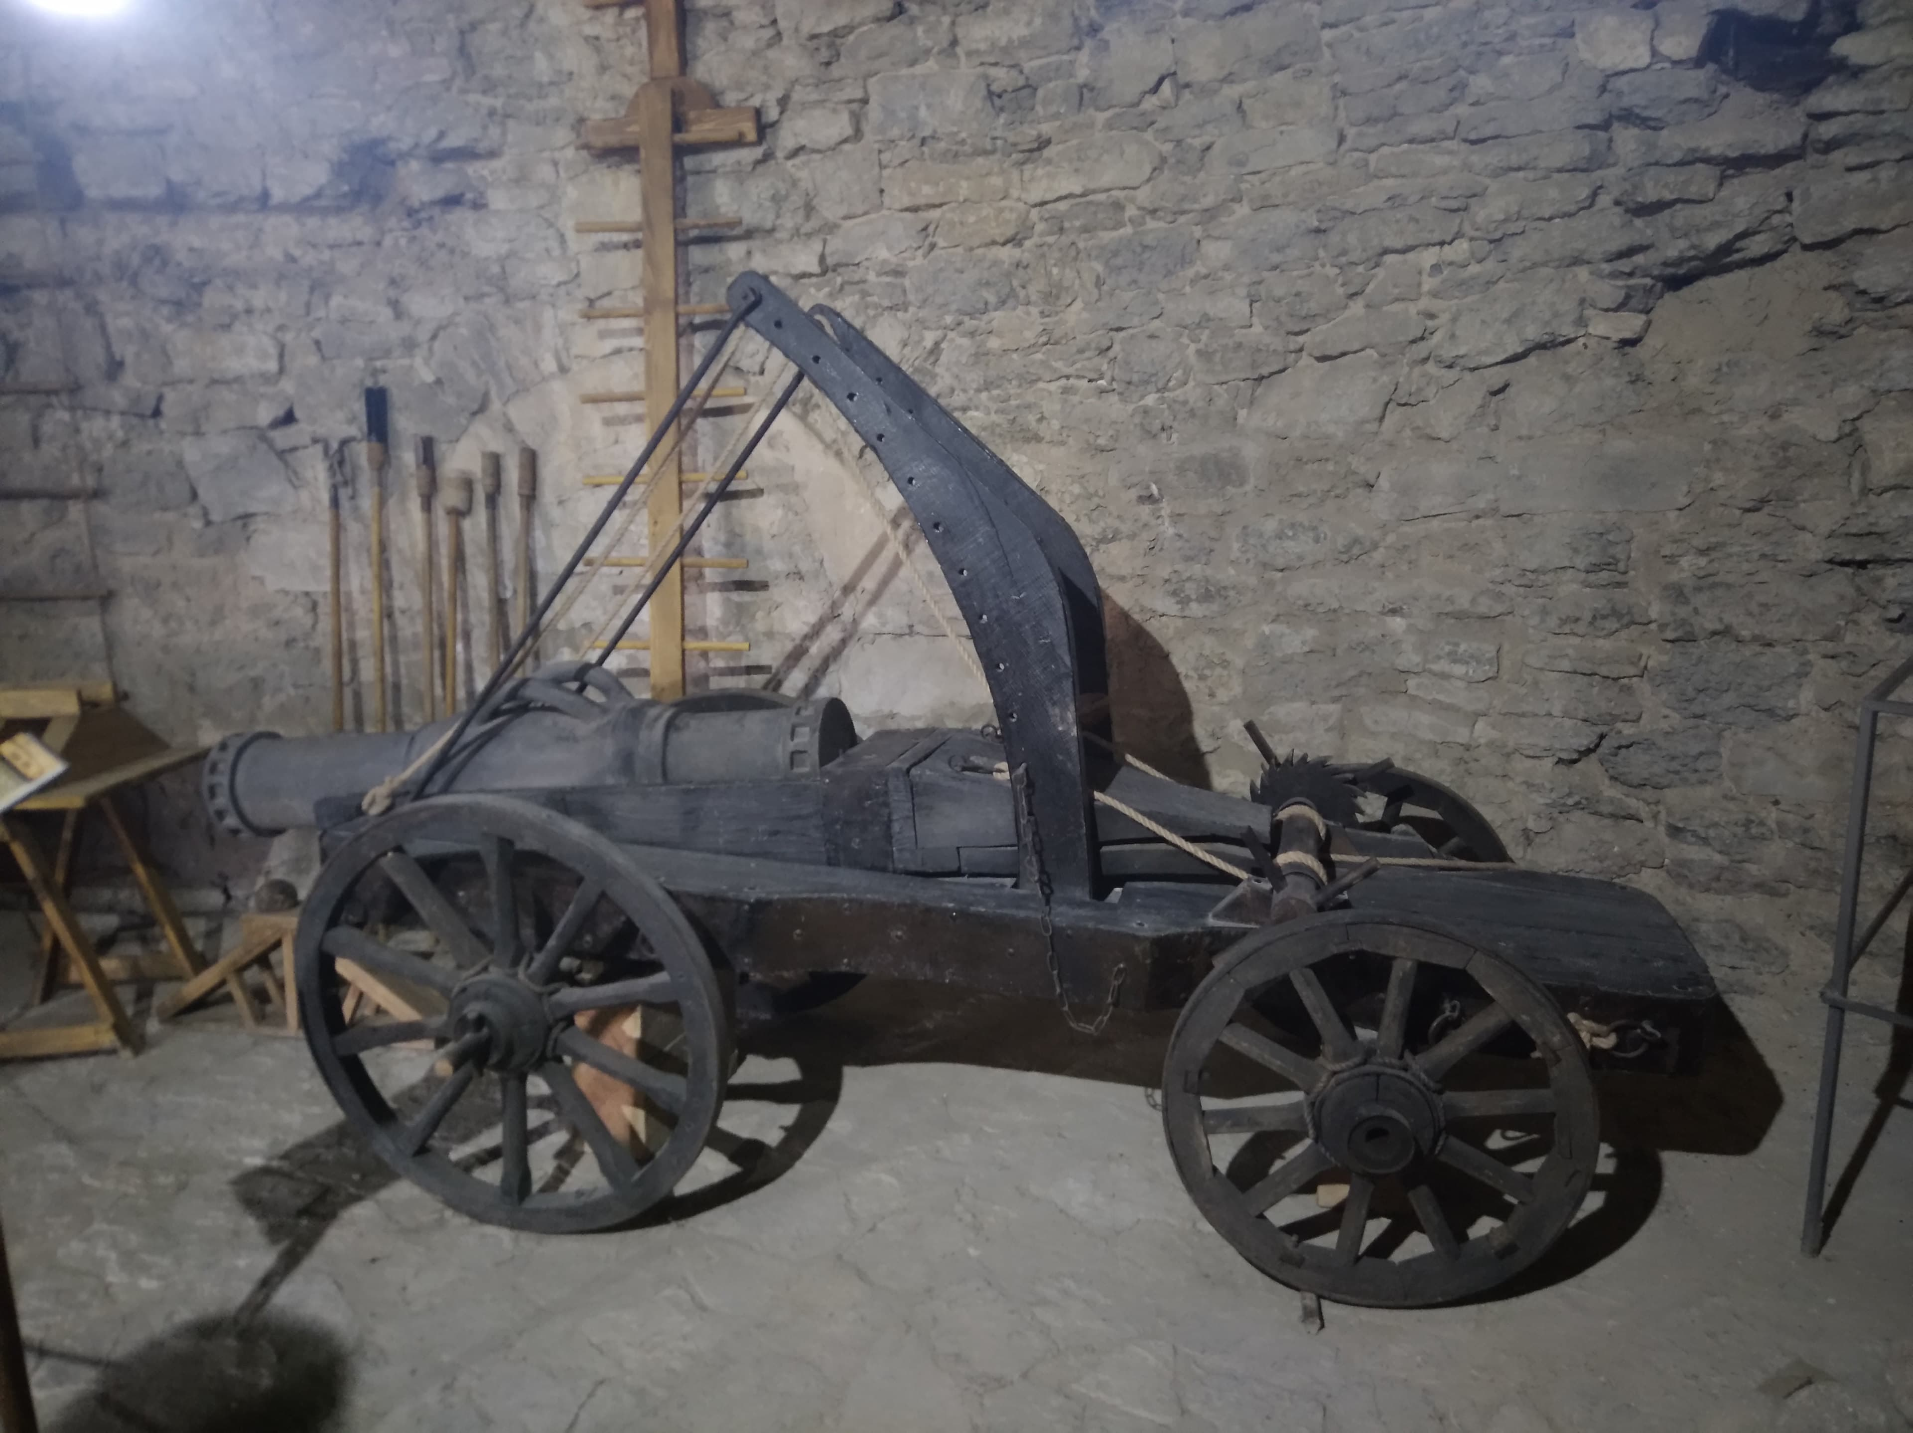
Metal exhibits

