Slide 1
Pre-history
Virtual tour round local museums in Ukraine

Slide 2
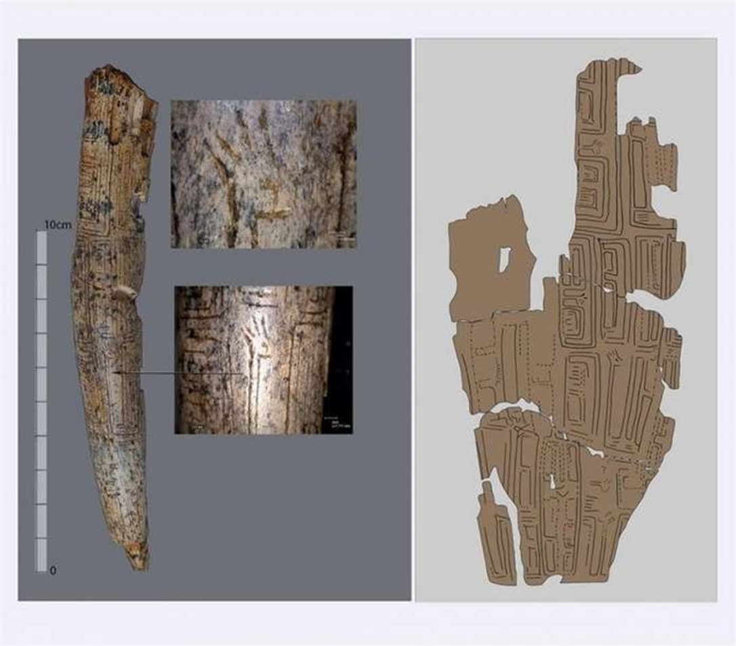
the village of doroshivtsi
A mammoth tusk was found in the Chernivtsi region. The age of the unique find is more than 22 thousand years old. It is known that a rare archeological artifact with scratched images of deer and labyrinths was found near the village of Doroshivtsi. Along with the tusk, they also found whole points made of mammoth tusk and reindeer bones. According to the archaeologists, this indicates that ancient hunters knew the technology for processing this material.

Slide 3
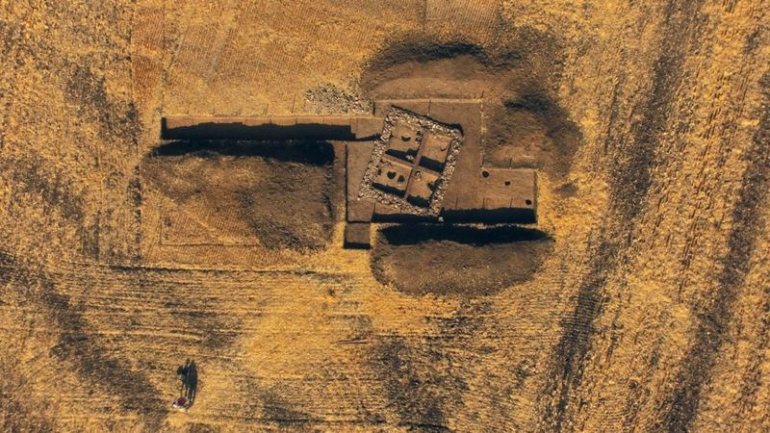
the village of Komariv
In the field between the villages of Komariv and Dnistrivka, Kelmenets district, Chernivtsi region, the remains of a mysterious building of late Roman times (III-IV centuries AD) were excavated by archaeologists.

Slide 4
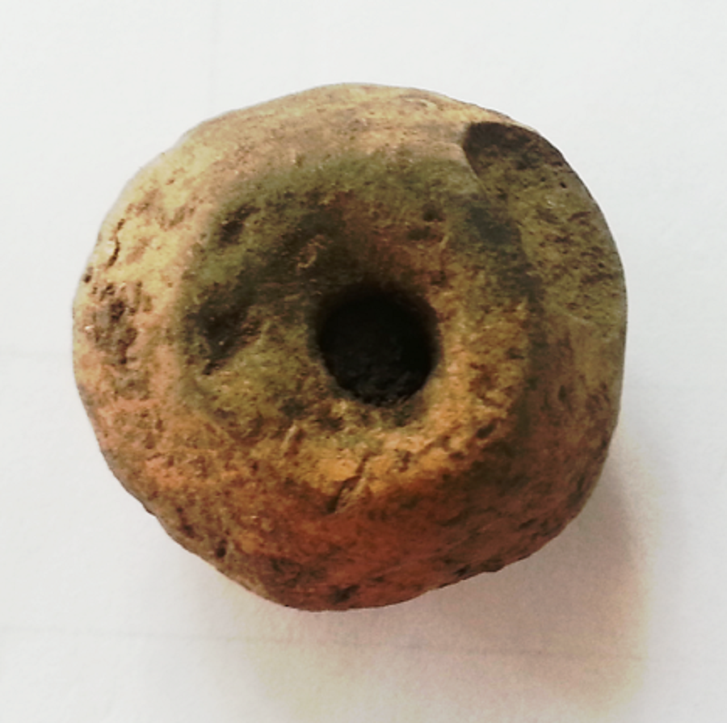
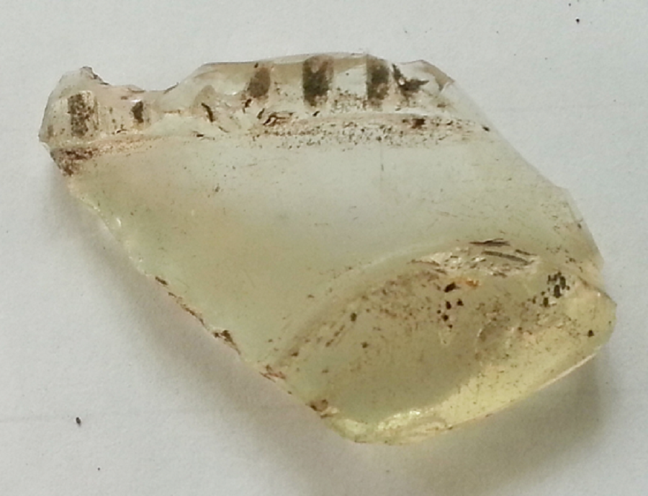
the village of Komariv
In the village of Komariv, Kelmenets district, Chernivtsi region, during the excavations, archaeologists found these unique artifacts (III c. A.D.): parts of clay and glass vessels, Roman coins, spurs, etc.

Slide 5
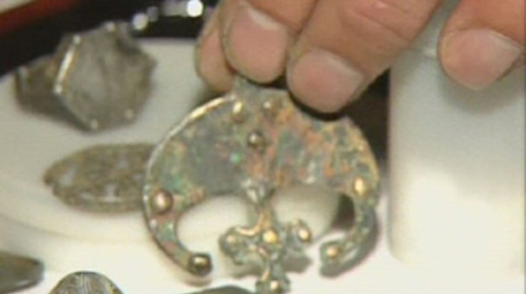
The village of koroviy
The finds in the village of Koroviy in the Chernivtsi region are two and a half thousand years old and include pieces of adornment, rings, coins.
In the vicinity of the village there are settlements of Trypillia culture (III BC), Bronze Age (II BC) and Slavs (VIII-X centuries AD).

Slide 6
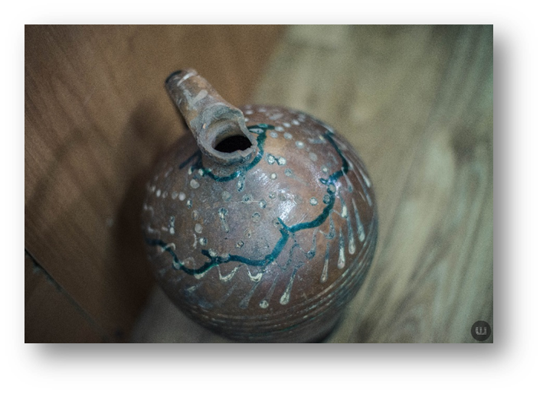
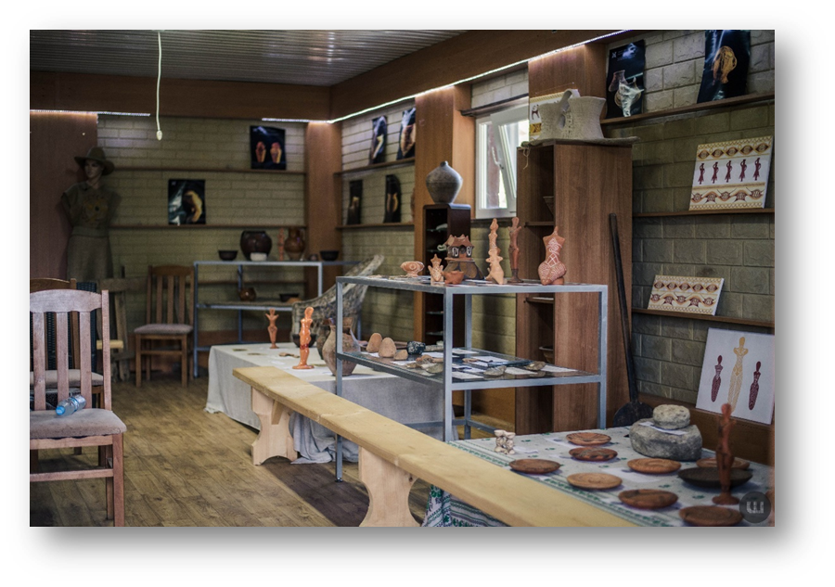
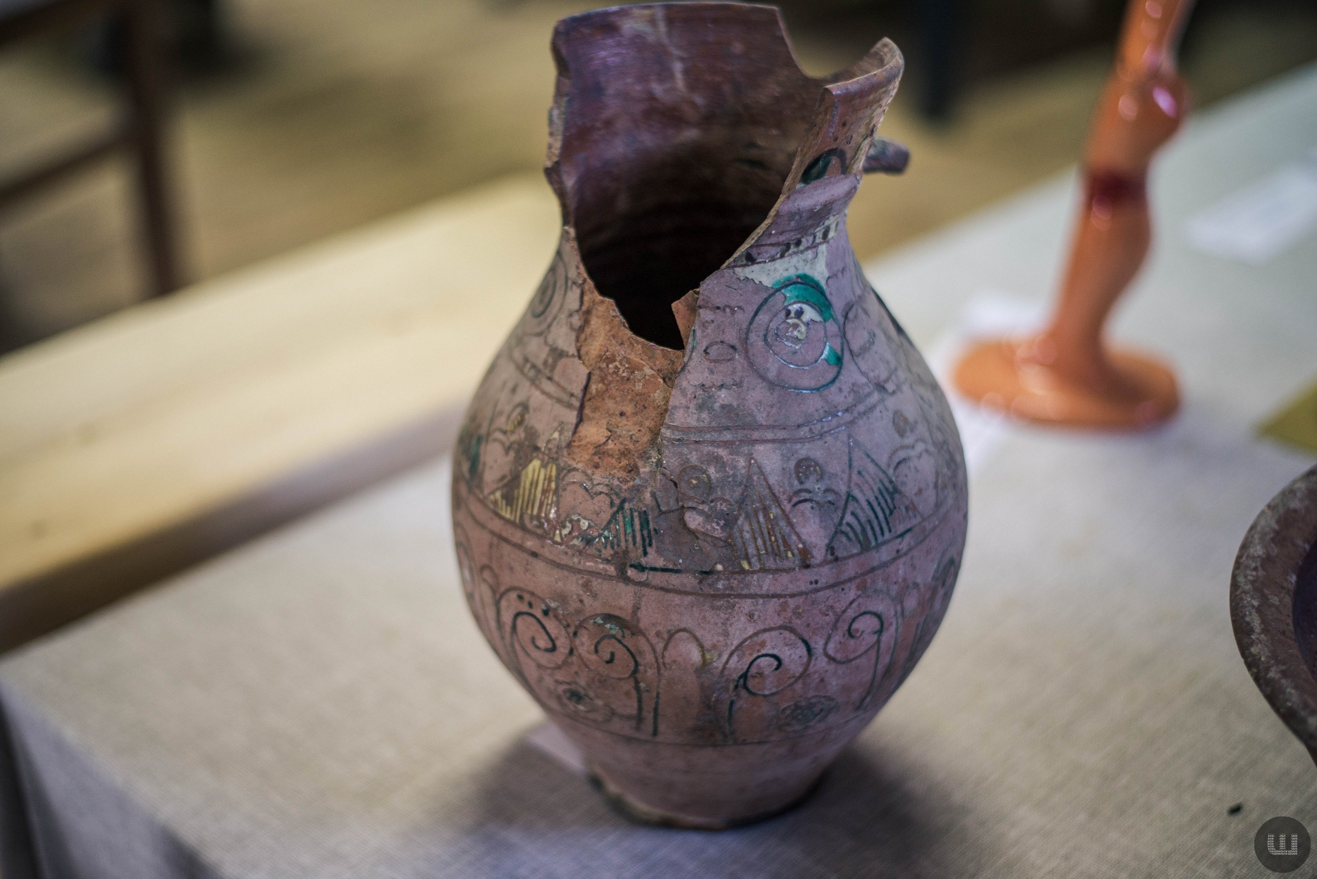
Village of Shypyntsi
The Museum of Trypillia Culture in the Kitsman district, Chernivtsi region, preserves the remains of exhibits, which are more than VI millennium old. Here, visitors can better imagine the spirit of the Trypillia era.

Slide 7
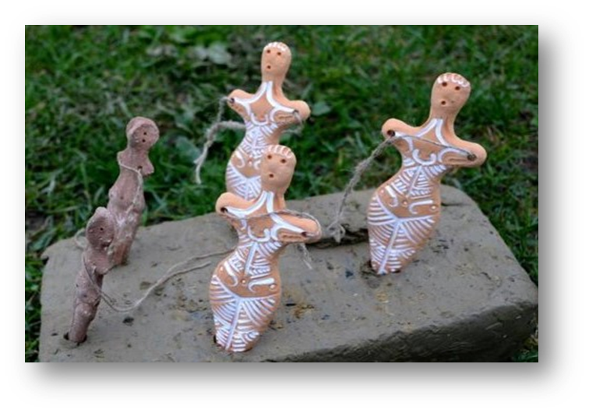
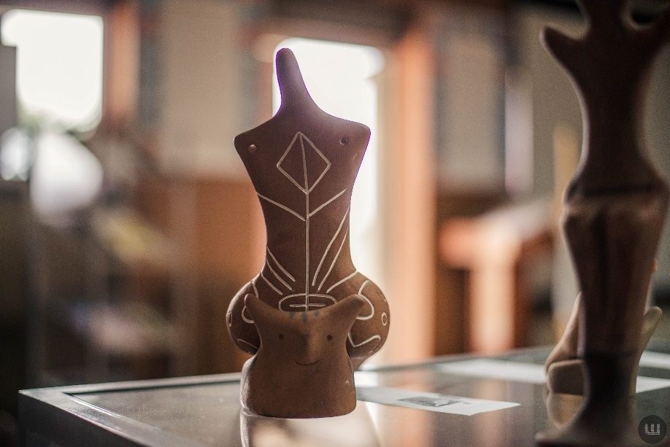
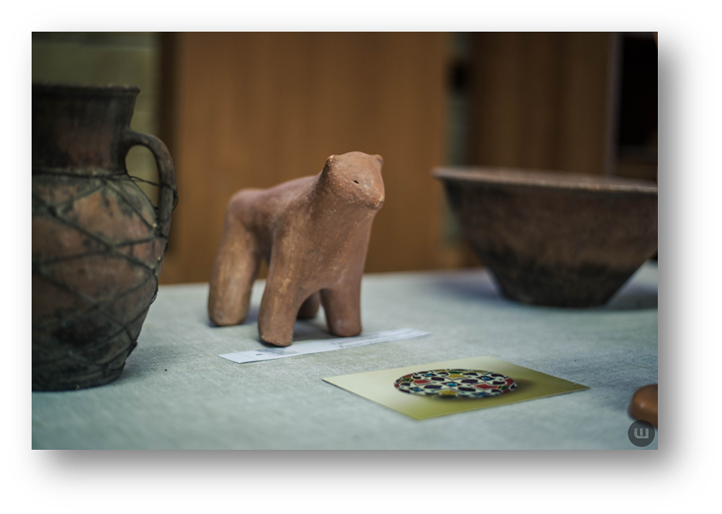
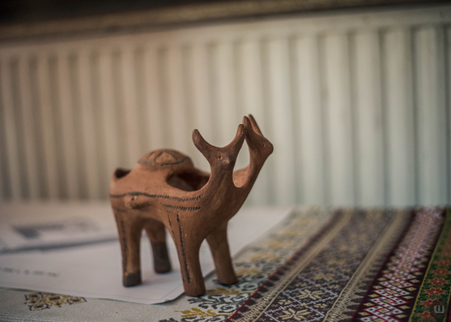
Shypyntsi Museum, Chernivtsi region, Ukraine
The excavations of settlements of Trypillia culture were carried out in the village of Shypyntsi. Many figures of women-guardians, terracotta statuettes, as well as figures of women with babies - the so-called Trypillia Madonnas - were found here.

Slide 8
Trypillian culture
Trypillian culture derives its name from the village of Trypillia in Kyiv region, Ukraine, where artifacts of this ancient civilization were first discovered in 1896.
Archeological excavations show that Trypillian people lived from about 5400 to 2700 BC on a vast area extending from the Carpathian piedmont, east to the Dnipro River, and south to the shores of the Black sea.
The culture is characterized by advanced agriculture, developed metallurgy, pottery-making, sophisticated architecture and social organization, including the first proto-cities on European soil.
The remains of one of the largest burnt out Trypillian buildings ever found have been uncovered during recent excavations at the Trypillian ‘mega-site’ of Nebelivka in Kirovograd region, Ukraine, and interpreted as a massive temple, dating from 4000 BC.

Slide 9
Trypillian culture
A 6,000-year-old temple found at the Trypillian mega-site of Nebelivka in Kirovograd region, Ukraine. Image credit: Nataliia Burdo / Mykhailo Videiko.

Slide 10
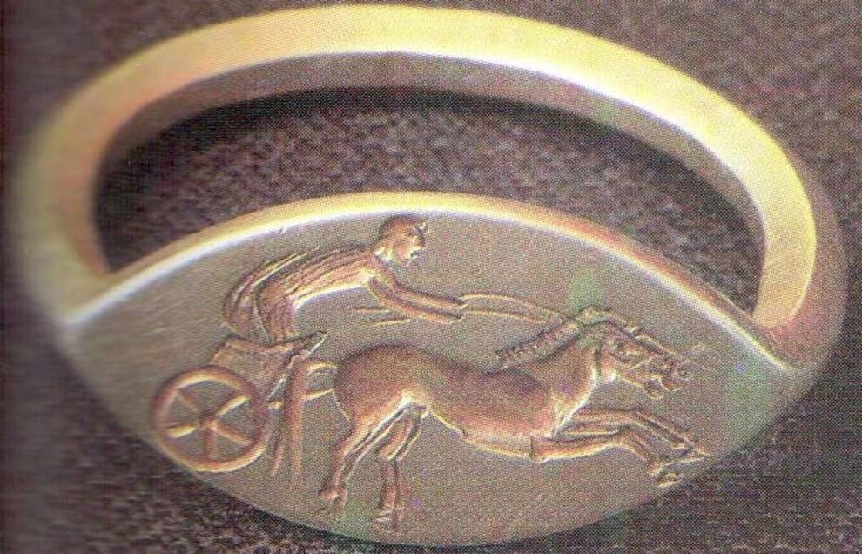
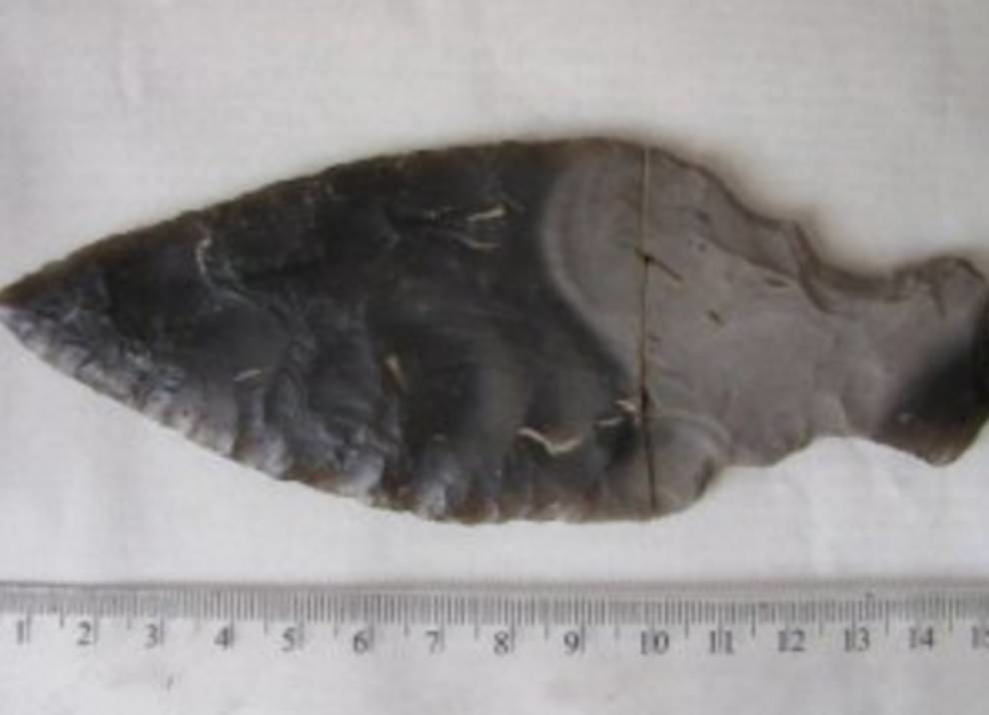
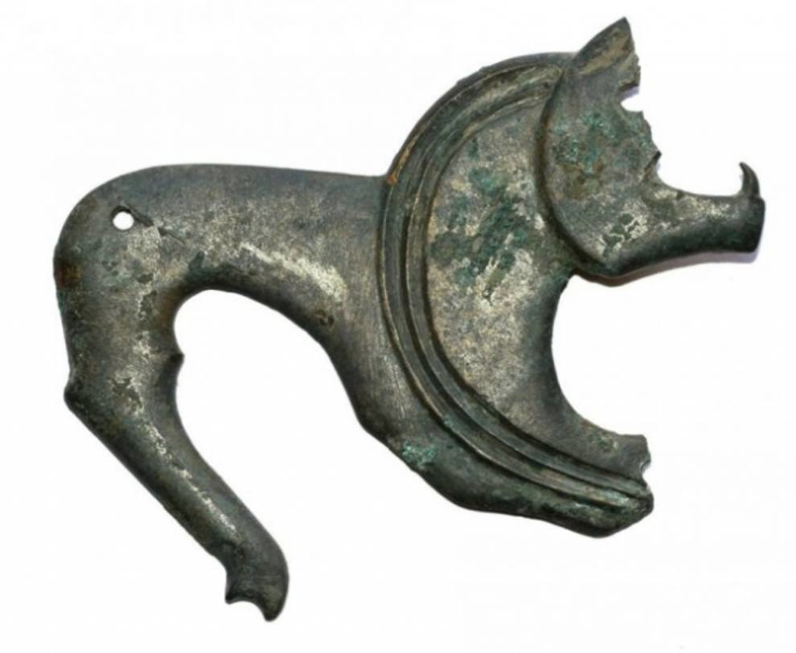
archaeological finds of Ukraine
Photo © galinfo.com.ua
This antique ring with the image of Achilles was found in the Poltava region. To be more precise, the Scythian burial ground in the Pereshchepino tract, near Belsk, Kotelevo district, Poltava region, became the place of detection. The ring shows a chariot with a pair of horses, led by Achilles..
Photo © galinfo.com.ua
In the village of Zeleny Yar, Kola District, Ivano-Frankivsk Region, a local resident Victor Spivak stumbled upon a silicon spear. The man uprooted the old stump when he saw the tip of the spear. He immediately reported the discovery to employees of the local history museum. According to researchers, the find is 10 000-40 000 years.
A bronze overlay dated to the 6th-7th centuries was revealed during the study of the multi-layer settlement of Markovici-1 in Volyn. It represents a figured plate - the main element of a specific type of zoomorphic jewelry that was part of the so-called "treasure ants" - a special group of antiquities of the early Slavs.

Slide 11
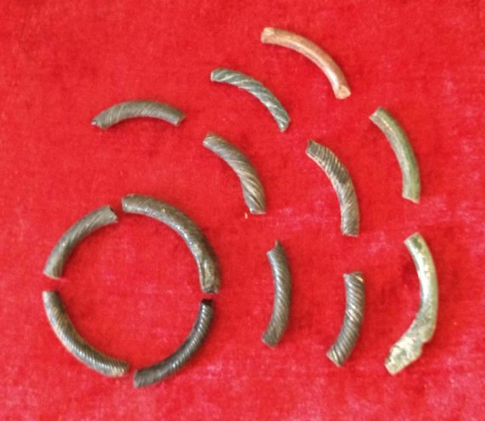
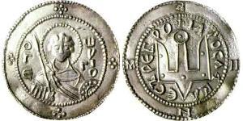
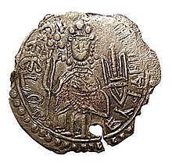
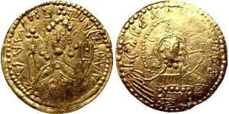
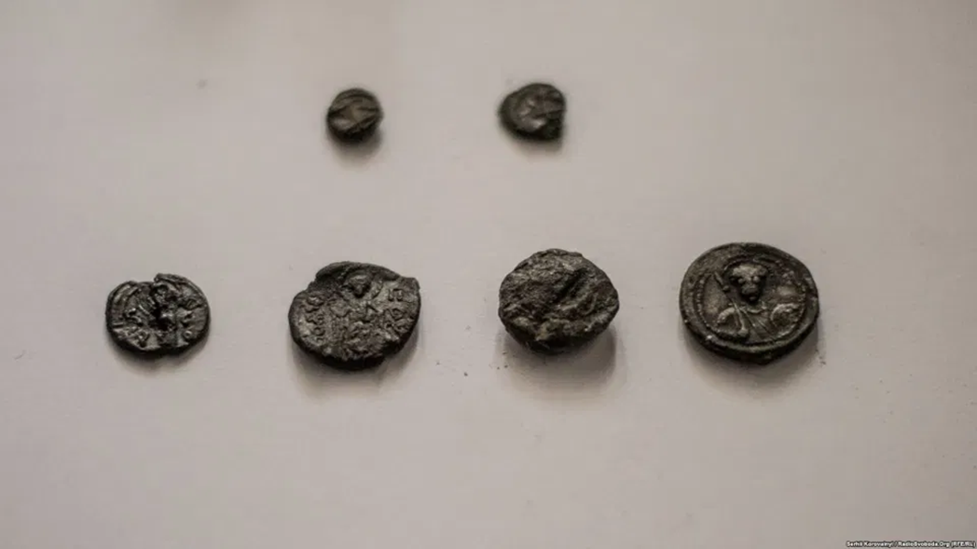
Historical finds from Kyivan Rus
Srebrennik Kyivan Rus
(862 - 1240)
Glass bracelets
Coin of Vladimir the Great
Six unique royal seals found under Poshtova Square, Kyiv

Slide 12
ancient Greek exhibits at the Odesa Archeological Museum

