Slide 1
THE LEGEND OF MAGIC BEANS
Hana Fojtíková, Eliška Havlíková, Tereza Šandová

Slide 2
THE BROTHERS GRIMM (18-19 CENTURY)
Jacob Grimm, Wilhelm Grimm
Germans
Grimm brothers are famous in German and world literatures with their collection of folk tales, songs and legends
They formed a perfect work team in which Jacob focused on linguistic studies, while Wilhelm was a literary scholar
Through their lifetime work, the Brothers of Grimm have proved that fairy tales can be recorded and then published in printed form in their original wording and thus further disseminated.

Slide 3
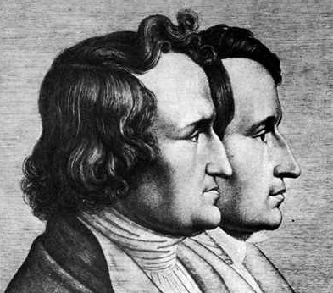
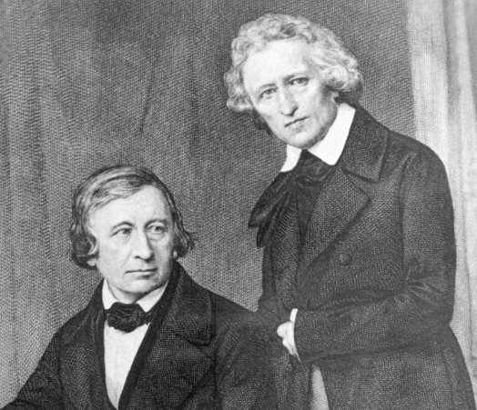
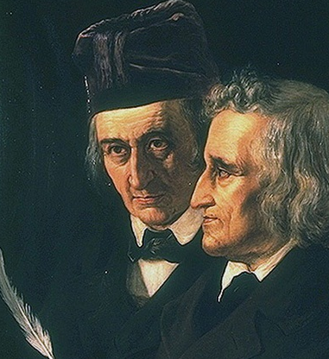
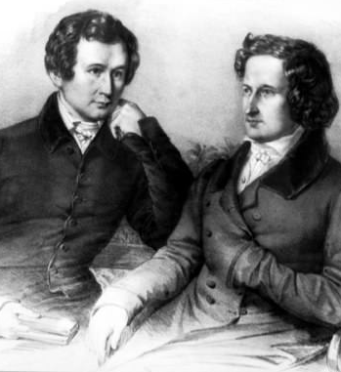

Slide 4
FAIRYTALE VERSION
Jack and the Beanstalk is an English fairy tale. It appeared as "The Story of Jack Spriggins and the Enchanted Bean" and as Benjamin Tabart's moralised "The History of Jack and the Bean Stalk".Henry Cole, publishing under pen name Felix Summerly popularised the tale in The Home Treasury and Joseph Jacobs rewrote it in English Fairy Tales in 1890. Jacobs' version is most commonly reprinted today and it is believed to be closer to the oral versions than Tabart's because it lacks the moralising.

Slide 5
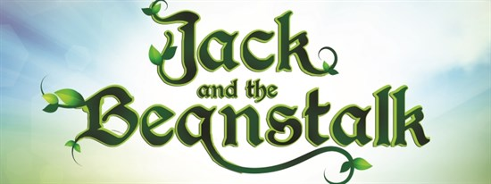
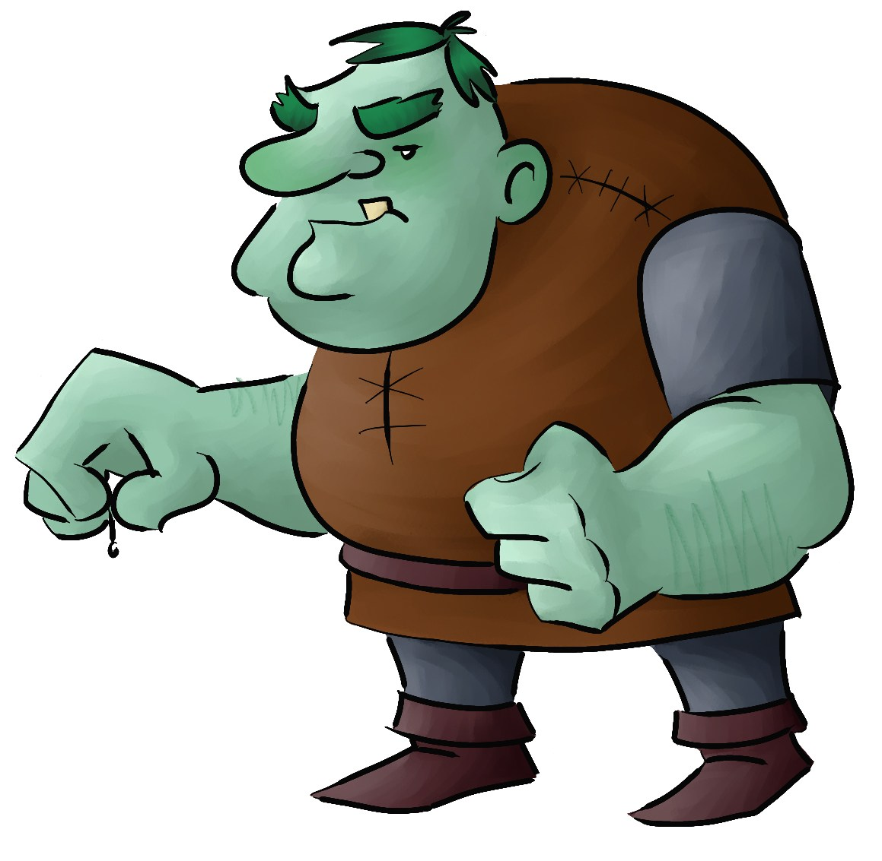
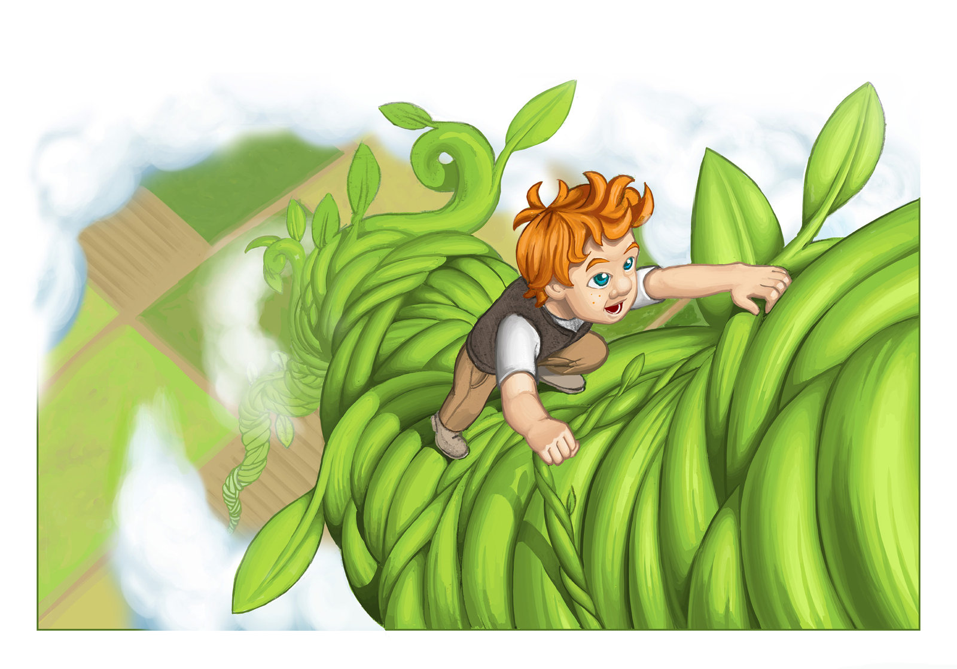
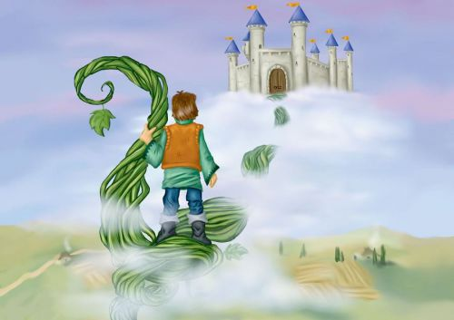
Fairytale in English

Slide 6
FILM VERSION
The name of movie is "Jack the Giant Slayer"
Movie is very much different from the original version
The main hero is a young farmer Jack, who loves legend, his most favorite is about magic beans, king Eric and giants
But legend is reality and he convinced himself that the beans could cause great problems
Jack fights with the giants, who want to gain area, which were in the past their
Director: Bryan Singer
Actors: Nicholas Hoult – Jack, Eleanor Tomlinson – princess Isabell

Slide 7
