Slide 1
Creative of the world
Tomas Kocian

Slide 2
Egypt
In the beginning was sea and in the middle was hill - island of flames
Got Thovt carried the egg
From this egg hatched the Sun – got Amon
Amon from clay creative human

Slide 3
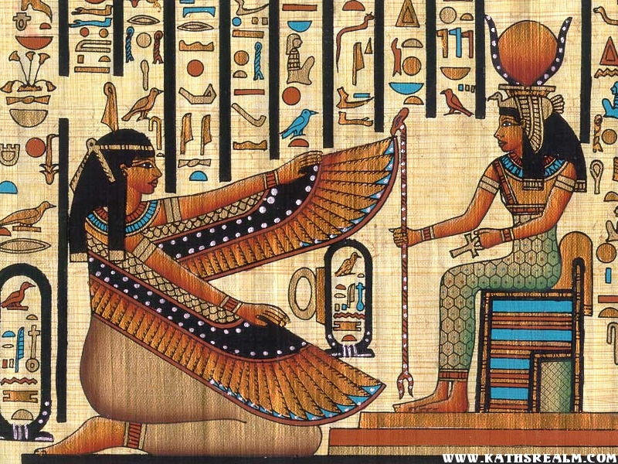

Slide 4
Greece (from Hésiodés)
In the beginning was Chaos
From Chaos rise Gaia (earth), Éros (connecting power), Erebos (dark) and Nyx (night)
Gaia from self creative the sky, mountains and sea
Erebos and Nyx born Day and Light

Slide 5
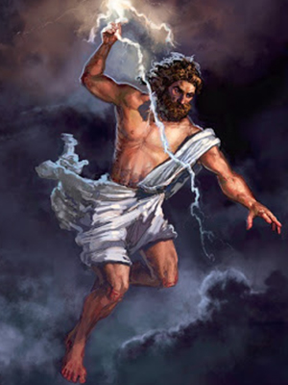
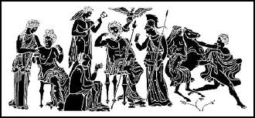

Slide 6
Vikings
In the beginning was empty gap with 2 world (fiery, ice-cold)
From melting snow were created giant (Ymi) and cow
Ymi gave birth to Ódin, Vili and Vé between him broke out the war
Bor‘s sons produced from wood first people

Slide 7
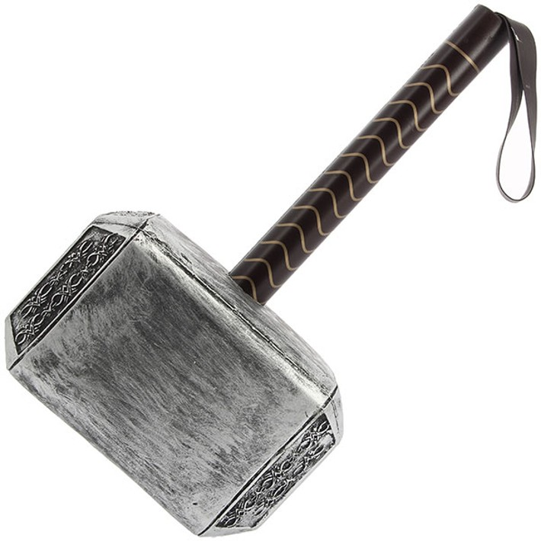

Slide 8
Aztec
Firs was got Ometeotla
He had 4 sons
They creatived (and destroyed) 4 world
5. world has created self-esteem of god Nanahuatzina
In this world was creatived peoples

Slide 9
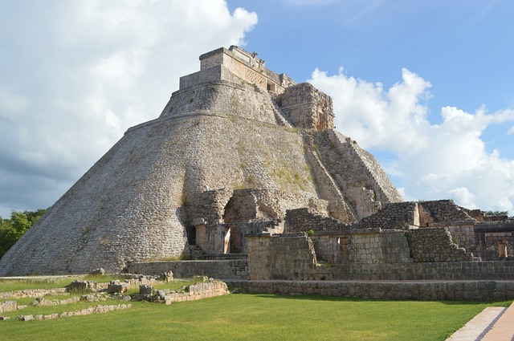

Slide 10
Arab
All creatived Alláh

Slide 11
resources
http://www.starovekyegypt.net
http://spqr.cz/content/stvo%C5%99en%C3%AD-sv%C4%9Bta-boh%C5%AF
http://vikingove.mysteria.cz/stvoreni-sveta.html

Slide 12
Any guestion?

Slide 13
Thanks you for your attention

