Slide 1
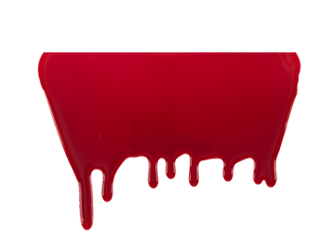
Indonesian cannibals
Josef Ambruz, Petr Švábík, Albert Foldyna

Slide 2
How they look?
Their latin name is Homo floresiensis
People call them Flores man, Little man or Hobbits
Their height were about 3,5 feet (1,1m)
They were hairy
They ate babyes of natives
They were active at night

Slide 3
100% Real video with cannibals
https://youtu.be/LjrJw_9Vt2g?t=1m57s

Slide 4
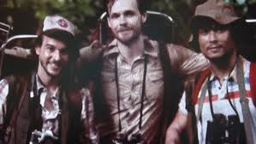
Expedicion of Dr. Timothy darrow
Dr. Darrow and dr. Gary Ward examined birds
Their local guide was Drajat Saputra
They shot cannibals on camera

Slide 5
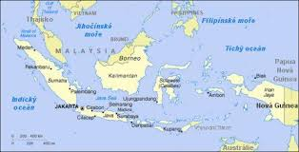
Story
Dr. Timothy Darrow, along with Dr. Gary Ward, was on the Indonesian islands to study birds. They also travelled with their local guide Drajat Saputra.First day they deployed nets and wanted to catch birds. But they couldn´t, because their nets were broken every morning. They did not know about cannibals, but a few days later they shot them on camera. They became very scared, so they decided to leave. On their way back, they saw a rare bird, they wanted to take him on camera. Gary Ward climbed up on the tree. But the cannibals sliced the rope. Dr. Ward fell down and died. Survivors were sleeping in the tent, they found out in the morning they were surrounded. Everybody ran away, but only survived dr. Darrow. Saputra's body was never founded.

Slide 6
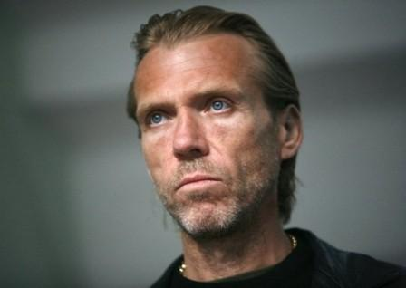
The end of story
Dr. Darrow escaped from the cannibals. He travelled back to home. At home he said, what happend on islands. Police didn´t believe him and send him to jailhouse like murderer. In jailhouse he created documentary film about his history with Animal Planet. He died in prison and after his death it turned out he was telling the truth.

Slide 7
Videos, films
https://www.youtube.com/watch?v=CFgADGukuWo
https://www.youtube.com/watch?v=ewI3i5v0LzE

Slide 8
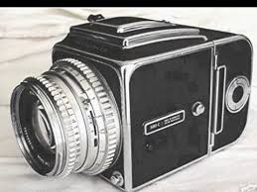
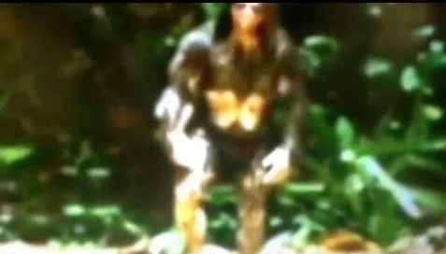
pictures

Slide 9
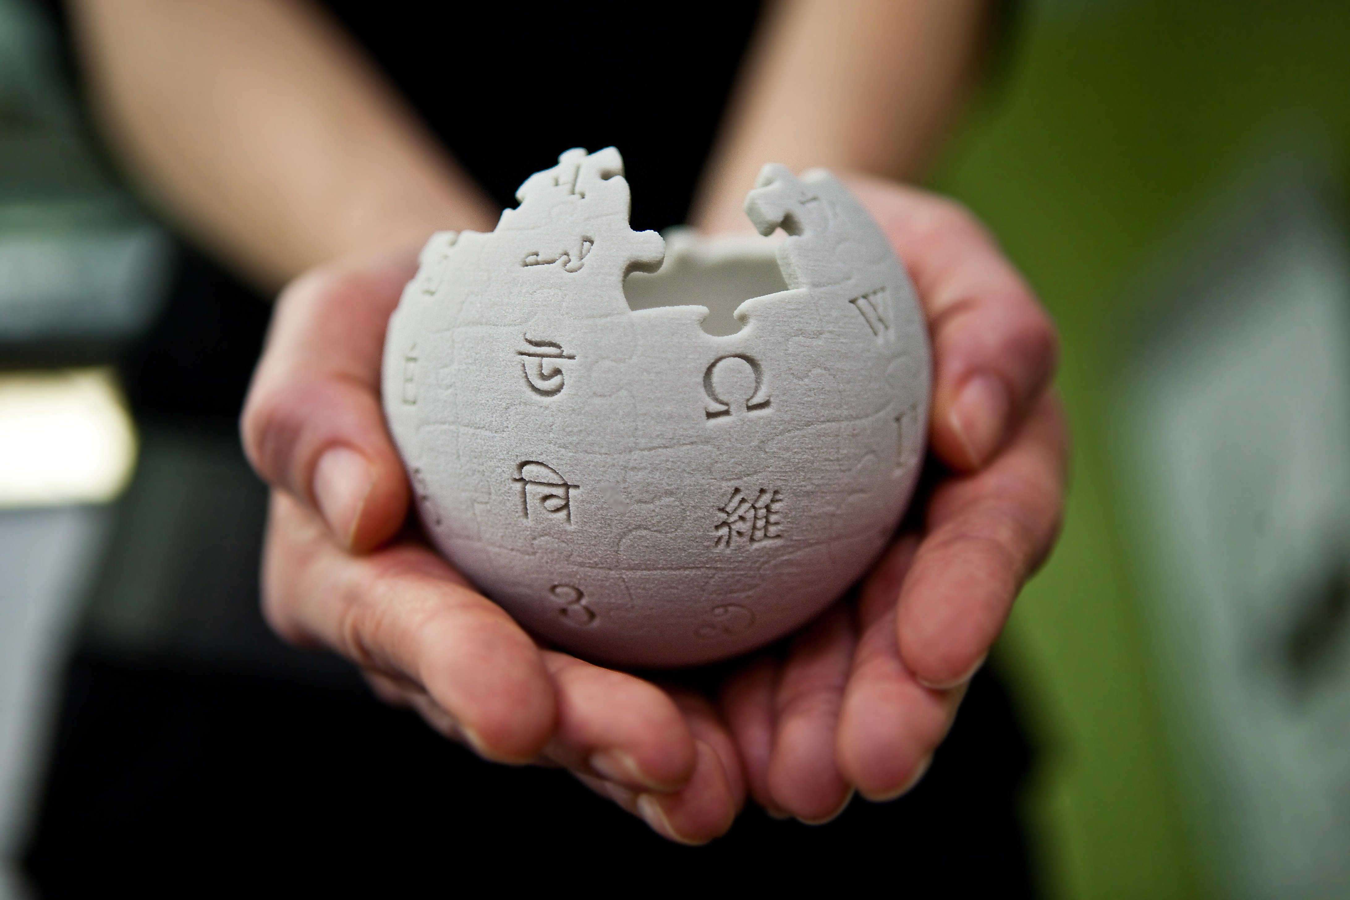
resources
Wikipedia
Google pictures
Youtube

Slide 10
Thanks for your attention

