Slide 1
Name of Zlín
Dalibor Dohnal, Lukáš Javora, Martin Strouhal

Slide 3
1st theory
Zlín was captured by enemy army
Citizens were defending
They pour boiling water on enemy soldiers
After that, enemies named it Zlín, because evil is in czech zlo - zlín

Slide 5
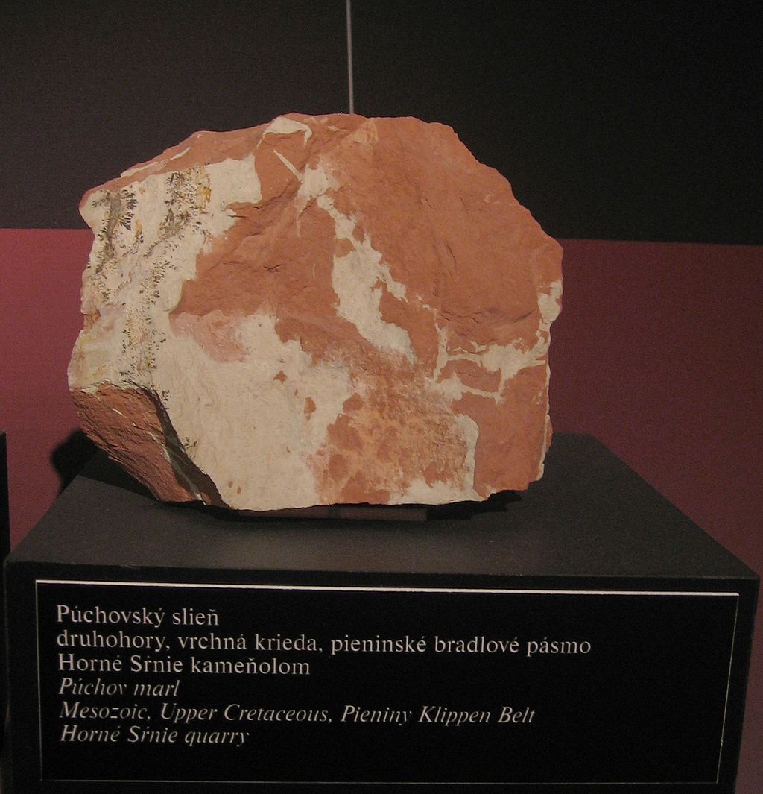
2nd theory
Named after earth
After marl, what is in czech slín

Slide 6
3th theory
The enemy army marched through Zlín
Horseman killed some woman
Other residents pulled him down from his horse and they nailed him alive at gate

Slide 8
Resources
http://www.zlin.estranky.cz/clanky/stary-zlin/zlinske-baje-a-povesti.html
https://cs.wikipedia.org

Slide 9
Thanks for your attention

