Slide 1
The little prince
Natálie Kotasová, Sára Kostková, Zuzana Gerichová, 3TB

Slide 2
Basic information
The Little Prince (French: Le Petit Prince) first published in 1943, is a novella, the most famous work of French aristocrat, writer, poet, and pioneering aviator Antoine de Saint-Exupéry.
The novella is one of the most-translated books in the world and was voted the best book of the 20th century in France. Translated into 300 languages and dialects, selling nearly two million copies annually, and with year-to-date sales of over 140 million copies worldwide, it has become one of the best-selling books ever published.

Slide 3
Antoine de Saint-Exupéry
Antoine Marie Jean-Baptiste Roger, comte de Saint-Exupéry. He was born in French in 29 June 1900 and he died in 31 July 1944. He was a writer, poet, aristocrat, journalist, and pioneering aviator. He became a laureate of several of France's highest literary awards and also won the U.S. National Book Award. He is best remembered for his novella The Little Prince and for his lyrical aviation writings, including Wind, Sand and Stars and Night Flight.

Slide 4
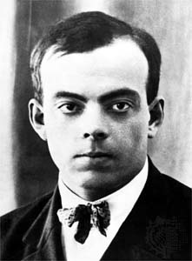

Slide 5
The Little Prince
The Little Prince is a poetic tale, with watercolour illustrations by the author, in which a pilot stranded in the desert meets a young prince visiting Earth from a tiny asteroid. The story is philosophical and includes social criticism of the adult world. It was written during a period when Saint-Exupéry fled to North America subsequent to the Fall of France during the Second World War, witnessed first hand by the author and captured in his memoir Flight to Arras. The adult fable, according to one review, is actually "...an allegory of Saint-Exupéry's own life - his search for childhood certainties and interior peace, his mysticism, his belief in human courage and brotherhood, and his deep love for his wife Consuelo but also an allusion to the tortured nature of their relationship."

Slide 6
THE LITTLE PRINCE
Though ostensibly styled as a children's book, The Little Prince makes several observations about life and human nature. For example, Saint-Exupéry tells of a fox meeting the young prince during his travels on Earth. The story's essence is contained in the fox saying that "One sees clearly only with the heart. The essential is invisible to the eye." Other key morals articulated by the fox are: "You become responsible, forever, for what you have tamed," and "It is the time you have lost for your rose that makes your rose so important." The fox's messages are arguably the book's most famous quotations because they deal with human relationships.

Slide 7
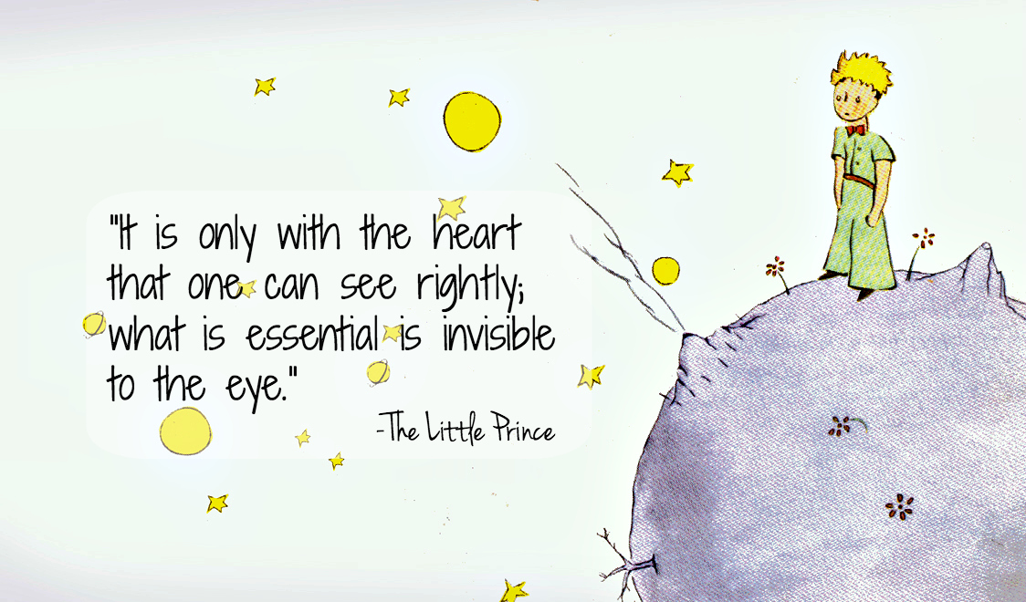

Slide 8
Inspirations
Prince - Saint-Exupéry may have drawn inspiration for the prince's character and appearance from his own self as a youth, as during his early years friends and family called him le Roi-Soleil (the Sun King) because of his golden curly hair.
Rose - Many researchers believe that the prince's kindhearted but petulant and vain rose was inspired by Saint-Exupéry's Salvadoran wife Consuelo de Saint Exupéry, with the small home planet being inspired by her small native country, El Salvador, also known as "The Land of Volcanoes".
Video: https://www.youtube.com/watch?v=fEPqgSNLfK8

Slide 9
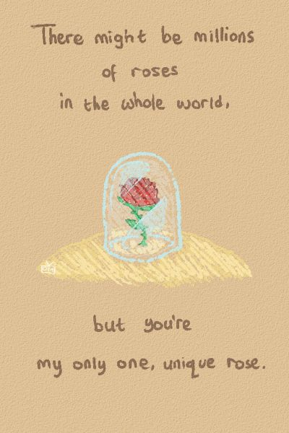
Any questions?
Please, no.

Slide 10
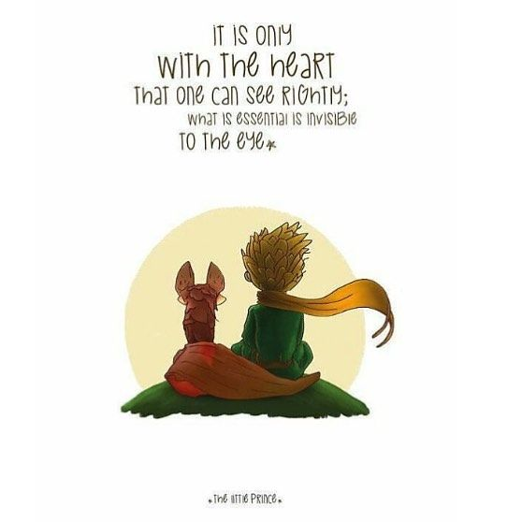
Thank you for your attention!

