Slide 1
The Snow Queen
Klára Staňková, Kristýna Vlková

Slide 2
The story of Kay, the little boy whose heart and eye are pierced by a splinter of glass.
Published on 21 December 1844
About the Mirror and Its Pieces
A Little Boy and a Little Girl
The Flower Garden of the Woman Who Knew Magic
The Prince and the Princess
The Little Robber Girl
The Lapp Woman and the Finn Woman
What Happened at the Snow Queen's Palace and What Happened Afterwards

Slide 3
Story
Devil in the form of evil troll
Magic mirror
It sees beautiful and ugly aspects
Attemp to carry mirror in heaven
To make fools of angels and God
It falls to earth and shattered into a bunch of little pieces
Blowns by the wind all over Earth
Gets into peoples hearts
Making their eyes like the troll-mirror itself and freezing their heart

Slide 4
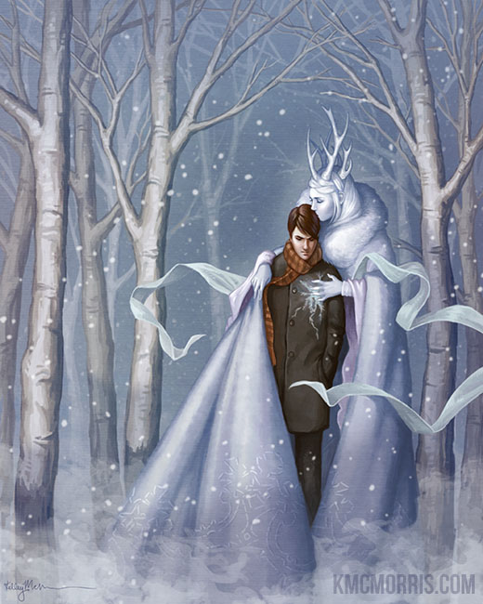
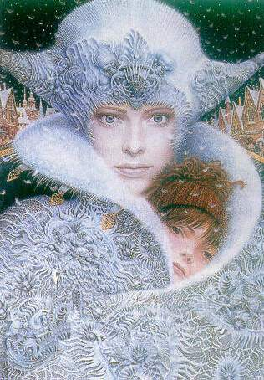

Slide 5
Hans Christian Andersen
(2 April 1805 – 4 August 1875)
Danish writer
The Little Mermaid
The Princess and the Pea
The Ugly Duckling
A lot of fairytales

Slide 6
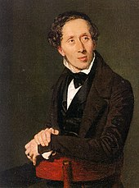

Slide 8
Thank you for your attention!

