Slide 1
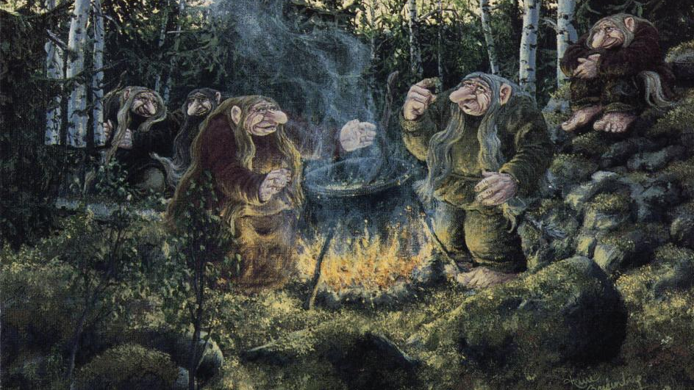
Trolls in Norway
Petra Vavrusova 3TB

Slide 2
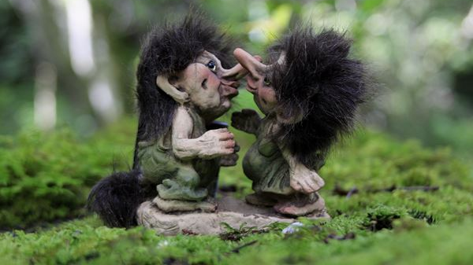
Trolls are mysterious beings that are connected with nordic mythologic.
They are similiar with humans, but they reach varied sizes.
Originally, they were giants or descendants of giants.
But they gradually diminished and nowadays they reach the size of the elf or small person.
They also live in family.
Large trolls are very strong, but they are often stupid. They also prefer to hurt people. Smaller trolls are smarter and don‘t hurt.

Slide 3
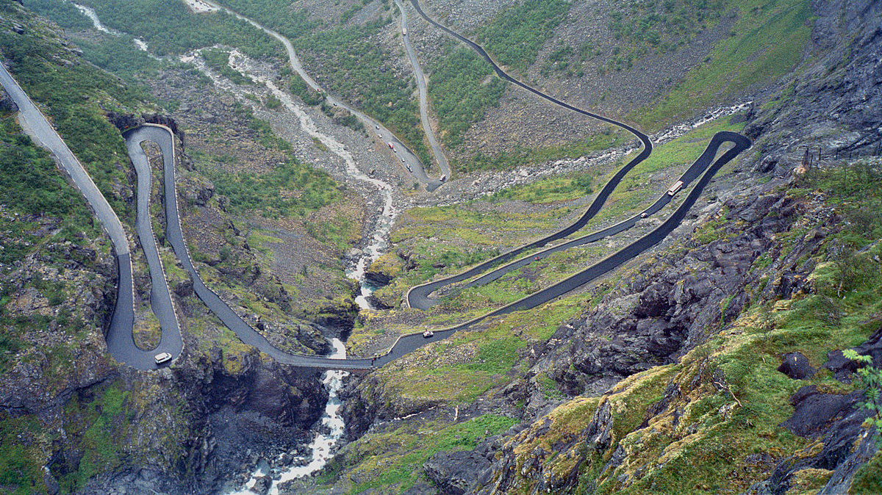
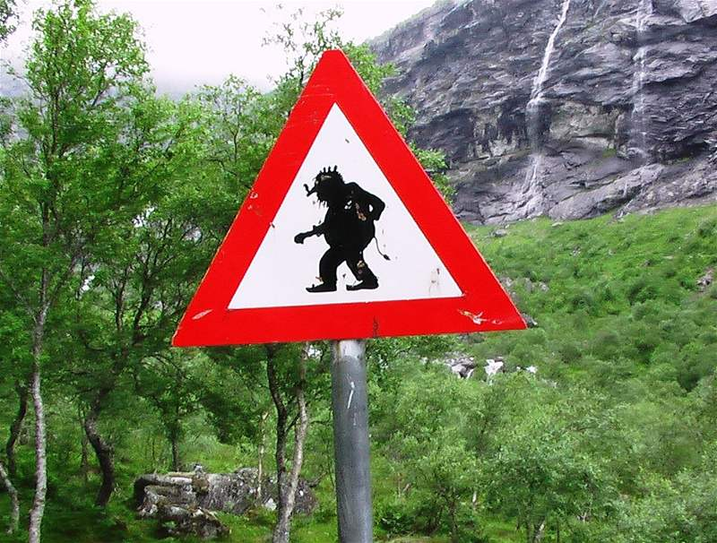
The most famous place with Trolls is Norweigan the Isterdalen Valley near Rauma where it was a trade trail Trollstigen (Troll‘s trail) passing through the territory of the trolls and steeply rising serpentine from the sea up to 800 meters.
The place is right a traditional stop for all tourists.

Slide 4
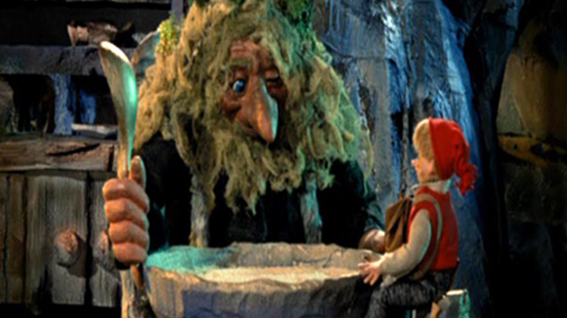
Now a fairy tale
Ashlad and the hungry troll

Slide 5
Once there lived a woodcutter who had three sons. The eldest two lads were big and strong, but the third boy was different. His name was Ashlad, and he loved to sit in front of the hearth and read and dream. The elder boys often teased him.
"What good is reading?" they would ask.
When the woodcutter grew old and his debts began to mount, he called his two eldest sons to his side.
"I'm too old for this work," he said, "you'll have to chop wood to pay our debts."
The two sons went into the forest.
Just as they prepared to chop down a tree, a hideous troll called out, "Chop my wood and I'll kill you."
Terrified, the sons ran home. "The troll will kill us if we chop his wood," they told their father.
Now the father was distraught. "Who will help me pay our debts? We're doomed!" he lamented.
But Ashlad said, "I'll chop the wood."
The others laughed, but Ashlad did not care. He had read about trolls, and so he packed a big round cheese in his bag, and then tucked the bag inside his shirt. Then he walked into the woods.
Just as Ashlad raised his ax, a voice thundered, "Chop my wood and I'll kill you!"
Ashlad did not run. He turned, reached into his bag, and pulled out the big round cheese.
"What's that?" asked the troll.
Ashlad smiled. "A big rock," he said, and then he squeezed the cheese until water dripped out of it.

Slide 6
The troll was stunned. "You squeezed water out of that rock!" he exclaimed.
"I did," Ashlad said, "and I'll do the same to you unless you help me chop this wood and carry it home.
"Very well," said the troll.
The two worked until it was almost sunset.
The troll did not want to lose his wood, so he said, "Let's go to my place and eat before we take this wood to your home."
"Good idea," Ashlad said.
The two prepared a stew.
"How much would you like?" asked the troll.
Ashlad grinned. "More than you, I'm sure," he said.
The troll howled with laughter. "No man can eat as much as I.“
"We'll see," said Ashlad, and the two sat down. Ashlad began to spoon up stew, and whenever the troll wasn't looking, he slipped a spoonful into the bag hidden beneath his shirt.
This went on until the troll was full. "You're not full?" asked the troll, staring in wonder at this little man.
"I'm getting there," Ashlad said, "so I think I'll make more room." Ashlad took his knife and made a slit in his shirt, into the hidden bag.
"Doesn't that hurt?" the troll asked.
"A little," answered Ashlad, "But it gives me more room," and he resumed eating. "Why don't you try it?" he asked the troll.
So the troll lifted up his knife and did just what Ashlad had done, and he died.
Ashlad then carried the troll's jewels and gold home, pleased to be able to help his family. He always knew that his reading and learning would pay off!

Slide 7
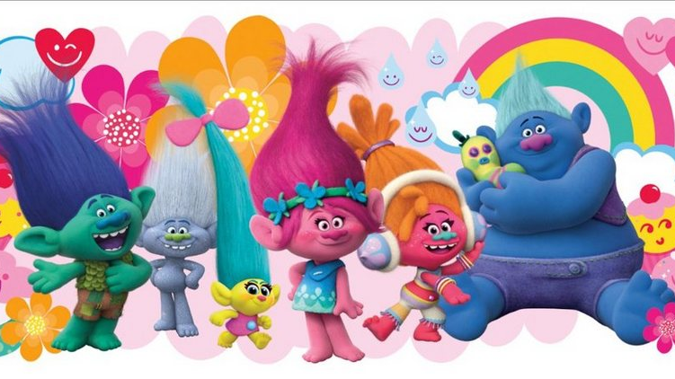
The end

