Slide 1
Little mole
Petra šikudová, Kryštof trčala 3tb
2017-18

Slide 2
Basic information
Created by zdeněk miler
From czechoslovakia
1. episode was broadcast in 1957
49 episodes

Slide 3
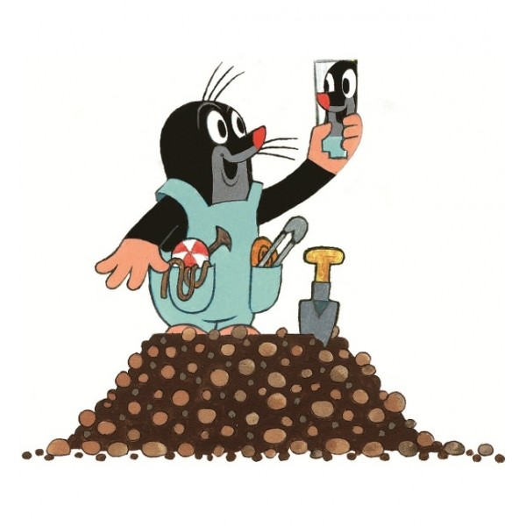
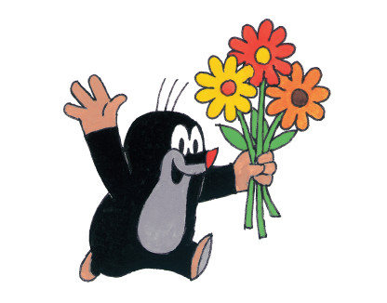
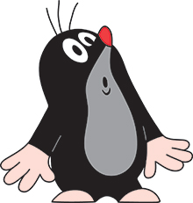
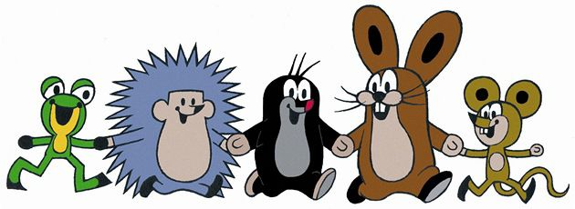

Slide 4
Zdeněk Miler
Born 21.2. 1921
Dead 30.11. 2011
Director and artist
Career start in zlin
Then at barrandov studios

Slide 5
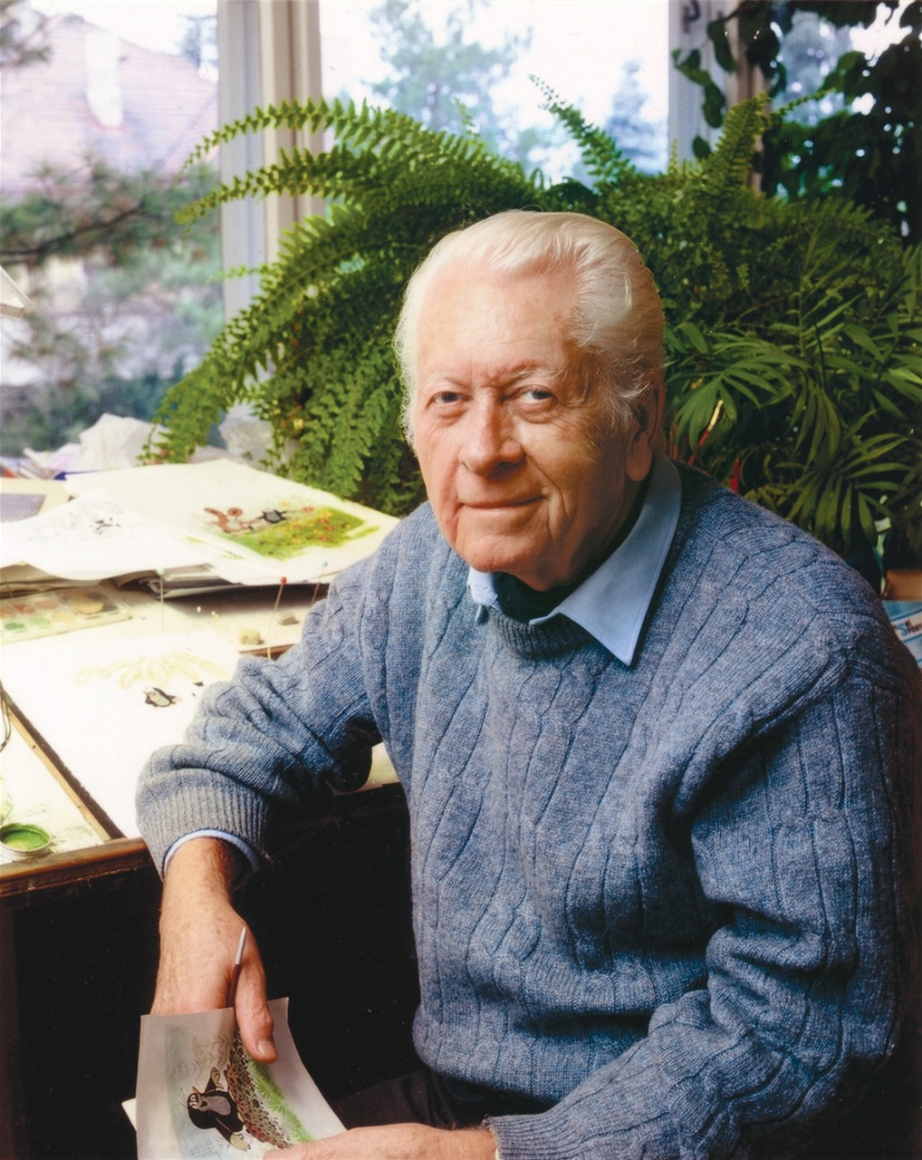
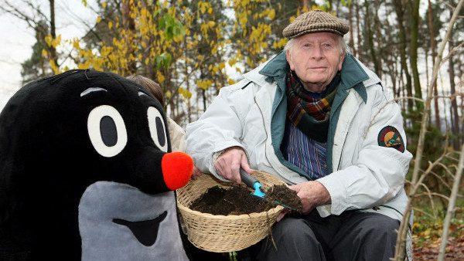

Slide 6
history
First episode was named: "How a mole came to the panties"
Mole was original because walt disney didn´t use this animal
Milers daughters dubed the mole voice for first episodes

Slide 7
MOLE AND PANDA
MILERS GRANDDAUGHTER CLOSED CONTRACT WITH CHINE TV
THEY ARE IN 3D
THE MOLE SPEAKS HERE
IN MARCH 2016 WAS FIRST BROADCAST IN CZECH REPUBLIC

Slide 8
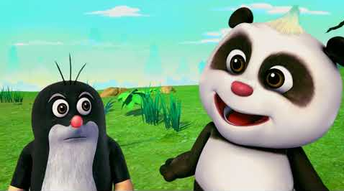
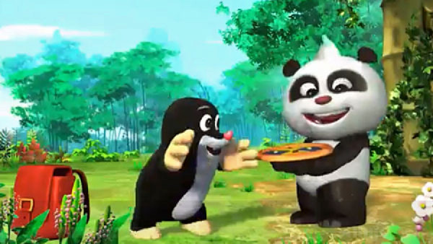

Slide 9
Mole in the universE
THE PLUSH FIGURE OF THE MOle WAS A symbol OF THE MISSION
Mole flew on the draft A.J. Feustel

Slide 10
THE examples
MoLE AND PANDA:
https://www.stream.cz/pohadky/krtek-a-panda/10017738-pritel-z-dalky
https://www.stream.cz/pohadky/krtek-a-panda/10017739-uvitaci-vecirek
LiTTLE MOLE:
https://www.stream.cz/pohadky/krtek/10000776-jak-krtek-ke-kalhotkam-prisel
https://www.stream.cz/pohadky/krtek/10000654-chemikem
https://www.stream.cz/pohadky/krtek/10000663-paraplicko

Slide 11
