Slide 1
The little prince
Natálie Kotasová, Sára Kostková, Zuzana Gerichová, 3TB

Slide 2
Basic informationS
The Little Prince, published in 1943, is a novel, the most famous work of a French writer Antoine de Saint-Exupéry
The novel was voted the best book of the 20th century in France
The book was translated into 300 languages and it´s one of the best-selling books ever

Slide 3
Antoine de Saint-Exupéry
Antoine de Saint-Exupéry was born in France in 1900 and he died in 1944
He was a writer, poet, aristocrat, and pioneering aviator
He became famous in France and also won the U.S. National Book Award
He is the best remembered for his novel The Little Prince

Slide 4
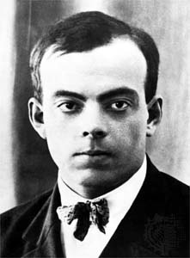

Slide 5
The Little Prince
The Little Prince is a poetic tale
The story is philosophical and includes social criticism of the adult world
It was written during a period when Saint-Exupéry fled to America
The adult fable is an allegory of Saint-Exupéry's own life

Slide 6
THE LITTLE PRINCE
The Little Prince makes several observations about life and human nature
The story's essence is contained in the fox saying that "One sees clearly only with the heart. The essential is invisible to the eye."
Another key moral told by the fox is "It is the time you have wasted for your rose that makes your rose so important."

Slide 8
Inspirations
Prince: Saint-Exupéry may have drawn inspiration for the prince's appearance from his own self
Rose : Many readers believe that the prince's rose was inspired by Saint-Exupéry's wife
Video: https://www.youtube.com/watch?v=fEPqgSNLfK8

Slide 9
Any questions?
Please, no.

Slide 10
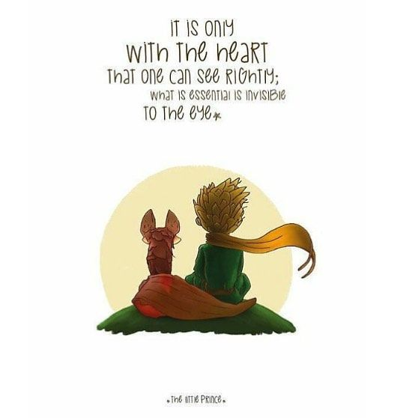
Thank you for your attention!

