Slide 1
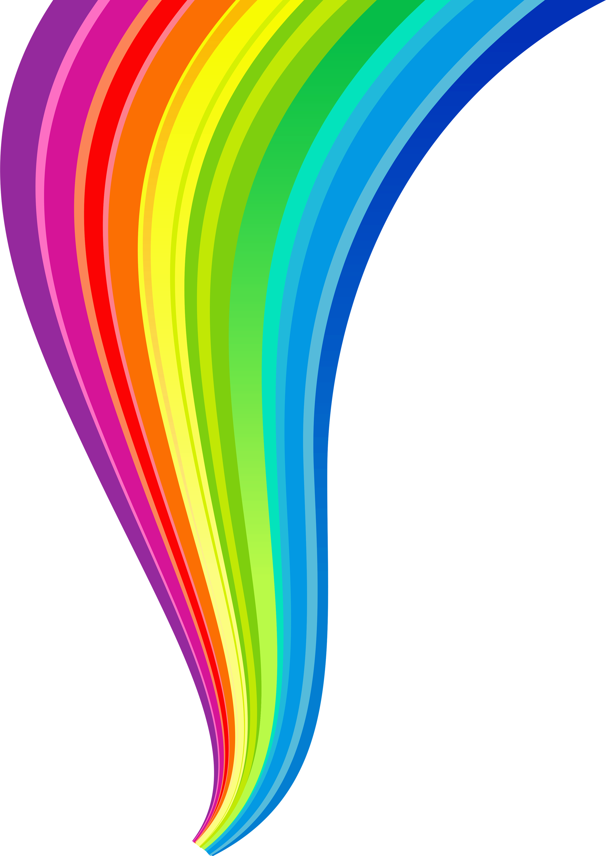
Ragnarök
Lidey S., Emmma C.

Slide 2
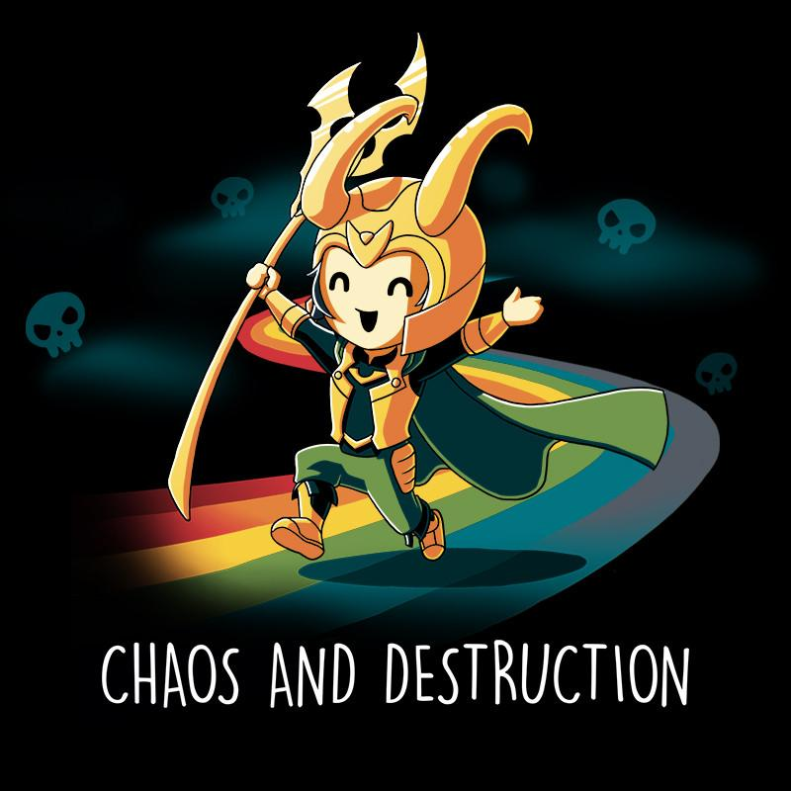
What is Ragnarök?
is the name the Norse gave to the end of their mythical cycle, during which the cosmos is destroyed and re-created
you could translate Ragnarök to English as “The Doom of the Gods”

Slide 3
Ragnarök

Slide 4
While some scholars have attempted to portray Ragnarök as being much like the Christian “End Times,” where the world is destroyed once and for all and historical time is abolished, other scholars, have realized that the tale of Ragnarökconveys a very, very different message.

Slide 5
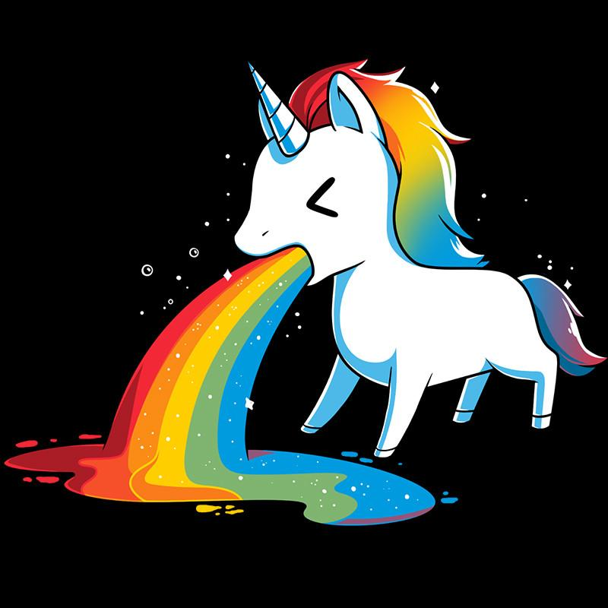
Given that the accounts of the destruction of the world in the Old Norse primary sources are immediately followed by accounts of its re-creation, the assertion that Ragnarök describes the end of linear history is completely unfounded.

Slide 6
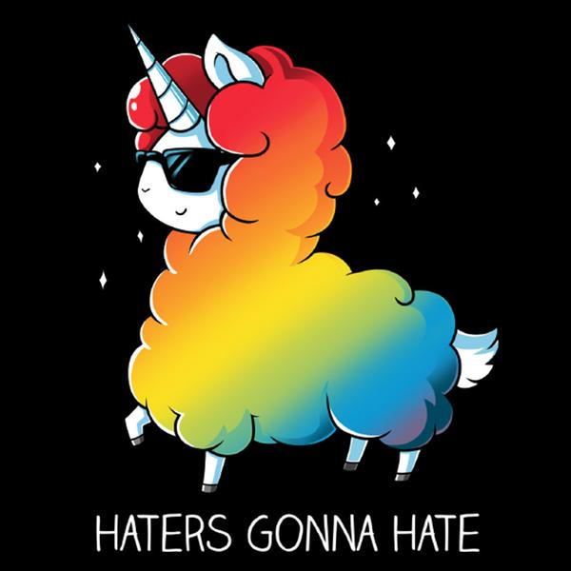
A more sensitive reading of the primary sources makes it obvious that what Ragnarök describes is a cyclical end of the world, after which follows a new creation, which will in turn be followed by another Ragnarök, and so on throughout eternity.
In other words, creation and destruction are points at opposite ends of a circle, not points at opposite ends of a straight line.

Slide 7
Thank you for your attention, darlings!

