Slide 1
The lengend of forefathers

Slide 2
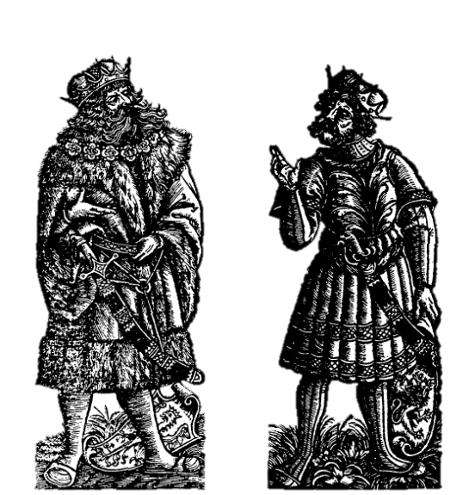
The legend
Lech Czech
This legend is about a king of Crotian country, which had three sons – Czech, Lech and Rus. These brothers didn‘t like the situation in Croatian country, so they decided to setle theyr own countries. Forefather Czech settled Bohemia, Lech settled Great Moravia and Poland and Rus settled all the east-slavonic countries.
This legend has many versions, but this is the „first“, or correctly the oldest one.

Slide 3
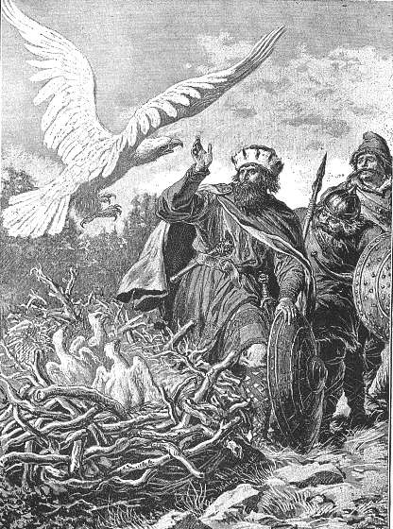
Origin
The origial legend is from a Polish chronicle (but it‘s written because of Hungarian king)
The legend, which we described is written by Polish writer, because Hungarian king‘s request (he probably wanted to unite all the Slavonic and post-slavonic countries (including Hungaria, part of Austria and Polabian Slavs)

Slide 4
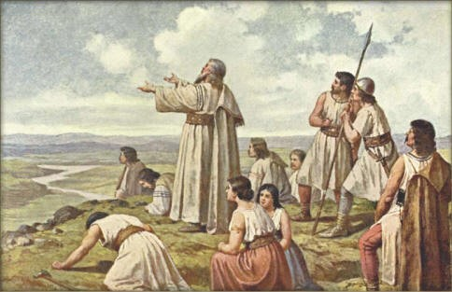
Development
The original one, is that by a polish writer, but today there are many versions of it (Cosmo‘s chronicle – the „Czech“ version; the Polish version which says, that brothers went hunting instead of founding countries and many others)
Czech on the Říp mountain

Slide 5
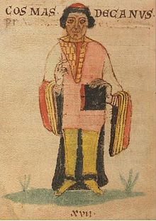
Examples from chronicles
Cosmo‘s Chronicle : „Charvatská země, část prvotní veliké vlasti Slovanské. V té Charvatské zemi bytovala četná plemena, příbuzná jazykem, mravy, způsobem života. I stalo se, že se strhly mezi nimi vády a krvavé boje o meze a dědiny. Vstal rod na rod, příbuzní bojovali proti příbuzným a hubili se navzájem.„
(translated: „Croatian country, the part of the very first slavonic nation. In this Croatian coutry were many tribes, which had similar language but diferent habits and lifes. And they were arguing and fighting with others because of teritories. The clan was againts the clan, relatives againts relatives and they were murdering each other.“)

Slide 6
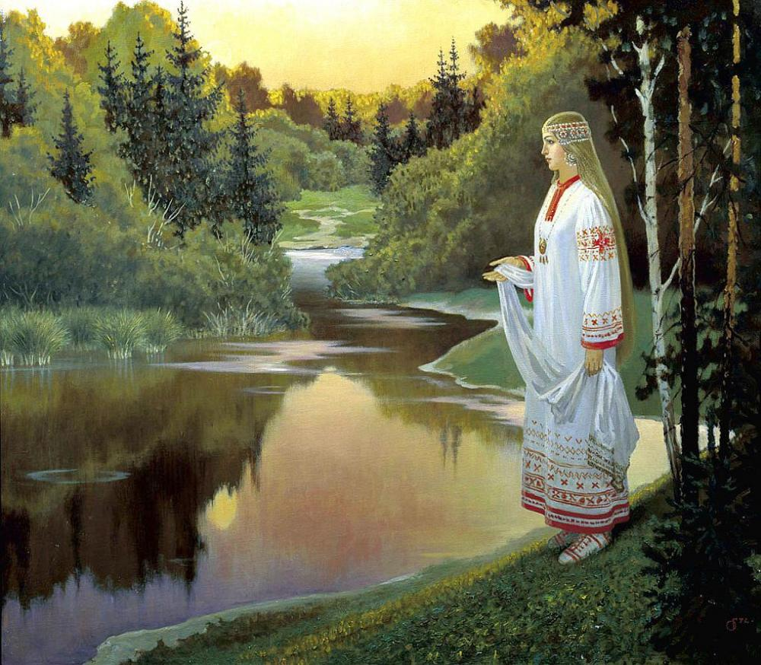
Influencing reality
This legend dindn‘t actualy efected the reality, but the original (by polish writer) probably should. We personaly think, that this legend was made to unite the slavonic and post-slavonic countries and make one of the biggest empires of the whole time.

Slide 7
Any questions?
Thank you for your attention.

