Slide 1
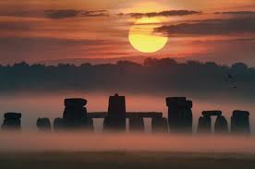
Stonehenge
Filip Kocián, 3TB

Slide 2
Basic information
This is a prehistoric stone monument.
The dating of this building is from a Neolitical age

Slide 3
Building
There were the big stones in the circle
This circle has 33 metres in diameter.

Slide 4
What we don´t know?
Who build this?
Why they build it?
Build this UFO?

Slide 5
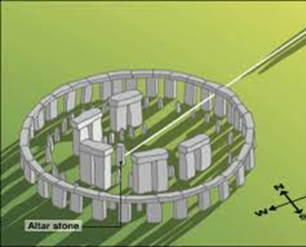
What we now.
In the summer solstice the Stonehenge shine in the particular way.
We found similar buildings at Egypt and at the South America
Calendar
ritual place
Ritual Cemetry

Slide 6
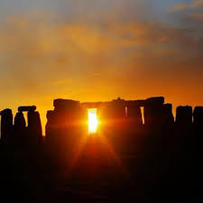

Slide 7
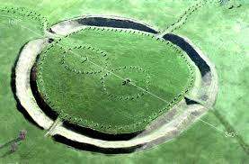
Avebury

Slide 8
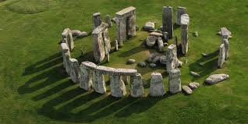
Thanks for you attention

