Slide 1
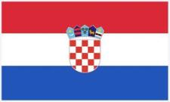
GeoNight_21 PROJECT
My country
My region
My town
CROATIA
DALMATIA
SPLIT

Slide 2
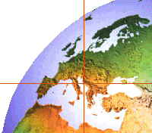
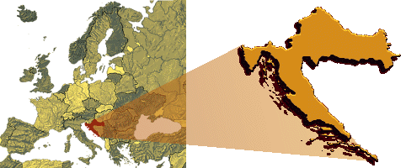
CROATIA IS
on the crossroads between
Central Europe
and the
Mediterranean.

Slide 3
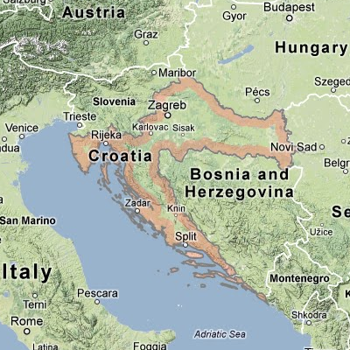
CROATIA
Croatia is half way to the North Pole and the Equator.
It borders with Italy, Slovenia, Bosnia and Herzegovina, Serbia, Montenegro, Hungary

Slide 4
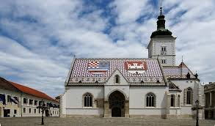
CROATIA
Republic of Croatia was proclaimed 25th June 1991

Slide 5
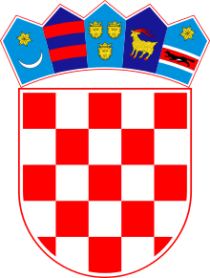
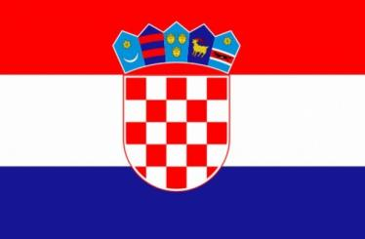
CROATIAN NATIONAL FLAG
Croatian National flag is red-white-blue
Coat of arms is made of 25 red and white fields with 5 crowns representing parts of Croatia.

Slide 6
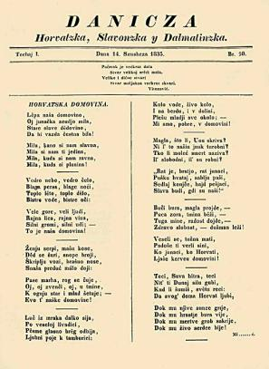
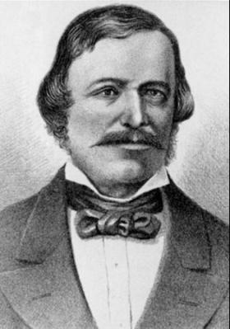
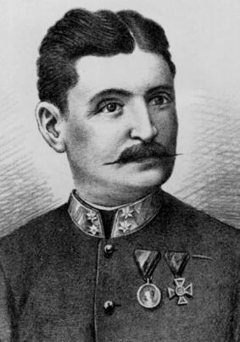
CROATIAN ANTHEM
The Croatian anthem Lijepa naša (Our Beautiful Homeland) was written by Antun Mihanović and set to music by Josip Runjanin.

Slide 7
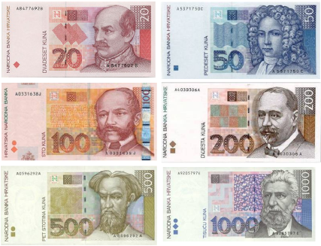
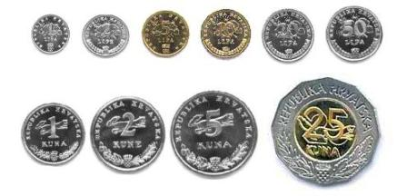
CROATIAN KUNA
The official Croatian currency is Croatian kuna(HRK).

Slide 8
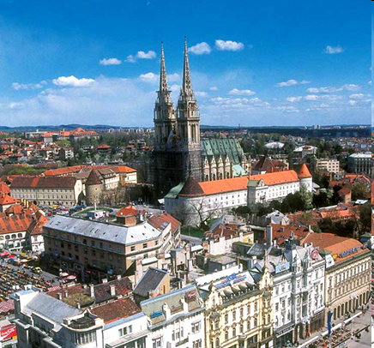
The capital is Zagreb
Zagreb is also the biggest city

Slide 9
CROATIAN ISLANDS
Croatia has over 1000 islands along the Adriatic coast.
The biggest islands are Krk, Cres.
The island of Korčula has the largest population.

Slide 10
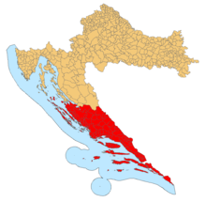
DALMATIA
Dalmacija – Dalmatia is a region where our hometown is situated.

Slide 11
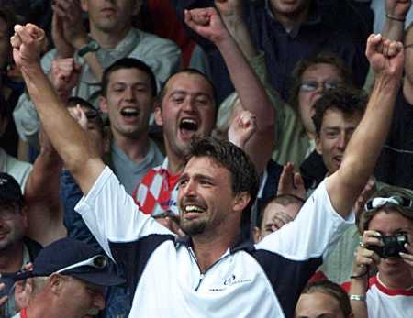
WE ARE PROUD OF…

Slide 12
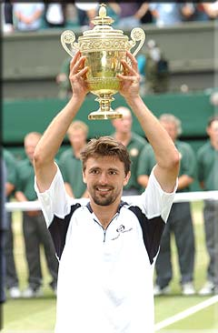
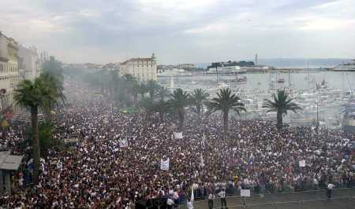
SPORT - GORAN IVANISEVIC
WIMBLEDON CHAMPION 2001
...and welcome in his hometown - Split
Winner

Slide 13
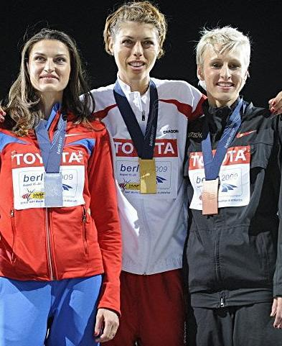
Janica and Ivica Kostelić
Blanka Vlašić

Slide 14
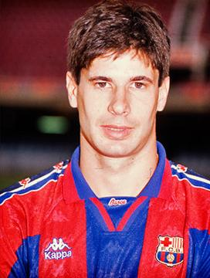
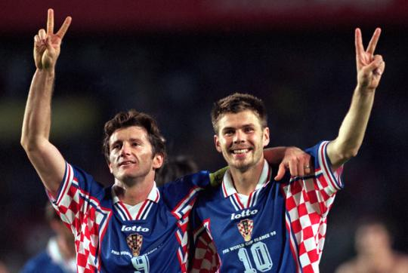
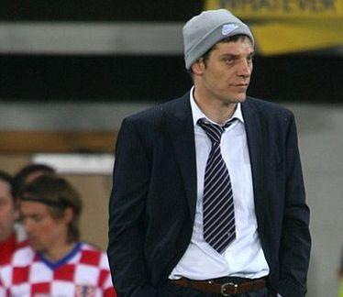
Football players
Goran Vučević
Davor Šuker - Zvonimir Boban
Slaven Bilić

Slide 15
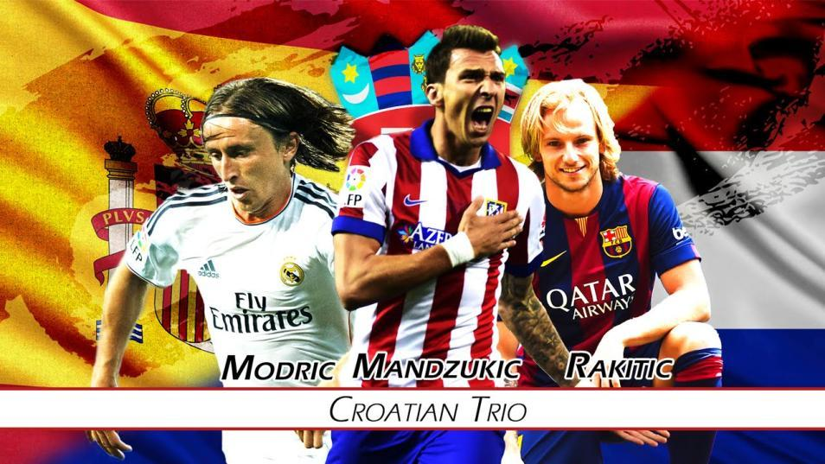

Slide 16
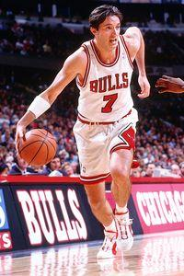
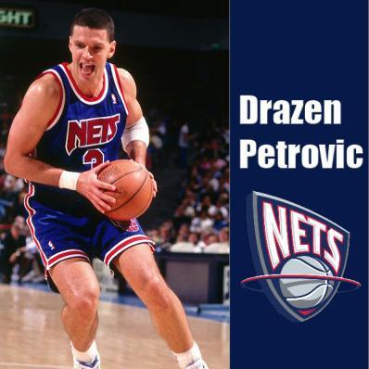
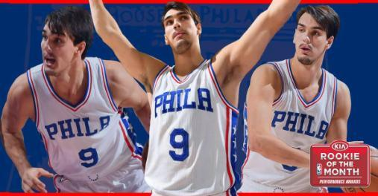
NBA PLAYERS FROM CROATIA
Toni Kukoč
Dario Šarić

Slide 17
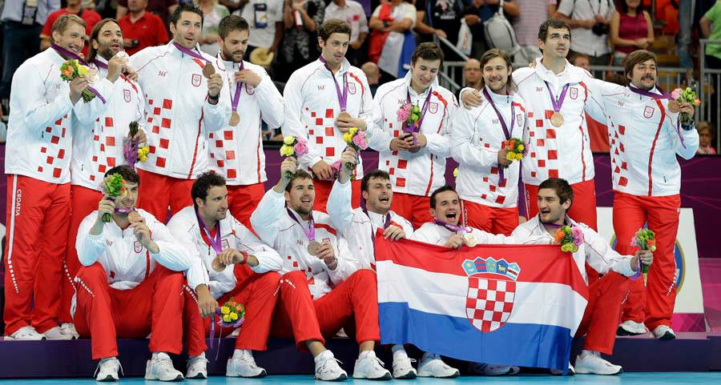
CROATIAN NATIONAL HANDBALL TEAM

Slide 18
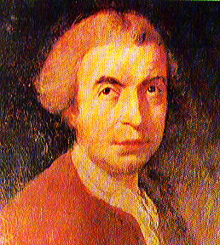
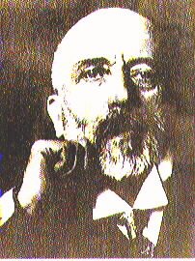
CROATIAN SCIENTISTS
Andrija Mohorovicic
Rudjer Boskovic

Slide 19
NIKOLA TESLA

Slide 20
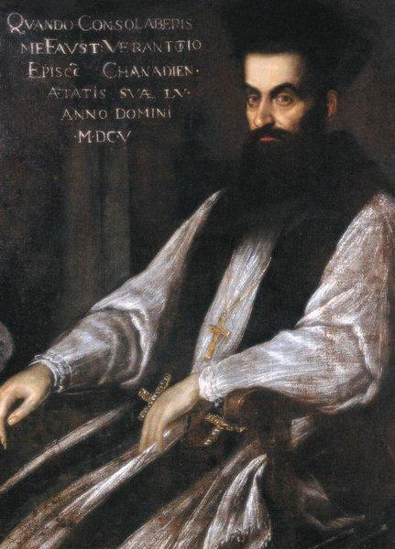
Faust Vrancic

Slide 21
CROATIA - HOMELAND OF CRAVATS

Slide 22
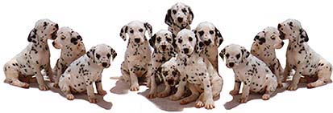
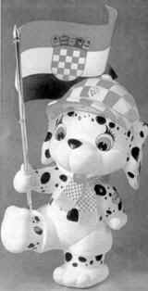
DALMATIAN DOG–NATIVE CROATIAN
Dalmatia - the coastal part of Croatia
Recognized as a Croatian breed
Croatian Mascot - 2000 Olympic games Sydney
Notes:
We know about organized breeding of this dog in the Djakovo bishopric already in the 14th century!
The name was given in the USA in the 19th century, previously also known as the Dubrovnik hunter.
Recognized as Croatian autochthonous breed in 1994.

Slide 23
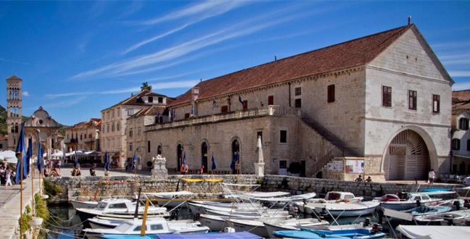
FIRST PUBLIC THEATER IN EUROPE
1612 - ON ISLAND HVAR

Slide 24
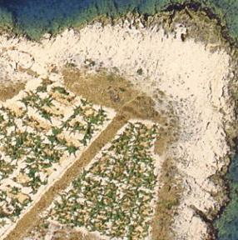
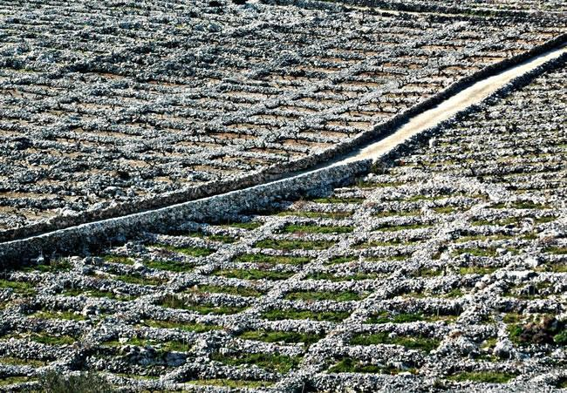
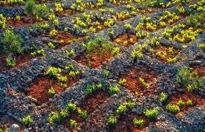
CROATIA IN UN-HERITAGE
Vineyards near Primosten
– a glory to human labor

Slide 25
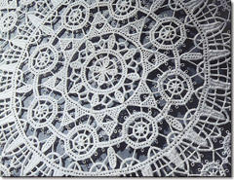
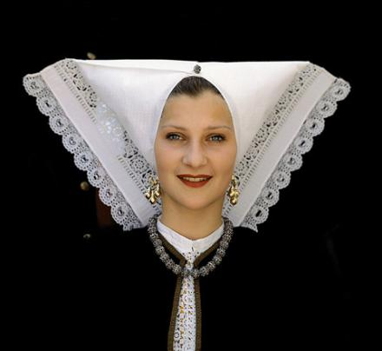
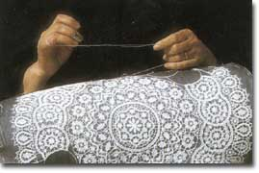
LACE – ISLAND PAG

Slide 26
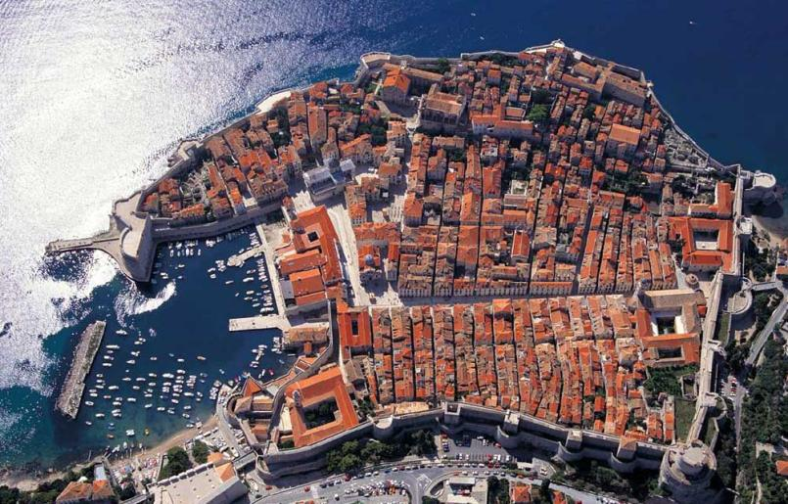
UN - WORLD HERITAGE
OLD CITY OF DUBROVNIK
Bernard Shaw: “Those who seek paradise on Earth
should come to Dubrovnik and see Dubrovnik.”

Slide 27
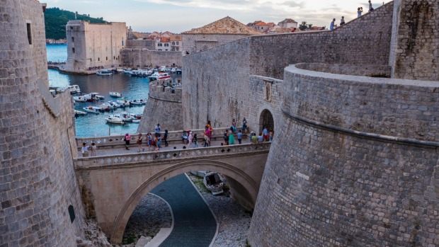
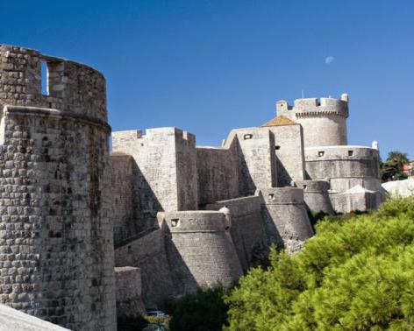
UN - WORLD HERITAGE
OLD CITY OF DUBROVNIK
City walls 8-16 ct.

Slide 28
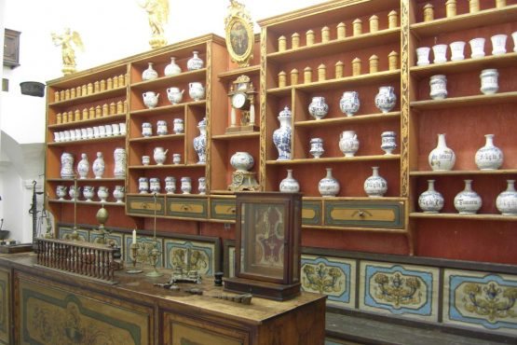
CITY OF DUBROVNIK
PEARL OF CROATIAN CULTURE
1317 - the first European pharmacy that has been working continuously.

Slide 29
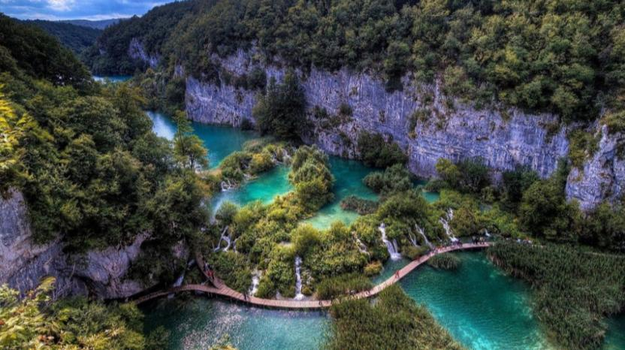
UN - WORLD HERITAGE
NP - PLITVICE LAKES

Slide 30
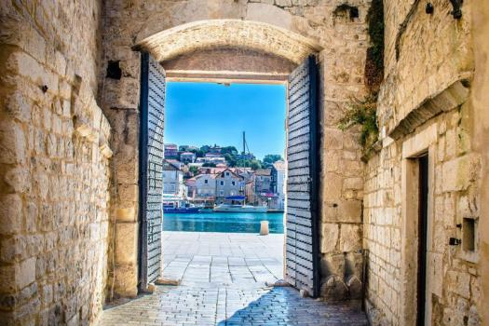
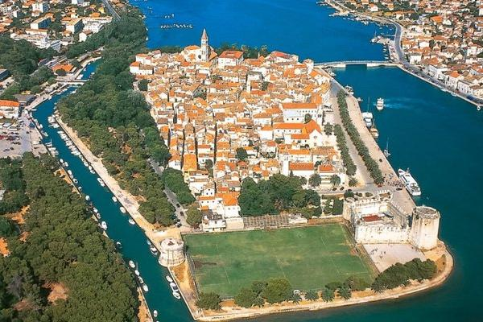
UN - WORLD
HERITAGE
Trogir old town

Slide 31
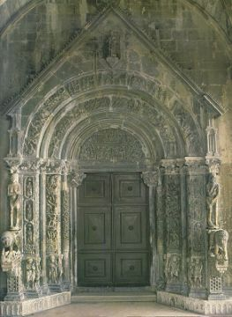
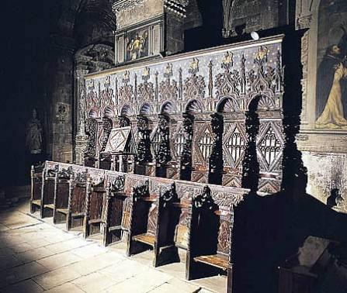
UN - WORLD HERITAGE
OLD TOWN OF TROGIR
Portal and choral seats of Trogir Cathedral

Slide 32
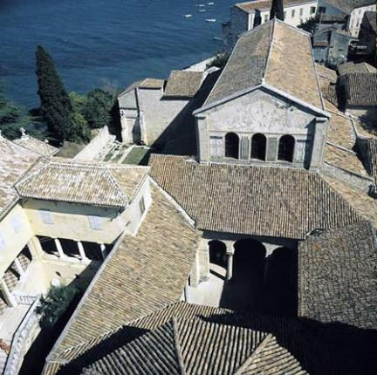
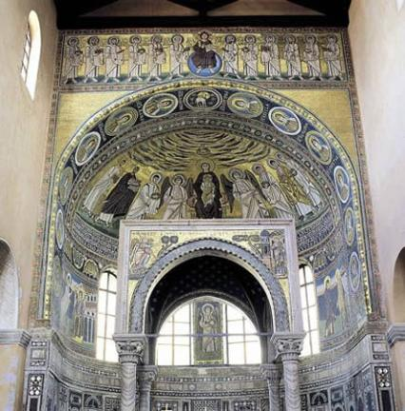
UN - WORLD HERITAGE
BASILICA OF EUPHRASIUS IN POREC
Euphrasius Basilica in Porec, Istria, built in the 6th century.

Slide 33
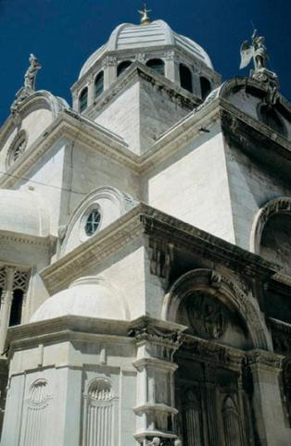
UN - WORLD HERITAGE
CATHEDRAL IN SIBENIK
Following the design of Juraj Dalmatinac (1441)
East end of Cathedral

Slide 34
UN - WORLD HERITAGE
CATHEDRAL IN SIBENIK
Baptistery

Slide 35
Split
The City of Split got it´s name from a flower called BRNISTRA or in Latin (Spalatos)

Slide 36
UN - WORLD HERITAGE
DIOCLETIAN PALACE IN SPLIT

Slide 37
CATHEDRAL IN SPLIT
THE OLDEST IN THE WORLD

Slide 38
RIVA
Promenade - a paradise for all our inhabitants

Slide 39
Bishop
Gregory of Nin, a guardian of language and religion
- now watches over the Golden Gate of Diocletian's Palace

Slide 40
PERISTYLE
One of the most beautiful open-air stages that has hosted the world's most famous opera and drama

Slide 41
Vestibul
-an entrance to the residential part of the Palace

Slide 42
St Duje
the mausoleum of the Roman emperor Diocletian who prosecuted Christians;
the place of worship of patron saint of Split

Slide 43
Temple of Jupiter
– the temple was built to honor the cult of Jupter
- now is St John's baptistery.

Slide 44
The smallest, narrowest street is
Pusti me da prođem
("let me pass")
It is a passage next to the Temple.

Slide 45
Marjan park forest – „the lungs of the city”

