Slide 1
FLIPSNACK

Slide 2
What is Flipsnack?
It is a digital platform for creating e-books and magazines from .pdf files

Slide 3
What is Flipsnack?
It is a digital platform for creating e-books and magazines from .pdf files

Slide 4
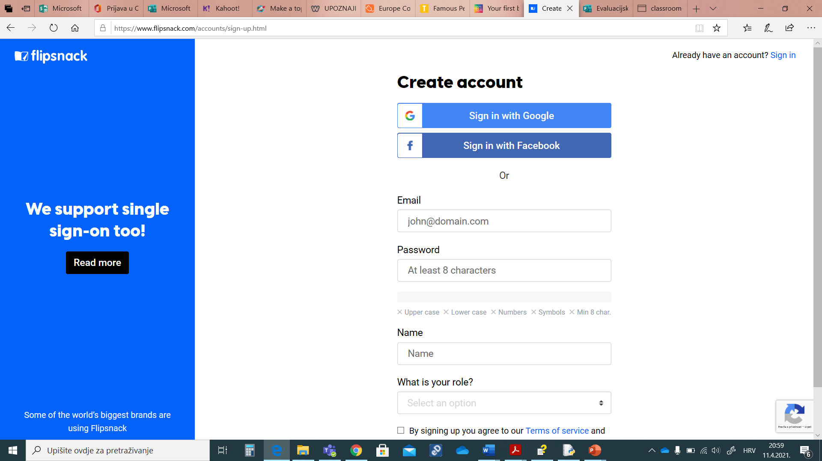
Sign in or create account
You can create account entering your email, password, name and role (teacher, student…)

Slide 5
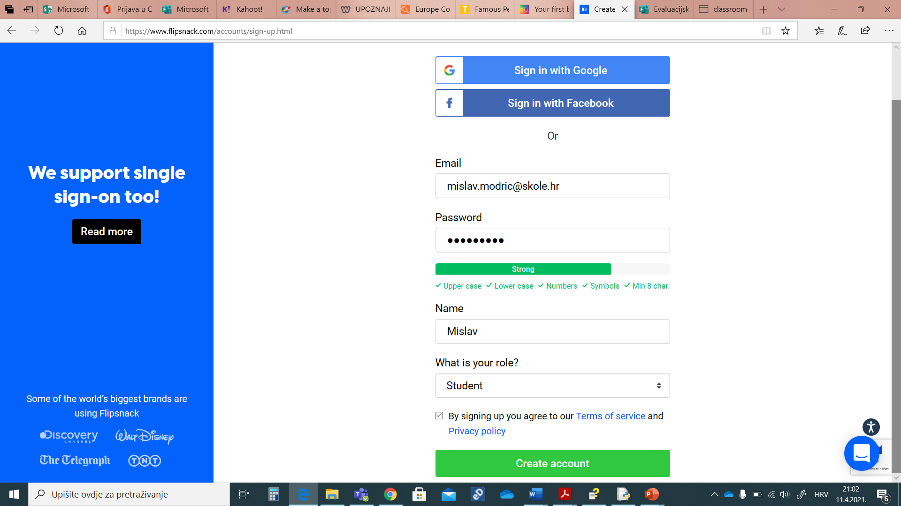
Sign in or create account
You can create account entering your email, password, name and role (teacher, student…)

Slide 6
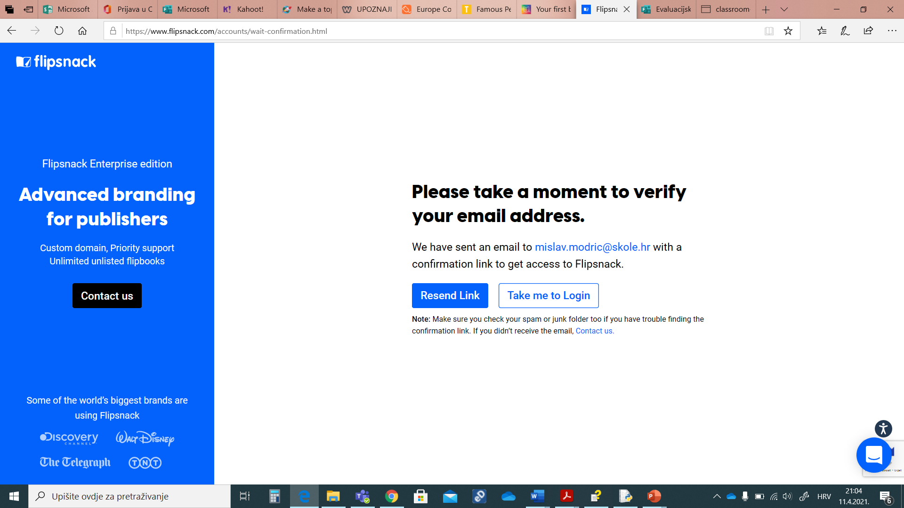
Sign in or create account
Check you mailbox and verify your email.

Slide 7
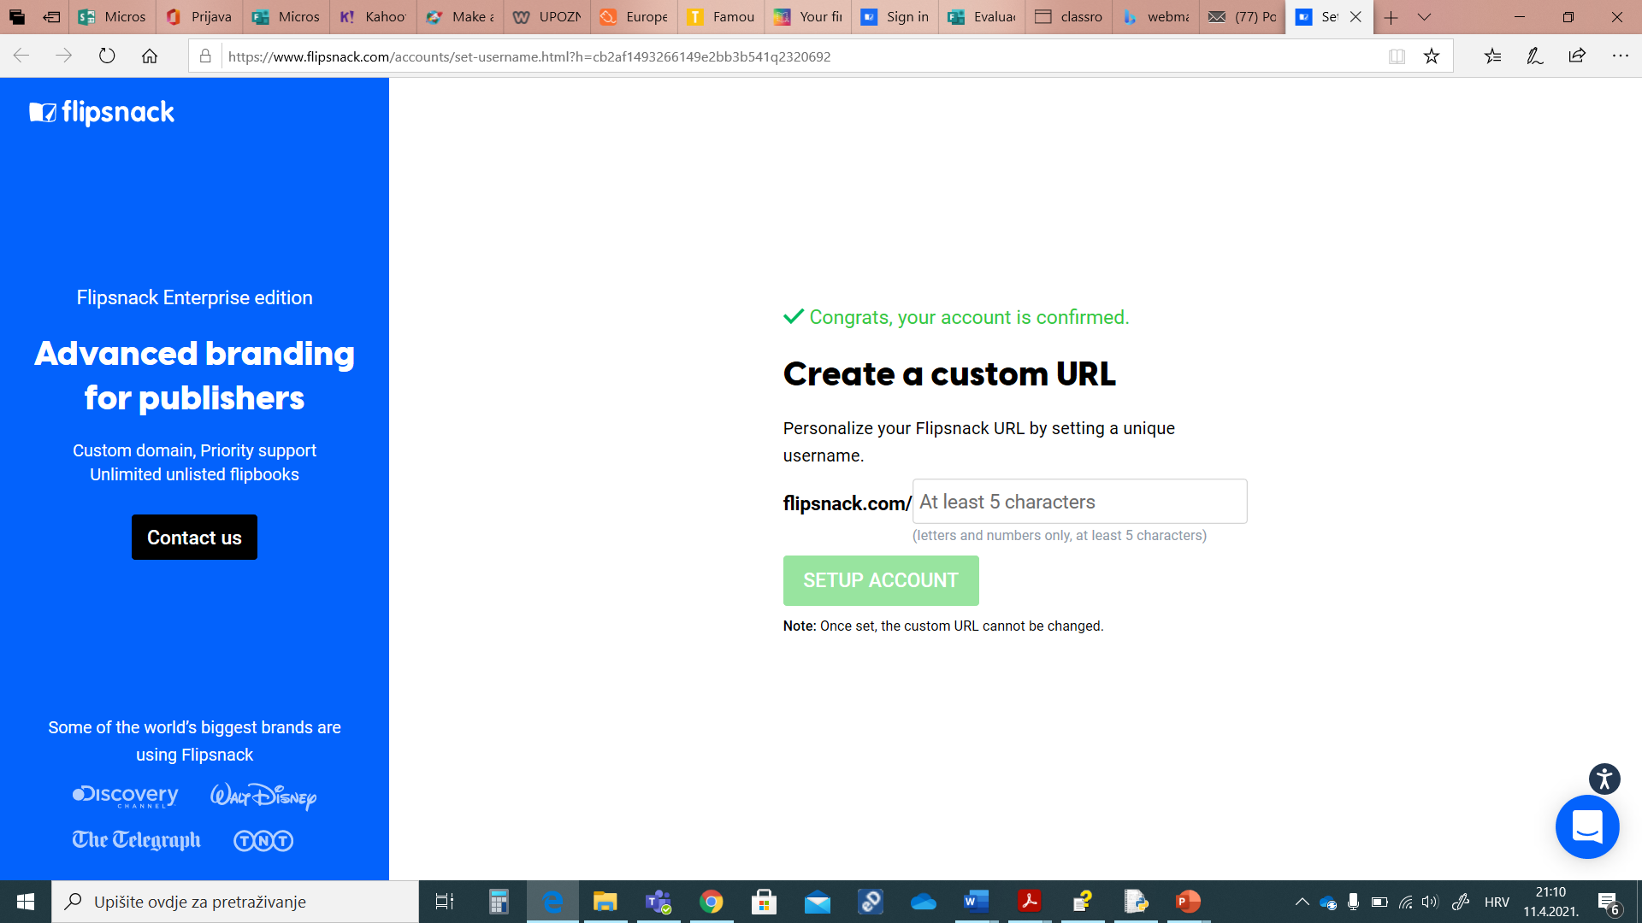
Choose your URL
You can put your name and surname for your URL

Slide 8
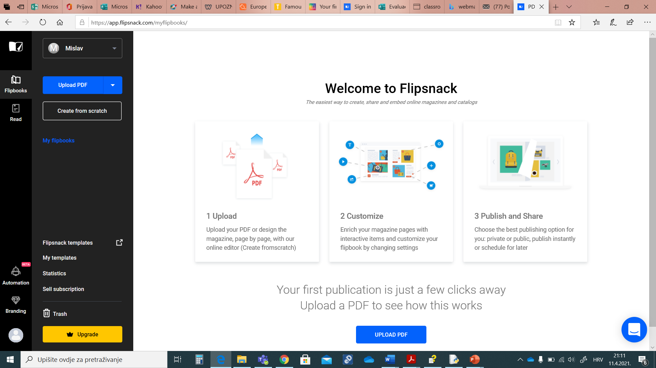
This is your homepage
You can upload you .pdf file and create your e-book.

Slide 9
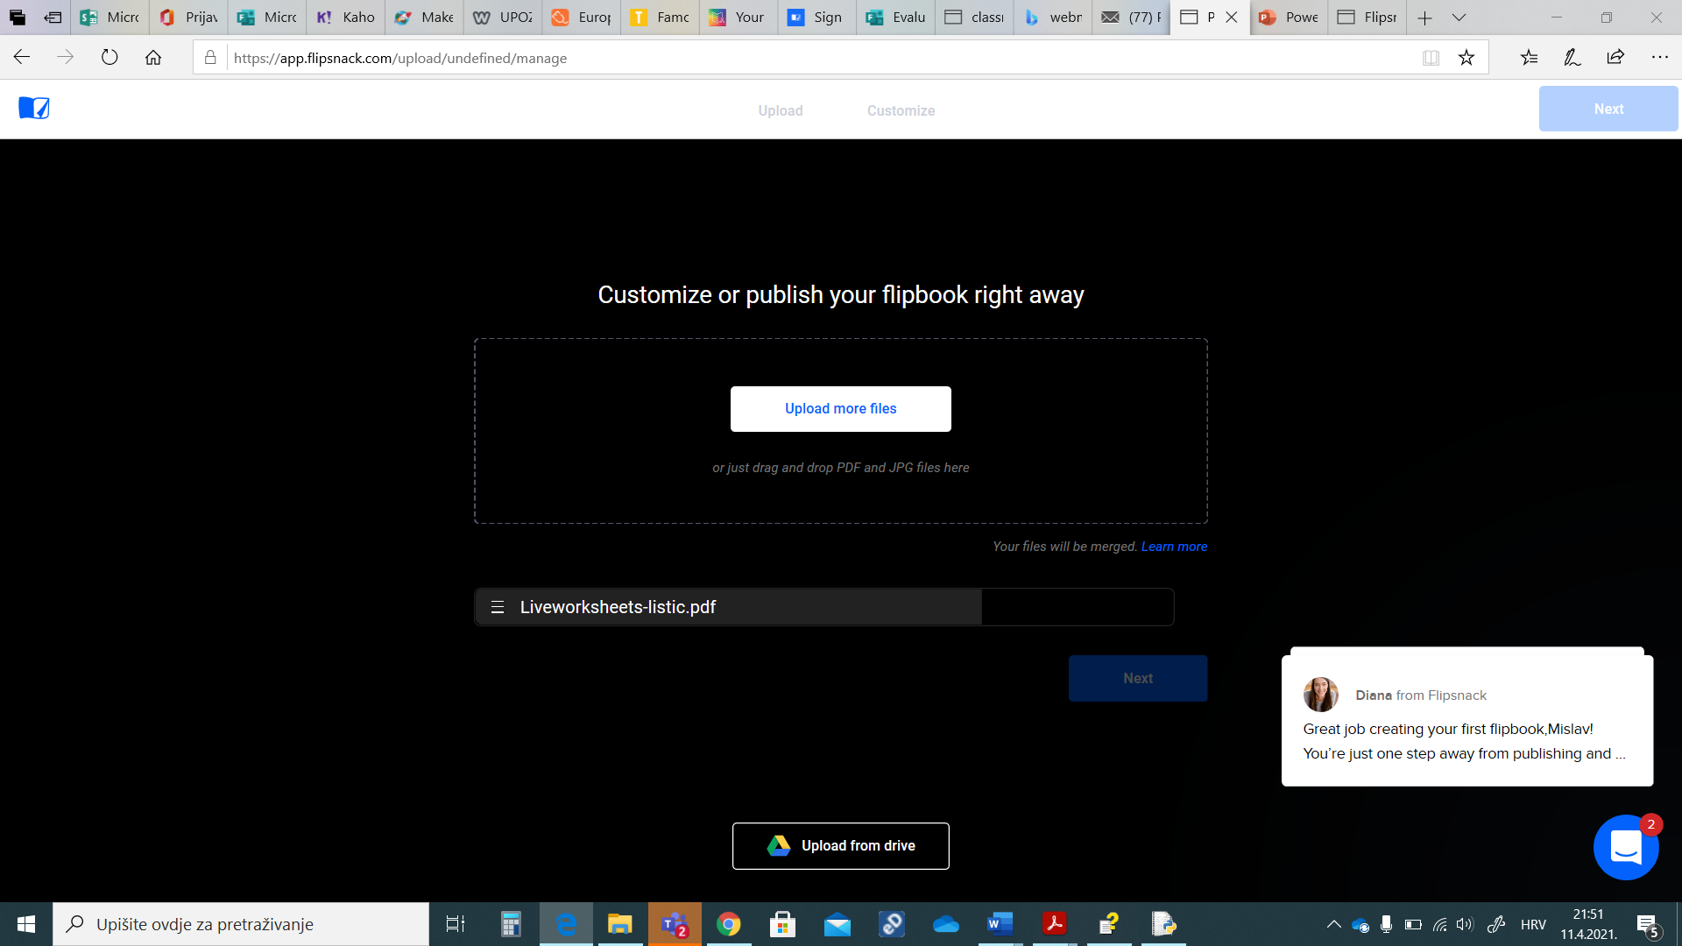
UPLOADING YOUR .PDF
After your .pdf is downloaded, click “NEXT”.

Slide 10
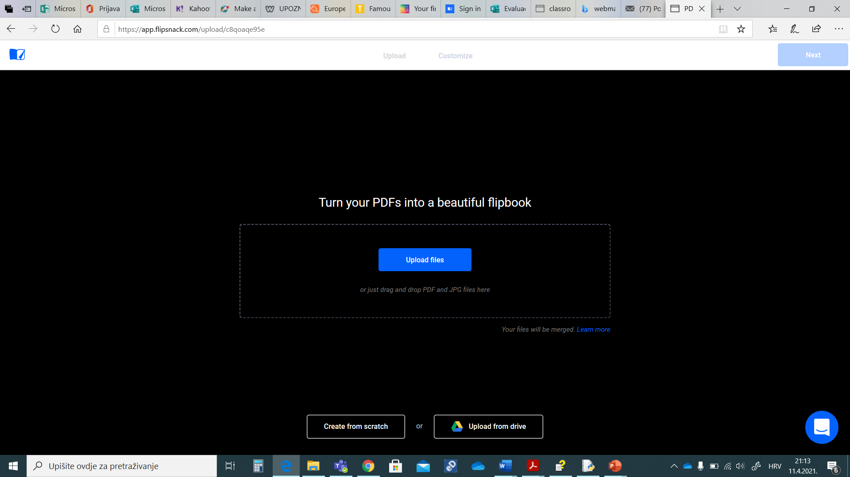
Or.....
Or you can start from scratch.

Slide 11
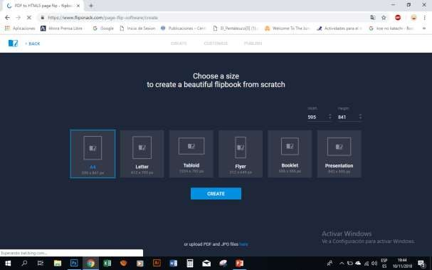
Making your own..
If you want to start from scratch, choose a size.

Slide 12
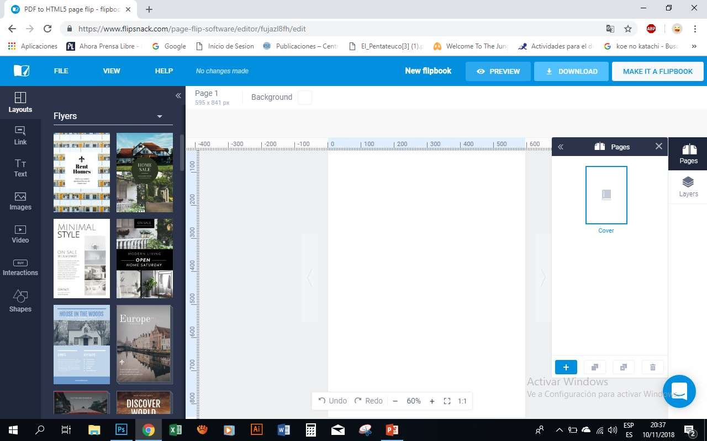
OPTIONS
The look
Pages of the
Links
document
Types:
Texto
Pictures
-flyers
s
-presentations
Videos
-brochures
Elements
Icons
Etc.
of the
Forms
document:
-Text
-pictures
- colors

Slide 13
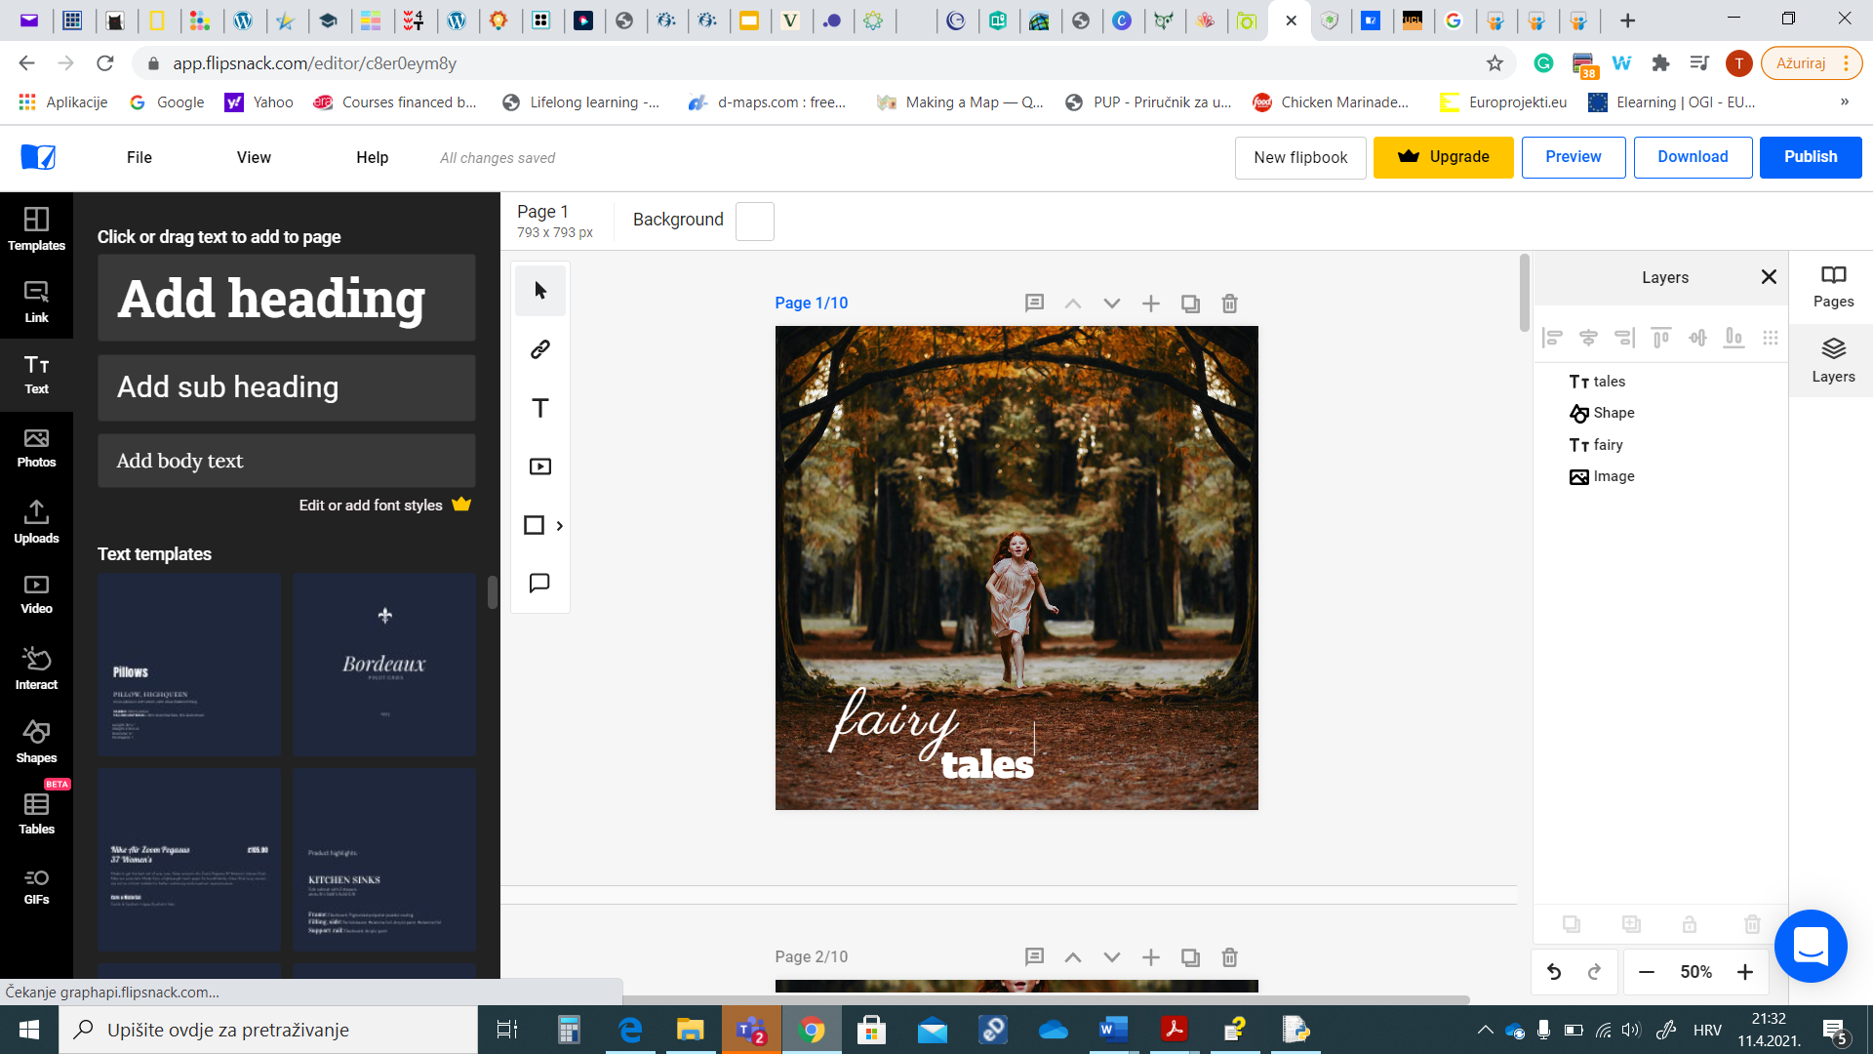
MAKE IT A FLIPBOOK
You can click "PREVIEW".
Once you have finished editing, click an option "MAKE IT A FLIPBOOK” or "PUBLISH" if you want to publish it on the platform.

Slide 14
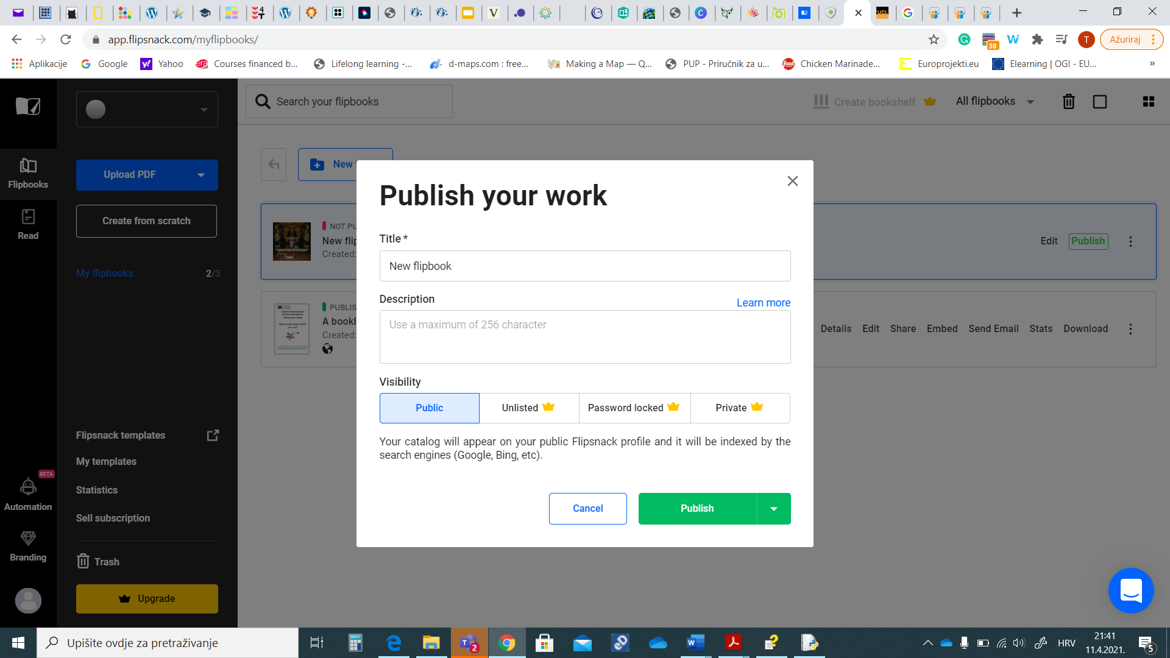
YOUR DOCUMENT IS BEING PUBLISHED
-after you give it a title and make it public

Slide 15
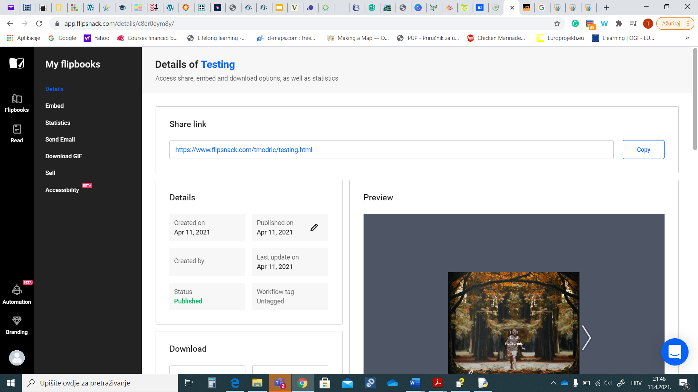
Share your work
You can share your e-book by copying link.

