Slide 1
Exchange meeting in Bamberg, Germany E.T.A. Hoffmann Gymnasium
from 14th to 19th October 2018
Kateřina Kvardová, 9.B

Slide 2
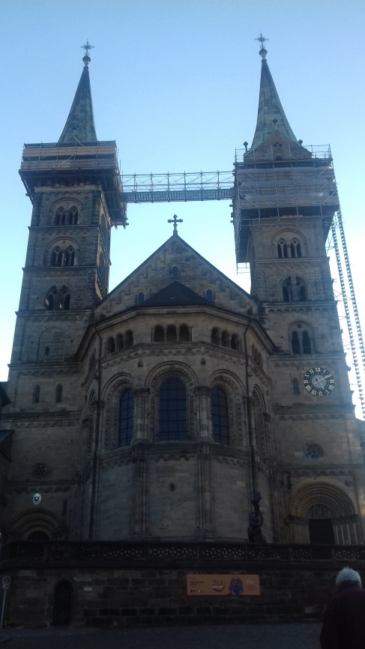
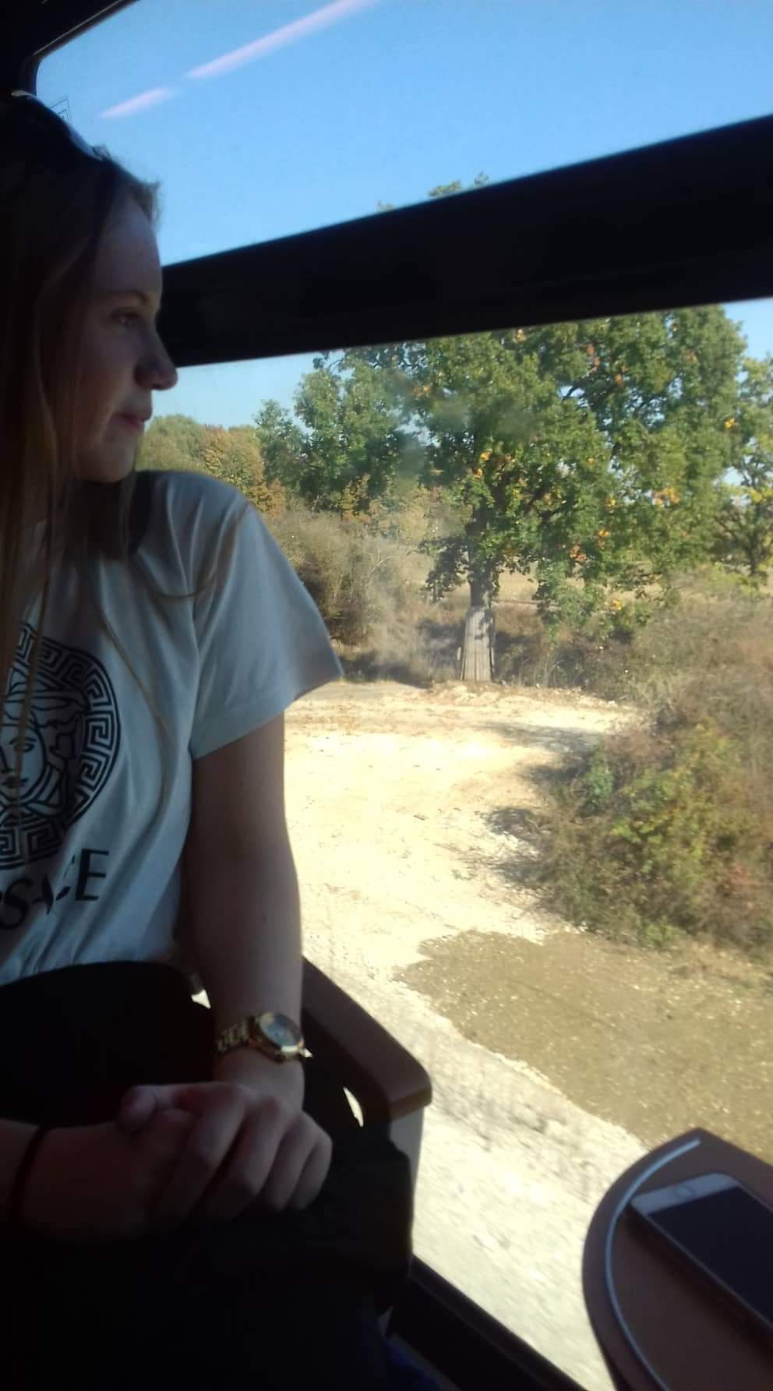
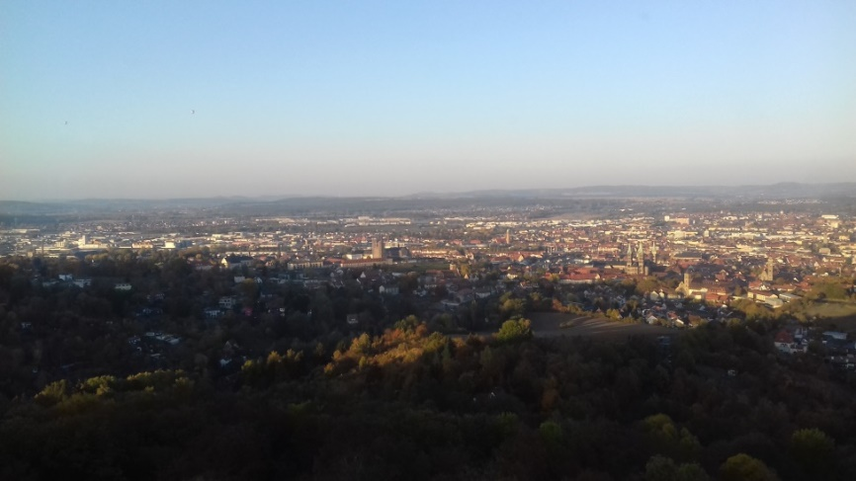
Sunday 14th October
Arrival ☺
Meeting with host families
Hanging out around Bamberg

Slide 3
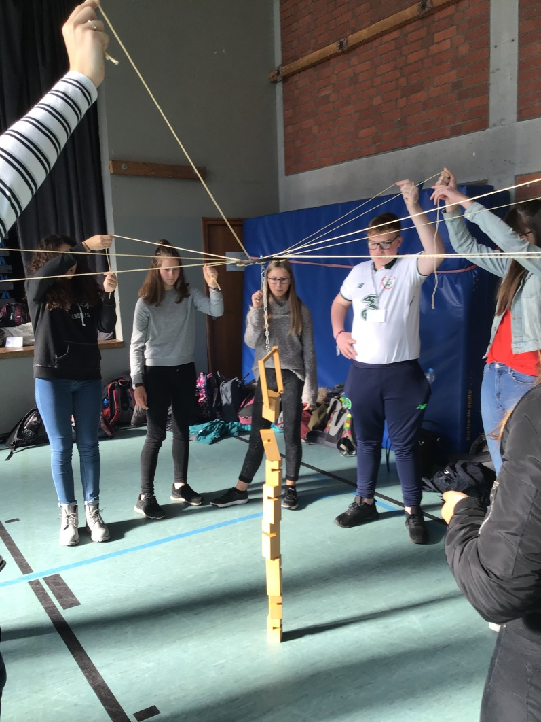
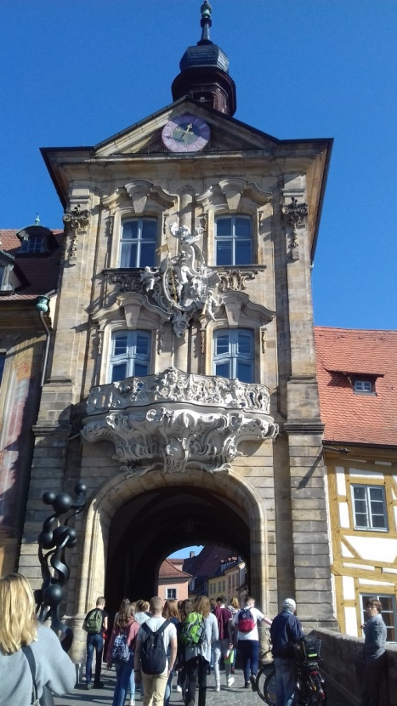
Monday 15th October
Ice-breaker activities (individual games, games for cooperation and team work)
School tour
Walk to city centre and old town hall
Impro theatre or making musical
instruments

Slide 4
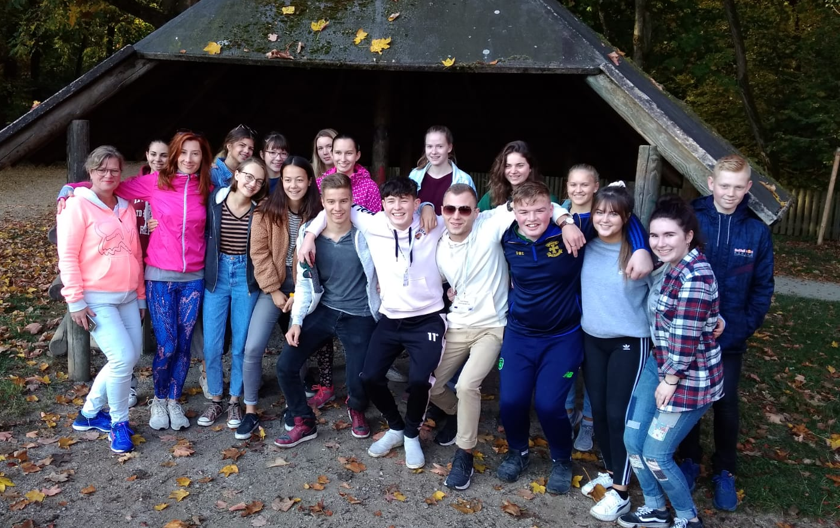
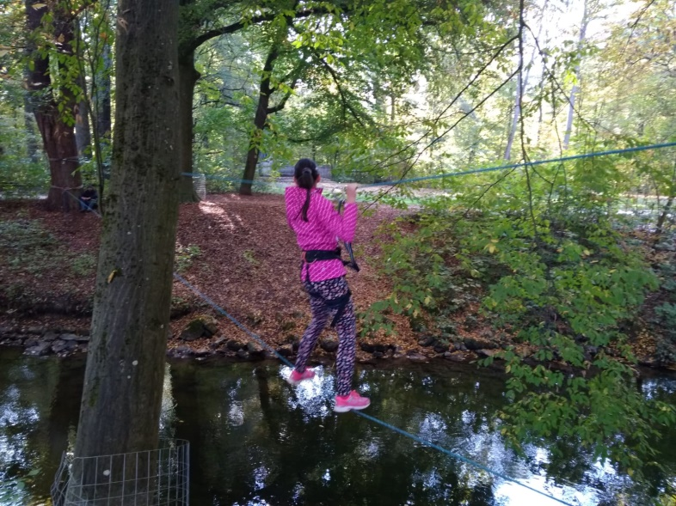
Tuesday 16th October
River crossing
City rallye: photo list, changing things

Slide 5
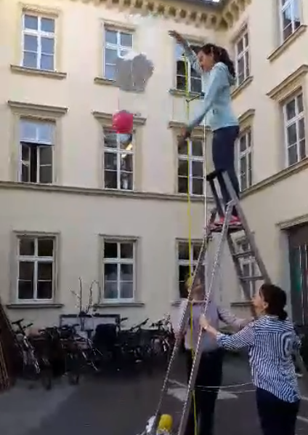
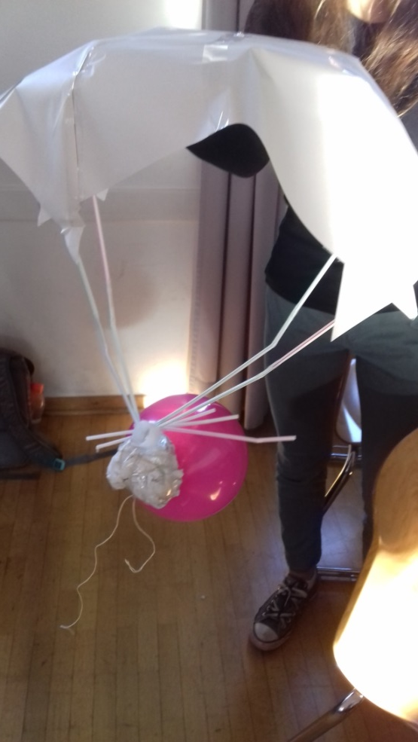
Wednesday 17th October
Creative science – egg must survive: 12 sheets of paper, string, balloon, 10 straws, scissors, tape
Impro theatre

Slide 6
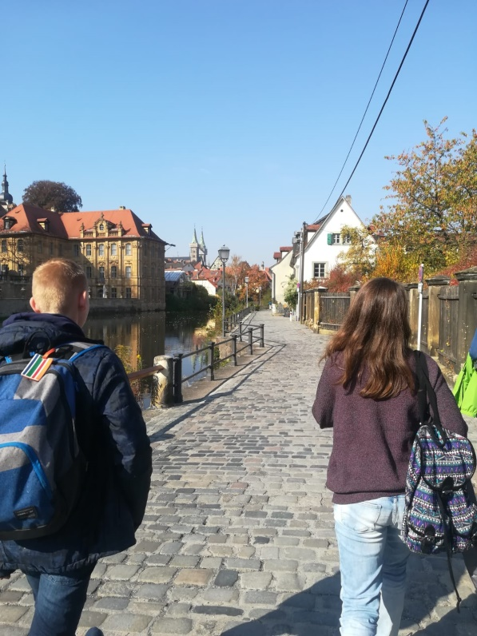
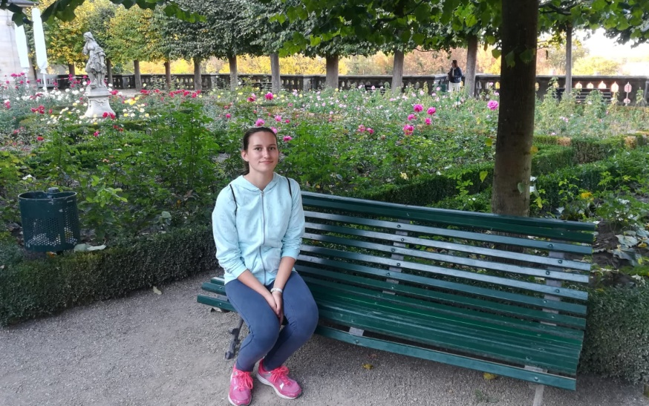
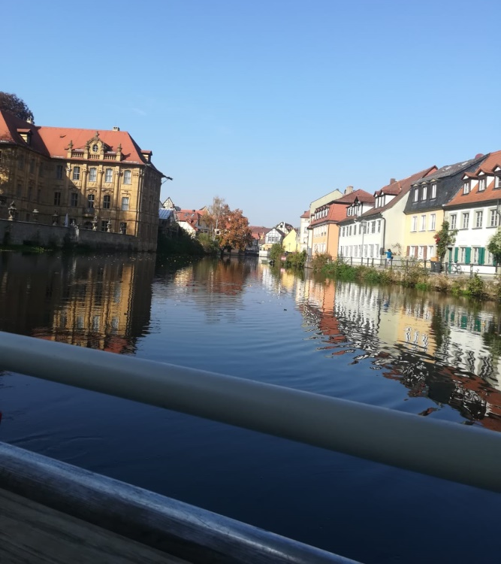
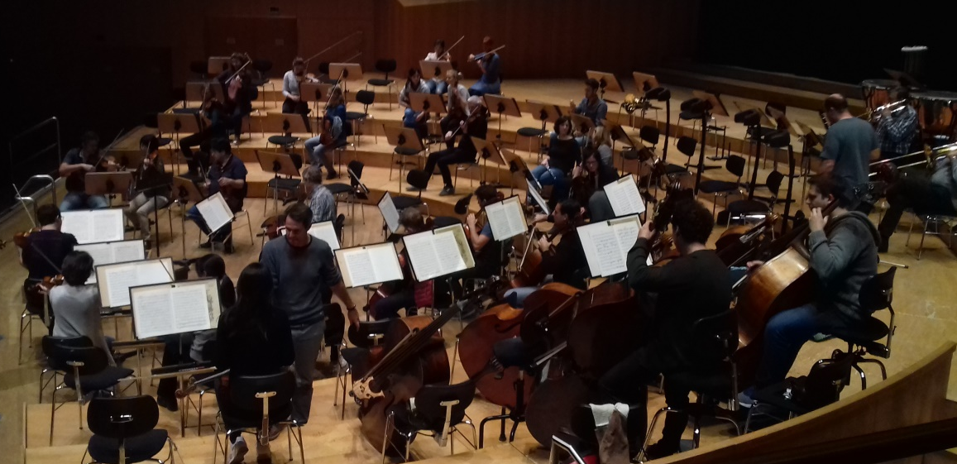
Hanging out on Wednesday

Slide 7
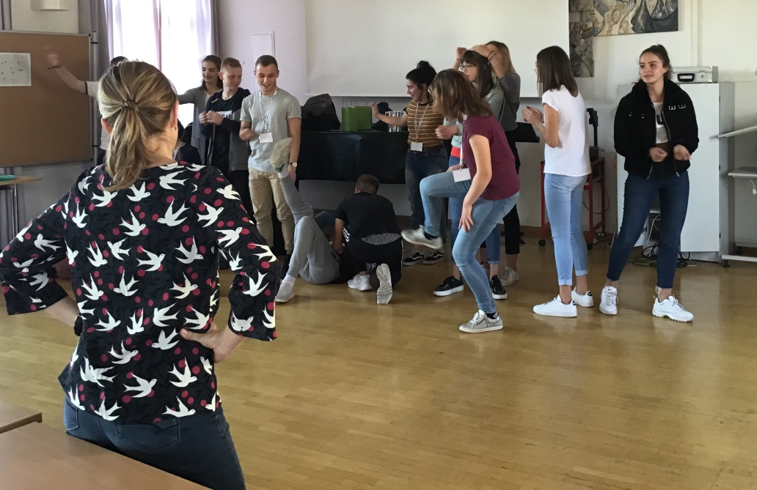
Thursday 18th October
Flashmob
Impro theatre
Playing Quidditch
Concert: flashmob
impro theatre
playing made instruments
school orchestra
Closing party

Slide 8
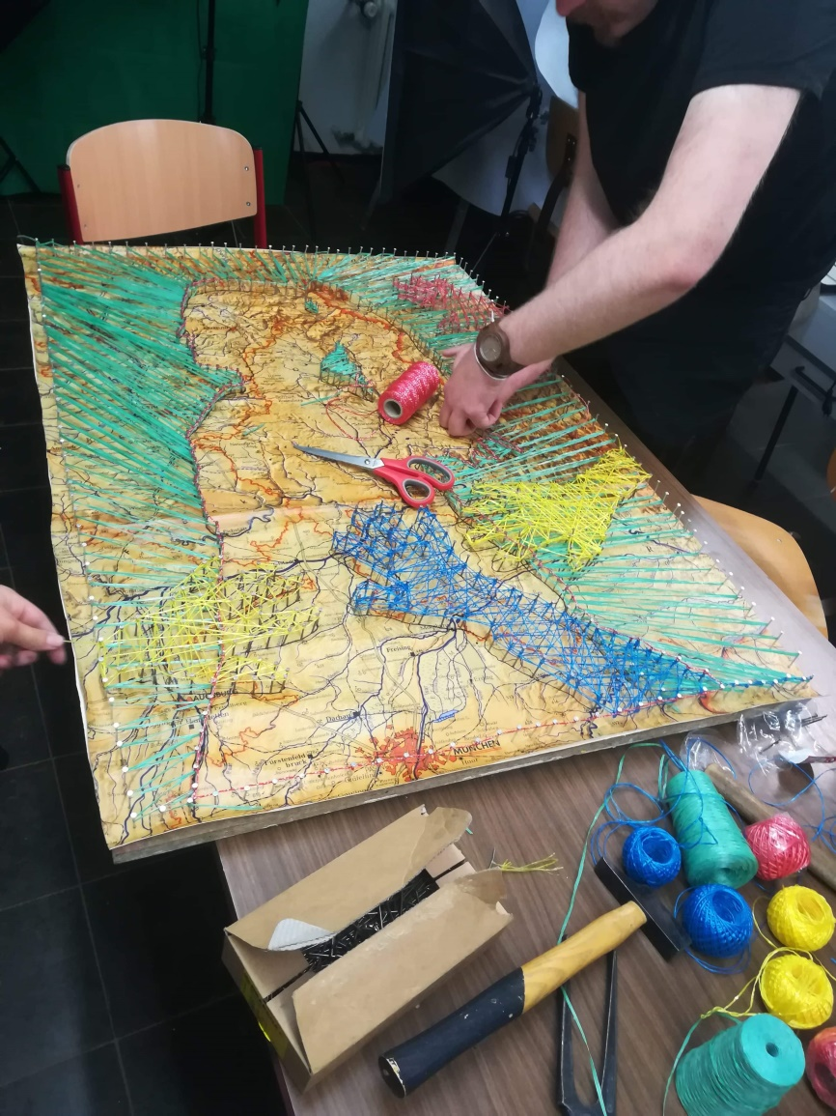
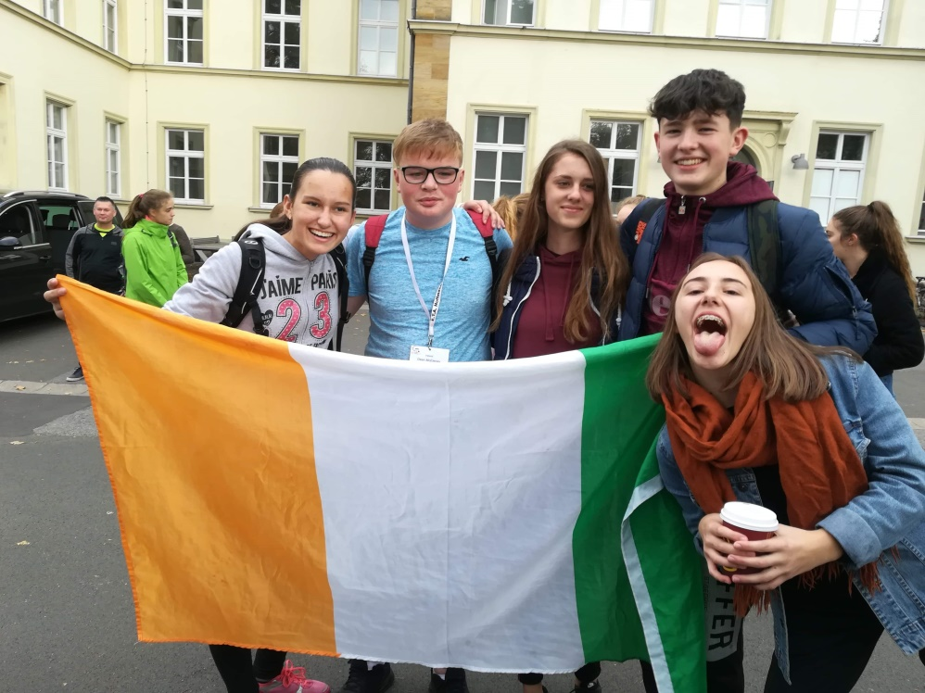
Friday 19th October
Creative art – string art (nails, hammers, strings)
Feedback, questionary
Departure ☹

